Slide 1
Unit 1

Slide 2
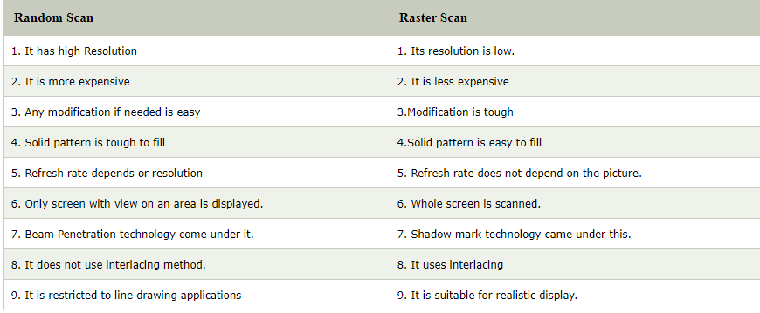
Differences between raster scan display and random scan display

Slide 3
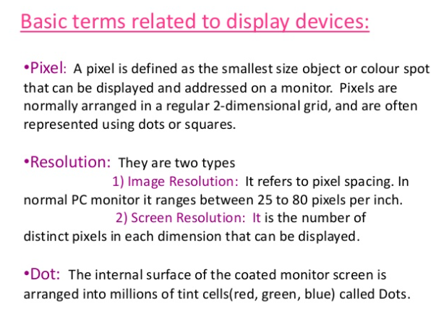

Slide 4
Concept of Pixel
Pixel
The full form of the pixel is "Picture Element." It is also known as "PEL." Pixel is the smallest element of an image on a computer display, whether they are LCD or CRT monitors. A screen is made up of a matrix of thousands or millions of pixels. A pixel is represented with a dot or a square on a computer screen.

Slide 5
The good thing is that a pixel cannot be seen as they are very small which result in a smooth and clear image rather than "pixelated." Each pixel has a value, or we can say a unique logical address.
It can have only one color at a time.
Colour of a pixel is determined by the number of bits which is used to represent it.
A resolution of a computer screen depends upon graphics card and display monitor, the quantity, size and color combination of pixels

Slide 6
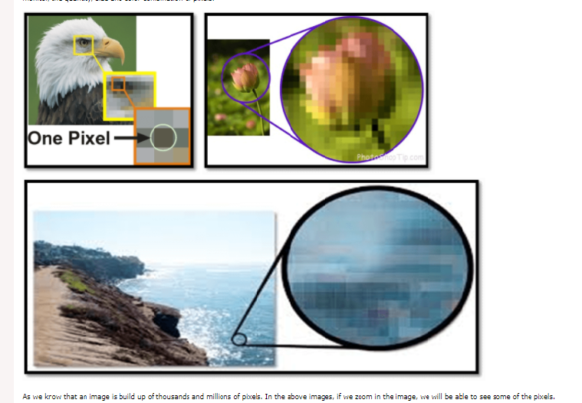

Slide 7

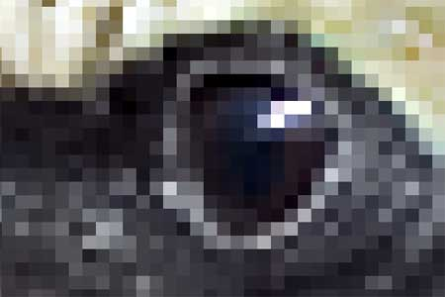
If such an electronic image is enlarged a lot, you can see that it consists of a matrix of picture elements. Such picture elements are called pixels. Below are the pixels that make up the eye of the bird.

Slide 8
Resolution as the definition of the number of pixels
In the above image, each row contains 3000 pixels and there are 2000 rows. Resolution describes the image size as the number of pixels it contains, typically as ‘width x height‘.
That means the above image of the bird has a resolution of 3000 x 2000 pixels.
Sometimes users are only interested in the total number of pixels. Those 6 million pixels equal a resolution of 6 megapixels.
The habit of using the term resolution to refer to the number of pixels in an image is typical for the photography market.

Slide 9
What is screen resolution?
The number of horizontal and vertical pixels on a display screen.
The more pixels, the more information is visible without scrolling.
Screen resolutions have a pixel count such as 1600x1200, which means 1,600 horizontal pixels and 1,200 vertical pixels.

Slide 10
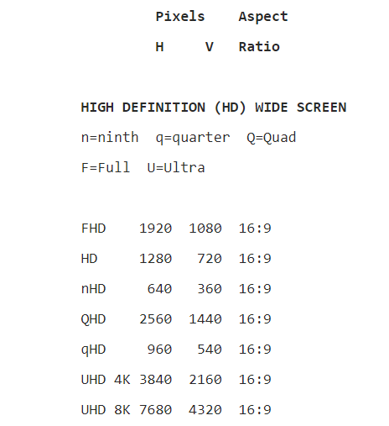
Examples of screen resolution

