Slide 1
Unit 1
DVST

Slide 2
Direct View Storage Tubes
DVST terminals also use the random scan approach to generate the image on the CRT screen. The term "storage tube" refers to the ability of the screen to retain the image which has been projected against it, thus avoiding the need to rewrite the image constantly.

Slide 3
An alternative method for maintaining a screen image is to store the picture information inside the CRT instead of refreshing the screen.
A direct-view storage tube (DVST) stores the picture information as a charge distribution just behind the phosphor-coated screen.
Two electron guns are used in a DVST. One, the primary gun, is used to store the picture pattern; the second, the flood gun, maintains the picture display .

Slide 4
DVST terminals also use the random scan approach to generate the image on the CRT screen.
The term "storage tube" refers to the ability of the screen to retain the image which has been projected against it, thus avoiding the need to rewrite the image constantly.

Slide 5
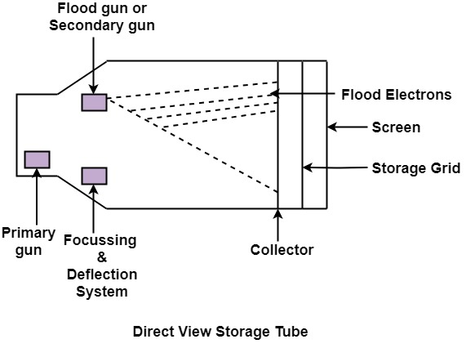
Function of guns: Two guns are used in DVST
Primary guns: It is used to store the picture pattern.
Flood gun or Secondary gun: It is used to maintain picture display.

Slide 6
Advantage:
No refreshing is needed.
High Resolution
Cost is very less
Disadvantage:
It is not possible to erase the selected part of a picture.
It is not suitable for dynamic graphics applications.
If a part of picture is to modify, then time is consumed.

