Slide 1
Unit 1

Slide 2
Raster Scan Displays are most common type of graphics monitor which employs CRT.
It is based on television technology. In raster scan system electron beam sweeps across the screen, from top to bottom covering one row at a time.
A pattern of illuminated pattern of spots is created by turning beam intensity on and off as it moves across each row.

Slide 3
A memory area called refresh buffer or frame buffer stores picture definition.
This memory area holds intensity values for all screen points. Stored intensity values are restored from frame buffer and painted on screen taking one row at a time.
Each screen point is referred to as pixels.

Slide 4
The basic working with example

Slide 5
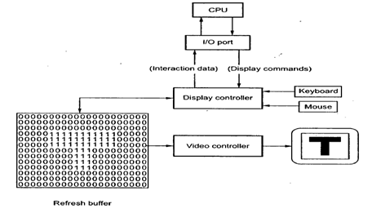

Slide 6
As shown in the figure the display image is stored in the form of 0s and 1s in the refresh buffer.
The video controller reads this refresh buffer and produces the actual image on screen.
It does this by scanning one scan line at a time, from top to bottom and then back to the top.
This scanning process is called refreshing.
Each complete scanning of a screen is normally called a frame.
Raster scan is most common method of displaying images on the CRT screen.

Slide 7
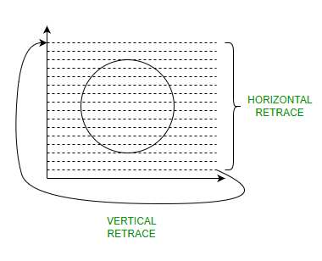

Slide 8
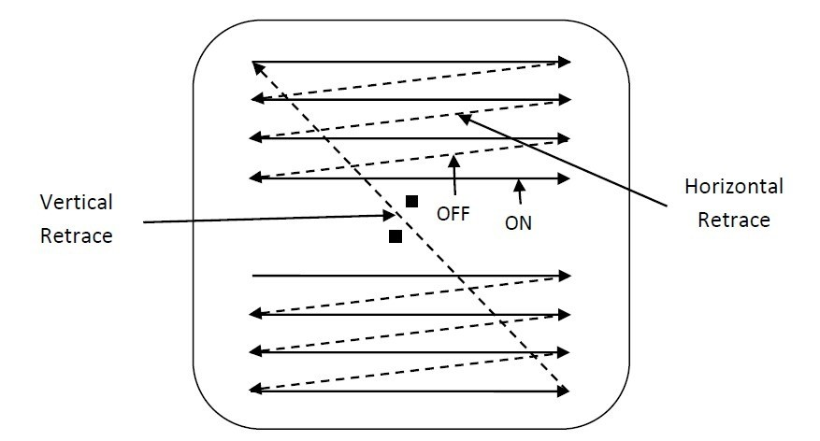

Slide 9
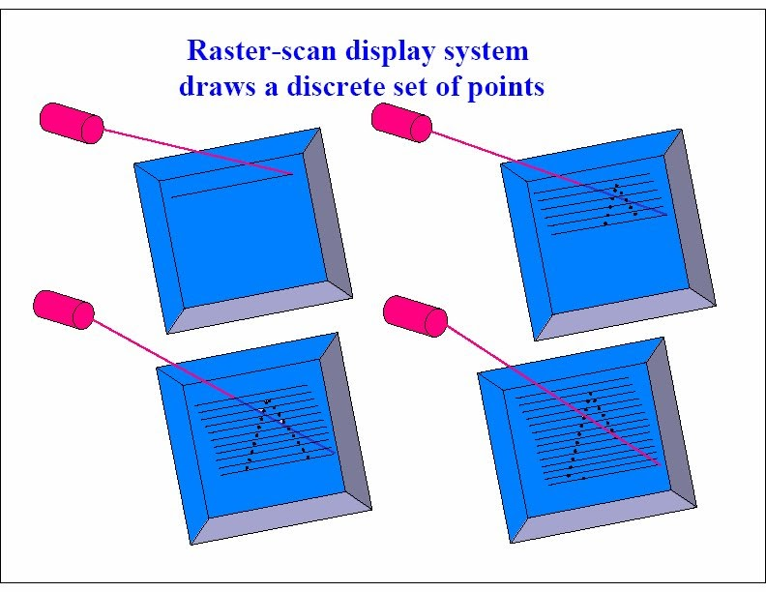

Slide 10
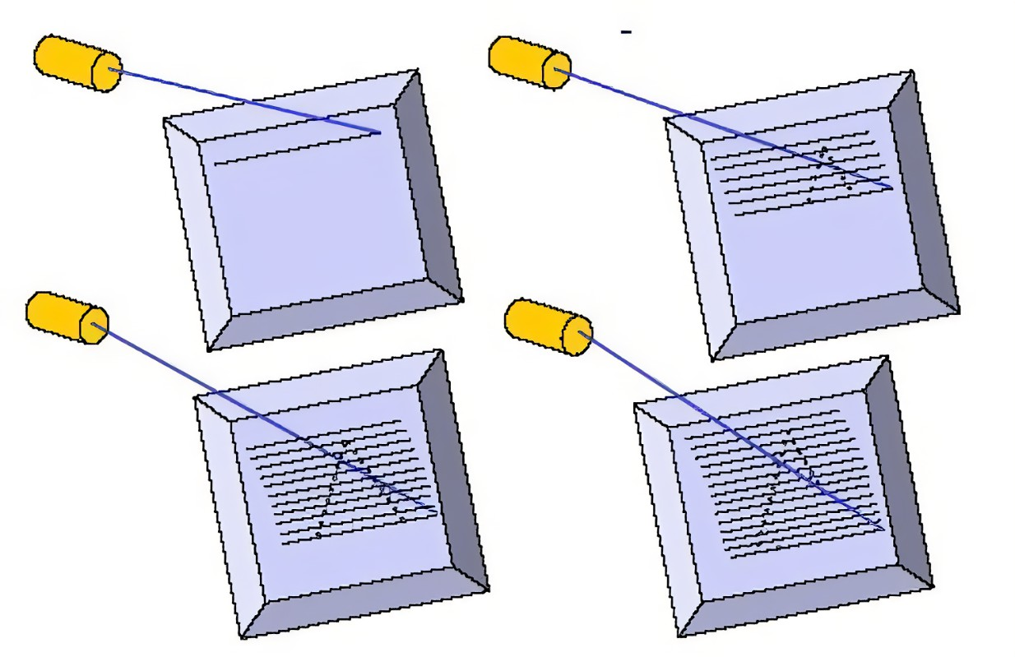

Slide 11
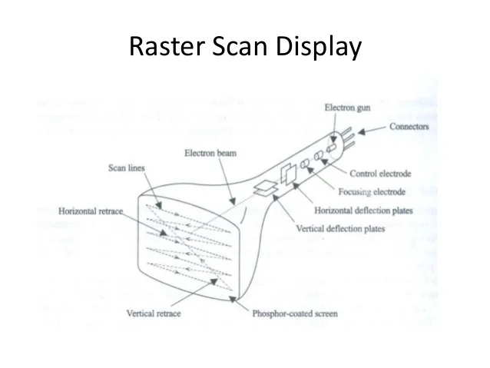

Slide 12
Raster-Scan Display controller:
An important function of display process is to convert a picture definition given in an application program into a set of pixel-intensity values for storage in refresh buffer.
This process is referred to as scan conversion.
The purpose of display processors is to relieve the CPU from graphics jobs.

Slide 13
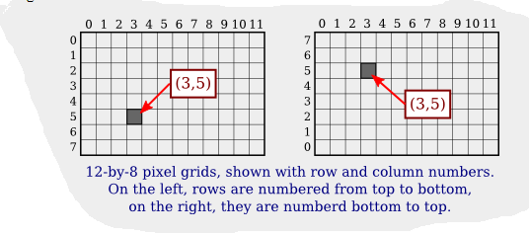
A digital image is made up of rows and columns of pixels.
A pixel in such an image can be specified by saying which column and which row contains it.
In terms of coordinates, a pixel can be identified by a pair of integers giving the column number and the row number.
For example, the pixel with coordinates (3,5) would lie in column number 3 and ro number 5.
Conventionally, columns are numbered from left to right, starting with zero.

