Slide 1
Unit 1

Slide 2
Raster Scan Displays are most common type of graphics monitor which employs CRT.
It is based on television technology. In raster scan system electron beam sweeps across the screen, from top to bottom covering one row at a time.
A pattern of illuminated pattern of spots is created by turning beam intensity on and off as it moves across each row.

Slide 3
A memory area called refresh buffer or frame buffer stores picture definition.
This memory area holds intensity values for all screen points. Stored intensity values are restored from frame buffer and painted on screen taking one row at a time.
Each screen point is referred to as pixels.

Slide 4
The basic working with example

Slide 5
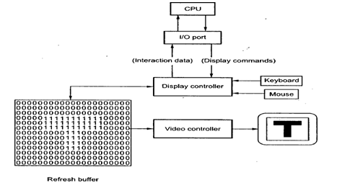

Slide 6
As shown in the figure the display image is stored in the form of 0s and 1s in the refresh buffer.
The video controller reads this refresh buffer and produces the actual image on screen.
It does this by scanning one scan line at a time, from top to bottom and then back to the top.
This scanning process is called refreshing.
Each complete scanning of a screen is normally called a frame.
Raster scan is most common method of displaying images on the CRT screen.

Slide 7
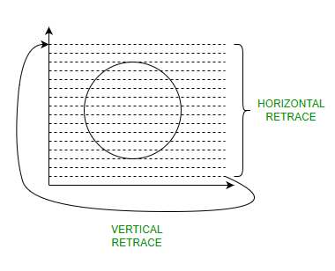

Slide 8
Raster-Scan Display controller:
An important function of display process is to convert a picture definition given in an application program into a set of pixel-intensity values for storage in refresh buffer.
This process is referred to as scan conversion.
The purpose of display processors is to relieve the CPU from graphics jobs.

Slide 9
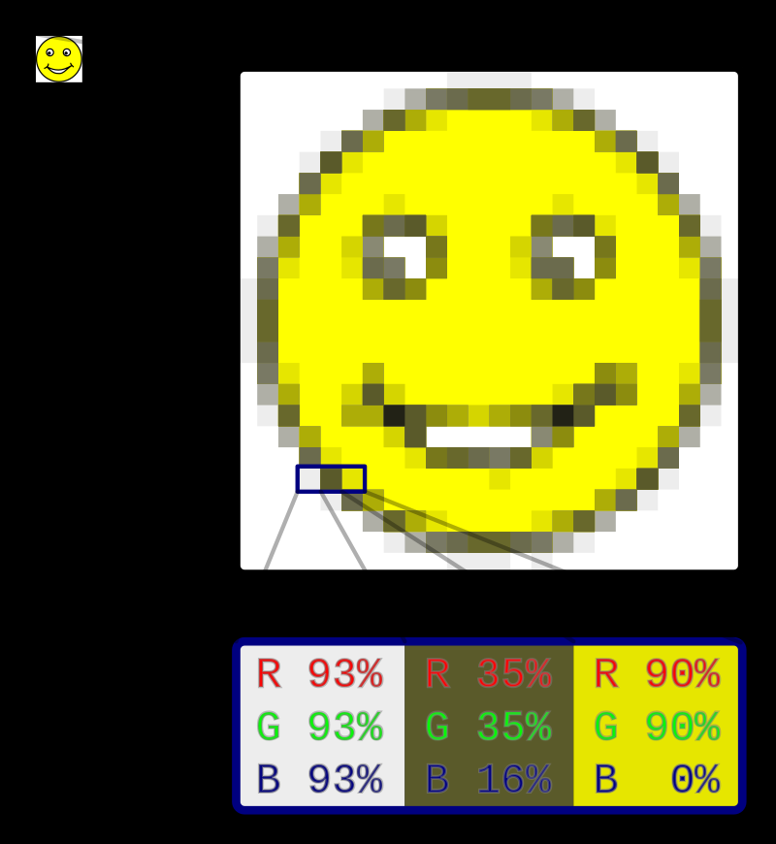
The picture on the top left corner is a raster image.
When enlarged, individual pixels appear as squares.
Enlarging in further, they can be analyzed, with their colors constructed by combining the values for red, green and blue.

Slide 10
Most modern computers have raster displays, where each on-screen pixel directly corresponds to a small number of bits in memory.
The screen is refreshed simply by scanning through pixels and coloring them according to each set of bits.
The refresh procedure, being speed critical, is often implemented by dedicated circuitry, often as a part of a graphics processing unit.

Slide 11
Using this approach, the computer contains an area of memory that holds all the data that are to be displayed.
The central processor writes data into this region of memory and the video controller collects them from there.
The bits of data stored in this block of memory are related to the eventual pattern of pixels that will be used to construct an image on the display.

Slide 12
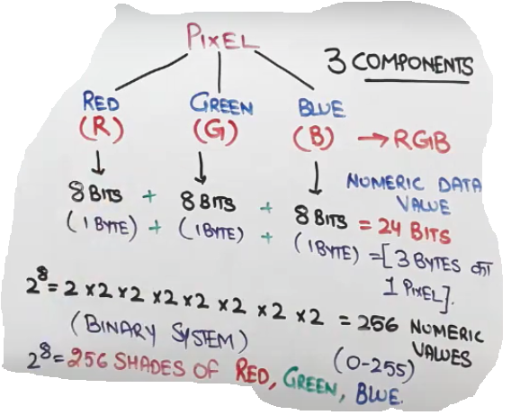

Slide 13
Total shades=256x256x256=16777216 shades

Slide 14
Example of raster images

Slide 15
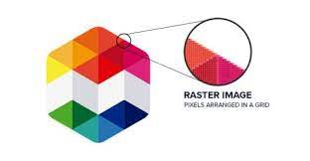

Slide 16


Slide 17
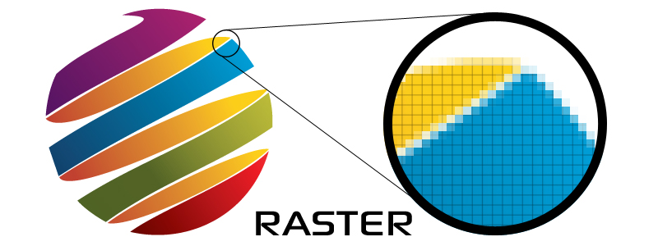

Slide 18


Slide 19


Slide 20
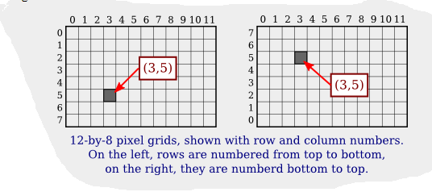
A digital image is made up of rows and columns of pixels.
A pixel in such an image can be specified by saying which column and which row contains it.
In terms of coordinates, a pixel can be identified by a pair of integers giving the column number and the row number.
For example, the pixel with coordinates (3,5) would lie in column number 3 and ro number 5.
Conventionally, columns are numbered from left to right, starting with zero.

