Slide 1
unit2

Slide 2
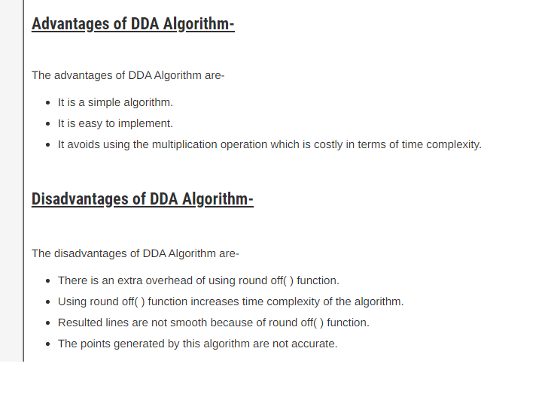

Slide 3
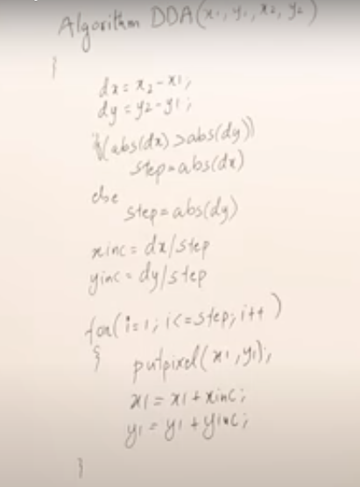

Slide 4
The Bresenham Line Algorithm

Slide 5
The Bresenham’s Line Algorithm
The Bresenham algorithm is another incremental scan conversion algorithm
The big advantage of this algorithm is that it uses only integer calculations

Slide 6
The Big Idea
Move across the x axis in unit intervals and at each step choose between two different y coordinates
For example, from position (2, 3) we have to choose between (3, 3) and (3, 4)
We would like the point that is closer to the original line
5
(x_{k}+1, y_{k}+1)
4
(x_{k}, y_{k})
3
(x_{k}+1, y_{k})
2
2
3
4
5

Slide 7
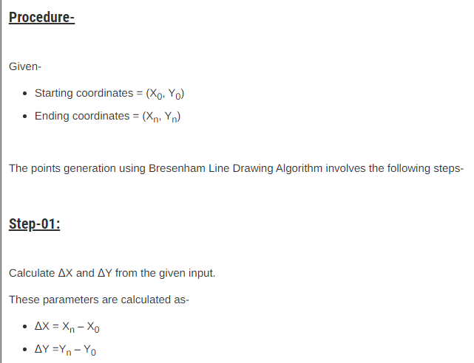

Slide 8
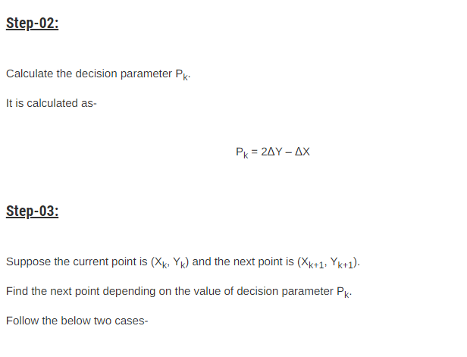

Slide 9
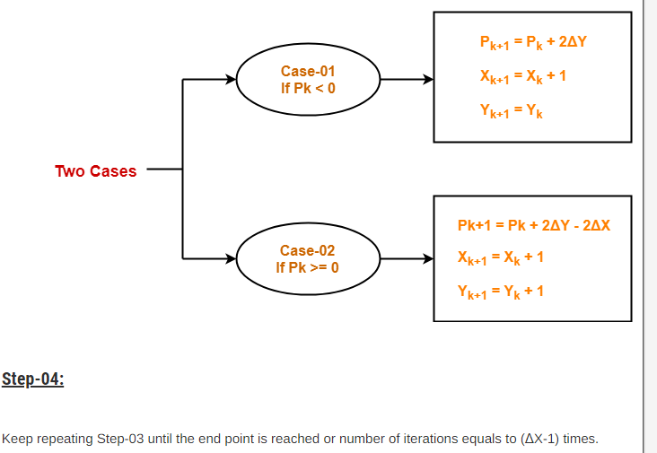

Slide 10
Example 4 u

Slide 11
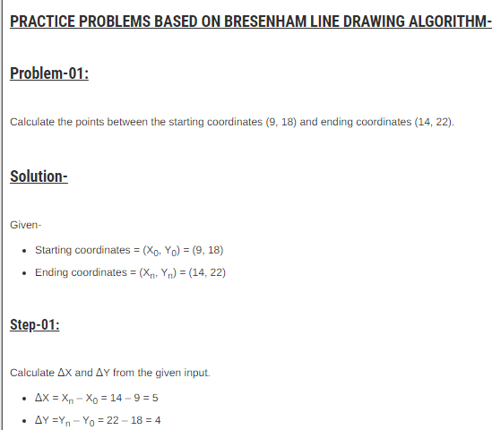

Slide 12
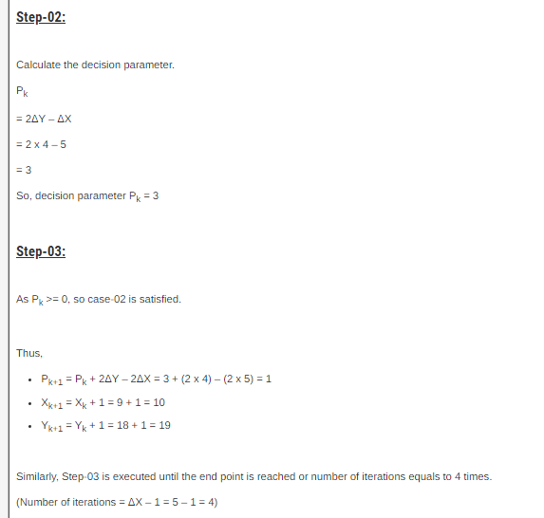

Slide 13
