Slide 1
Rockbuster Stealth LLC Data Analysis
Rusamijan Permison

Slide 2
INTRODUCTION
Rockbuster Stealth LLC is a movie rental company that used to have stores around the world. Facing stiff competition from streaming services such as Netflix and Amazon Prime
The Rockbuster Stealth management team is planning to use its existing movie licenses to launch an online video rental service in order to stay competitive

Slide 3
KEY QUESTIONS
Which movies contributed the most/least to revenue gain?
What was the average rental duration for all videos?
Which countries are Rockbuster customers based in?
Where are customers with a high lifetime value based?
Do sales figures vary between geographic regions?

Slide 4
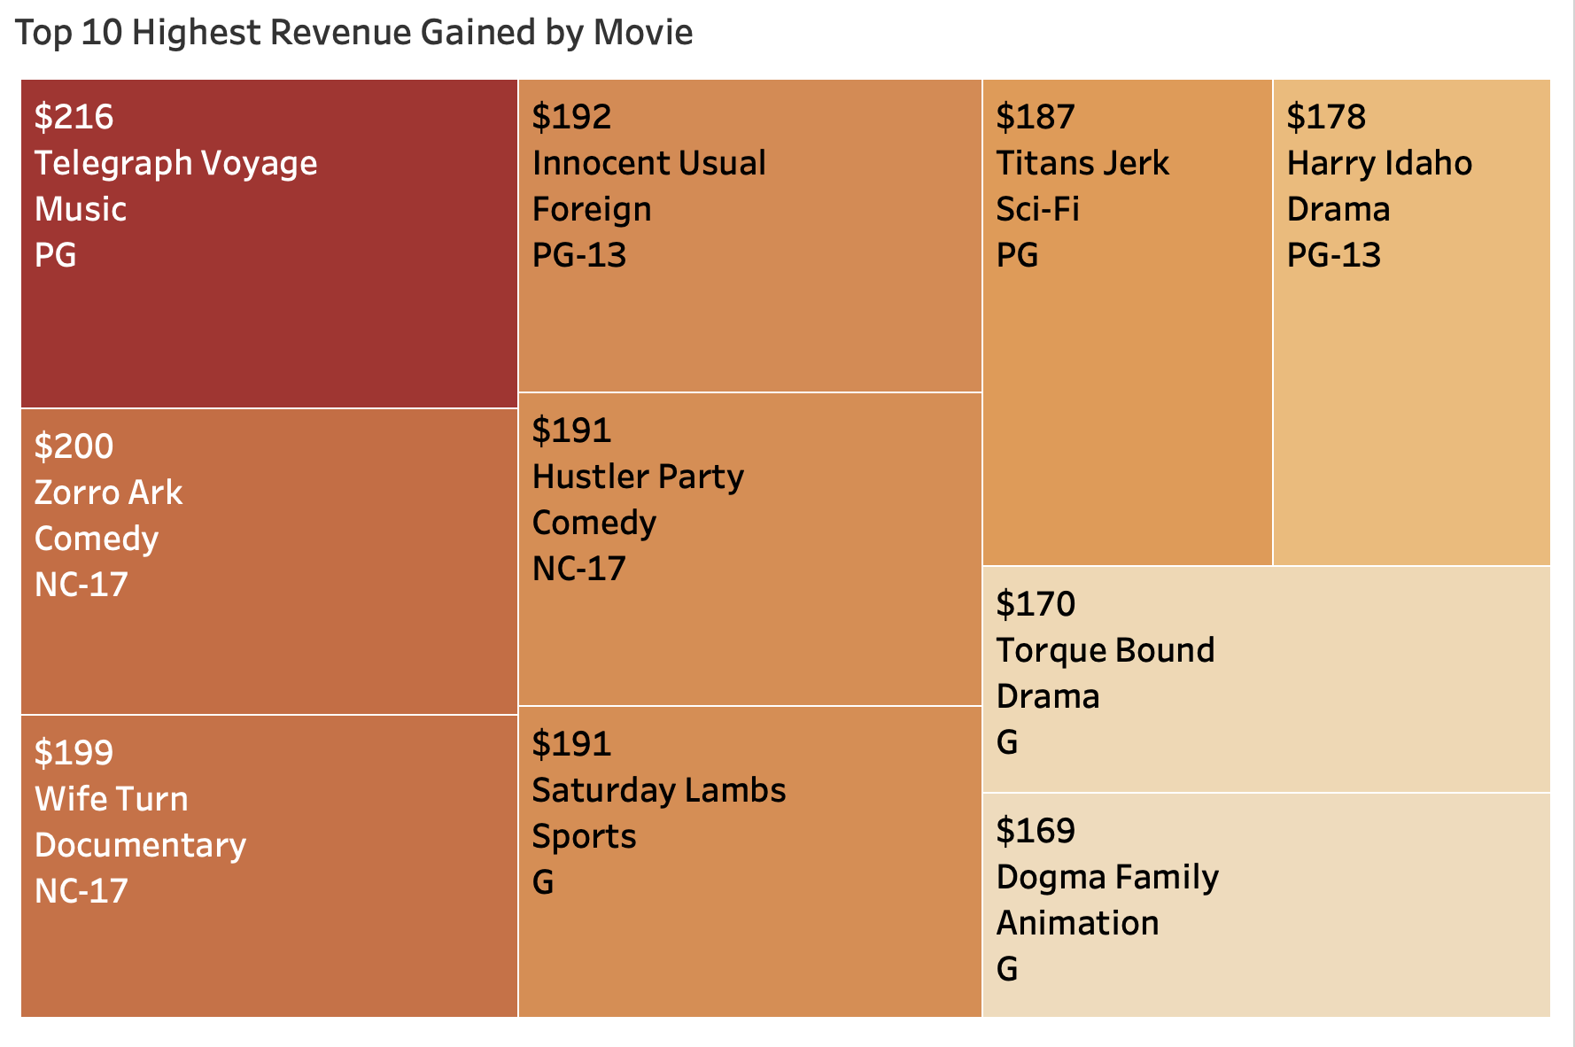
Which movies contributed the most to revenue gain?
This tree map represents top 10 highest movies in revenue. The darker the color, the higher revenue.
Telegraph Voyage is the top selling film, with $216 in revenue

Slide 5
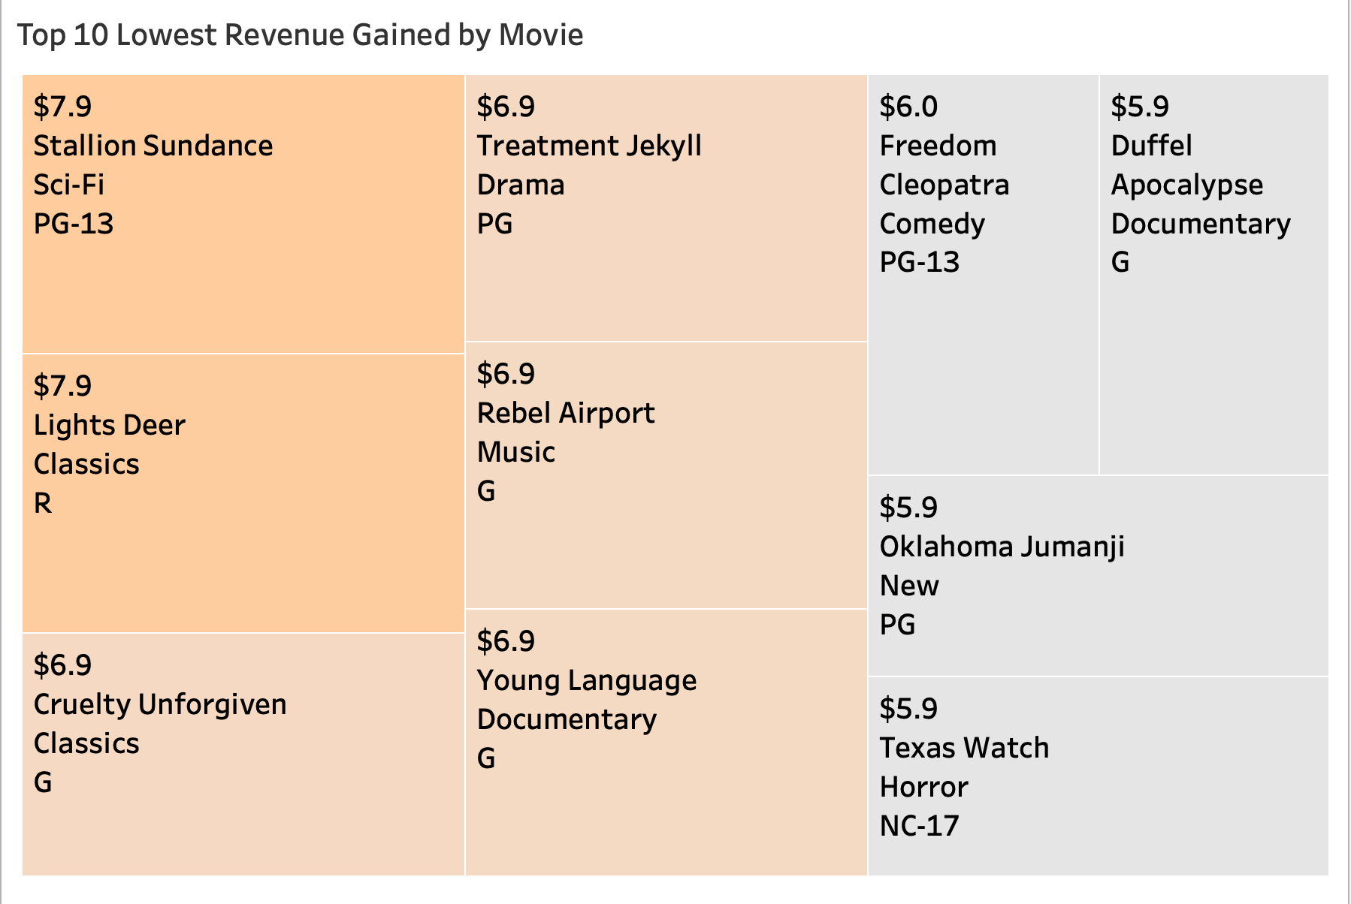
Which movies contributed the least to revenue gain?
This tree map represents top 10 lowest movies in revenue. The lighter the color, the lower revenue.
Texas Watch, Oklahoma Jumanji, Duffel Apocalypse are the lowest selling film, with $5.9 in revenue

Slide 6
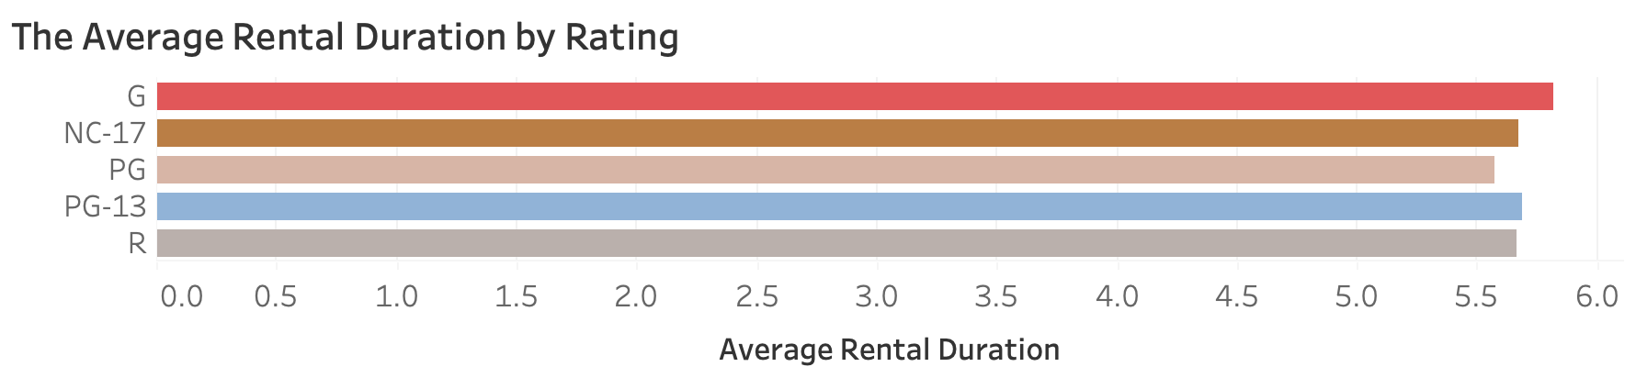
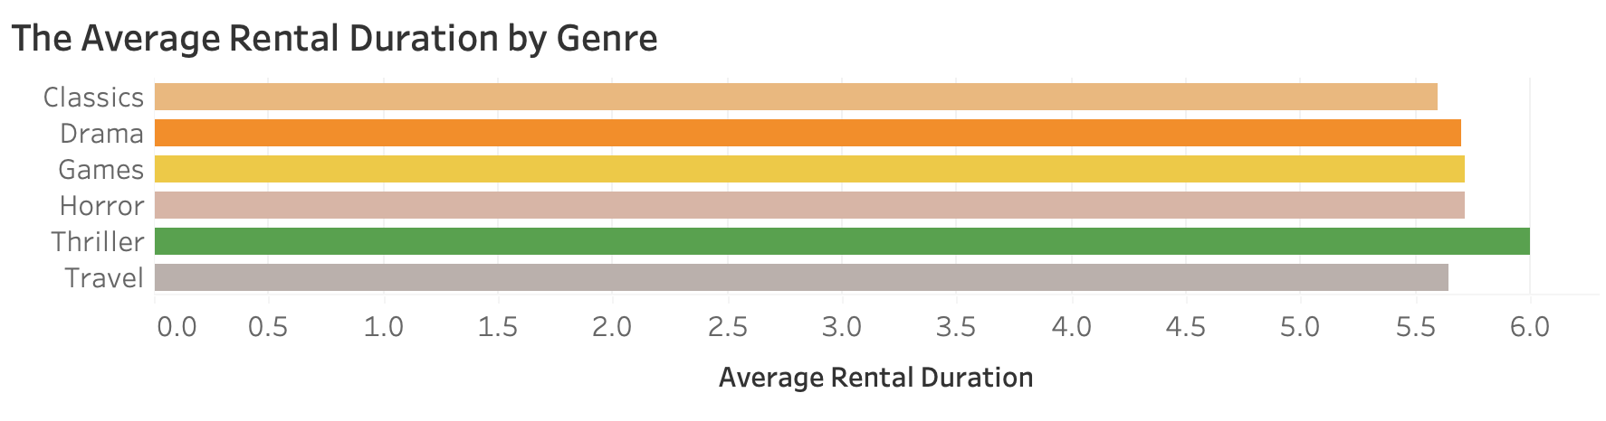
What was the average rental duration for all videos?
These charts represents the most customers that rent movies by rating and genre in between 4 and 5 days
G rating and Thriller have the high average rental duration

Slide 7
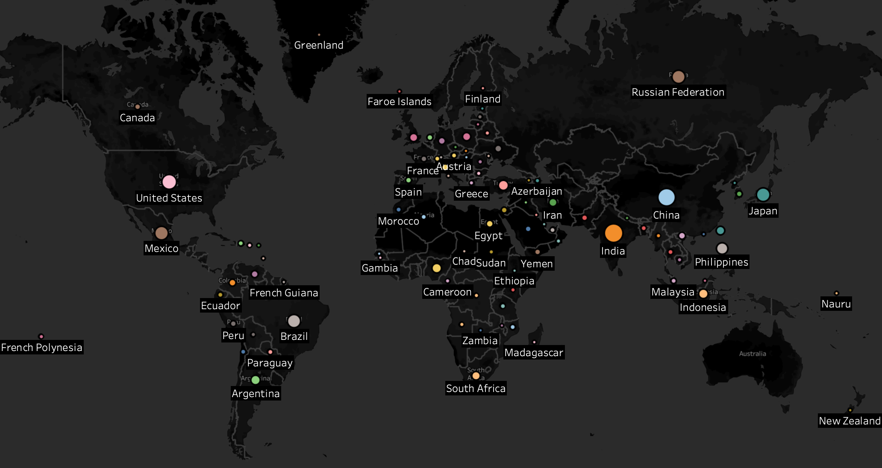
Which countries are Rockbuster customers based in?
Rockbuster customers are based in 108 countries. The larger circle is, the higher customer count that the country has.
India has the most Rockbuster customers

Slide 8
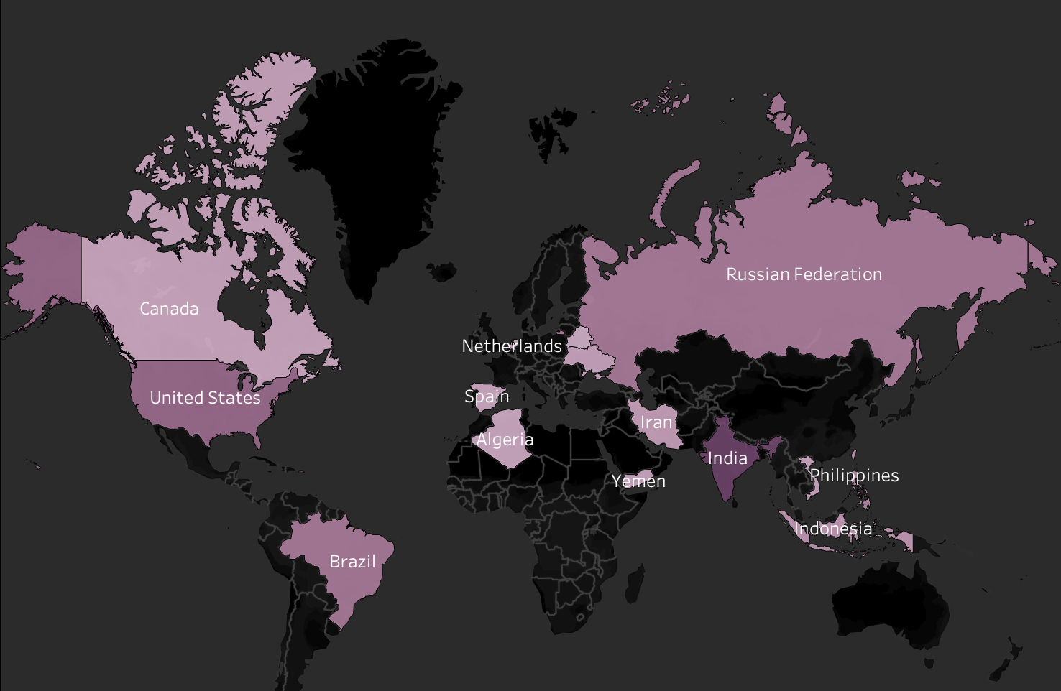
Where are customers with a high lifetime value based?
The map shows the distribution of the top 25 customers with a highest lifetime value The darker the color, the higher revenue that area gains.
The US and India have the highest amount of high life time valued customers.

Slide 9
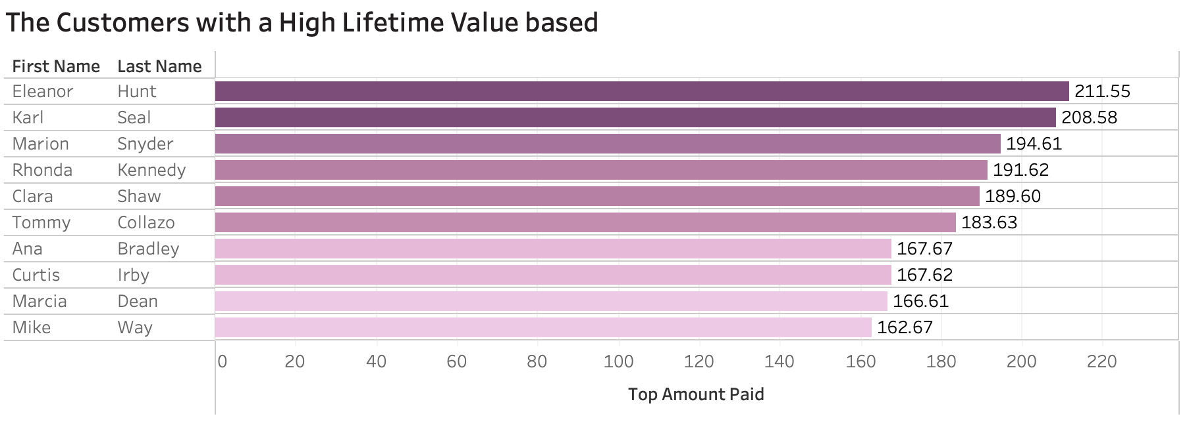
Where are customers with a high lifetime value based?
The bar chart shows top 10 customers with the highest lifetime value.

Slide 10
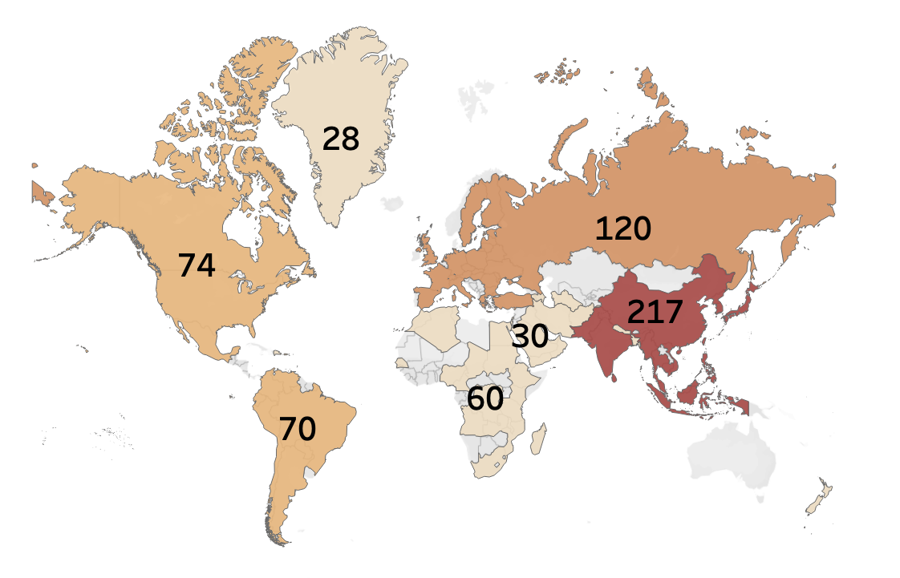
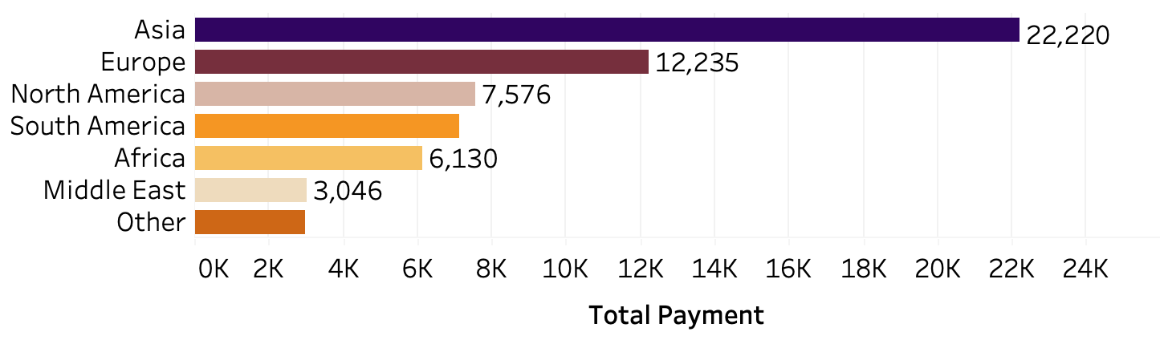
Do sales figures vary between geographic regions?
The shaded region represents total sales while the numbers are the customer count. The darker the color, the higher total sales that area gains.
Asia significantly leads the regions in both total sales and the number of customers

Slide 11
Conclusions
Telegraph Voyage is the highest revenue and Texas Watch, Oklahoma Jumanji, Duffel Apocalypse are the lowest selling film
The average rental duration for movie by genres and ratings are between 4-5 days
Rockbuster customers are based in 108 countries. India has the most Rockbuster customers
The top 10 customers with the highest lifetime values are in Asia, Europe, North America and South America
Asia significantly leads the regions in sales with $22,220

Slide 12
Recommendations
Revenue
Customers
Location
To maximize revenue and customer satisfaction. Rockbuster should prioritize launching the top 10 highest movies on their online video rental service.
To expand their customer, Rockbuster should conduct further analysis to understand why other regions are not performing as well as Asia and America.
To get a large and diverse customer base, Rockbuster should prioritize the Asia and American markets as their primary targets,

Slide 13
Thank You
Link:
Tableau Public

