Slide 1

End to End Automation in ETL Pipeline
Masters in computer science(Lincoln University) Presented by: Pikesh Maharjan (MCS-4th Sem) Supervisor: Prof. Sudan Jha, Ph.D.

Slide 2
Introduction
Exponential growth of data in every domain.
ETL (Extract, Transform, Load) is crucial to generate any meaningful information.
Traditional ETL processes require manual intervention.
Leading to various issues and time-consuming process.
Python and Machine Learning (ML) can enhance ETL automation.
This study focuses on automating schema detection and other meta data .
Reduces human effort and speeds up the ETL process.

Slide 3
Problem statement
ETL Processes uses commercial ETL tools which has high prices.
High dependency on ETL developers as it requires tool specific knowledge
Manual data type detection is time-intensive.
Human Intervention leading to time consuming and error prone process.
Delayed decision-making due to slow ETL processing.

Slide 4
Objectives
Remove Dependency on ETL Tools for Processing ASCII delimited Files.
Ensure one can process data up to Sql server without having tools specific knowledge.
Reduce Manual Intervention in ETL workflows.
Increase ETL processing speed.
Minimize errors and inconsistencies caused due to human interventions in ETL processing.

Slide 5
Literature Review
Previous Works | Key Findings
P.Pham “A Case Study in Developing an Automated ETL Solution” | Focused on minimizing manual steps by introducing automated steps for data extraction and transformation No mention specific ML algorithms No exploration of how to automatically detect column types
C. Van der Putten "Transforming Data Flow: Generative AI in ETL Pipeline Automation" | Discuss the Role of Machine Learning In ETL Automation of Creating SSIS Packages. It still is using SSIS as ETL Tool
Akisetty et al. "Automating ETL Workflows with CI/CD Pipelines for Machine Learning Applications" | Integrates CI/CD practices into ETL pipeline. Conceptual framework Requires knowledge of Devops as well as ETL systems.

Slide 6
Research Gaps
Use of ETL tools in Automation.
Most Studies automate the part of ETL process.
Many current solutions (e.g., SSIS, CI/CD pipelines) still require significant manual configuration.
Very few papers address the automation of data type inference directly using ML models.
Still Rely on Manual intervention.

Slide 7
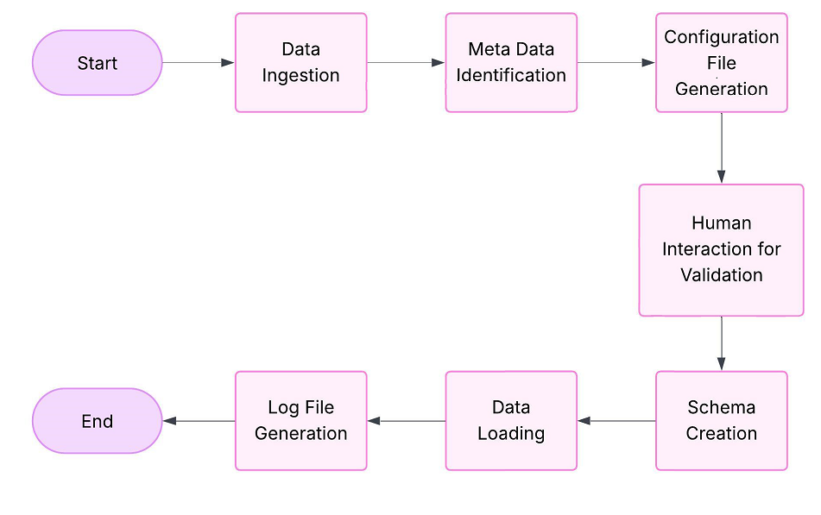
Architecture of Methodology
Fig: Methodology architecture for ETL automation

Slide 8
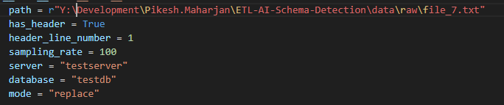
Methodology:
Data Ingestion: The process starts with a data ingestion where users can input the location of the file path along with some details that needs to be processed.

Slide 9
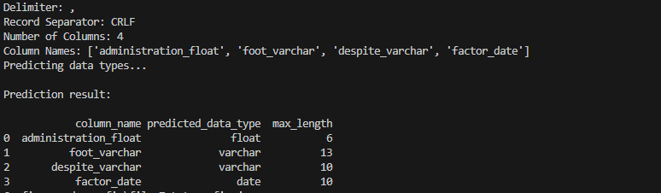
Methodology:
Meta Data Identification: To identify Meta data such as column delimiter, row separators, and column data types, a combination of rule-based logic and machine learning techniques is used.

Slide 10
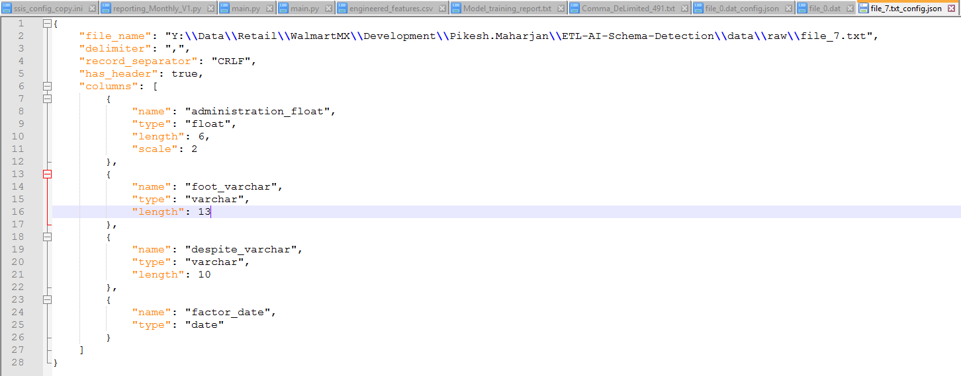
Methodology:
Configuration File Generation: Once the data types and other Meta data are identified, a configuration file is generated. This file provides detailed metadata about the dataset, including column names, data types, delimiters, and record separator.

Slide 11
Methodology:
Human Interaction for Validation: A provision is made for human users to review and modify the generated configuration file
Schema Creation: Using the instructions from the configuration file, the backend applies all schema creation.
Data Loading: This step involves loading the transformed data into a SQL Server database.
Log File Generation: All the log of loading files are logged into the log file along with errors if any.

Slide 12
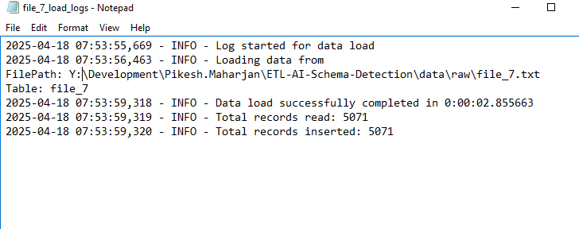
Methodology:
Log File Generation: All the log of loading files are logged into the log file along with errors if any.

Slide 13
Data Presentation and Algorithm
Data Generation : Used Python Script to Generate Custom delimited files
Model Used: Random Forest Classifier
Chosen for it accuracy and ability to handle mixed data types
Performs well with noisy datasets as well
Learns to predict column data types from sample records.
Notes:
NO publicly available labled data.

Slide 14
Discussion and Conclusion
Machine Learnings can be effective be used for automating key parts of ETL.
With combined use of scripts and models, we can move towards end-to-end ETL automation.
Reduces manual dependency lowering chances of issues in ETL processes.
Demonstrated how ETL automation can be achieved without using traditional ETL tools
System was tested on delimited files, showing adaptability of model to handle diverse datasets.
Project lays groundwork for future innovations, AI driven ETL processes.
Notes:
NO publicly available labled data.

Slide 15
Future Works
Handling different File connectors.
Defining multiple Target connectors.
Proper UI for user inputs and processing.
Introduction of complex Transformations logics.

Slide 16
THANK YOU

