Slide 1

End to End Automation in ETL Pipeline
Masters in computer science(Lincoln University) Presented by: Pikesh Maharjan (MCS-4th Sem) Supervisor: Prof. Sudan Jha, Ph.D.

Slide 2
Introduction
Exponential growth of data in every domain.
ETL (Extract, Transform, Load) is crucial to generate any meaningful information.
Traditional ETL processes require manual intervention.
Leading to various issues and time-consuming process.
Python and Machine Learning (ML) can enhance ETL automation.
This study focuses on automating schema detection and other meta data .
Reduces human effort and speeds up the ETL process.

Slide 3
Problem statement
ETL Processes uses commercial ETL tools which has high prices.
High dependency on ETL developers as it requires tool specific knowledge
Manual data type detection is time-intensive.
Human Intervention leading to time consuming and error prone process..
Lack of automation increases operational costs.
Delayed decision-making due to slow ETL processing.

Slide 4
Objectives
Remove Dependency on ETL Tools for Processing ASCII delimited Files.
Ensure one can process data up to Sql server without having tools specific knowledge.
Reduce Manual Intervention in ETL workflows.
Increase ETL processing speed.
Implement Python and pandas for efficient data handling.
Minimize errors and inconsistencies caused due to human interventions in ETL processing.

Slide 5
Methodology: (Research Design)
System Development: This phase involves designing and implementing an ETL automation framework using Python and Pandas with machine learning for schema detection.
Data Processing: The implemented system extracts raw data, applies schema creation based on the detected data types, and loads structured data into the target system.
Log File Generation: The Log of each details of Data loading along with error if any is generated.

Slide 6
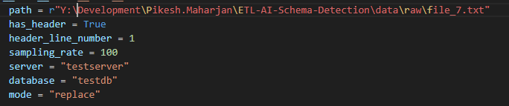
Methodology:
Data Ingestion: The process starts with a data ingestion where users can input the location of the file path along with some details that needs to be processed.

Slide 7
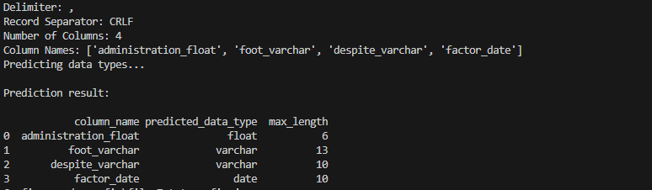
Methodology:
Meta Data Identification: To identify Meta data such as column delimiter, row separators, and column data types, a combination of rule-based logic and machine learning techniques is used.

Slide 8
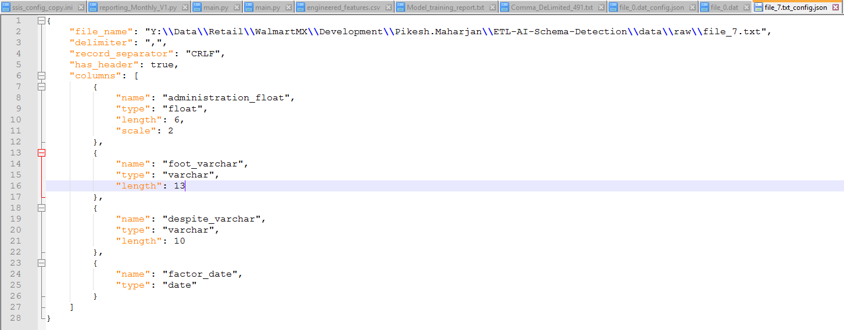
Methodology:
Configuration File Generation: Once the data types and other Meta data are identified, a configuration file is generated. This file provides detailed metadata about the dataset, including column names, data types, delimiters, and record separator.

Slide 9
Methodology:
Human Interaction for Validation: A provision is made for human users to review and modify the generated configuration file
Schema Creation: Using the instructions from the configuration file, the backend applies all schema creation.
Data Loading: This step involves loading the transformed data into a SQL Server database.
Log File Generation: All the log of loading files are logged into the log file along with errors if any.

Slide 10
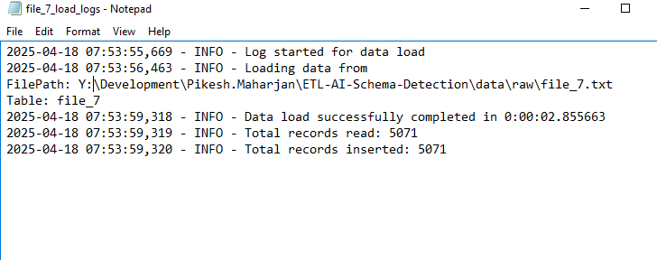
Methodology:
Log File Generation: All the log of loading files are logged into the log file along with errors if any.

Slide 11
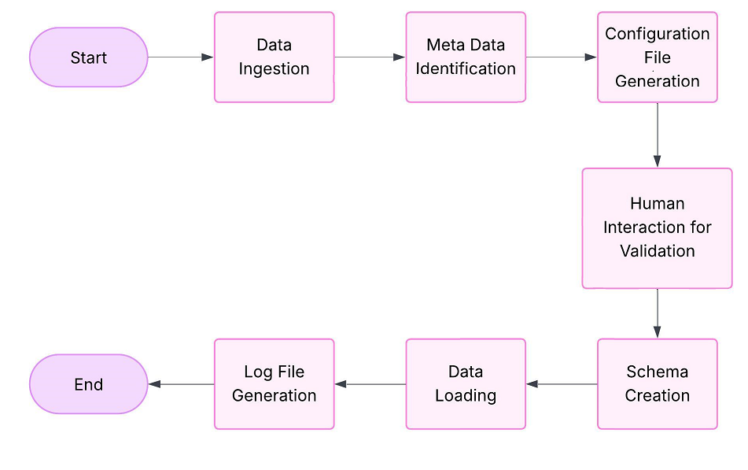
Data analysis and algorithm
Fig: Methodology architecture for ETL automation

Slide 12
THANK YOU

