Slide 1

Chapter 6 API Testing
Needful Information on API and ways to Test it
Presented by: Subina Maharjan

Slide 2
Agenda
1
WHAT IS AN API ?
2
TYPES OF API TESTING
3
TYPES OF REQUEST METHODS IN API TESTING
4
ERROR CODES IN API TESTING

Slide 3
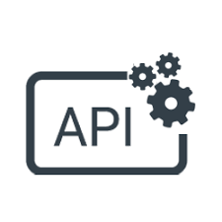
What is an API?

Slide 4
What is an API? (Application Programming Interface)
API is the acronym for Application Programming Interface,
a software intermediary that allows two applications to talk to each other.
each time you use an app like Facebook, send an instant message, or check the weather on your phone, you’re using an API. Note: API is a messenger that takes the request and tells a system what you want to do and brings the response back to you.
API has its own software development lifecycle (SDLC) of designing, testing, building, managing, and versioning.
Modern APIs adhere to standards, that are developer-friendly, easily accessible and understood broadly

Slide 5
To explain this better
Imagine you’re sitting at a table in a restaurant with a menu of choices to order from. The kitchen is the part of the “system” that will prepare your order. What is missing is the critical link to communicate your order to the kitchen and deliver your food back to your table. That’s where the waiter or API comes in. The waiter is the messenger – or API – that takes your request or order and tells the kitchen – the system – what to do. Then the waiter delivers the response back to you; in this case, it is the food.

Slide 6
More to the API
What an API Also Provides Is a Layer of Security
Your phone’s data is never fully exposed to the server, and likewise the server is never fully exposed to your phone. Instead, each communicates with small packets of data, sharing only that which is necessary—like ordering takeout. You tell the restaurant what you would like to eat, they tell you what they need in return and then, in the end, you get your meal.

Slide 7
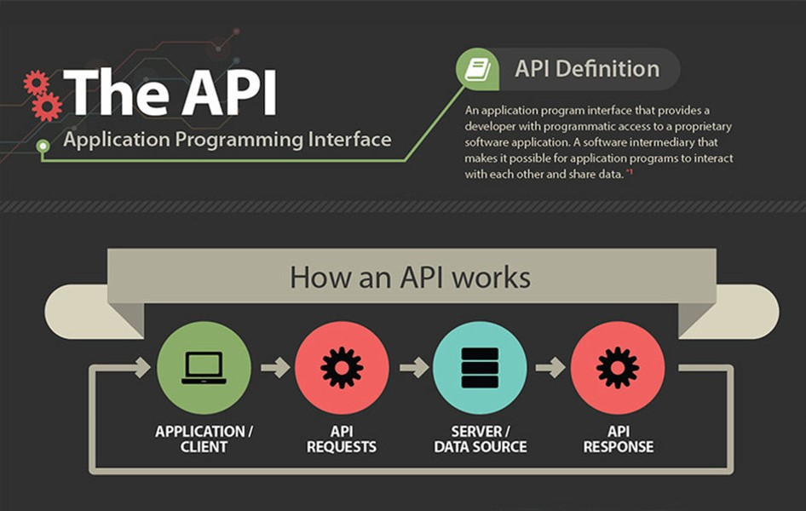

Slide 8
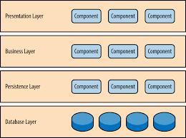
Layered Architecture Pattern

Slide 9
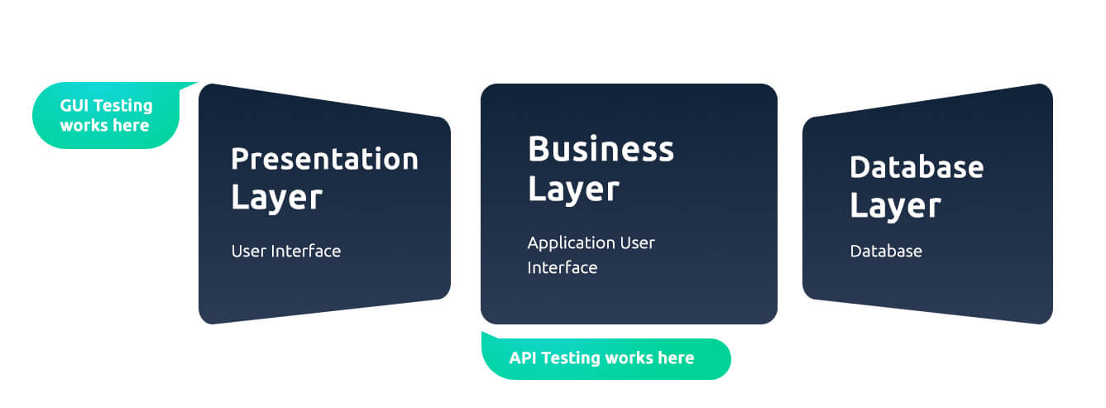
API Testing Stands At

Slide 10
Types of API Testing
1. Functional Testing: To make sure that all the API endpoints are up and working and doing what exactly they are supposed to so.
2. Reliability Testing: Making sure that the API works in case of connecting it to various devices and don’t just get disconnected any time.
3. Load Testing: When various servers sends request to an API, it is necessary to make sure that the API responds to all of them.
4. Security Testing: While giving authentication, it is important to make sure that no security breaches happen in between. No more than required data is shared. Have appropriate authentications, permissions, and access controls.
5. Integration Testing: All the APIs connected to each other communicate properly. And addition of features in the API do not cause addition of some bugs in other API modules.
6. Usability Testing: The API is functional and on the top of it, user-friendly.

Slide 11
Importance of API Testing
– To ensure the APIs work as expected
– To specify and ensure the application can handle the desired load
– To establish the APIs work seamlessly through the operating systems and devices
– To ensure the data that passes through the API is instead of compliance & security
– To make sure all the business rules have been correctly implemented at the API level
– To enable a better user experience
– To ensure easier expansion of applications
– To make sure the API provides the required functionality

Slide 12
Type of API’s
SOAP
REST
SOAP stands for Simple Object Access Protocol and REST stands for Representational State Transfer.
Since SOAP is a protocol, it follows a strict standard to allow communication between the client and the server whereas REST is an architectural style that doesn’t follow any strict standard
SOAP uses only XML for exchanging information in its message format whereas REST is not restricted to XML and its the choice of implementer which Media-Type to use like XML, JSON, Plain-text.

Slide 13
Soap API(XML)
<note>
<link type="text/css" rel="stylesheet" id="dark-mode-general-link"/>
<link type="text/css" rel="stylesheet" id="dark-mode-custom-link"/>
<style type="text/css" id="dark-mode-custom-style"/>
<to>Tove</to>
<from>Jani</from>
<heading>Reminder</heading>
<body>Don't forget me this weekend!</body>
</note>

Slide 14
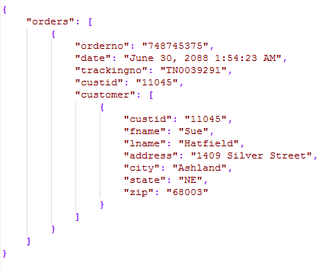
Rest API(Json)

Slide 15
How Does a REST Request Work
A REST request is made up of the following parts:
An HTTP verb that describes what action should be taken
A Uniform Resource Locator (URL) that defines the location of the request
HTTP headers that provide information to the server about the request
A request body that provides further details for the request (this can sometimes be empty)
Here are the most common HTTP verbs/Methods:
A GET request fetches a record from a database
A POST request adds a new record to a database
A PUT request replaces a record with a new one
A PATCH request replaces part of a record with new information
A DELETE request removes a record from a database

Slide 16
HTTP headers can provide information to the server such as:
The Host: the domain and port number of the user making the request
Authorization: the credentials of the user making the request
The Content-Type: the format of the information provided in the body of the request
How Does a REST Request Work

Slide 17
Response Codes
Response codes are three-digit codes used to describe the result of the REST request.
Code | Status | Description
200 | OK | The request was successfully completed.
201 | Created | A new resource was successfully created.
400 | Bad Request | The request was invalid.
401 | Unauthorized | The request did not include an authentication token or the authentication token was expired.
403 | Forbidden | The client did not have permission to access the requested resource.
404 | Not Found | The requested resource was not found.
405 | Method Not Allowed | The HTTP method in the request was not supported by the resource
500 | Internal Server Error | The request was not completed due to an internal error on the server side.

Slide 18
Data we need for API Testing
What endpoints are available?
What HTTP verbs can I use with those endpoints?
Are any of the verbs limited by authorization?
Which fields are required in the requests?
What are the validation limits on the fields?
What response codes should I expect for a successful request?
What response codes should I expect for an unsuccessful request?
What sort of error messages will be returned in the body of an unsuccessful request? DEMO: http://dummy.restapiexample.com/ https://reqres.in/

Slide 19
Authorization Token
Bearer authentication (also called token authentication) is an HTTP authentication scheme that involves security tokens called bearer tokens.
The name “Bearer authentication” can be understood as “give access to the bearer of this token.
” The bearer token is a cryptic string, usually generated by the server in response to a login request.
The client must send this token in the Authorization header when making requests to protected resources:

Slide 20
Difference between API testing and Unit testing
Unit testing | API testing
Developers perform it | Testers perform it
Separate functionality is tested | End to end functionality is tested
A developer can access the source code | Testers cannot access the source code
UI testing is also involved | Only API functions are tested
Only basic functionalities are tested | All functional issues are tested
Limited in scope | Broader in scope
Usually ran before check-in | Ran after build is created

Slide 21
Types of Bugs that API testing detects
Fails to handle error conditions gracefully
Unused flags
Missing or duplicate functionality
Reliability Issues. Difficulty in connecting and getting a response from API.
Security Issues
Multi-threading issues
Performance Issues. API response time is very high.
Improper errors/warning to a caller
Incorrect handling of valid argument values
Response Data is not structured correctly (JSON or XML)

Slide 22
Challenges of API Testing
Challenges of API testing includes:
Main challenges in Web API testing is Parameter Combination, Parameter Selection, and Call Sequencing
There is no GUI available to test the application which makes difficult to give input values
Validating and Verifying the output in a different system is little difficult for testers
Parameters selection and categorization is required to be known to the testers
Exception handling function needs to be tested
Coding knowledge is necessary for testers

Slide 23
Swagger for API Testing
What is Swagger?
Swagger is the largest framework for designing APIs using a common language and enabling the development across the whole API lifecycle, including documentation, design, testing, and deployment.
The framework provides a set of tools that help programmers generate client or server code and install self-generated documentation for web services.
https://petstore.swagger.io/
https://idratherbewriting.com/learnapidoc/pubapis_swagger.html

Slide 24
More study materials
https://www.guru99.com/api-testing.html
https://www.guru99.com/postman-tutorial.html

Slide 25
Thank you
ANY QUESTIONS?

