Slide 1
Technoprenuership TCP231 Module 11: IT Business Model and GLOBALIZATION
Lecture by: Ashitosh Sah

Slide 2
IT Business Model and Globalization
Time value of Money
Revenue Generation
Pricing Structure and Price Elasticity
Channels of distribution
Strategic Partners
Cultural Differences in communication

Slide 3
Characteristics of Digital Business Model
There is often a confusion about digital offerings vs. digital business models. In generally a digital offering is just an addition to existing services or products like an app for your product, a Chabot for contacting the support or a interface to control the product. Digital business models on the other side have certain characteristics that help to distinguish them from digital offerings:
1. The value is created using digital technologies
When the value proposition of the offered service is (solely) based on digital technologies, then we have one big indicator for a digital business model. Amazon, Alibaba, Facebook, Google, etc. wouldn’t be possible without the use of the Internet.
2. Digital business models are new to the market
One of the best examples is the difference between digital offerings and digital business models. When you are reading your energy consumption via an app, then it is a digital offering of your electricity provider. When you order transportation via an app that matches your request with a driver, then this is a digital business model.

Slide 4
Characteristics of Digital Business Model
3. Digital customer acquisition and distribution
To become a customer and to use a service you need to use digital channels. Digital business models are sometimes solely based on digital channels. This is especially important for business models that rely on early onboarding (Freemium Model) or on marketplaces (e.g. Amazon puts advertisements when you search online).
4. USP is created digitally
When the customer is willing to pay for your services and offerings which are created online, then there is a strong indicator of a digital business model as the customer value can be created digitally and also monetized.

Slide 5
Types of Business Model
Nine “ Verticals” based on common business models, not industry
-ENTERPRISE
-SAAS
-USAGE –BASED
-SUBSCRIPTION
-TRANSACTIONAL
-MARKETPLACE
-E-COMMERCE
-ADVERTISING
-HARDWARE

Slide 6
Types of Business Model
An enterprise company sells services or software to other businesses on a single-license basis. These contracts have fixed terms, designated contract values, and come up for renewal at the end of the term.
Examples: Docker, Cloudera,FireEye

Slide 7
Types of Business Model
A SaaS(software-as-a-service) company sells subscription-based licenses for a cloud hosted software solution.
Examples: Segment, Ironnclad, Sendbird

Slide 8
Types of Business Model
A subscription company sells a product or service, usually to a consumer, on a recurring basis.
Examples: The Athletic, Dollar Shave Club, Blue Apron

Slide 9
Types of Business Model
A transactional company enables a financial transaction on behalf of a customer and collects a fee ( usually a percentage of the underlying transaction).
Examples: Stripe, PayPal, Coinbase, Brex

Slide 10
Types of Business Model
A marketplace company acts as an intermediary in the sale of a good or service between sellers and buyers, generally collecting a percentage of the total transaction value.
Examples: Airbnb, eBay

Slide 11
Types of Business Model
A e-commerce company sells physical goods online. Generally, e-commerce companies manufacture and inventory those goods.
Examples: Warby Parker, Bonobos, Memebox

Slide 12
Types of Business Model
An advertising company offers a free service to consumers and derives revenue entirely or predominantly from advertisers. Common advertising companies include social networks and content sites
Examples: Snapchat, Twitter, Reddit

Slide 13
Types of Business Model
A hardware company sells physical devices to consumers or businesses.
Examples: Fitbit, GoPro, Xiaomi

Slide 14
What is Time Value of Money ?
The time value of money (TVM) states that a sum of money held today is more valuable than a future payment.
This money concept is true because dollars held today can be invested to earn a rate of return. The time value of money is also referred to as the net present value of money.

Slide 15
Why is the time value of money important?
There’s an opportunity cost related to future cash flows. If your business receives a payment in 3 years, rather than today, you lose the opportunity to invest that money and earn a return. A future sum of money is worth less due to inflation.

Slide 16

Time value of money formula
In this formula, FV is the future value of money, PV is the present value of money, and i is the interest rate. The number of compounding periods per year is given by n.
The future value of money is based on a growth rate. That rate depends on the interest rate and the period of time involved (typically a number of years).

Slide 17
Present value of a single sum
This method takes a future payment and uses discounting to determine the future payment’s present value. Note that this present value method assumes compounding interest annually.
Assume that your business will receive a $10,000 payment 3 years from now. You assume an interest rate, also called a discount rate, of 5%.
Find the present value formula for a single sum ($10,000) for 3 years at 5%. This table reports that the present value factor is 0.864 (with rounding). The $10,000 received 3 years from now is worth ($10,000 X 0.864), or $8,640 today.

Slide 18
Future value of a single sum
You can also take a single sum held today and use future value tables to determine the payment’s future value. This future value method also assumes compounding interest annually.
For this example, assume that you have $3,000 today and expect to earn a 7% return for 6 years. This future value table factor for 6 years at 7% is 1.5, and the future value of the $3,000 payment is $4,500.
By calculating compound interest manually, you get a better idea of how compounding increases the return on an invested amount.

Slide 19
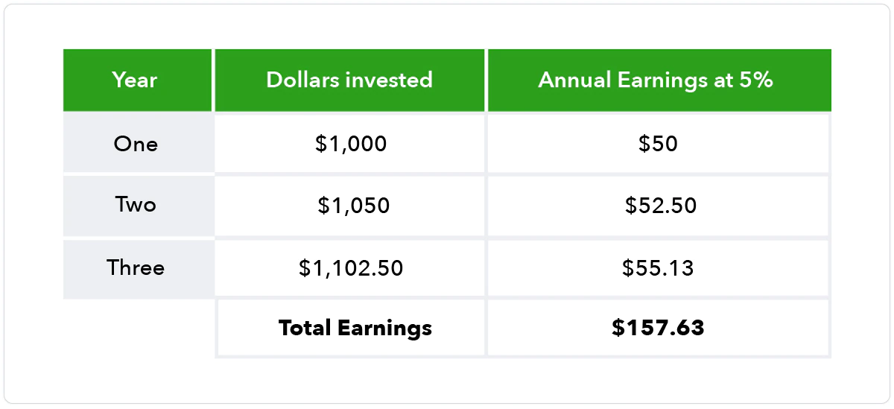
How compound interest builds future value
Compounding interest is defined as earning “interest on interest,” and when you compound interest, your total earnings can be much higher. The number of time periods determines how much more money you earn using compounding.
Notes:
https://quickbooks.intuit.com/r/accounting/time-value-of-money/

Slide 20
What Is a Revenue Model?
A revenue model is a blueprint that shows how a startup business will earn revenue or gross income from its standard business operations, and how it will pay for operating costs and expenses. This model is one of the key performance indicators (KPIs) for a company to measure the profitability of its pricing strategy and product sales.
Revenue model is sometimes used as another term for a business model, which is a structure for generating value for customers. However, these terms are not interchangeable but there is a connection between them. A revenue model is part of a business model, serving to explain how a company’s goods or services are made, distributed, and sold for profit.

Slide 21
What Is the Purpose of a Revenue Model?
The purpose of a revenue model is to manage a company’s revenue streams, which are its sources of income from target customers in different demographics and locations.
With a revenue model, a business can determine crucial factors that can help it thrive and grow. Companies use the information from a revenue model to determine how much money they will have to focus their sales and marketing on a target audience, develop new goods and services for customers, and ultimately determine their place and future in their particular market. Without a revenue model, companies, and especially startups, can generate costs that can make their business unsustainable.

Slide 22
6 Types of Revenue Models
There are many different types of revenue models for businesses, including:
Advertising model. The advertising model is frequently used by media companies whose platforms include content with advertising, such as newspapers, search engines, and social media sites. Revenue is generated by charging advertisers based on various criteria, including the size of the ad space or number of clicks.
Freemium model. “Freemium” is a business plan in which a company offers access to its product or services, such as a software product, for no charge to customers, but sets a licensing fee for premium features and functionality within a tier format. This model is often used as a monetization strategy for apps.

Slide 23
6 Types of Revenue Models
3. Licensing model. In the licensing model, a company rents content that they own to third parties. This model is frequently used by software companies in place of transactional sales of their product, and for intellectual property, such as trademarks and patents.
4. Markup model. The markup model is a common revenue model, especially among retailers and wholesalers, as well as e-commerce sites. Here, revenue generation is created by buying a product and then increasing or marking up the price before selling it to customers.

Slide 24
6 Types of Revenue Models
5. Production model. Also known as a transactional revenue model, the production model is also one of the most common revenue models. Using the production model, a company produces or manufactures a new product for sale, and generates revenue when the customer pays for it.
6. Subscription model. The subscription revenue model allows a company’s target audience to use a product or service for a predetermined and contracted rate and period of time. It’s a popular source of revenue for cloud-based or software-as-a-service (SaaS) companies, and online entertainment hosting companies. This model differs from the licensing model in that the subscription has a fixed term, while licensing continues in perpetuity until the licensee or property owner terminates the deal.

Slide 25
3 Factors to Consider When Choosing a Revenue Model
1. Product value. The revenue model you choose should connect to your value proposition, which is a statement that clearly expresses your product or service's distinct selling points to potential customers. Is your product something that is sold or licensed? Does it involve a tier structure for payments? Does it generate income from a per-user arrangement? The value that your product delivers to the consumer should be reflected in your revenue model.

Slide 26
3 Factors to Consider When Choosing a Revenue Model
2. Customers. An understanding of the customer segments that use your business will also help you determine your revenue model. Single customers may benefit from a subscription model, but larger companies may require a different approach, such as licensing.
3. Competition. How does your competition in the financial market generate revenue? Studying their strategies will help you determine if your current model is more successful than that of other companies in the marketplace, or if you should consider adopting a different approach.

Slide 27
What is Price Elasticity of Demand?
Price elasticity of demand (PED) is a critical concept in the law of demand. It is a measurement of how demand for a good will be affected by changes in its price. In other words, PED is a way to figure out the responsiveness of consumers to fluctuations in price, as opposed to price elasticity of supply, which determines the responsiveness of supply to price.
While equations can sometimes be complicated, this one is super simple and easy.

Slide 28
How to Calculate Price Elasticity of Demand
Here’s the basic price elasticity of demand formula you can use:
Price Elasticity of Demand = (% Change in Quantity Demanded)/(% Change in Price)
When the price elasticity of a good is less than 1, it’s considered inelastic. That means a one-unit increase in price resulted in a less than one unit decrease in demand. On the other hand, if the coefficient (the absolute value) is more than 1, the good is elastic. That means a unit increase in price will cause an even greater drop in demand. Theoretically, total revenue will be maximized when the price elasticity of a good equals 1, or in other words, when demand is unit elastic.

Slide 29
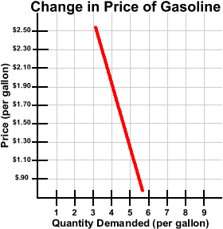
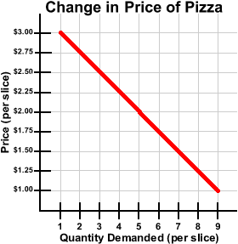

Slide 30
How to determine the price elasticity of demand for your product
Is the product a necessity or a luxury good?
How available are close substitutes?
How much does your product actually cost?
How long will this price change last?

Slide 31
What are the types of price elasticity?
There are two types of price elasticity of demand:
elastic demand and
inelastic demand..
Elastic demand happens when the demand changes for goods is sensitive to price changes.
Inelastic demand is when the demand for goods is not affected much by price changes. Common goods typically have elastic demand, while necessities have inelastic demand.

Slide 32
Example
Elastic demand is used to describe the scenario where the change in demand is sensitive to a small change in price. For example, if we see a large change in the price of Lays chips, consumers are more likely to shift to a different brand, driving the demand down and vice versa. This means that chips have elastic demand due to the availability of close substitutes.
Inelastic demand describes the scenario where fluctuations in price do not change the demand for a good. For example, gas is required for cars to run and there are no substitutes for the gas availability. This means that anyone who has a car will have to pay for gas regardless of how high the prices are, making demand inelastic.

Slide 33
Why is price elasticity of demand important?
A distribution channel is the set of steps it takes for a product to get in the hands of the key customer or consumer.
Distribution channels can be direct or indirect.
Distribution can also be physical or digital, depending on the kind of business and industry.

Slide 34
Distribution Channels
Knowing the price elasticity can offer
insight into how a market will react to price changes. This
is important for businesses that are making pricing decisions as raising or lowering prices will directly impact the number of sales.
Factoring price elasticity of demand is a key step for companies to determine the right pricing objectives within their niche.

Slide 35
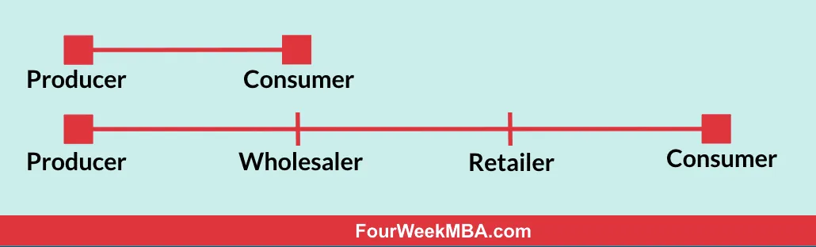
Types of distribution channels
At a higher level, distribution channels can be broken down, in direct channels, and indirect channels. This primarily depends on how long is a chain between who makes the product and the final consumer.
The number of steps it takes will make the distribution channel direct or indirect.

Slide 36
Types of distribution channels
direct distribution strategy a producer can access the consumer, in an indirect distribution strategy, the producer will meet its consumer demands via third-parties wholesalers or retailers
a direct approach makes the value chain shorter and at the same time allows more control by the producer on how the final customer experiences the product or service offered.
At the same time, a direct-to-consumer strategy is quite expensive and not always effective enough to allow proper distribution. Therefore, companies often use a mixture of direct and indirect distribution strategies, which determine their marketing mix.

Slide 37
What are strategic business partnerships?
A strategic business partnership is a long-term business relationship focused on creating joint value for two or more organizations. The more value created by the partnership, the more strategic it is.
A strategic business partnership is not a business relationship that looks to exchange or extract value for your business from the other organization.

Slide 38
What are strategic business partnerships?
A small business, for example, might partner with an industry-specific organization or association in order to reach a specific target market. Access to that member base allows the small business to promote its products or services and show its relevance to that audience.
Another example is partnering with an organization or association so your business can share high-value thought leadership content with its audience or network to further establish your authority and expertise in your market niche.

Slide 39
Benefits of strategic partnerships
Overcome business fears
Increase your expertise and resources
Decrease your cost of acquisition
Create predictable revenue streams
Provide incremental lift to sales and revenue

Slide 40
Common strategic business partnerships
Research, development and big data
Subject matter experts and content developers
Market engagement and co-promoters
Solution integrators and co-sellers
Peer group communities

Slide 41
What is GLOBALIZATION?
Globalization is the increase in the flow of goods, services, capital, people, and ideas across international boundaries.
“We live in an age of globalization,” says Harvard Business School Professor Forest Reinhardt, who teaches Global Business. “That is, national economies are ever more tightly connected with one another than ever before.”

Slide 42
WHAT DOES IT MEAN TO BE AN INTERNATIONAL BUSINESS?
An international business is any company that operates and produces or sells goods between two or more countries. There are three ways a business can be considered international:
It produces goods domestically and sells domestically and internationally.
It produces goods in a different country but sells domestically.
It produces goods in a different country and sells domestically and internationally.

Slide 43
WHAT DOES IT MEAN TO BE AN INTERNATIONAL BUSINESS?
If your business falls into one of these categories, there are two types of international business models to consider: transnational and multinational.
Transnational corporations have offices in multiple countries, each responsible for a different facet of the organization. For instance, marketing may be based in London, research and development in Bogota, and software development in New York.

Slide 44
WHAT DOES IT MEAN TO BE AN INTERNATIONAL BUSINESS?
An example of a successful transnational corporation is Nestlé, which splits business operations for each of its brands by region. There are over 100 Nestlé offices worldwide with distinct responsibilities. For instance, the Nestlé Research Center is located in Switzerland, which acts as the hub that oversees each brand-specific research and development center, of which there are 23. All Nestlé offices operate under the company’s headquarters in Switzerland.

Slide 45
WHAT DOES IT MEAN TO BE AN INTERNATIONAL BUSINESS?
Multinational corporations also have offices in multiple countries, but unlike transnational corporations, each is a microcosm of the larger organization. This means each office has, for example, its own leadership, marketing, sales, research and development, technology, and human resources teams. An example of a multinational corporation is PepsiCo, which has 32 offices across 24 countries.

Slide 46
FACETS OF GLOBAL BUSINESS TO CONSIDER
Globalization doesn’t just refer to the location of a firm’s offices and customers—it also encompasses the nuances and economic factors of conducting business internationally and existing in a global economy. Even if your company operates domestically, globalization can influence the way you do business. Here are a few factors to consider when thinking about how global business impacts your organization:
Politics and laws: International politics can color relationships between nations and regulate what products are allowed in and out of their borders. Keeping up with current events can help you prepare for the business impacts of shifts in policy and foreign affairs.

Slide 47
FACETS OF GLOBAL BUSINESS TO CONSIDER
The environment: There’s no global issue more pressing than climate change. Unfortunately, globalization can contribute significantly to its negative effects due to increased transportation of materials and products, business travel, and the number of factories. If you’re engaging in global business, keep sustainability in mind to avoid contributing to climate change.
Macroeconomics: Principles of macroeconomics can allow you to compare countries’ financial health on a one-to-one basis and draw connections between trends. Some metrics to know include:
Gross domestic product (GDP)
Unemployment rate
Inflation rate
Degree of income inequality
Currency exchange rate

Slide 48
FACETS OF GLOBAL BUSINESS TO CONSIDER
Human rights: Because laws dictating human rights—including labor laws—differ from country to country, operating as a global business requires research and critical thought to ensure you’re not exploiting people for labor, even if it’s technically legal. Ethics are required for making decisions that may cost your business money at the expense of protecting human rights.
Cultural differences and language barriers: Operating a global business requires knowing and respecting other cultures. Without understanding the areas you do business in, you could unintentionally offend someone and harm your working relationships. In the case of language barriers, this may require you to hire translators and multilingual employees to bridge the gap.
Human rights: Because laws dictating human rights—including labor laws—differ from country to country, operating as a global business requires research and critical thought to ensure you’re not exploiting people for labor, even if it’s technically legal. Ethics are required for making decisions that may cost your business money at the expense of protecting human rights.
Cultural differences and language barriers: Operating a global business requires knowing and respecting other cultures. Without understanding the areas you do business in, you could unintentionally offend someone and harm your working relationships. In the case of language barriers, this may require you to hire translators and multilingual employees to bridge the gap.

