Slide 1
Technoprenuership TCP231 Module 3: VALUE PROPOSITION
Lecture by: Ashitosh Sah

Slide 2
3. Value Proposition
Benefits vs features, relation to needs, and high value adding
Solution driven or efficiency improvement
Value = benefits/cost
Value proposition statement including Needs, Approach, Benefits per cost, Competition
Task – Value Proposition Canvas

Slide 3
Overview
Welcome! To the third module of this course.
For this lesson, we will be discussing what is value proposition and how it is developed based on the customer/user profile.

Slide 4
Learning Objective
By the end of this module, you should be able to:
Define value proposition; and
Make a value proposition about your products / services.

Slide 5
Value Proposition (Definition)
A value proposition is a statement which identifies clear, measurable and demonstrable benefits consumers get when buying a particular product or service.
It should convince consumers that this product or service is better than others on the market.

Slide 6
Value Proposition
A value proposition is a statement that answers the ‘why’ someone should do business with you. It should convince a potential customer why your services or product will be of more value to them than similar offerings from your competition.
You know why your company is great, but do your potential customers know what sets your brand apart?

Slide 7
Value Proposition
A good value proposition can give you an advantage over your competitors and is often what your prospects use to evaluate you. And for many consumers, your value proposition is the first thing they encounter when exploring your brand. So, have a clear, concise value proposition is more important than ever.
You’ve got less than a minute to capture a site visitor’s attention.

Slide 8
Value Proposition
Identify all the benefits your product or services offer
Describing what makes these benefits valuable in a quick digestible way
Identify your customer’s main problem your value proposition helps solve.
By connecting this value to your buyer’s challenges your value proposition will become more clear. This is what helps differentiate your brand as the best provider of this product or service.

Slide 9
Value Proposition
The value proposition statement should consist of these components:
1. What your product/service is
2. The target customer
3. The value you provide them
Emergent property: why your product is unique

Slide 10
Top Characteristics of a Great Value Proposition
Be concise and easy to understand
Define what you do
Make it easy for someone to find you in an online search
Explain how your product resolves a pain point for your potential customer
Be displayed prominently on your website and/or your consumers touch points
Answer the question: “If I am your ideal customer, why should I buy from you instead of any of your competitors?”

Slide 11
Which are value proposition?
10x faster
1-click purchase
Voice Activation
Inexpensive, free
2-day delivery
Low emissions
Fair trade certified
Organic
None of the above …
These are Features, Functions, and Technologies.

Slide 12
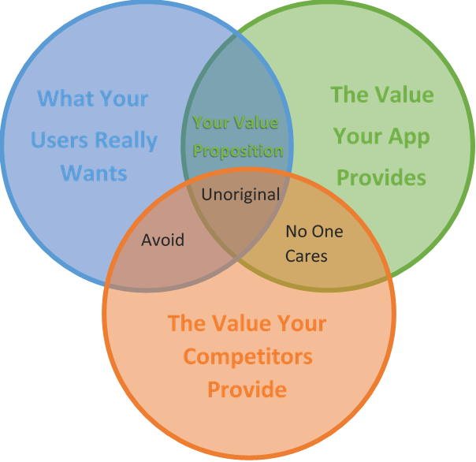

Slide 13
Value Proposition
“Saves you 30 minutes every day”
“Helps you stop smoking so you can live longer”
“Make sure you never miss your favorite TV show”
“Helps you look 10 years younger”
“Let’s people know you’re stylish and trendy”
“Let’s you enjoy retirement early”
“You’ll never be stuck without your digital documents”
“You’ll always be able to get a ride home”

Slide 14
Value Proposition
Uber – The Smartest Way to Get Around. ...
Apple iPhone – The Experience IS the Product. ...
Unbounce – A/B Testing Without Tech Headaches. ...
Slack – Be More Productive at Work with Less Effort. ...
Digit – Save Money Without Thinking About I

Slide 15
Examples:
What is it?
For whom?
Values?
Good: “Winners is a
department store that
offers fashion conscious
consumers the latest
brand names for up to
60 per cent
off.” (Winners)
Bad: “Winners is an
off-price department
store owned by TJX
that employs
international
sourcing and buying
power.”

Slide 16
Examples:
What is it?
For whom?
Values?
Good: “Winners is a
department store that
offers fashion conscious
consumers the latest
brand names for up to
60 per cent
off.” (Winners)
Bad: “Winners is an
off-price department
store owned by TJX
that employs
international
sourcing and buying
power.”

