Slide 1
Technoprenuership TCP231 Module 4: Market Research & Customers Identification
Lecture by: Ashitosh Sah

Slide 2
4. Market Research & Customers Identification
Customer needs, pain points and demographics
Market research and validation
The decision-making process
Target customer profile, persona

Slide 3
Key to Success
Whether you’re a new entrepreneur, an established business owner, or an employee within a company, your success is often measured by how well you convince potential customers to purchase your product or service.
It requires understanding your business’s market and competition, its differentiating factors and value proposition, and, most importantly, your ideal buyer.
You need to know the motivations, goals, challenges, and desires that lead them to purchase a solution like yours.

Slide 4
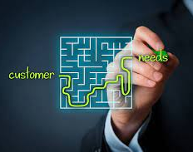
Customer Needs
We can think about this concept in terms of customer “needs.”
What does a potential customer need that leads them to your solution?
Understanding that need can enable you to
tailor your sales and marketing messaging,
inform your product research and development, customer service, and other aspects of your business.

Slide 5
What are Customer Needs ?
A customer need is a need that motivates a customer to purchase a product or service. The need can be known (i.e., the customer can put it into words) or unknown, and is the ultimate factor that determines which solution the customer purchases.
Effective way to determine and evaluate customer needs is by using the lens of “jobs to be done.”

Slide 6
Customer Needs as Jobs to Be Done
“ Customers don’t purchase a product; instead, they hire it to complete a certain job or task.” Harvard Business School Professor Clayton Christensen
A job to be done is defined as a “circumstances-based description of understanding your customers’ desires, competitive set, anxieties, habits, and timeline of purchase.”
Understanding of customer jobs to be done helps business
avoid disruption and
identify new opportunities

Slide 7
3 MAIN TYPES OF CUSTOMER NEEDS
Customer needs can be broken out into many different varieties and categories.
Ultimately, all customer needs can be categorized into three main types:
Functional needs
Social needs
Emotional needs.

Slide 8
FUNCTIONAL NEEDS
Functional needs are the most tangible and obvious of the three main types of customer needs. Customers typically evaluate potential solutions based on whether they’ll help them achieve a particular task or function. The product or service that best addresses their functional need is likely to be the one they purchase, or hire.
For example, a customer who’s planting a garden for the first time might say, “I need a garden hose.” Meanwhile, an experienced gardener might tailor their criteria by saying, “I need a hose that’s long enough to reach my vegetable garden from my backyard spigot.” Another customer who’s dealt with the frustration of using a low-quality product might tailor their need differently by saying, “I need a high-quality garden hose that won’t tear or kink from regular use.”

Slide 9
SOCIAL NEEDS
A social need is a customer need that relates to how a person wants to be perceived by others when using a product or service. While social needs aren’t typically a customer’s primary concern when considering a purchase, they can influence their final decision.
Social needs are often more difficult for a company to identify, and vary substantially from customer to customer.
By understanding various social needs, you can look for patterns among your users. If enough of your customers share a particular need, consider how it can inform your product development, sales, and marketing processes.

Slide 10
SOCIAL NEEDS
For example, imagine the customer is a member of a gardening association. Members of this association have an affinity for high-tech gardening tools and regularly discuss new products they’ve tried. The customer may decide, either consciously or unconsciously, to purchase a hose with advanced features—for example, one that connects to a smart water controller—to bond with other association members.
On the other hand, the customer is an environmentalist who’s active in various communities, they might be more concerned about whether a hose is made from sustainable materials that their fellow environmentalists use.

Slide 11
EMOTIONAL NEEDS
Emotional needs are similar to social needs in that they’re typically secondary to functional needs. Whereas social needs refer to how a customer wants to be perceived by others when using a product, emotional needs refer to how a customer wants to feel.
Example, consider the reasons why the customer gardens. If they find gardening to be a relaxing hobby, they may be more likely to choose a basic hose over a high-tech option. Alternatively, if gardening triggers memories of the customer’s grandparents, they might opt for a brand that evokes that nostalgia.
While emotional needs can be difficult to pinpoint, companies that identify those of their customers can use the information to tailor and optimize their product messaging.

Slide 12
IDENTIFYING CUSTOMER NEEDS
There are several strategies you can use to identify those needs.
Reflecting on your experiences
observing others' behaviors
conducting customer interviews
By understanding your customers’ needs and the jobs they hire your products or services to perform, it’s possible to not just avoid disruption, but drive innovation within your organization and industry.

Slide 13


Slide 14
What are Customer Pain Points?
Pain points are the specific challenges and problems that customers experience in your industry or within your market.
There are an endless number of pain points that your customers could be experiencing, but they are all persistent problems that drive customers to seek out solutions.
While a pain point could be something like physical pain or emotional pain, they are most commonly struggles or inconveniences that they face when dealing with other businesses.
When a customer has pain points, what they really have are unmet needs that need to be satisfied in the form of products or services that your brand can provide.

Slide 15
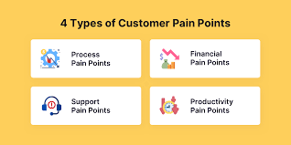
Types of Customer Pain Points

Slide 16
Types of Customer Pain Points
Financial Pain Points
Issues a customer has that involve money, like overpriced products and services or unclear spending.
Process Pain Points
Issues a customer has that deal with the processes within their daily lives, like time-consuming tasks and complicated methods.
Productivity Pain Points
Issues a customer has that come from a lack of streamlined experiences or efficiencies where time and resources aren’t utilized properly.
Support Pain Points
Issues a customer has that make them feel like they don’t have the help they need, like confusing tasks and processes or a lack of guidance.

Slide 17
How Do You Find Customer Pain Points?
Identifying these pain points is key to building solutions that address customer needs.
There are a few ways you can go about determining what your customer pain points are, including:
Conduct Customer Research and Surveys
Apply Social Listening Tactics
Set Up a Live Chat Feature

Slide 18
What are the Most Common Customer Pain Points?
Some of the most common issues include:
Delayed Support Responses
Inconsistent Experience
Lack of Communication
Poor Quality Products and Services
Lack of Knowledge and Experience
Complicated Buyer Processes

Slide 19
How Do You Solve Customer Problems?
Some of the most common issues include:
Ask Customers About Their Needs
Offer Solutions and Give Options
Follow Up with Customers
Align Your Solutions to Customer Needs
When you understand what the common pain points are in your industry or market, you can leverage your own brand solutions as an alternative that brings in new business and establishes your brand reputation.
Solving customer pain points is just one step in the customer journey, which is the process that a lead takes in order to become a customer of your brand.

Slide 20
Customer Demographics
Customer demographics are categories of consumer populations that are relevant to a business' purposes, such as marketing and product design. The term also refers to the study of such categories in a business context.
Customers (and potential customers) can be categorized according to an almost endless number of variables. Some of the most common customer demographics for business purposes include age, gender, geographical location, education level, marital status, household income, occupation and hobbies.

Slide 21
Customer Demographics
Demographics are one of the key elements of customer segmentation. Targeting specific groups of customers enables more efficient allocation of marketing resources and increases the opportunities for cross- and up-selling.
makes more personalized interaction possible,
improving customer service and
fostering customer loyalty and retention.
More appropriately targeted marketing efforts are typically more relevant to the customer’s needs and, as a result, more welcome.

Slide 22
Market Research and Validation
Market Research
The planning, collection and analysis of data relevant to marketing decision making and the communication of the results of this analysis to management.
Why it should be done
• To improve the quality of the decision making
• Trace problems
• Focus on keeping existing customers
• Understand changes in marketplace

Slide 23
Market research process
• Define the research problem
• Develop the research plan
• Collect data
• Analyze the data
• Report findings

Slide 24
The Decision making Process
The value proposition statement should consist of these components:
1. What your product/service is
2. The target customer
3. The value you provide them
Emergent property: why your product is unique

Slide 25
Target Customer Profile, Persona
A target consumer profile is a detailed synopsis of your ideal customer. All successful brands will have a range of customers. There’ll be differences in age, interests, lifestyle, and location. There’ll be some who only buy once, never to return; others will buy occasionally. A certain number will be repeat buyers — loyal shoppers who you can potentially turn into brand ambassadors.
From a company-centric view, these guys are part of your extended family. They’ll often have shared characteristics, philosophies, career trajectories, or similar levels of disposable income.

Slide 26
Target Customer Profile, Persona
Buyer personas are semi-fictional representations of your ideal customers based on data and research. They help you focus your time on qualified prospects, guide product development to suit the needs of your target customers, and align all work across your organization (from marketing to sales to service).
As a result, you'll be able to attract high-value visitors, leads, and customers to your business who you'll be more likely to retain over time.

Slide 27
Decision making process
Decision making is the process of making choices by identifying a decision, gathering information, and assessing alternative resolutions.
Using a step-by-step decision-making process can help you make more deliberate, thoughtful decisions by organizing relevant information and defining alternatives. This approach increases the chances that you will choose the most satisfying alternative possible.

Slide 28
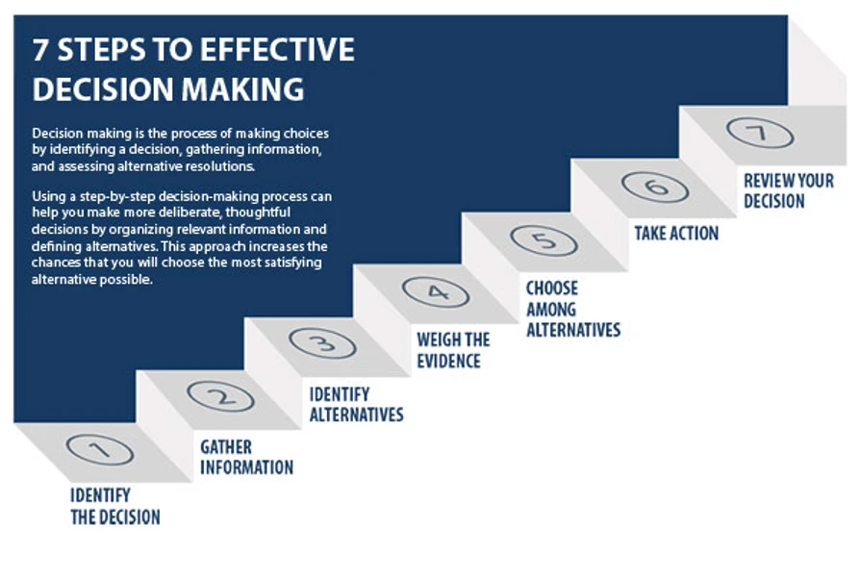

Slide 29
Step by step Decision making process
Step 1: Identify the decision
You realize that you need to make a decision. Try to clearly define the nature of the decision you must make. This first step is very important.
Step 2: Gather relevant information
Collect some pertinent information before you make your decision: what information is needed, the best sources of information, and how to get it. This step involves both internal and external “work.” Some information is internal: you’ll seek it through a process of self-assessment. Other information is external: you’ll find it online, in books, from other people, and from other sources.

Slide 30
Step by step Decision making process
Step 3: Identify the alternatives
As you collect information, you will probably identify several possible paths of action, or alternatives. You can also use your imagination and additional information to construct new alternatives. In this step, you will list all possible and desirable alternatives.
Step 4: Weigh the evidence
Draw on your information and emotions to imagine what it would be like if you carried out each of the alternatives to the end. Evaluate whether the need identified in Step 1 would be met or resolved through the use of each alternative. As you go through this difficult internal process, you’ll begin to favor certain alternatives: those that seem to have a higher potential for reaching your goal. Finally, place the alternatives in a priority order, based upon your own value system.

Slide 31
Step by step Decision making process
Step 5: Choose among alternatives
Once you have weighed all the evidence, you are ready to select the alternative that seems to be best one for you. You may even choose a combination of alternatives. Your choice in Step 5 may very likely be the same or similar to the alternative you placed at the top of your list at the end of Step 4.
Step 6: Take action
You’re now ready to take some positive action by beginning to implement the alternative you chose in Step 5.
Step 7: Review your decision & its consequences
In this final step, consider the results of your decision and evaluate whether or not it has resolved the need you identified in Step 1. If the decision has not met the identified need, you may want to repeat certain steps of the process to make a new decision. For example, you might want to gather more detailed or somewhat different information or explore additional alternatives.

