Slide 1
Technoprenuership TCP231 Module 8: Financial Analysis and Accounting Basics
Lecture by: Ashitosh Sah

Slide 2
8. Financial Analysis and Accounting Basics
Organize financial plan for new ventures in technopreneurship
Importance of financial plan
Preparing financial statements and capital budgeting in IT Business
Cash flow statements and projection
Income (P&L) statements; accrual accounting, depreciation, operating expense
Balance sheets; equity, liability
Breakeven time

Slide 3
Have to pay the bills
Why money matters in a startup
Desirable outcome !!
Sign of a sustainable business model

Slide 4
According to the Harvard Business Review
“75% of all startups fail”
Chances of failure can be reduced drastically if proper time and energy is invested in the financial planning.
Effective planning helps you deal with inevitable bumps in the road
Financial plan allows to describe the vision of the business in a concrete way
Helps you predict where your start up will be in next few years

Slide 5



Financial Plan can be broken down into three documents
Income
Statement
Balance
Sheet
Cash Flow
Statement

Slide 6


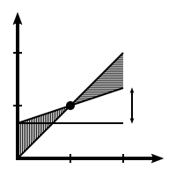





Business Health
Breakeven point
Cash Collection
Debt financing

Slide 7
Knowing Business Health
Pay taxes properly
Make big decisions
Attract investors
Catch mistakes

Slide 8




Income Statement
Revenue
Expenses
Net Income

Slide 9



Balance Sheet
Assets
Liabilities
Equity

Slide 10

Cash Flow Statement
Beginning balance in cash
+
Net changes in operating,
investing, and financing
=
Ending cash balance

Slide 11

Importance of Financial Plan
Assistance in overall business planning
Ensuring the health and integrity of capital structure
Determining sufficient funding amount
Securing funding in a timely manner
Securing funds on most favorable terms
Determining appropriate responses to new challenges and opportunities
Instilling discipline and maintain focus
Maximizing ROI upon Execution of Exit Strategy

Slide 12

Estimating Financial Funds
Step 1 : Startup Expenses
Startup expenses are one-time expenses that occur before you open your doors for business and start selling your product or service.
Expenses are money you pay for services, like legal expenses, design services, rent, intangible things.
Expenses reduce your taxable income, but cannot be depreciated over time.
After startup, expenses are accounted for in your profit and loss table.

Slide 13
Estimating Financial Funds
Step 1 : Startup Expenses
It includes
Legal
Logo design
Initial website design
Insurance
Payroll
Rent/ Security deposit
Computer and office equipment
Training
Pre-opening marketing
Office Supplies
Consultants
Misc and others

Slide 14
Estimating Financial Funds
Step 2 : Startup Assets
Assets are tangible things like tables and chairs, land equipment's, and even sometimes intangible things like intellectual property, that you own.
Unlike expenses, assets are not deductible against income.
But assets whose value declines over time can be depreciated.
After startup, you will list your assets on your balance sheet.

Slide 15
Estimating Financial Funds
Step 2 : Startup Assets
Cash in the bank: In addition to cash that you will use to cover your ongoing monthly expenses (which we will calculate in the next step), you might want some additional cash in your bank account when you open your doors for business. This money could be used simply as a safety net or to cover any unforeseen expenses during the first few months of business.
Starting inventory: If you sell products, you should include the money spent on the inventory you have at the start of business. If you are starting a service-based business with no inventory, feel free to leave a zero in this field.
Other current assets: These are normally things like supplies, napkins, and other small items that last less than a year but are still considered assets. You might make a list elsewhere and put the total here. The standard is different for every business.
Office furniture: Chairs, tables, shelves, small appliances all fall into this category. If you purchased the furniture prior to start up, it should be included here.

Slide 16
Estimating Financial Funds
Step 2 : Startup Assets
Signage: This includes the sign outside in the parking lot, for instance, as well as in-store signs that you'll use to announce sale items or to categorize your inventory.
Leasehold improvements: Here's where you'll account for money spent on fixing up the place after you find it and rent it but before your starting date. Remember to include things like new lighting, paint, repaving the parking lot, etc.
Plant and equipment: The costs here will vary greatly depending on the type of business you are starting. Generally considered long-term or fixed assets, these are items that depreciate over more than five years and are likely to last at least that long.
Land: The land your company owns is also considered a long-term asset. You want to list the purchase price, not the current value, because you're reflecting the money you've actually put into this particular asset.
Other assets: The list of what could be considered "other assets" is long. Intellectual property, which might be hard to quantify, fixtures for you store or office, or equipment that went beyond what the IRS allowed you to consider expenses can be entered here.

Slide 17
Estimating Financial Funds
Step 3 : Recurring Costs
• One of the hardest estimates is the cash you'll need to have in the bank as a war chest, or cash reserve, to keep the business afloat during the normal lean months, just after the start, before sales grow enough to support the normal cash outlays.
• There's no magic formula. You may have heard some time-worn guidelines, like the one that says you should have six months‘ worth of expenses stored up before you start. This isn't a bad idea, but realistically,
Can you afford it?
Can you raise the money?
Are you able to get some early sales, to offset expenses?
Can you get to a monthly break-even point sooner, or will it take you longer?
In the end, what you need is a reasonable estimated guess..

Slide 18
Estimating Financial Funds
Step 3 : Recurring Costs
• Monthly Expenses: Running monthly expenses, often called the burn rate. This is at best an estimated guess.
• Rent:
• Utilities:
• Payroll:
•Inventory:
• Marketing:
• All other:
• How many months?
• Number of months:
• How many months of expenses do you think you'll need? (Set an estimate here; be conservative, and remember, there is no
absolute right or wrong answer)

Slide 19
Estimating Financial Funds
Your startup costs are the sum of what you will spend as startup expenses, plus what you need to spend to buy startup assets, plus the cash you need to have in the bank the day you open your business.
Startup Expenses: Rs 0.00
Startup Assets: Rs. 0.00
Cash for Recurring Costs: Rs. 0.00
Total Startup Costs: Rs. 0.00
Your Estimate: Rs 0.00
What's next?
The next step in starting your business, once you have figured out how much it will cost, is to figure out where the money will come from.

Slide 20
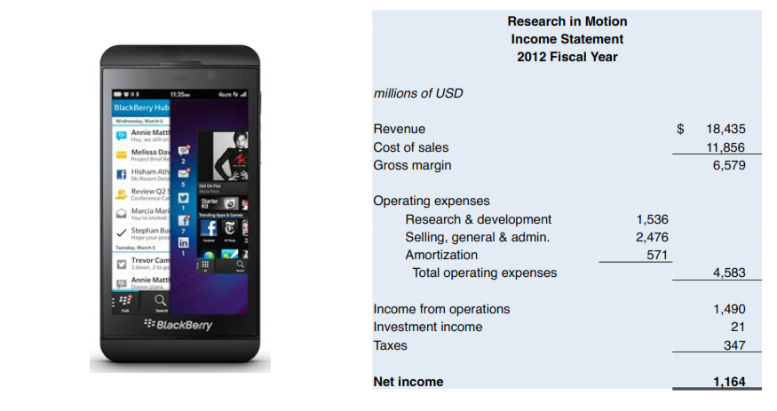
The Income Statement

Slide 21
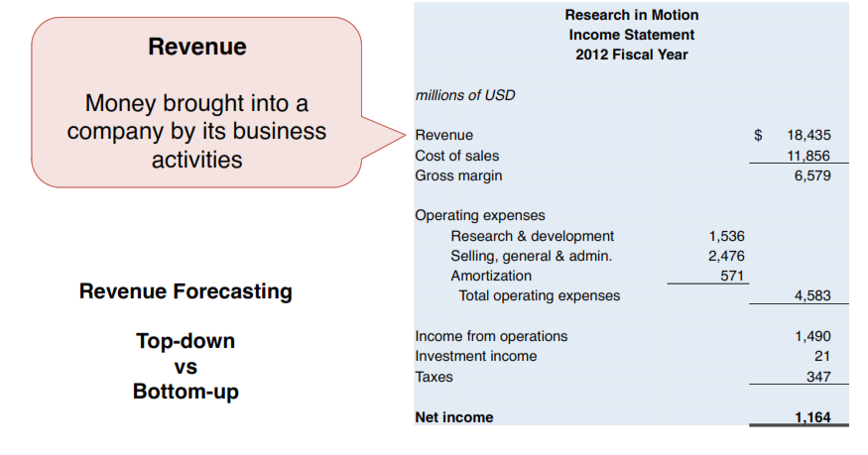
The Income Statement

Slide 22
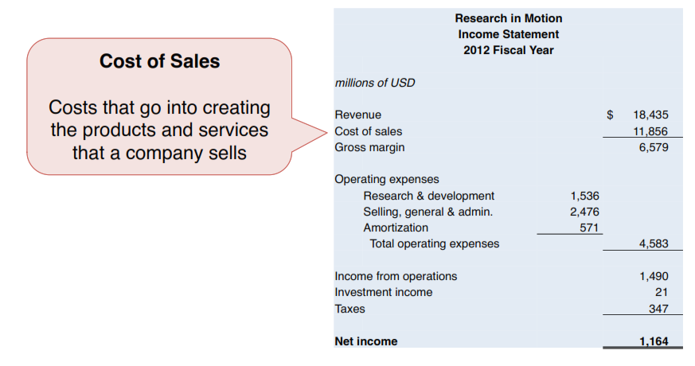
The Income Statement

Slide 23
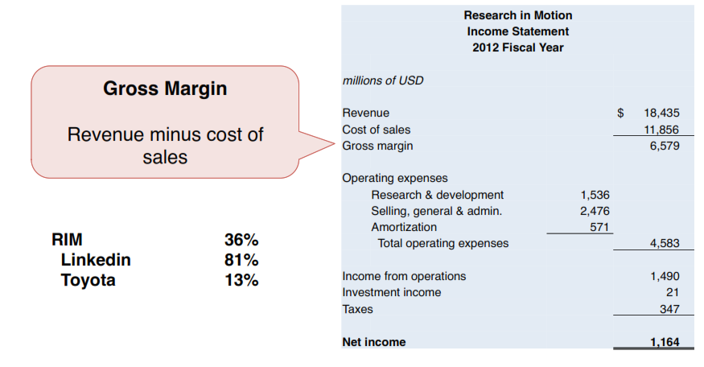
The Income Statement

Slide 24
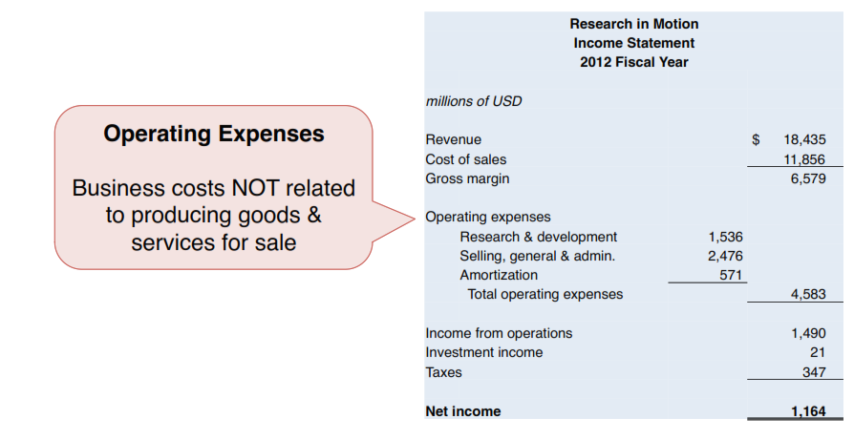
The Income Statement

Slide 25
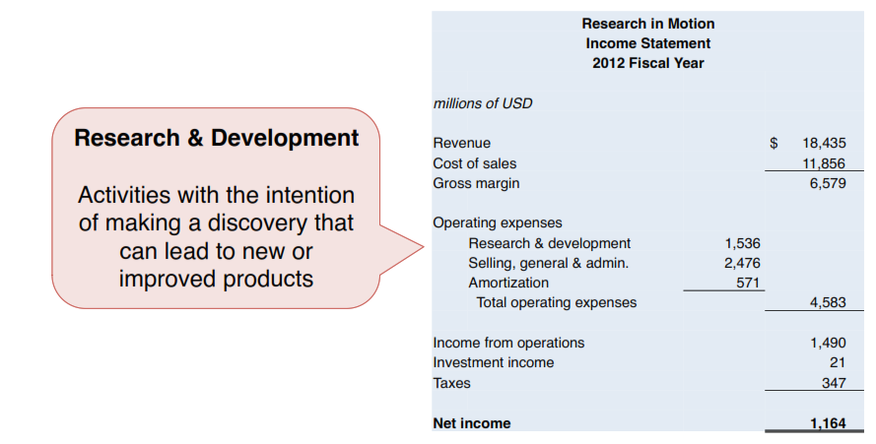
The Income Statement

Slide 26
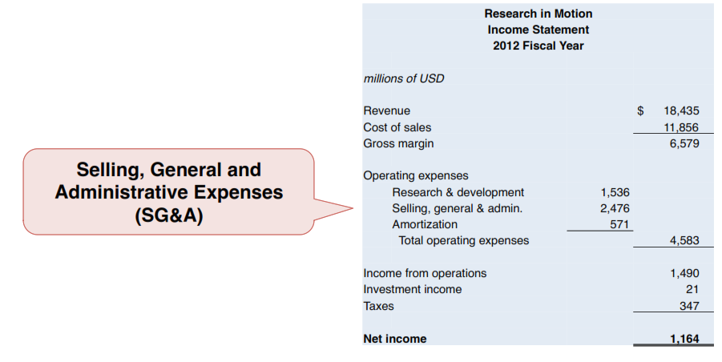
The Income Statement

Slide 27
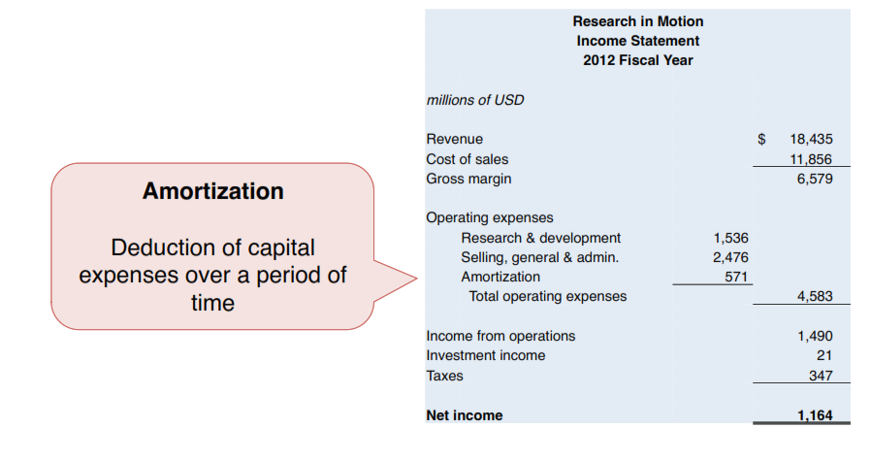
The Income Statement

Slide 28
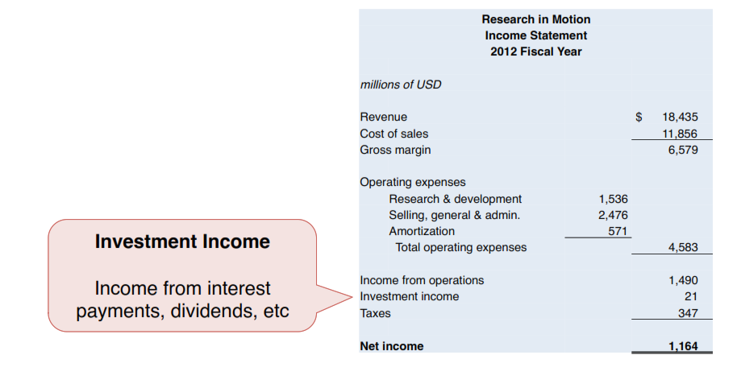
The Income Statement

Slide 29
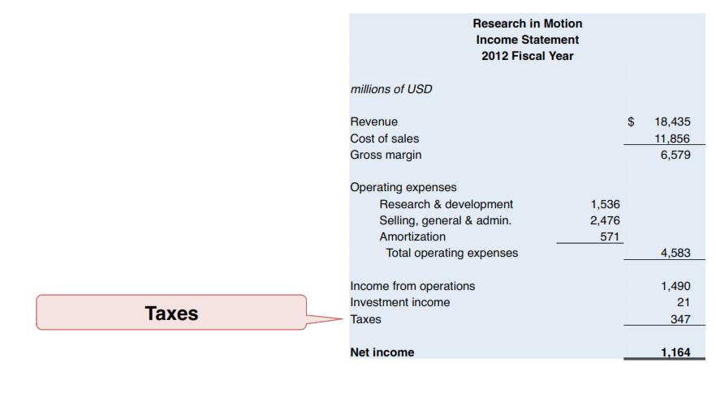
The Income Statement

Slide 30
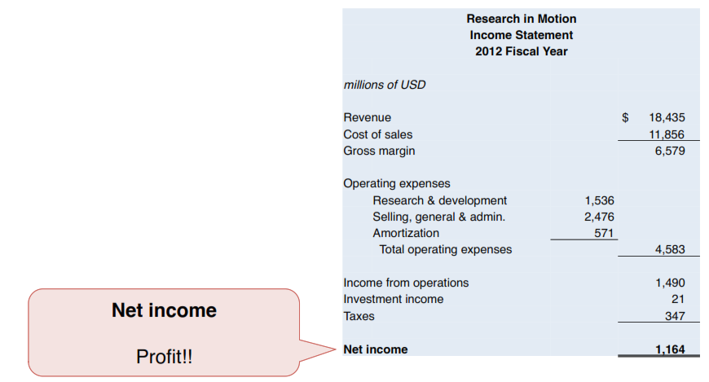
The Income Statement

Slide 31
The Income Statement

Slide 32
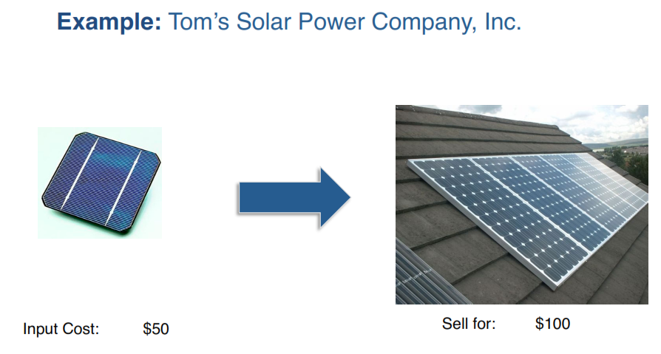
Why Worry About Cash?

Slide 33
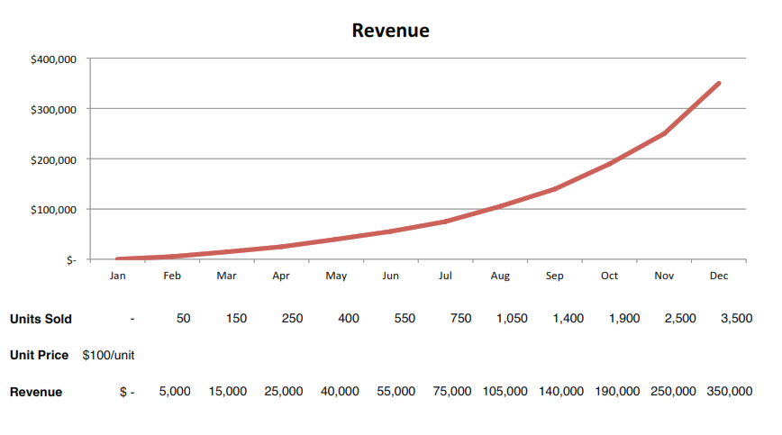
Why Worry About Cash?

Slide 34
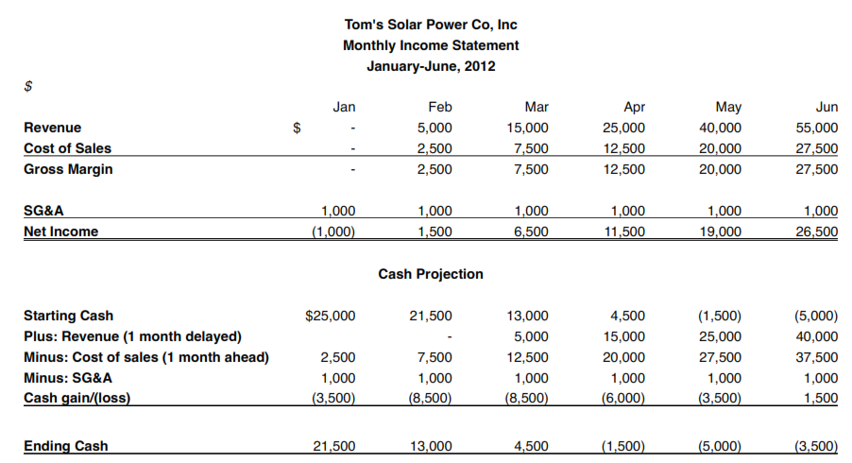
Why Worry About Cash?

Slide 35

Lesson: Forecast Cash Flows

Slide 36
Lesson: Forecast Cash Flows
Earning Before Interest, Taxes, Depreciation and Amortization
A measure of a company’s cash flow from operations

Slide 37

EBITDA

Slide 38
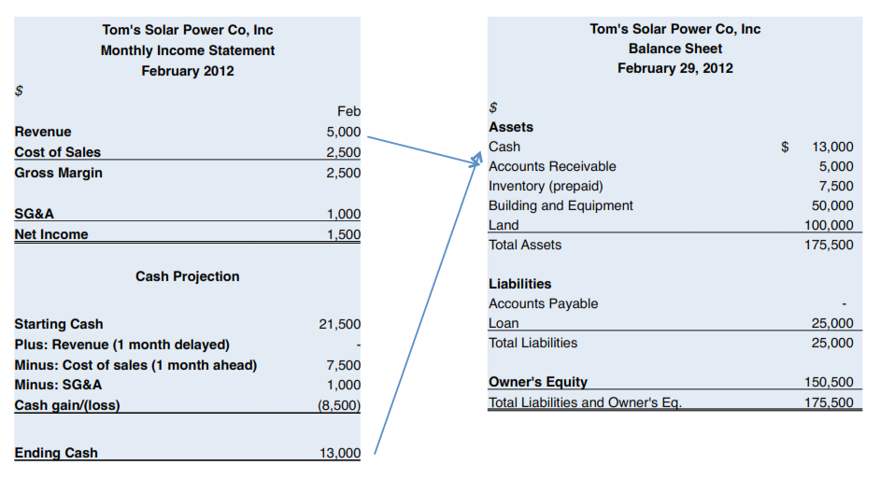
The Balance Sheet

Slide 39
Break-even Analysis
In the initial stages of the new venture, it is helpful for the entrepreneur to know when a profit may be achieved.
This will provide further insight into the financial potential for the start-up business.
Break-even analysis is a useful technique for determining how many units must be sold or how much sales volume must be achieved in order to break even.
Breakeven is that volume of sales at which the business will neither make a profit nor incur a loss.

Slide 40
Break-even Analysis
The break-even sales point indicates to the entrepreneur the volume of sales needed to cover total variable and fixed expenses.
Sales in excess of the break-even point will result in a profit as long as the selling price remains above the costs necessary to produce each unit (variable cost).

Slide 41
Break-even Analysis
The break-even formula is derived in Figure 10.8 and is given as:
B/E (Q) = TFC / (SP - VC/unit [marginal contribution])
As long as the selling price is greater than the variable costs per unit, some contribution can be made to cover fixed costs.
Eventually, these contributions will be sufficient to pay all fixed costs, at which point the firm has reached breakeven.

Slide 42
Break-even Analysis
The major weakness in calculating the breakeven lies in determining whether a cost is fixed or variable.
For new ventures these determinations will require some judgment. However, it is reasonable to expect such costs as depreciation, salaries and wages, rent, and insurance to be fixed.
Materials, selling expenses such as commissions, and direct labor are most likely to be variable costs.
The variable costs per unit can usually be determined by allocating the direct labor, materials, and other expenses that are incurred with the production of a single unit.

Slide 43
Break-even Analysis
Thus, if we determine that the firm has fixed costs of P250,000, variable costs per unit of P4.50, and a selling price of P10.00, the breakeven will be as follows:
B/E = TFC / (SP - VC/unit)
= P250,000 / PI0.00 - P4.50
= P250,000 / P5.55
= 45,454 units

Slide 44
Break-even Analysis
Any units beyond 45,454 that are sold by the above firm will result in a profit of P5.50 per unit. Sales below 45,454 units will result in a loss to the firm.
In those instances where the firm produces more than one product, breakeven may be calculated for each product.
Fixed costs would have to be allocated to each product or determined by weighting the costs as a function of the sales projections.

Slide 45
Break-even Analysis
Thus, it might be assumed that 40 percent of the sales are for product X; hence 40 percent of total fixed costs would be allocated to that product.
If the entrepreneur feels that a product requires more advertising, overhead, or other fixed costs, this should be included in the calculations. In addition, the entrepreneur can try different states of nature (e.g., different selling prices, different fixed costs and/or variable costs) to ascertain the impact on breakeven and subsequent profits.

