Slide 1
Technoprenuership TCP231 Module 9: Raising capital
Lecture by: Ashitosh Sah

Slide 2
Raising Capital
Sources: debt and venture capital
Incubators, accelerators
Grants, competitions

Slide 3

Why Business Needs Finance
Finance refers to sources of money for a business.
Finance is life blood of business;
It is a pre requisite to mobilize resources for organizing industrial production.
It is also vital for trade: retail, wholesale, export, import;
Firms need finance to:
Start up a business, eg pay for premises, new equipment and advertising.
Run the business, eg having enough cash to pay staff wages and suppliers on time.
Expand the business, eg having funds to pay for a new branch in a different city or country.

Slide 4
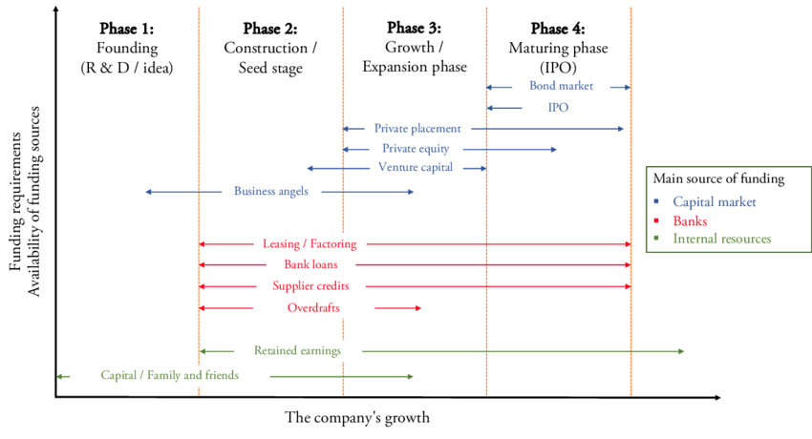

Slide 5

Sources of Finance
Friends
Family
Other resources, such as savings, credit cards, loans and investments
Other sources includes
Banks
Finance companies
Investment companies
Government grants
It can broadly categorized into Debt and Equity financing

Slide 6
Sources of Finance
Friends
Family
Other resources, such as savings, credit cards, loans and investments
Other sources includes
Banks
Finance companies
Investment companies
Government grants
It can broadly categorized into Debt and Equity financing

Slide 7


Sources of Finance
Debt Versus Equity
Debt Financing
Secured financing of a new venture that involves a payback of the funds plus a fee ( interest for the use of the money)
Equity Financing
- Involves the sale ( exchange) of same of the ownership interest in the venture in return for an unsecured investment in the firm.

Slide 8
Debt Financing
Advantages
No loss of ownership is required.
More borrowing allows for potentially greater return on equity.
During periods of low interest rate, the opportunity cost is justified since the cost of borrowings is low
Disadvantages
Regular ( monthly) interest payments are required
Continual cash-flow problems can be intensified because of payback responsibility.
Heavy use of debt can obstruct growth and development

Slide 9
Sources of Debt Financing
Trade Credit
Credit given by suppliers who sells goods on account.
Accounts receivable Financing
Short-term financing that involves either the pledge of receivables as collateral for a loan or the sale of receivables at a discounted value (factoring).
Finance Companies
Asset-based lenders that lend money against assets such as land, receivables, inventory, and equipment

Slide 10
Sources of Debt Financing
Equity Instruments
Give investors a share of the ownership.
Loan with warrants provide the investor with the right to buy stock at a fixed price at some future date.
Convertible debentures are unsecured loans that can be converted into stock.
Preferred stock is equity that gives investors a preferred place among the creditors in the event the venture is dissolved.
Common stock is the most basic form of ownership and is often are sold through public or private offerings.

Slide 11
Equity Financing
Advantages
No monthly payments.
Goals of the investors are fully aligned with founders: company success, capital gains
Large fund volume available
Long time horizon
Disadvantages
Lost of Ownership: eventual loss of control
Founders now report to Board of Directors : Emotional issue for many founders.
Focus on exit Strategy: Equity investors expect sale, merger or IPO.

Slide 12
Sources of Equity Financing
Funding from the entrepreneur
- money invested by entrepreneur from is savings
Family and friends
-funding provided by friends and family to start a venture
Strategic partners
- Companies with similar interest and complementary product and service provide fund to support their own business in the future

Slide 13
Sources of Equity Financing
Angel investors
- Wealthy individuals and entrepreneurs provide fund to support the startup with the hope to gain profit in the future believing in their idea.
Private placement
- A process of inviting subscription to the securities of a corporate issuer by means other than public offering.
- Private placement usually refers to non-public offering of shares in a public company.

Slide 14
Sources of Equity Financing
Venture Capitalist
- a private equity investor that provides capital to companies with high growth potential in exchange for an equity stake.
IPO
- raising capital from the public to finance a company for part ownership of the company(shareholding).

Slide 15
Bootstrapping
Advantages
No monthly payments.
No loss od ownership.
No agreements.
Disadvantages
Threatens domestic tranquility.
Difficult to make large capital commitments.
Hard to recruit top-notch talent.
Risk of losing strategic focus by chasing tactical opportunities

Slide 16
Grants and Competitions
Advantages
No monthly payments.
No loss od ownership.
Variety of sources
Friendly to early stage businesses.
Disadvantages
Highly competitive.
Only available for technologies already of interest to certain agencies. ( incremental, not revolutionary improvements)
Limited to certain amount
Can become a “hamster wheel”
To many reporting requirements

Slide 17
Business Incubator
A business incubator is a program that supports early-stage startup companies to expedite profitability and success. Incubators provide startups with valuable resources such as free office space, equipment, mentorship, a collaborative community, and networking opportunities with potential funding sources, like angel investors and venture capitalists. Business incubators focus on brand-new businesses that still need to develop a product idea and business model.
Many types of companies and organizations sponsor startup incubator programs, including universities, non-profit organizations, for-profit development corporations, government-run economic development organizations, and venture capital firms. To submit to a business incubator, you'll need to go through an application process that typically involves meeting the incubator's specific criteria and submitting a viable business plan.

Slide 18
Startup Accelerator
A startup accelerator program expedites the growth of existing companies that have developed business models and validated products in the marketplace. Startup accelerators provide companies with valuable resources such as mentorship, free coworking spaces, legal services to help secure intellectual property, a collaborative work ecosystem, and access to industry influencers and potential investors.
Startup accelerators take on businesses that already have a solid foundation to build upon, so accelerators focus their guidance and resources to help ventures scale up as quickly as possible. In addition, accelerators commonly give their ventures a seed investment and take equity stakes in the companies. While funding for startup accelerators may come from both private and public sources, accelerators are more likely to be private organizations.

Slide 19
Difference between Business Incubator vs Startup Accelerator
Stage of the Venture
Focus on early phase startup that are in the product-development phase and do not have a developed business model.
Seed funding
Do not typically invest capital into ventures, but they may ask for an equity stake in exchange for the valuable resources they're providing.
Program timeline
Incubate a business idea as long as needed to build a successful company—and that incubation period may take one to two years
Stage of the Venture
Focus on speeding up the growth of existing companies that already have a minimum viable product (MVP) in the hands of early adopters with an established product-market fit.
Seed funding
Standard practice for accelerators to provide ventures with a seed investment in exchange for an equity stake in the company
Program timeline
Run more like a startup boot camp and tend to have a set time frame of only three to six months.

Slide 20
VC/ PE companies in nepal
Nepal Private Equity Association
Accelerator Nepal
Business Oxygen(BO2)
Dolma
One to Watch
Team Venture
True North Associates
Kriti Venture and Fund
Tele Venture
Safal Partners
Global Equity Fund
Aadhyanta

Slide 21
Accelerator and incubation program
I3 business – Nepal Commuitere
Enterprise – NYEF and One to Watch
Next Lunch Pad
Idea Studio
AgriBusiness Incubation Program
Skill up Nepal
Faster capital

Slide 22
Fund Raising material
Need a high quality
Pitch Deck
Projected Financials
Executive Summary

Slide 23
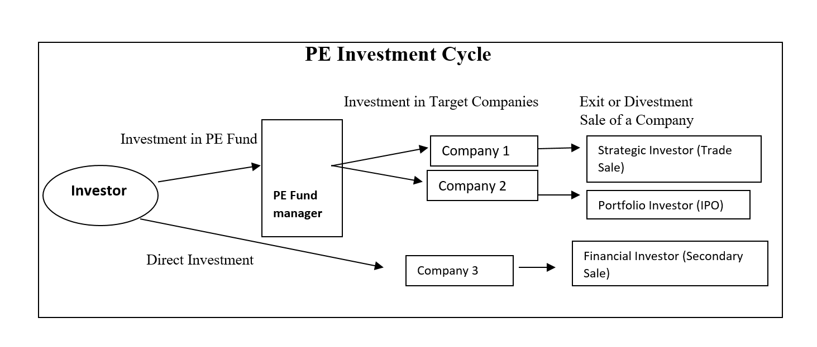

Slide 24
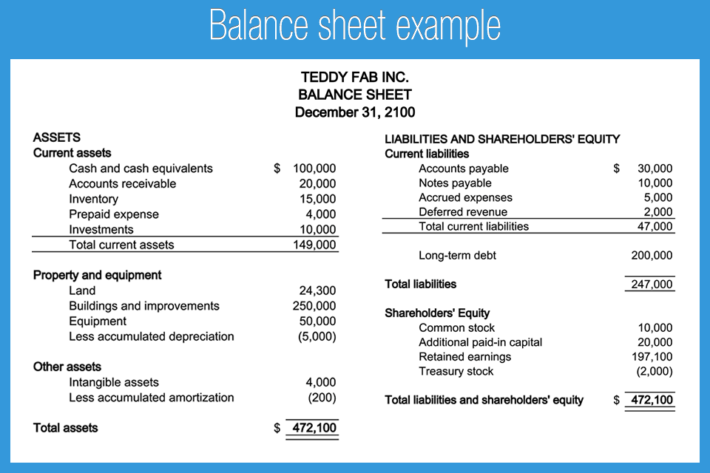

Slide 25
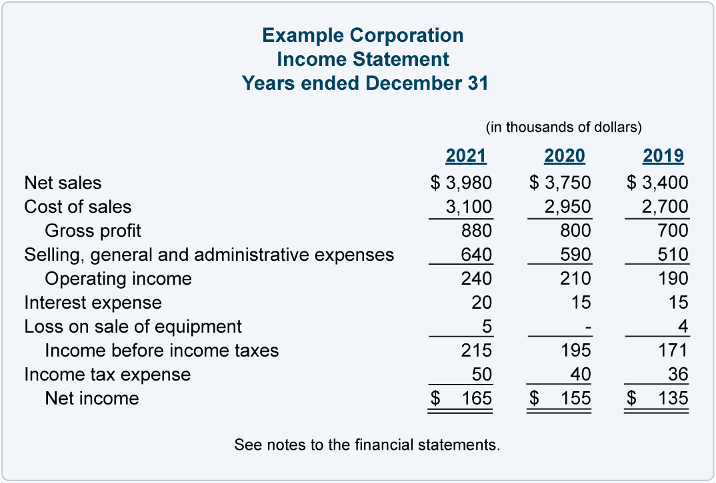

Slide 26
