Slide 1

Covid-19 case prediction
Team : Tech_Mak
Meet Pedhadiya AU1841056
Ayush Kaneria AU1841062
Mihir Chauhan AU1841065
Krunal Pagdar AU1841066

Slide 2

Introduction
Covid-19 Global Pandemic
Rapidly spreading virus across world
Prediction of cases
To handle future situation
Distribution of Medical resources
Take necessary decisions

Slide 3

Problem Statement
Rapidly evolving pandemic nowadays
Improper prediction tends to inefficient distribution of medical resources
Analyze the situation
Optimal Allocation of the medical resources

Slide 4
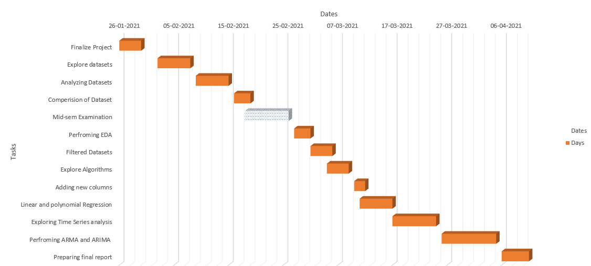
GANTT CHART

Slide 5

Existing Body of work
Polynomial Regression with degree =3
Time series analysis
Dickey-Fuller test
Rolling statistic
Decomposition
ARMA & ARIMA Model
Prediction for next 7-days

Slide 6

Performed polynomial regression with degree=3
Got accurate results with higher degree polynomial regression but it increases calculation and analysis
Our Approach
Time series analysis
Perform Rolling Statistic and Dickey-Fuller test to check stationarity in data

Slide 7
Apply ARMA model on to Dataset
Our Approach
Apply ARIMA model on to Data set
Forecast covid-19 cases for next 7 days

Slide 8
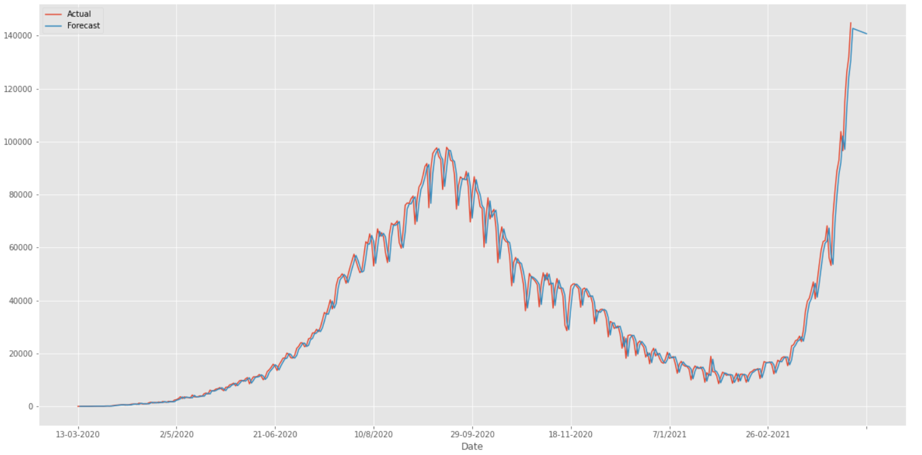
Final Results
ARMA FOR NEXT 7 DAYS PREDICTION OF COVID-19 CASES

Slide 9
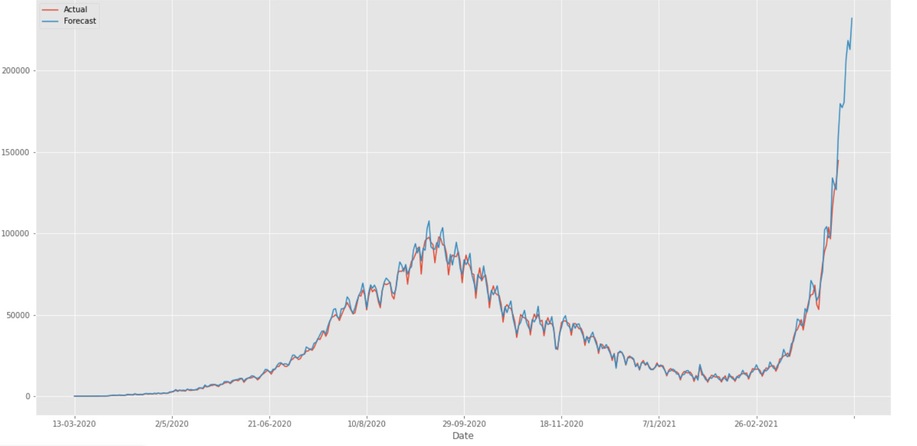
Final Results
ARIMA FOR NEXT 7 DAYS PREDICTION OF COVID-19 CASES

Slide 10

Conclusion
Getting good accuracy on ARIMA with value of
Autoregressive lag (p) = 3
Moving Average (q)=3
order of differentiation (d) = 1
Prediction of 'Daily confirm cases' for next 7-days

Slide 11
Role of each group member
Meet
Ayush
Mihir
Krunal
Documentation
presentation
Literature Review
coding
Documentation
Literature Review
Literature Review
Presentation
Analysis
Coding
Documentation
LIterature Review

Slide 12
References
A. Khakharia et al., “Outbreak Prediction of COVID-19 for Dense and Populated Countries Using Machine Learning,” Ann. Data Sci., vol. 8, no. 1, pp. 1–19, 2021, doi: 10.1007/s40745-020-00314-9.
Y. Zoabi, S. Deri-Rozov, and N. Shomron, “Machine learning-based prediction of COVID-19 diagnosis based on symptoms,” npj Digit. Med., vol. 4, no. 1, pp. 1–5, 2021, doi: 10.1038/s41746-020-00372-6.
Hyndman, R. and Athanasopoulos, G., 2021. Forecasting: Principles and Practice. 2nd ed. [ebook] Available at: <https://otexts.com/fpp2/index.html>
Time series analysis. (2020, June 17). Retrieved April 11, 2021, from https://www.statisticssolutions.com/time-series-analysis/
DATASET : https://www.covid19india.org/

