Slide 1

AN INTRODUCTION TO AJAS CODING CLUB

Slide 2
Our Aim
Our aim is to make our members atleast understand a general purpose language,framework,develop a skill and help them find and acheive their passion.

Slide 3
Orientation on programming

Slide 4
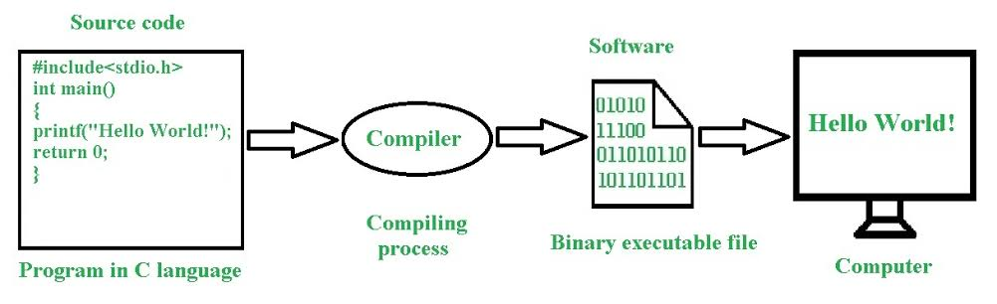
How does a program work(the given is a c script)

Slide 5
What is a program?
It is to provide (a computer or other machine) with coded instructions for the automatic performance of a task.
What is programming?
Computer programming is the process of performing a particular computation, usually by designing and building an executable computer program. Programming involves tasks such as analysis, generating algorithms, profiling algorithms’ accuracy and resource consumption, and the implementation of algorithms.

Slide 6
How does programmers code?
Computer programmers write, modify, and test code and scripts that allow computer software and applications to function properly. They turn the designs created by software developers and engineers into instructions that a computer can follow

Slide 7
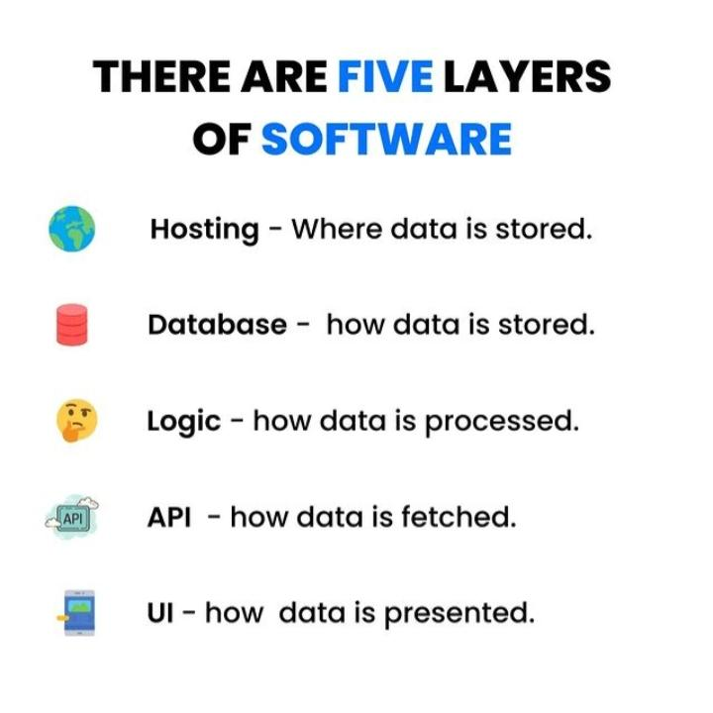

Slide 8
Different phases of development of a program

Slide 9
Problem Solving Phase
Analysis and Specification
Understand (define) the problem and what the solution must do
Algorithm Development
Develop a comprehensive unambiguous logical sequence of steps to solve the problem
Verification of Algorithm
Follow steps closely (manually) to see if solution works

Slide 10
What is problem solving?
The process of finding solutions to difficult or complex issues. Problem solving is the process of identifying a problem, developing an algorithm for the identified problem and finally implementing the algorithm to develop a computer program

Slide 11
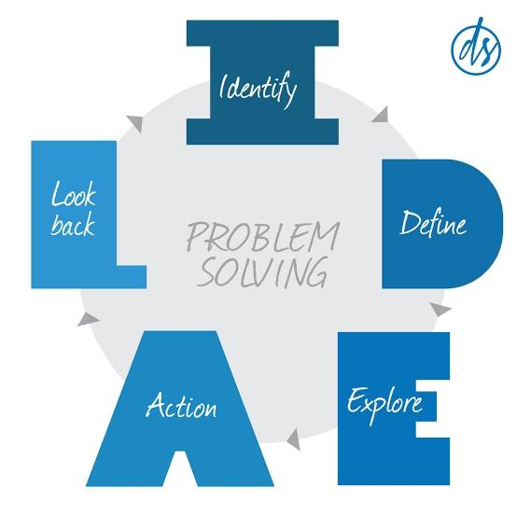

Slide 12
Implementation Phase
Program Development
Translate algorithm into a program written in a programming language
Program Testing
Test program for syntactical and logical errors. Fix the errors.

Slide 13
Maintenance Phase
Use
Use the program to solve real world problems
Maintain
Modify the program to meet changing requirements

Slide 14
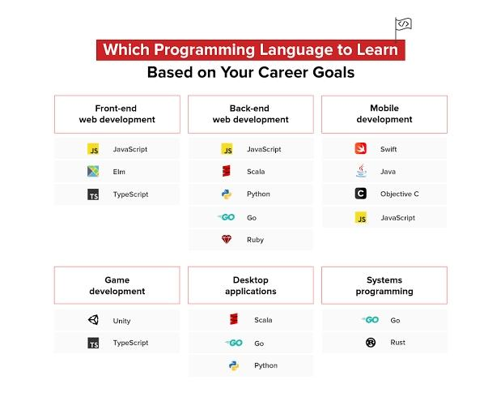

Slide 15
Communities and Networks

Slide 16


Slide 17
About
Ajas Coding club was founded in 2021 by Meehad,Irfana,Rasha and Sumana starting with 17 members now it has grown to a club of 84 members actively working with self-learning,peer-to-peer learning and bootcamps programs after regular class hours. We support students to learn from their mistakes so we promote them to debug by giving them codes with errors.
We supported students to participate in inter college tech fest and centralised our personal networks through whatsapp to gather more information and to know about more events.Now AJAS Coding Club has collabrated with Mulearn to form Mulearn ajas to increase its network and community support.

Slide 18


Slide 19
IEDC

Slide 20
Blochub

Slide 21

FOSS CELL

Slide 22

Tkinterhub

Slide 23
Our Execom
Campus Lead: Sumana
Co-Lead and IoT Interest group Lead: Meehad
Finance Lead: Shabeeb
Media Lead: Hiba
Event Lead: Fida
Junior Lead: Ameenulla
Junior girl Lead: Afniya
Assistant Media Lead: Rayan hany
Web development Interest group Lead: Shamil kc
Cyber security Interest Group Lead: Anshed
Ai Interest Group Lead: Sajjad
Female Co-lead: Radwa
Staff co-ordinator: Irshad Sir

Slide 24
Thank you

