Slide 1
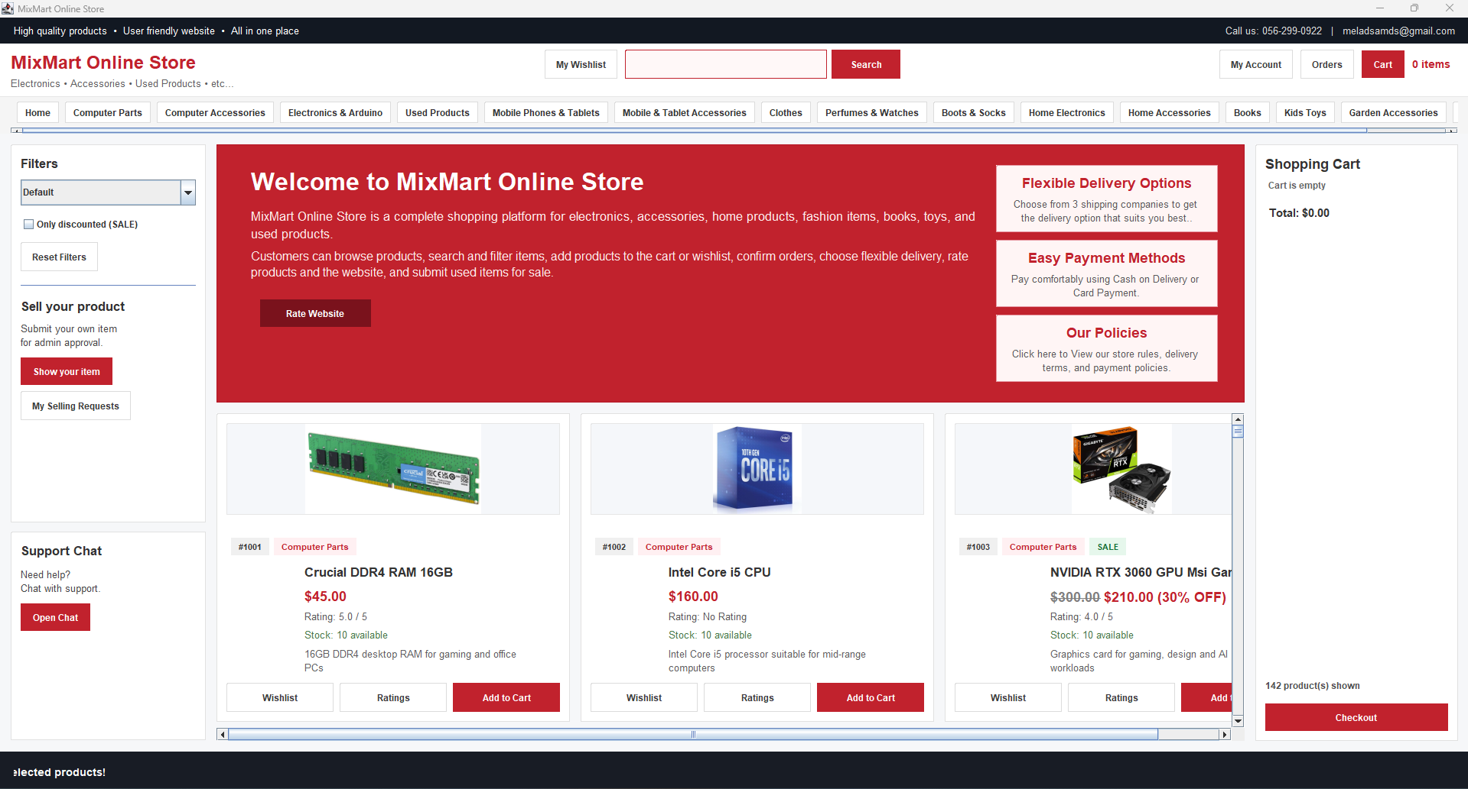
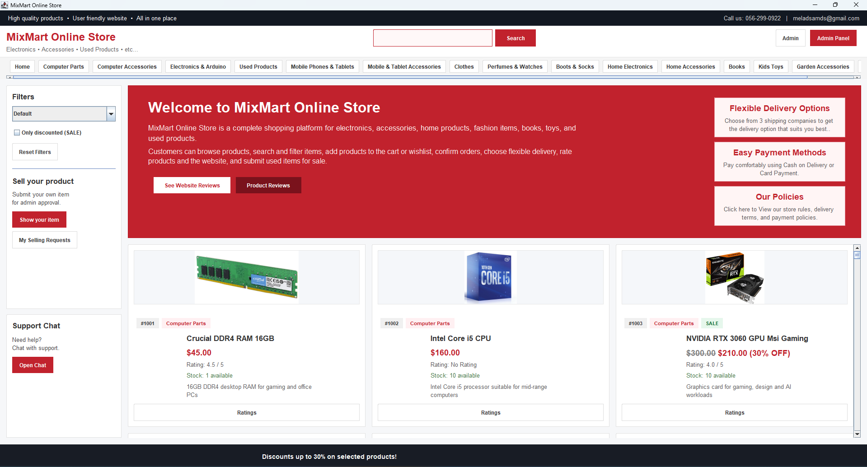
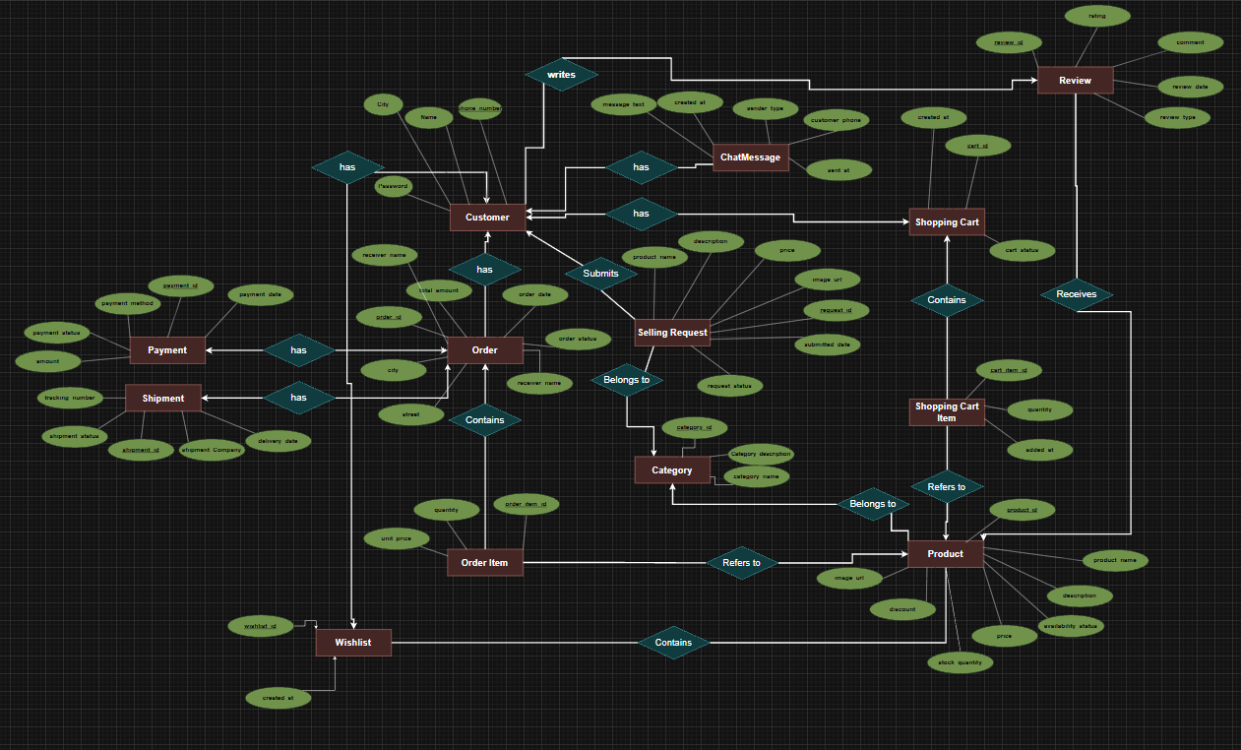
Mix Mart Online
Online Shopping Store Database Project
Java Swing + MySQL + JDBC
Customer home screen
Admin home
ERD
Prepared by: Melad Sam (12323283) and Emad Ataout (12322222)
Course: Database Systems | An-Najah National University | Spring 2026
Slide 1
Notes:
Open the presentation by introducing the project name, team members, and the main technologies used.

Slide 2
Project Idea & Problem
Mix Mart Online | Final Project Demo
Why this database-backed store was built
Online stores need organized product, order, stock, payment, and customer data.
Manual or file-based storage can cause repeated data, missing orders, and stock mistakes.
Mix Mart Online connects a real Java Swing GUI with a MySQL database to support daily store operations.
Project result
A working desktop shopping system with customer workflows, admin workflows, database relationships, validations, and testing screenshots.
Home page: products, filters, cart, categories
Slide 2
Notes:
Explain the problem: a store needs a structured database, not disconnected files. Then show that the home page is connected to product and cart data.

Slide 3
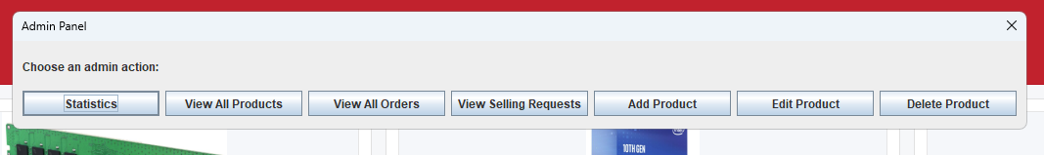
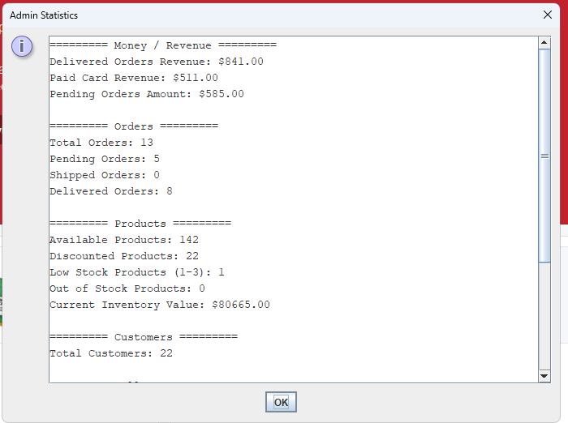
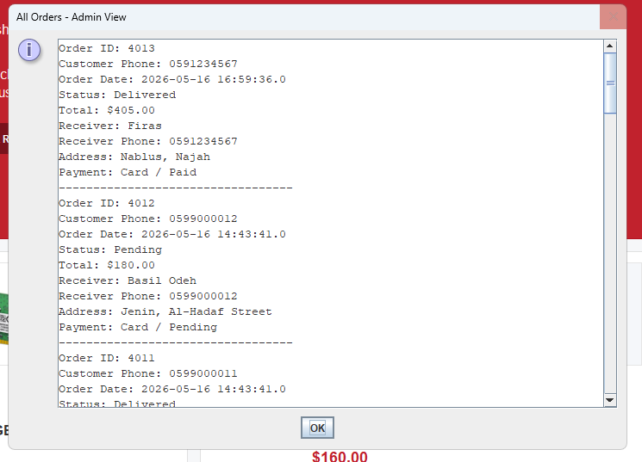
System Architecture & Technologies
Mix Mart Online | Final Project Demo
Simple layered structure: GUI → DAO/JDBC → MySQL
Frontend
Connection Layer
Database
Java Swing desktop interface for forms, buttons, dialogs, product cards, cart sidebar, and admin panels.
DAO classes separate SQL operations from GUI code. JDBC connects Java with MySQL and executes queries.
MySQL database: online_shoping_store_database. Stores customers, products, carts, orders, payments, shipments, reviews, selling requests, and chat.
Key DAO classes
CustomerDAO
ProductDAO
CartDAO
OrderDAO
ReviewDAO
WishlistDAO
SellingRequestDAO
ChatDAO
AdminStatsDAO
Admin panel navigation
Statistics
Selling requests
Slide 3
Notes:
Describe the three layers and why DAO classes make the code easier to maintain.

Slide 4
Database Design
Mix Mart Online | Final Project Demo
Main entities and relationships
Core tables
Customer, Category, Product
ShoppingCart + ShoppingCartItem
Orders + OrderItem
Payment + Shipment
Review, Wishlist, SellingRequest, ChatMessage
2
central roles
13
main database tables
FK
relationship driven design
ER diagram
Slide 4
Notes:
Point to the ERD. Mention that Customer and Product are central, and orders connect customers with purchased products.

Slide 5
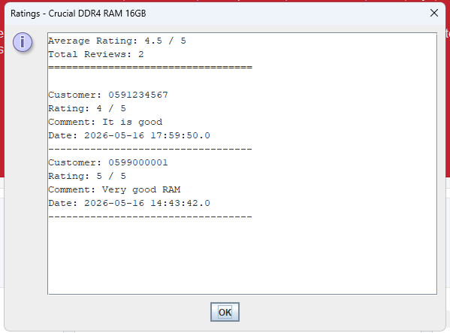
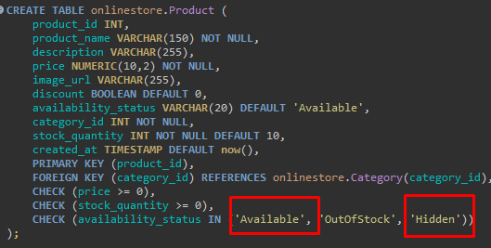
Normalization & Data Integrity
Mix Mart Online | Final Project Demo
How repeated data and invalid values are reduced
1NF
2NF
3NF
Order products and cart products are not stored as repeated columns. They are separated into OrderItem and ShoppingCartItem.
Product data stays in Product instead of being repeated inside relationship tables.
Category, payment, shipment, and review details are separated into their own tables.
Integrity rules used in SQL
Primary keys identify records.
Foreign keys connect related tables.
Unique constraints prevent duplicates.
CHECK constraints control statuses, ratings, prices, and stock.
Default values support dates and initial statuses.
SQL CHECK example
Rating data
Slide 5
Notes:
Use this slide to explain normalization in simple terms and why constraints keep the database valid.

Slide 6
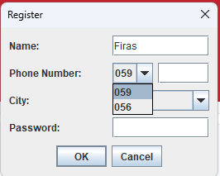
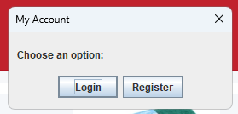
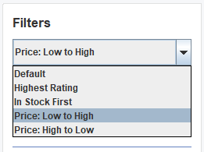
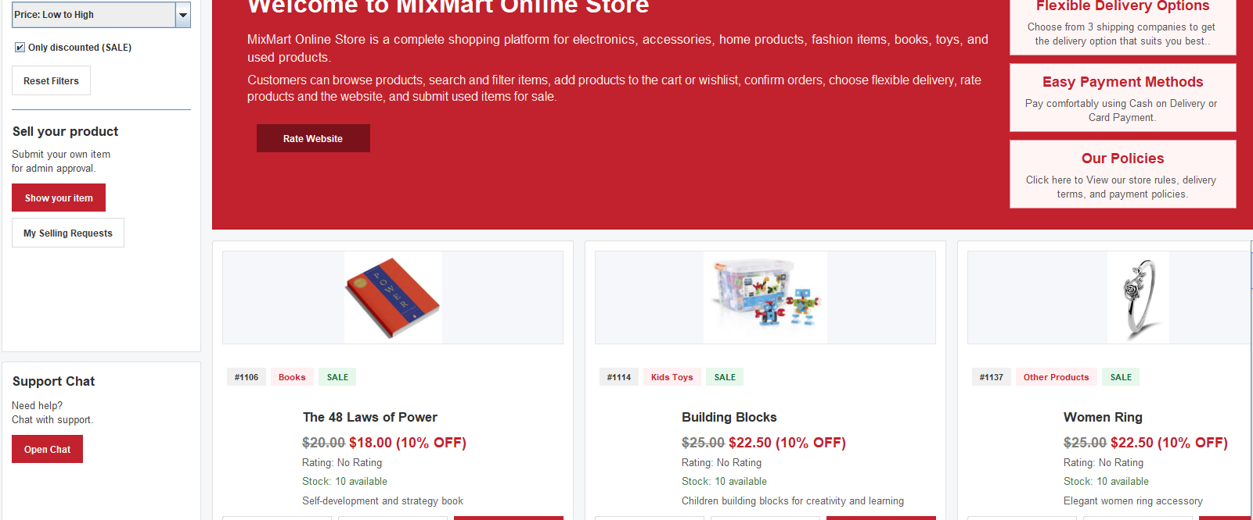
Customer Workflow
Mix Mart Online | Final Project Demo
From account creation to final order
Register or log in with valid phone rules.
Browse products by category or search/filter text.
Add products to cart or wishlist.
Checkout with receiver details and payment method.
Confirm shipment and review products after delivery.
Use support chat when help is needed.
Account options
Register form
Sort/filter
Search result screen
Slide 6
Notes:
Explain the normal customer path and then mention that each action is saved or validated using the database.

Slide 7
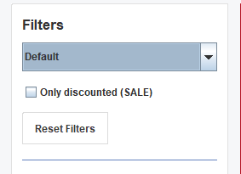
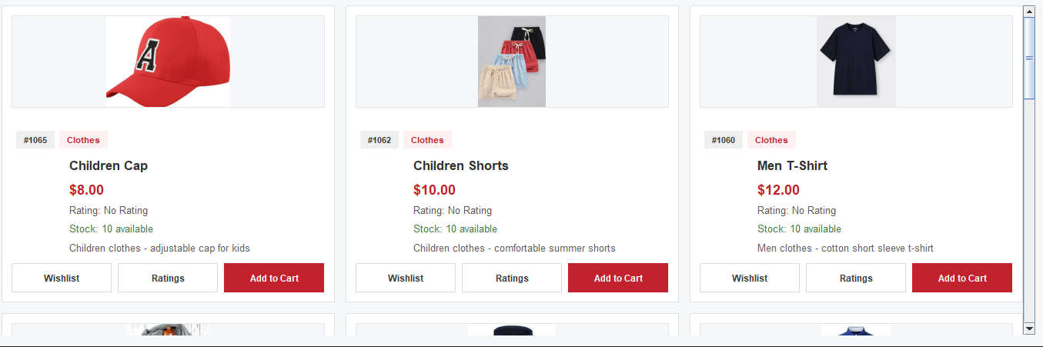
Customer Side: Home, Search, Filters
Mix Mart Online | Final Project Demo
Core browsing features used during the demo
Sorting
Discount filter
Home screen
Demo focus: show category navigation, sorting, discount filter, reset filters, and search results.
Category result
Slide 7
Notes:
This slide supports the live demo: show how products are loaded, filtered, and searched.

Slide 8
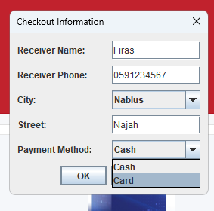
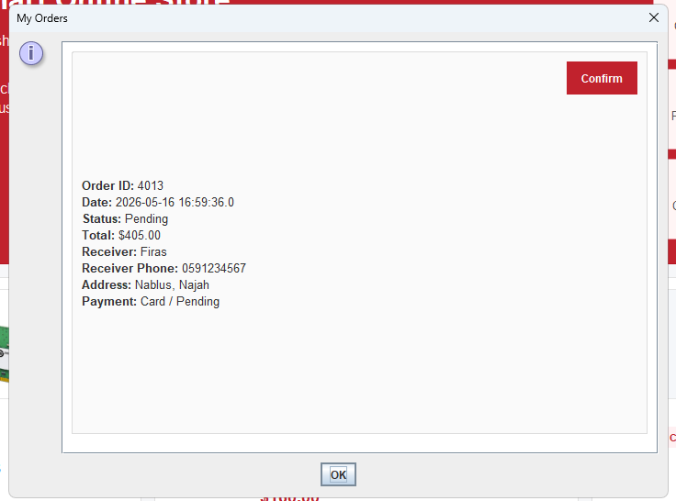
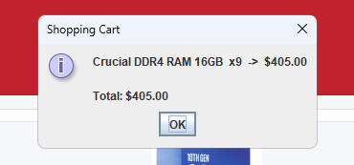
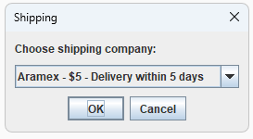
Cart, Checkout & Orders
Mix Mart Online | Final Project Demo
Database operations behind shopping actions
Cart summary
Checkout info
Order window
Shipping company
What happens in the database?
Cart item quantity is updated.
Checkout creates order and order items.
Payment and shipment records are stored.
Stock is reduced after successful order.
Validation prevents buying beyond stock.
Demo moment
Show adding a product, increasing quantity, checkout, and order confirmation.
Slide 8
Notes:
Use this slide when showing the cart and checkout workflow in the recorded or live demo.

Slide 9
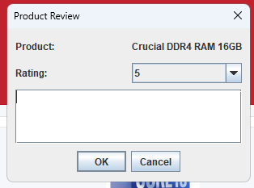
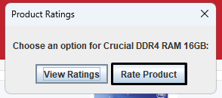
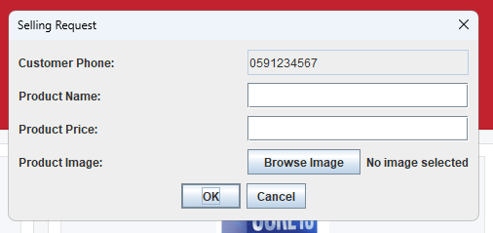
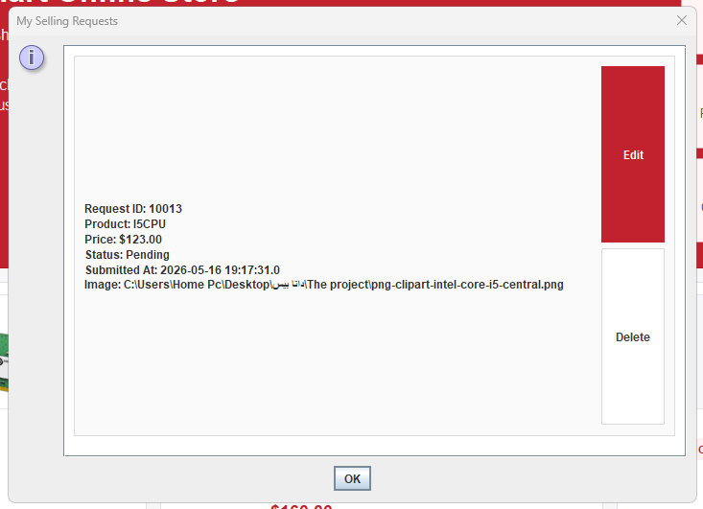
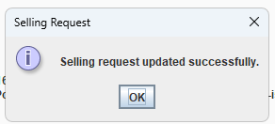
Reviews & Selling Requests
Mix Mart Online | Final Project Demo
Features that connect customers with the store after purchase
Review options
Product review form
View ratings
Selling request form
Business rules
Product reviews are allowed only after valid order status.
Website reviews can be edited by the customer.
Selling requests remain pending until admin approval.
Pending requests can be edited or deleted by the customer.
Submitted request
Request updated
Slide 9
Notes:
Mention that reviews and selling requests are not just screens: they are connected to Review and SellingRequest tables.

Slide 10
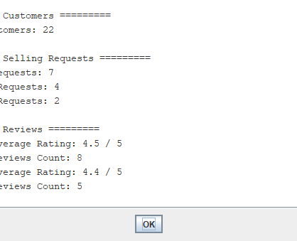
Admin Side: Monitoring & Control
Mix Mart Online | Final Project Demo
Admin features used to manage the store
Statistics part 1
Statistics part 2
Admin home after login
View statistics
Manage products
View orders
View reviews
Accept/reject selling requests
Support customers through chat
Admin panel buttons
Slide 10
Notes:
Use this slide to introduce the admin mode and the management buttons.

Slide 11
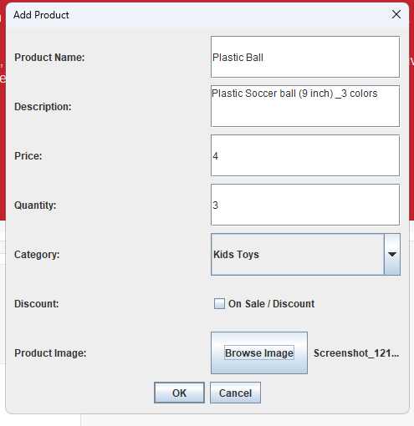
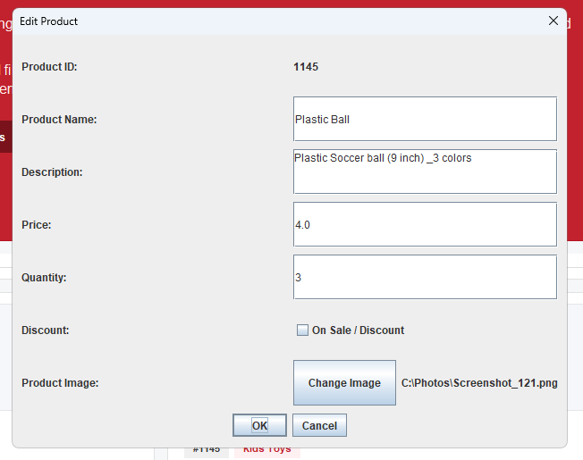
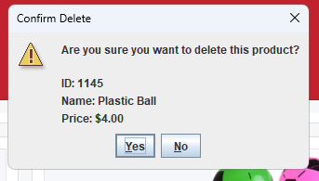
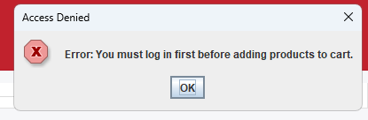
Admin Product & Request Management
Mix Mart Online | Final Project Demo
Adding, editing, hiding products and handling requests
Add product
Edit product
Confirm hide
Selling requests
Important implementation detail
Deleting a product is implemented as hiding it using the availability status. This keeps historical order data safe and removes the item from customer views.
Product hidden message
Slide 11
Notes:
Explain that the admin does not really delete a product from the database; the status changes to Hidden.

Slide 12
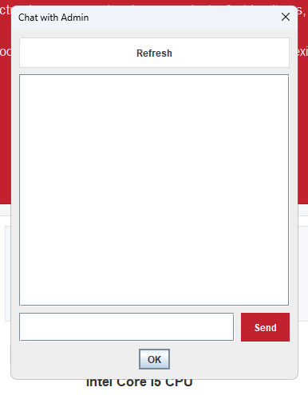
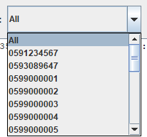
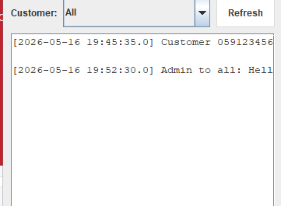
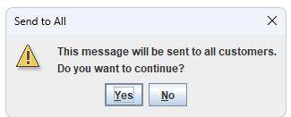
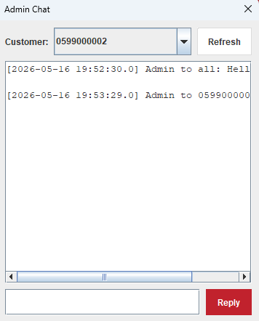
Support Chat
Mix Mart Online | Final Project Demo
Customer-admin communication stored in the database
Select customer
Broadcast warning
Customer chat
Admin chat
Chat logic
Customers send messages to admin.
Admin can reply to one customer.
Admin can send one message to all customers.
Messages are ordered by time and stored in ChatMessage.
Admin reply screen
Slide 12
Notes:
Mention that ChatMessage includes customer_phone, sender_type, message_text, and sent time.

Slide 13
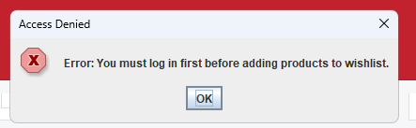
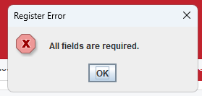
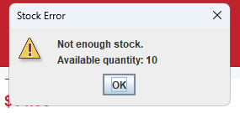
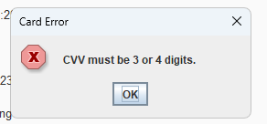
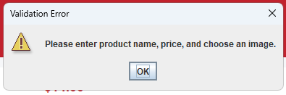
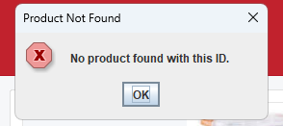
Testing & Validation
Mix Mart Online | Final Project Demo
Manual tests for customer, admin, and database rules
Login required
Required fields
Stock error
CVV error
Registration and login validation
Cart quantity and stock validation
Checkout receiver data validation
Card information validation
Admin add/edit/delete validation
Selling request and chat testing
Add product error
Product not found
Testing result
The system was checked through customer and admin scenarios to verify GUI behavior, SQL operations, relationships, and validation messages.
Slide 13
Notes:
This slide proves the system was tested with realistic inputs and error cases.

Slide 14
Final Submission Package
Mix Mart Online | Final Project Demo
Files that support the final delivery
Java source code with GUI and DAO classes
SQL script and database dump
ER Diagram PDF/Image
Normalization document
Project report
PowerPoint presentation
Product images folder
Recorded video demo with team participation
ERD
GUI
Demo recording focus
The video should show the project from the idea to the final system, then demonstrate the customer side, admin side, database design, validation, and core features live in action.
SQL
Admin data
Slide 14
Notes:
Use this slide to confirm that the required deliverables are prepared: slides, video, source code, SQL, ERD, normalization, and report.

Slide 15
Conclusion
Mix Mart Online | Final Project Demo
What the project demonstrates
Mix Mart Online connects database theory with a working Java application.
ER modeling and relational schema design
Normalization and SQL constraints
JDBC and DAO-based database connectivity
Customer and admin workflows
Testing, validation, and final demo preparation
Final customer GUI
Thank you
Final admin GUI
Melad Sam | Emad Ataout
Slide 15
Notes:
End by summarizing that the project is complete, tested, and ready for presentation.

