Slide 1
SAL_BW_Project_3
Retail Sales Data – Price Trends

Slide 2
Objective:
Clean and merge multiple retail CSV files, load them into SQL, extract business insights, and perform sales trend analysis using Pandas, Seaborn, and Matplotlib.

Slide 3
Index
Part 1: Data Preparation (Using Pandas)
Part 2: SQL Insights
Part 3: EDA & Visualization

Slide 4
Part 1: Data Preparation (Using Pandas)
Download and use the Retail Dataset from Kaggle
Clean and merge the data:
Handle missing values
Remove duplicate or canceled orders
Create columns like TotalPrice = Quantity * UnitPrice
Export cleaned data to a CSV.

Slide 5
Part 2: SQL Insights
Top 10 customers by total spending.
Total sales by country.
Find the month with the highest sales.
Average order value per customer.

Slide 6
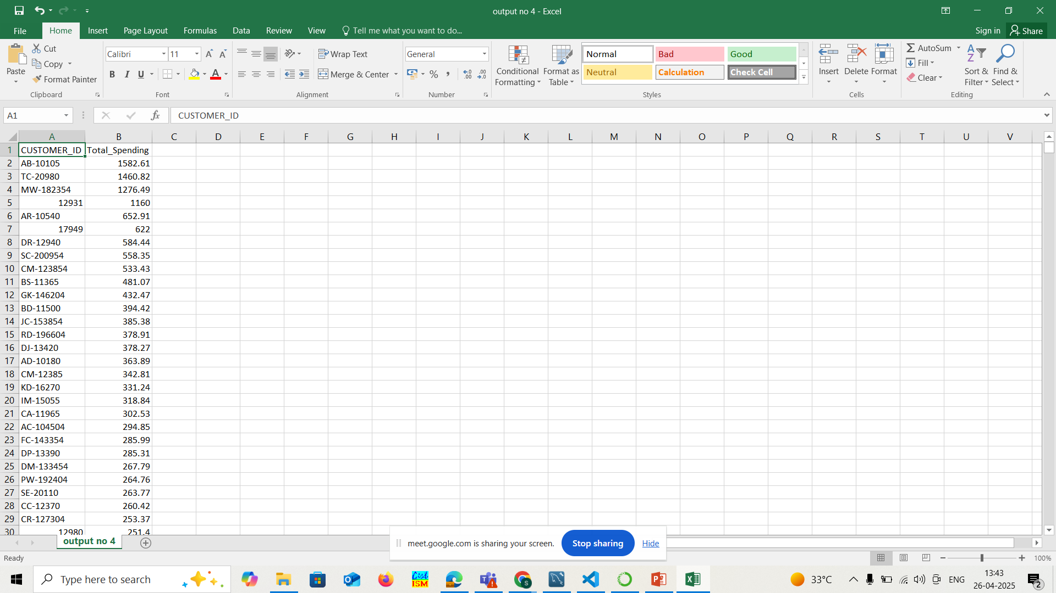
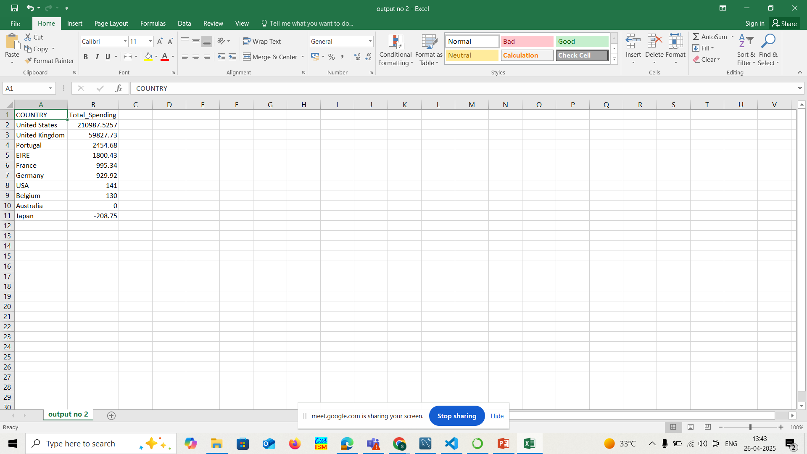
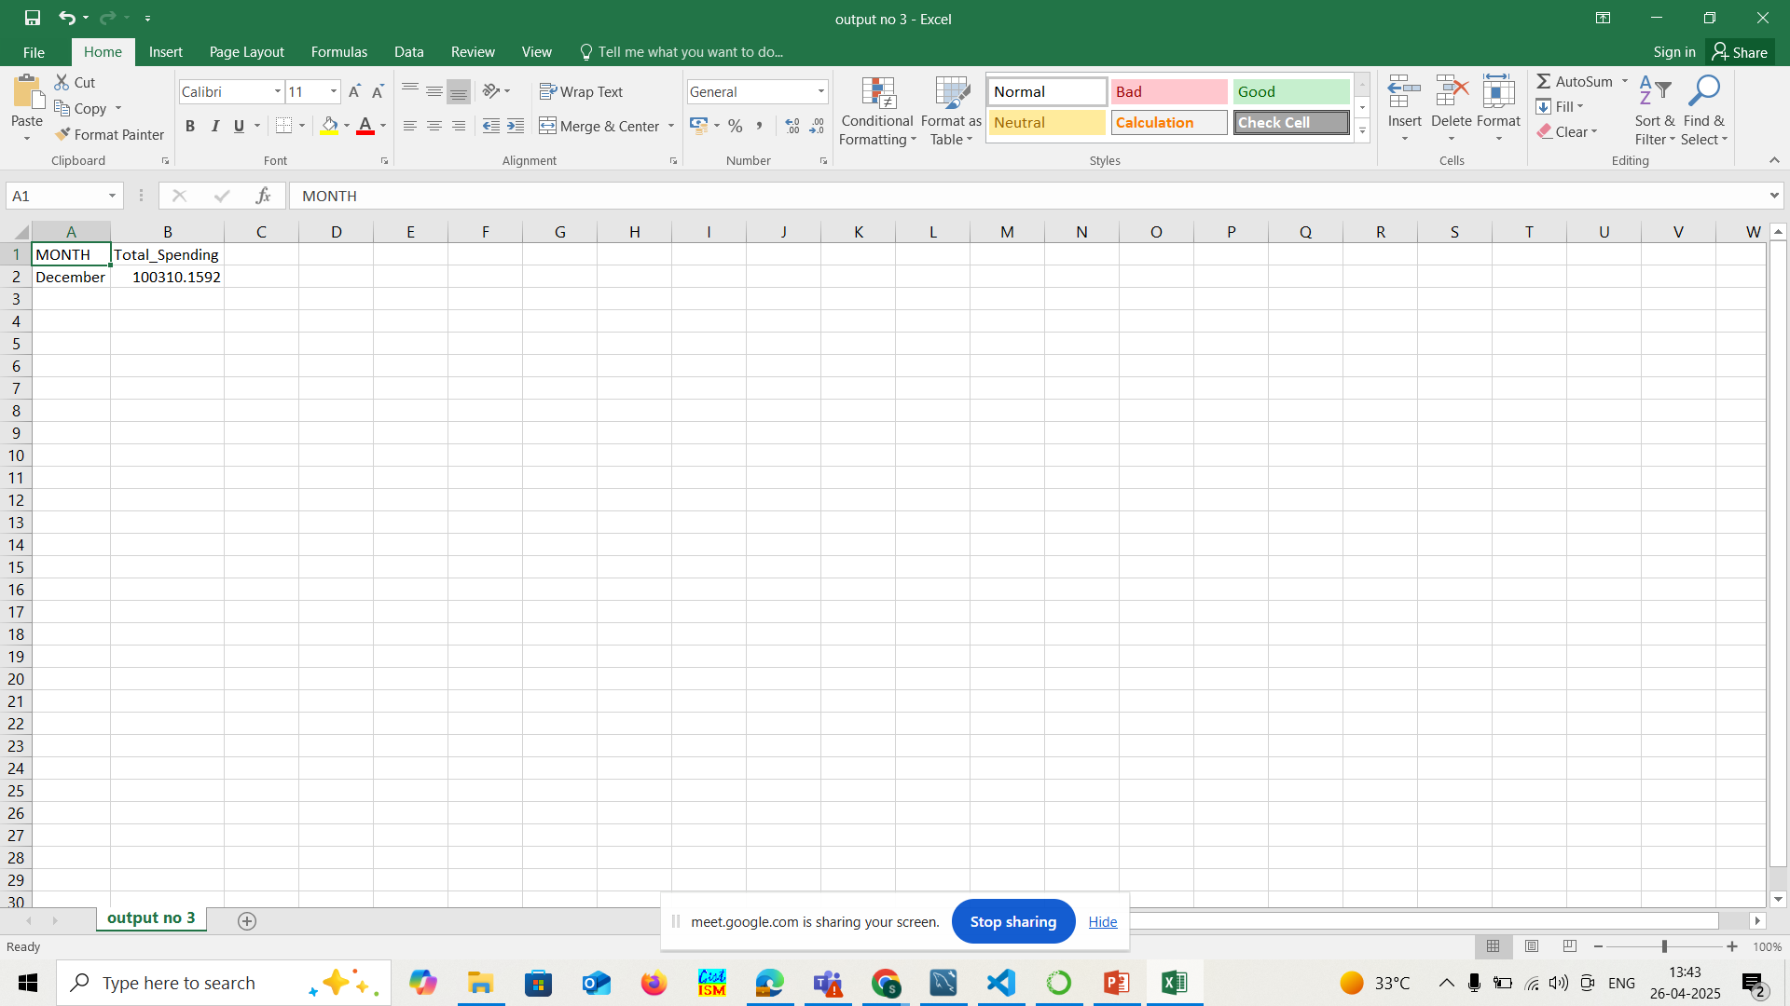
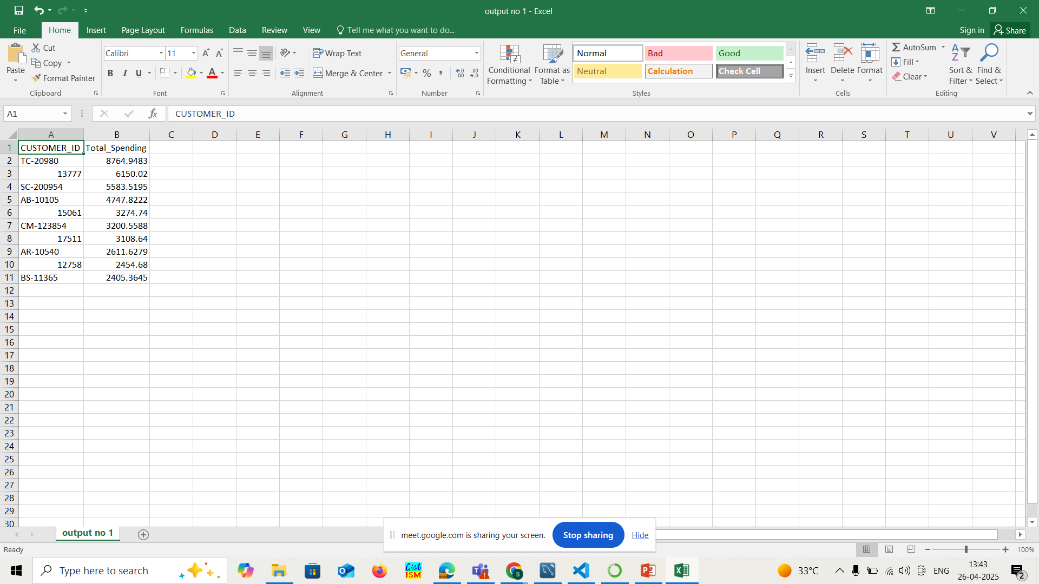
1.Top 10 customers by total spending
2.Total sales by country.
3.Find the month with the highest sales.
4.Average order value per customer.

Slide 7
Insights Drawn
1.Top 10 customers by total spending.
-This shows a list of the 10 customers who have spent the most money in total.The list is sorted from the highest spender to the lowest among the top 10.
2.Total sales by country.
-Displays the total sales (spending) grouped by each country.The results are sorted in descending order, so the country with the highest total sales appears at the top.
3.Find the month with the highest sales.
-Shows which month (by name) had the highest total sales across the dataset.It’s sorted in descending order of sales and limited to just the top month.
4.Average order value per customer.
-Calculates the average amount spent per order by each customer.The result is sorted by highest average order value, so you can identify high-spending customers per order.

Slide 8
Part 3: EDA & Visualization
Use Pandas for group-by aggregations and filtering.
Visualizations:
Time series line plot: Monthly sales trend
Bar chart: Top countries by revenue
Pie chart: Contribution of top 5 customers
Heatmap: Sales by month and country

Slide 9
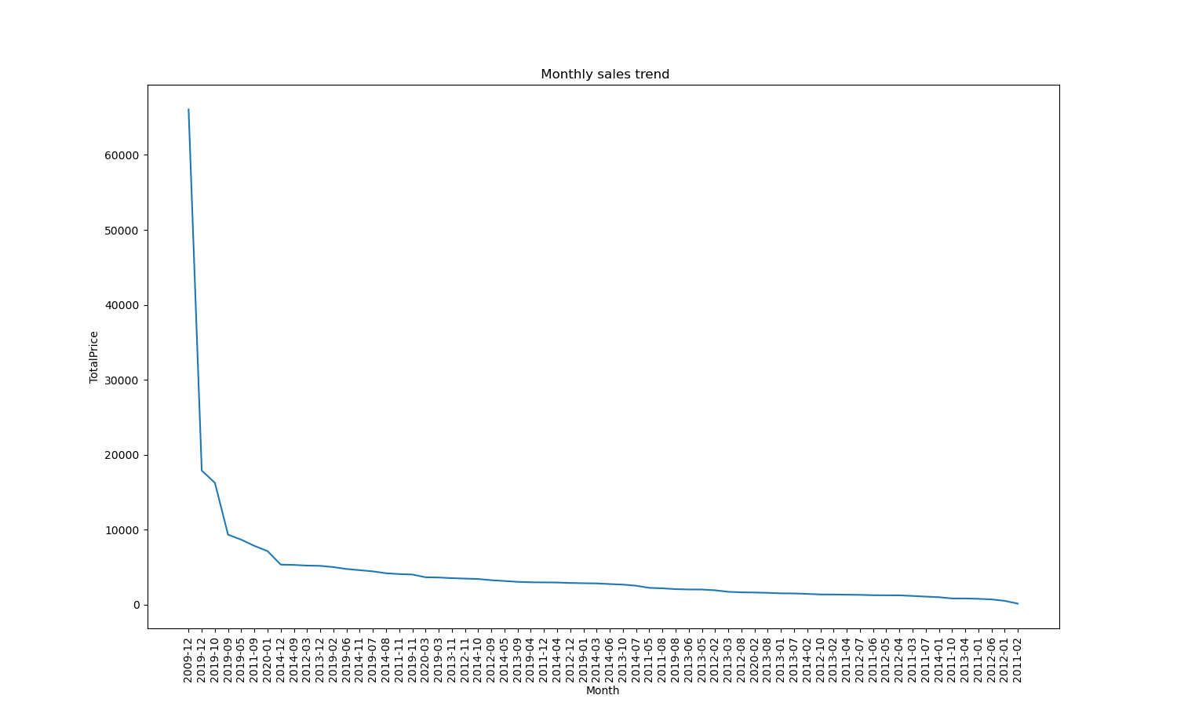
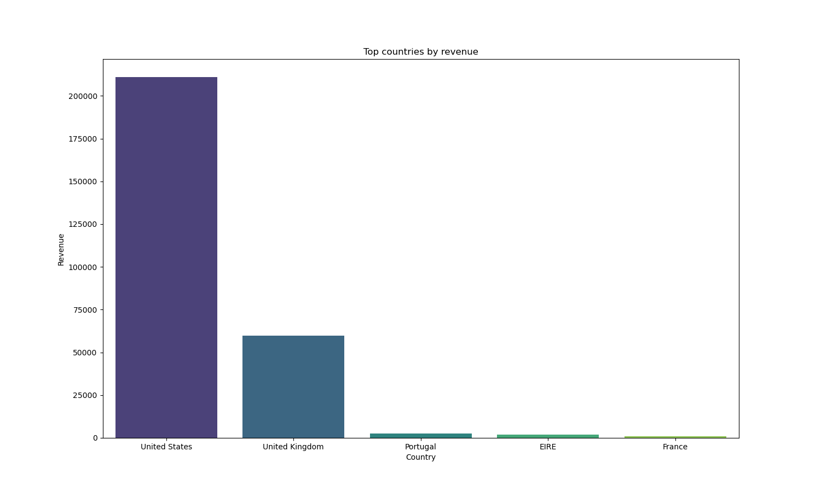
1.Time series line plot: Monthly sales trend
2. Bar chart: Top countries by revenue

Slide 10
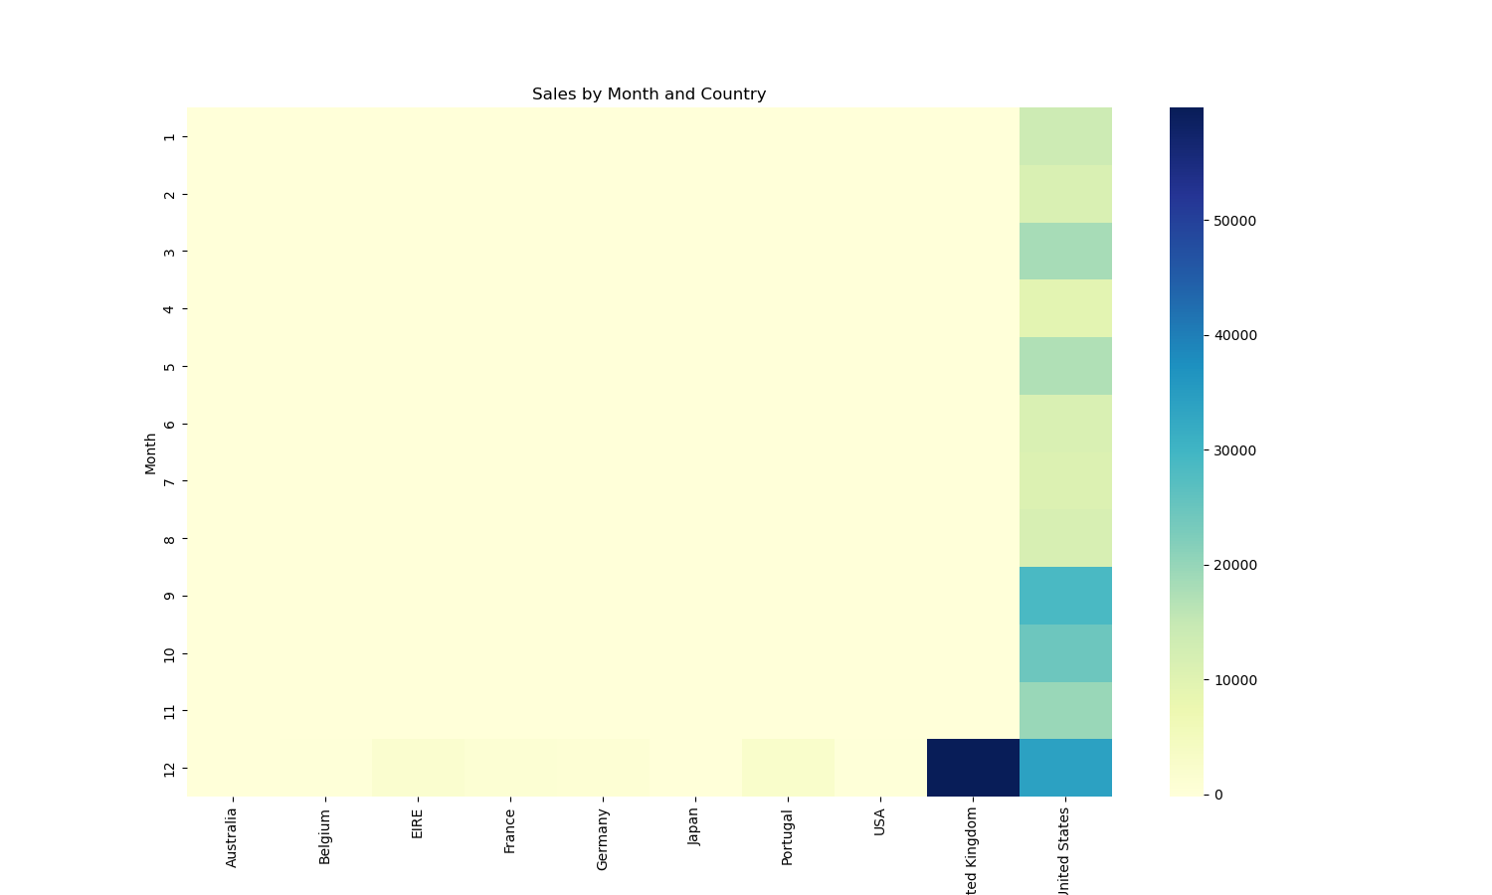
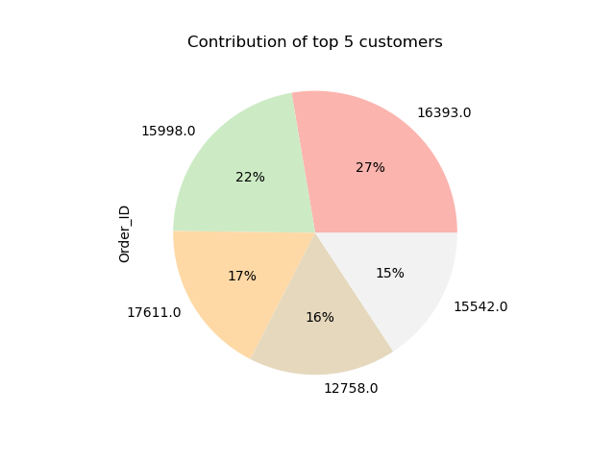
3. Pie chart: Contribution of top 5 customers
4. Heatmap: Sales by month and country

Slide 11
Insights from Analysis
1. Sales Trends :
We observed a significant increase in sales starting from December 2009, peaking at approximately 70,000. However, the growth was followed by a gradual decline in the subsequent months and years. To boost future sales, we suggest:
Price reductions,
Offering more discounts, or
Promoting high-rated products.
2. Top Contributing Countries :
United States was the top contributor to sales every month.
United Kingdom saw a spike in December, emerging as the highest contributor for that month.
France showed the lowest sales revenue.
3. Top Customers :
Customer ID 16393 contributed 27% of the total orders.
Customer ID 15542 had the smallest contribution at 15%. This insight could help target top customers with personalized offers or loyalty programs.
4. Monthly and Country-wise Sales Distribution :
United States led in sales every month, while United Kingdom dominated in December.
Identifying seasonal trends and focusing marketing efforts on high-performing countries during peak months could maximize revenue.

Slide 12
Thank you

