Slide 1
SALARY ANALYSIS DASHBOARD
Salary Analysis using 3,000 Employee Records
Pivot Tables • KPIs • Charts • Filters & Slicers

Slide 2
Introduction
Salary analysis helps organizations understand compensation patterns across employees.
This project analyzes salary, bonus, experience, department, job level, education, location and employment type.
The dashboard converts 3,000 employee records into KPIs and visual insights for easier decision-making.
The analysis is designed for HR planning, salary benchmarking and workforce management.
2

Slide 3
Problem Statement
Organizations need a clear view of how employee compensation changes across roles, experience and business functions.
Raw salary data is difficult to interpret without aggregation and visualization.
The objective is to identify salary differences, compensation patterns and high-value employee segments.
A dashboard provides a single view for comparing departments, job levels, education, locations and employment types.
3

Slide 4
Dataset Overview
Rows collected before preprocessing
3,000
Rows after preprocessing
3,000
Columns
15
Missing values
0
Duplicate Employee IDs
0
Main measure
Annual Salary
4

Slide 5
Row & Dataset Analysis
Total records analyzed: 3,000.
Each row represents one employee record.
15 fields cover identity, demographics, job information, salary, bonus and total compensation.
No records were removed during preprocessing because the provided dataset already had complete employee IDs and no missing values.
The cleaned dataset was validated for numeric salary fields and derived compensation calculations.
5

Slide 6
Data Preprocessing & Cleaning
1. Checked missing values → 0 missing cells
2. Checked duplicate Employee_ID values → 0 duplicates
3. Standardized text/category fields
4. Converted numeric salary and experience fields to numeric types
5. Validated salary, experience and bonus ranges
6. Recalculated Annual Salary, Annual Bonus and Total Compensation for consistency
6

Slide 7
KPI Summary
Core KPIs used in the dashboard
Total Employees
3,000
Average Annual Salary
₹926,528
Median Annual Salary
₹900,000
Minimum Salary
₹216,000
Maximum Salary
₹2,220,000
Average Total Compensation
₹83,349
Average Experience
6.61 years
Average Bonus
₹6,139
7

Slide 8
Question 1
Which department has the highest average annual salary?
Key Insight
Engineering has the highest average annual salary at about ₹1,153,467, followed by IT at about ₹1,076,490.
Use: Pivot Table → Average → Chart
8

Slide 9
Question 2
How does salary vary across different job levels?
Key Insight
Average salary rises consistently with seniority. Lead employees average about ₹1,340,488, while Entry employees average about ₹731,046.
Use: Pivot Table → Average → Chart
9

Slide 10
Question 3
How does years of experience affect annual salary?
Key Insight
Salary increases strongly with experience: the 0–2 year group averages about ₹729,607, while 21+ years averages about ₹1,411,364.
Use: Pivot Table → Average → Chart
10

Slide 11
Question 4
Which location has the highest average employee salary?
Key Insight
Mumbai has the highest average salary at about ₹1,019,934; Salem is the lowest among the listed locations at about ₹816,253.
Use: Pivot Table → Average → Chart
11

Slide 12
Question 5
How does education level relate to average salary?
Key Insight
Employees with a PhD have the highest average salary at about ₹1,096,509, followed by Master's degree holders.
Use: Pivot Table → Average → Chart
12

Slide 13
Question 6
How does salary differ by employment type?
Key Insight
Full-time employees have the highest average salary at about ₹950,580; part-time employees have the lowest average among the three types.
Use: Pivot Table → Average → Chart
13

Slide 14
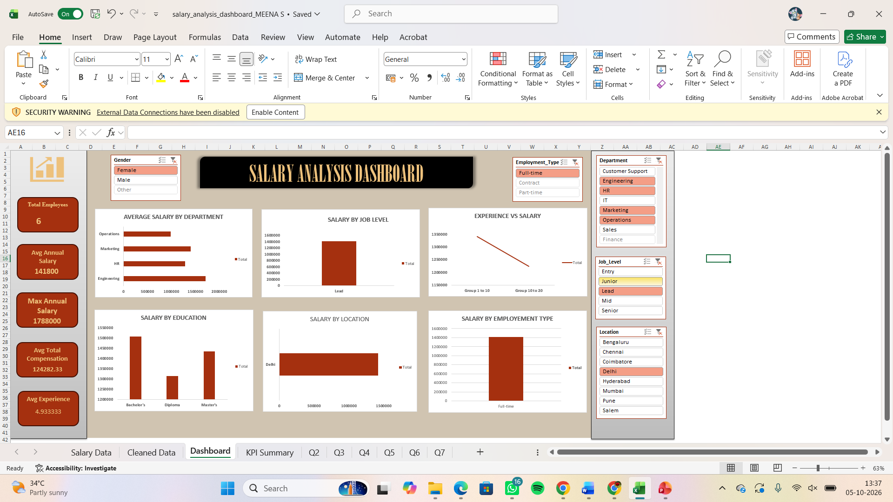

Slide 15
Five Key Insights
Engineering is the highest-paid department on average (≈ ₹1,153,467).
Lead-level employees have the highest average salary (≈ ₹1,340,488).
Average salary increases steadily with experience, reaching ≈ ₹1,411,364 for 21+ years.
Mumbai has the highest average location salary (≈ ₹1,019,934).
PhD holders have the highest average salary among education groups (≈ ₹1,096,509).
16

Slide 16
Slicers & Filters
SLICER: Department
Use to filter dashboard visuals
SLICER: Job Level
Use to filter dashboard visuals
SLICER: Location
Use to filter dashboard visuals
SLICER: Education
Use to filter dashboard visuals
SLICER: Employment Type
Use to filter dashboard visuals
SLICER: Gender
Use to filter dashboard visuals
Recommended dashboard filters: Department, Job Level, Location and Employment Type.
Use slicers to compare salary patterns for selected employee groups.
17

Slide 17
Conclusion
The salary dataset contains 3,000 employee records with 15 analytical fields.
The cleaned data supports reliable KPI calculations and comparative visual analysis.
Salary is strongly associated with job level and years of experience.
Department, location, education and employment type also show meaningful salary differences.
The final dashboard makes the analysis easier to monitor using KPIs, charts, filters and slicers.
19

