Slide 1
Service Virtualization

Slide 2
What is Service Virtualization
Service virtualization emulates the behavior of software components to remove dependency constraints on development and testing teams.
Virtual service is used to substitute a real system.
Service virtualization enables continuous testing by providing anytime, anywhere access to a complete, simulated test environment.

Slide 3
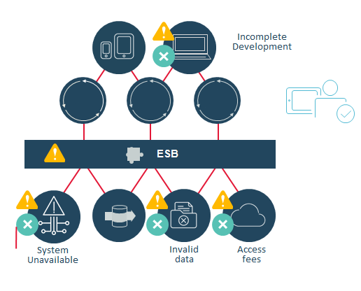
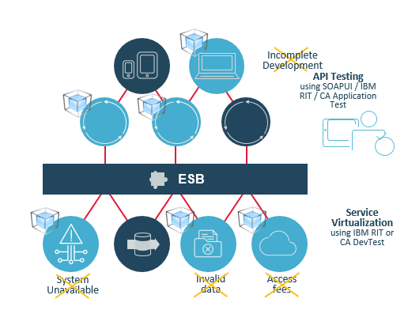
Eliminating the Dev/Test Constraints

Slide 4
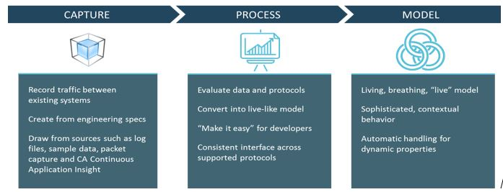
Working of Service Virtualization

Slide 5



Working of Service Virtualization
1) Existing Environment
TEST
(Manual, Automated)
System
Under Test
SOAP Request
Dependent System
Exercise SUT
SOAP Response
2) Recording a CA DEVTEST Virtual Service
TEST
(Manual, Automated)
System
Under Test
SOAP
Response
SOAP
Response
Dependent System
Exercise SUT
SOAP
Request
SOAP
Request
Virtual Service Recorder
3) Playback against the Virtual Service
TEST
(Manual, Automated)
Exercise SUT
System
Under Test
SOAP Request
SOAP Response
Virtual Service

Slide 6
Benefits Of Service Virtualization
Faster time-to-Market
Shift Left
Lesser constraints on Testing teams
Improved Product Quality

Slide 7
DevTest
DevTest : An integrated development environment(IDE) where test case assets and virtual service models are created and edited. We can run test cases and models locally in the workstation or stage them for a remote execution.
Coupled with two products:
CA Application Test : Allows all types of testing of multi-tiered architectures at an layer.
CA Service Virtualization: Allows for continuous development and testing of a software.

Slide 8
Key Components
Enterprise Dashboard: Monitor enterprise activity. Generate the Usage Audit Report
Registry: A central location for the registration of all CA SV Server and CA SV Workstation components
VSE: Used to deploy and run virtual service models.
Coordinator Server: The coordinator receives the test run information as MAR files, and coordinates the tests that are run on one or more simulator servers.
Simulator Server: The simulator runs the tests under the supervision of the coordinator server.
DevTest Portal: DevTest Portal is a web-based application that provides simpler access to the most commonly used workflows for DevTest products.

Slide 9
Virtual Service Image (VSI)
The Virtual Service Image Recorder generates service images.
Service images pretend to be what recorded informs of transaction.
It is the important component VSM
VSI keeps the information regarding request-response.

Slide 10
Virtual Service Model (VSM)
A Virtual Service Model (VSM) is a endpoint of a virtualized service.
Virtual Service Image recording creates a Virtual Service Model (VSM) with seven steps or nine steps, depending on the option chosen (More Flexible or More Efficient). Sometimes you would like to edit the VSM by editing generated steps or adding more steps.

Slide 11
Demo of Service Virtualization
Recording
WSDL
RR Pair
Deploying the Services

