Slide 1

THREE UK REBUS

Slide 2
Service Virtualization
Service virtualization emulates the behavior of software components to remove dependency constraints on development and testing teams.
Virtual service is used to substitute a real system.
Service virtualization enables continuous testing by providing anytime, anywhere access to a complete, simulated test environment.

Slide 3
Three UK
Challenges
Business Solution
Benefits
Unavailability of components was blocking component testing and channels integration testing.
No integration available with 3rd party systems to carryout CT and CIT testing.
Development/Testing team was facing a good amount of down time due to unavailability of related applications.
Identified dependent application
Identified involved interfaces for different applications
Virtualized around 39 services running on HTTPS/REST protocol.
Created real like virtual services that permits to test all possible different business scenarios.
To carry out CT, CIT execution virtual Services have been created as there is no integration available with 3rd party systems.
Successfully virtualized 39 APIs thereby enabling application development/testing from sprint-1 by leveraging CA DevTest Service Virtualization
Using virtual services, test team able to test around 700+ test cases and identified around 45 defects in early phase
Discovered Defects earlier in SDLC.
Eliminate Dev/Test Constraints
Able to test “what if” scenarios that are not possible to emulate with real backend systems

Slide 4
Actual Flow of Interaction
TIBCO
Channel
AEM/Mobile App + AMC
Vlocity - Salesforce
ERP (oracle)
Retail
CORM – Azure other applications
INSIGHTS – Azure IaaS
Genesys-Assisted Care
External Systems

Slide 5
Virtual Flow of Interaction
AEM/AMC
LISA acting as TIBCO
DevTest
(LISA) Server
Retail
Genesys
DB Server
Communication is on HTTPs protocol between Channel applications and LISA.
Notes:
Stubs will be deployed in the CA DevTest Server and the applications from Channels should be able to connect to the Stubs.
Connectivity should be enabled between Channel applications to DevTest Server
Connectivity should be enabled between DevTest Server to DB Server

Slide 6
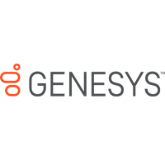
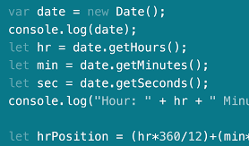

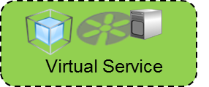


How it actually works
Application
Scripting
4
1
2
Request
Response
5
DB Configuration
Request triggered from Application
SV Service determines the Environment from the Request
SV Service connects to the appropriate Database based on Environment using DB Configuration
The Response object is created based on
Constants
Scripting Logic
Data fetched from Database
Response shared to Application
3
DB

Slide 8
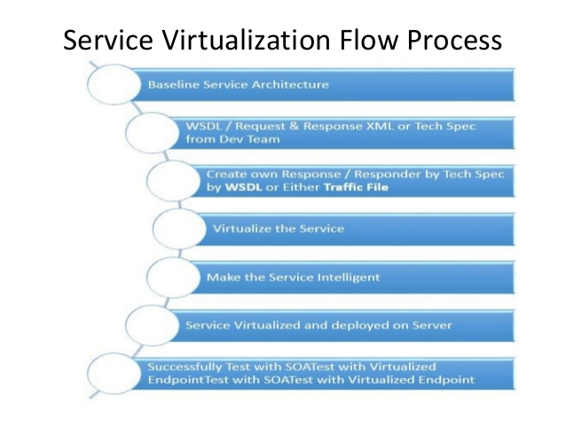

Slide 9
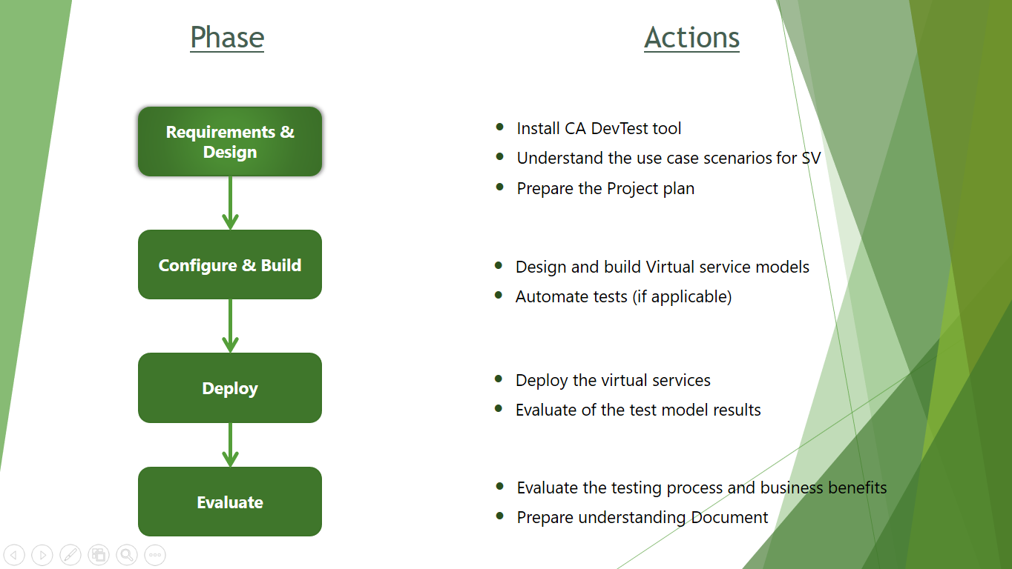


Slide 10





Requirements Gathering
Test Data For Virtual Services
Virtualize according to the functionality of the service
Deploy Virtual Service on the Server
Dev/Test team uses Deployed Virtualized Endpoint for their testing

Slide 11



Requirements Gathering
Virtualize according to the functionality of the service
Test Data For Virtual Services
Deploy Virtual Service On VSE Server.
Dev/Test team uses Deployed Virtualized Service Endpoint for their testing.

Slide 12
Requirements Gathering
Virtualize according to the functionality of the service
Test Data For Virtual Services
Deploy Virtual Service On VSE Server.
Dev/Test team uses Deployed Virtualized Endpoint for their testing.

Slide 13
Requirements Gathering
Test Data For Virtual Services
Virtualize according to the functionality of the service
Deploy Virtual Service On VSE Server.
Dev/Test team uses Deployed Virtualized Endpoint for their testing

Slide 14



Requirement Gathering
Configure and Build Virtual Service
Deploy the Virtual Service
Test Data For Virtual Services
Dev/Test team uses Deployed Virtualized Endpoint for their testing

Slide 15
Requirements Gathering
Configure and Build Virtual Service
Test Data For Virtual Services
Dev/Test team uses Deployed Virtualized Endpoint for their testing
Deploy the Virtual Service

