Slide 1

Credit Card Fraud Detection Using ML Model & Visuals in Power BI

Slide 2
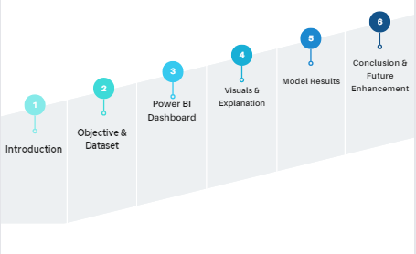
Agenda

Slide 3
Introduction
Credit cards are popular for online banking and are widely used in online transactions and e-commerce.
Nowadays most of E-commerce application system transactions are done through credit card and online net banking. These systems are vulnerable with new attacks and techniques at alarming rate.
As the digital landscape expands, credit card fraud detection becomes an imperative task for financial institutions.
The primary goal of this case study is to present an integrated strategy to credit card fraud detection in the United States dataset by integrating the visualization capabilities of Power BI with the predictive prowess of supervised machine learning models using the data analytics lifecycle and Python programming.
These findings can safeguard the financial interests of both credit cardholders and financial institutions.

Slide 4
Objectives
To analyze fraud rates in various states of USA during the period of two years from 2019 to 2020.
To Investigate which purchase category most likely to include fraud in the USA.
To identify target customers (whether old or new) who are significantly higher risk of falling victim to credit card fraud in various region of USA.
To classify or predict the patterns and trends associated with fraudulent activities during the period in the United States by using data mining techniques.
Purchase Category
State
City
Merchant
Month and Year wise

Slide 5
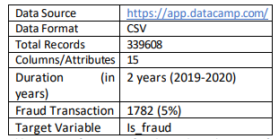
Dataset
The dataset contains the information of the two years of credit card transaction data of western United States .

Slide 6
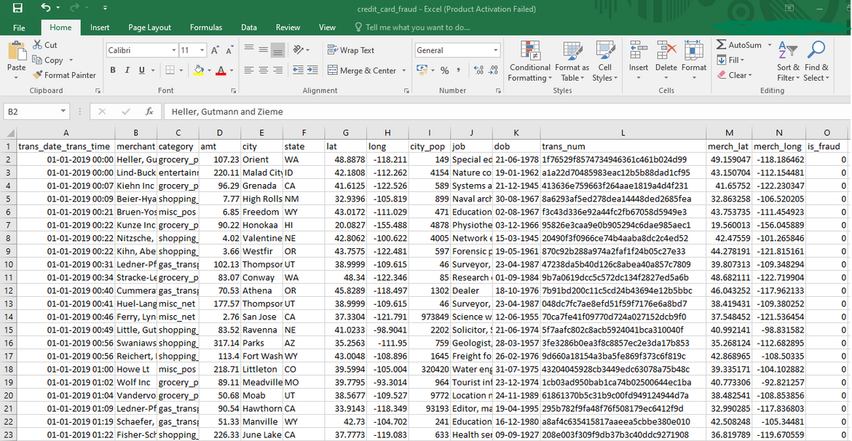
USA Credit Card Transaction Data CSV

Slide 7
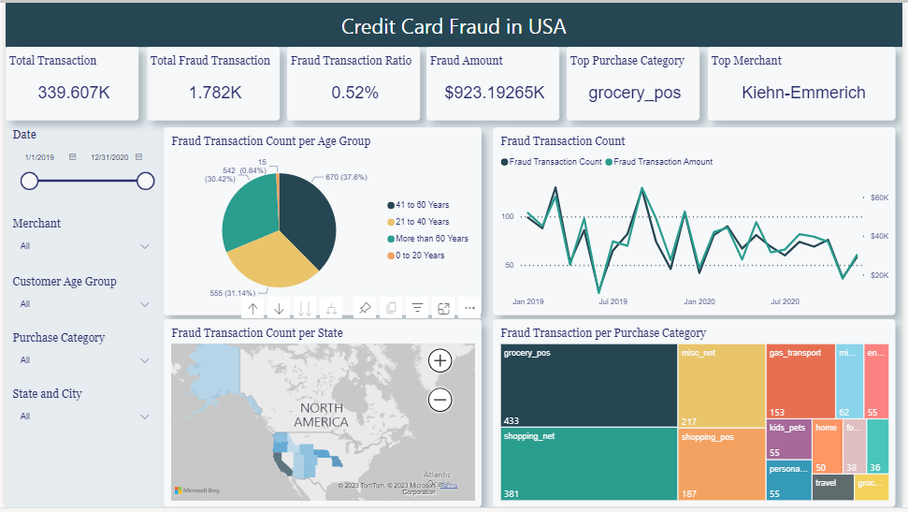
Power BI Dashboard

Slide 8
Power BI Visuals
Pie Chart:
This chart depicts the details about the various age group of the customers who are falling victim to credit card frauds in the USA during the period of two years.
Tree Maps:
The tree map gives the information on the distinct category affected by the credit card frauds in the shape of rectangles.
Basic Map:
The map represents the information on different state wise frauds by using latitude and longitude of credit card holder’s state in the USA.
Line Chart:
The line graph shows the half yearly and year wise number of frauds & fraud amount in the period of two years from 2019 to 2020.

Slide 9
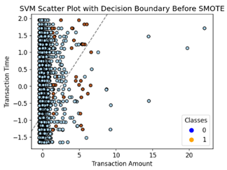
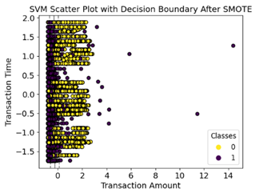
Model (SVM) Results
SVM Classification Before & After SMOTE (Oversampling)

Slide 10
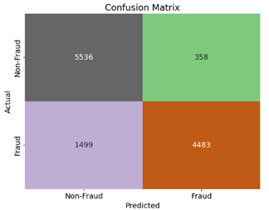
SVM Evaluation Metrics
Confusion Matrix
Accuracy Score 0.84 i.e. near to 1 means best fitted model.
High precision (0.86) indicates a low rate of false positives means less transaction incorrectly identified as fraud.
High recall (0.84) indicates a low rate of false negatives means less transaction incorrectly classified as non-fraud.
The F1 score (0.84) which was the near to 1 that means predicative model is best fitted to detect credit card fraud transaction in the USA.

Slide 11
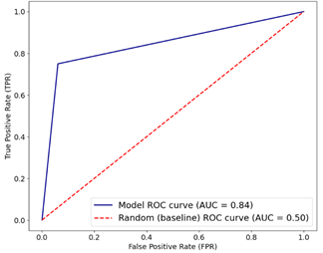
SVM Evaluation Metrics
ROC Curve
An AUC (Area Under Curve) of 0.84 is indicative of a SVM model that shows effective at differentiating between positive and negative examples.

Slide 12
Conclusion
The Power BI Dashboard analysis gives the relevant information to identify the specific pattern and trend of the credit card frauds in the USA .
The selected SVM model accuracy score 0.84 indicates the model is best fitted better performance model for the credit card fraud predication .
The both visualization and implemented SVM model results mostly achieved the objectives of this project.

Slide 13
Future Enhancement
Explore More visuals in Power BI for detail analysis and more interactive Visualization.
Implementation and comparison of two or more classification models such as random forest, decision tree for better result of fraud predication .

Slide 14
Thank You!

