Slide 1
Breast Cancer prediction
-Meena Madhavi gummadi

Slide 2
Goal of the project
Find whether the tumor cell is malignant(cancer cell) or benign (non-cancerous cell)
Study the attributes using plots
Impact to the different attributes of the data for malignant and benign cells
Predicting the tumor cell based on the value of the attributes.
Relation between the variables.
Find accuracy of the model

Slide 3
variables used
diagnosis – target factor, indicates cancer cell or not.
radius_mean: mean of distances from center to points on the perimeter)
texture_mean: Surface texture and standard deviation of gray-scale values
perimeter_mean: outer perimeter of the lobes
area_mean: area of the lobes
Smoothness_mean: local variation in radius lengths

Slide 4
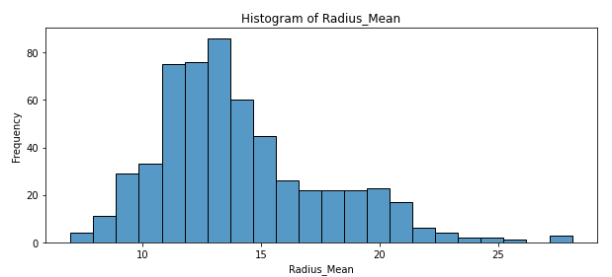
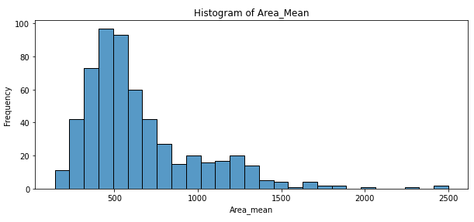
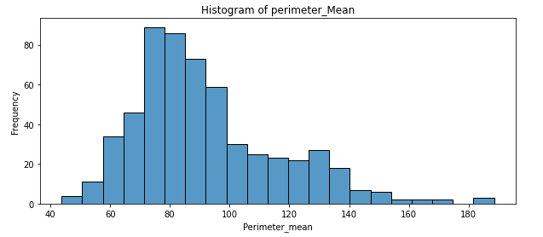
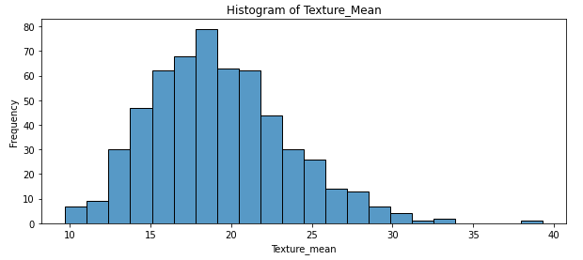
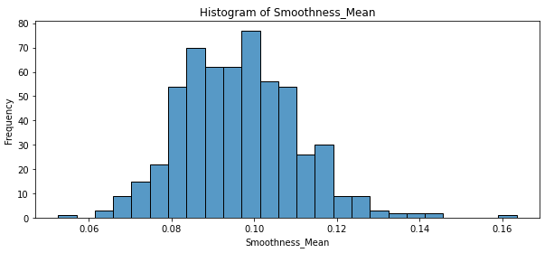
Histograms
From the above plots, I can say that for radius, texture, perimeter and area, the values are higher for malignant than benign. For Smoothness, benign has higher values.

Slide 5
Outliers
Looking at the histograms above, I see several unusual numbers in the benign and malignant distributions. These values could be errors or rare occurrences. Outliers are errors or unusual occurrences.
Calculating outliers:
Compute the first quartile (Q1- 25%) and third quartile (Q3- 75%),
Get the IQR (inter quartile range) = Q3-Q1, and
lastly compute Q1 - 1.5*IQR and Q3 + 1.5*IQR. Anything outside of this range is considered an Outlier.
The identified outliers can be eliminated or replaced with another appropriate value.

Slide 6
Identified outliers
Anything outside this range is Benign outlier: ( 7.6 , 16.8 )
Anything outside this range is Malignant outlier: ( 8.3 , 26.3 )
Anything outside this range is benign outlier: ( 8.2, 26.6 )
Anything outside this range is Malignant outlier: ( 12.6 , 30.4 )
Anything outside this range is benign outlier: ( 48.0 , 108.9)
Anything outside this range is Malignant outlier: ( 51.9 , 176.6)
Anything outside this range is benign outlier: ( 118.8 , 810.4 )
Anything outside this range is Malignant outlier: ( -42.3, 1951.42)
Anything outside this range is benign outlier: ( 0.05, 0.12 )
Anything outside this range is Malignant outlier: ( 0.068, 0.13 )

Slide 7
Mean, Mode, Spread, and Tails
Mean is calculated by mean() function
Mode is calculated by mode() function
Spread is a standard variation, can be calculated by var() function
Tails can be calculated by tail() function.
Alternatively, we can use describe() function to get them.
Dataframe.column.describe()

Slide 8
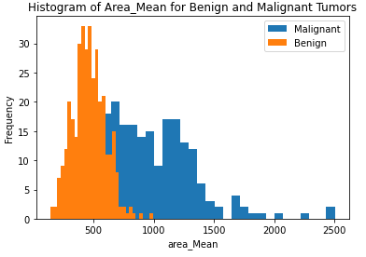
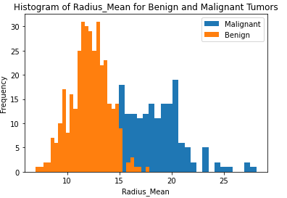
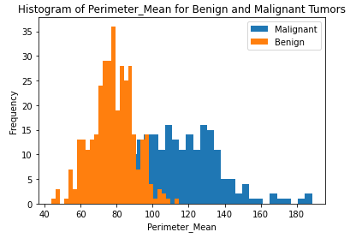
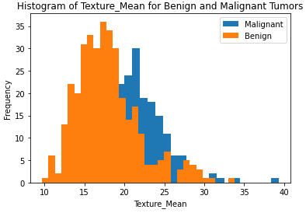
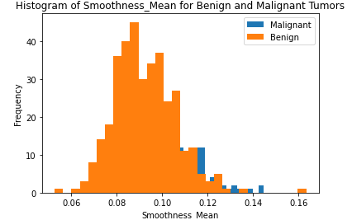
PMF
From the above plots, I can conclude that the malignant tumor has high radius, good textute, more perimeter, more area and less smoothness.

Slide 9
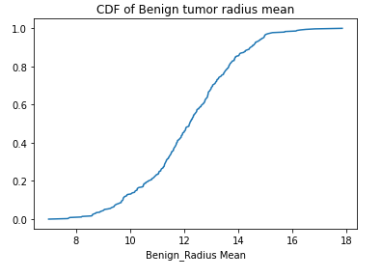
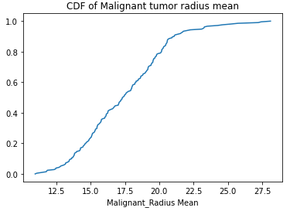
Cumulative Distribution function(CDF)
From the above CDF graphs, as the radius mean of the tumor increases the chance of turning benign cancer cell to malignant cell is increasing. Radius mean value of 15 is the highest point for benign tumor cell where as, it is the starting stage for the malignant cancer cell. From this, we can determine the radius of the cell that should be to detect as a cancer cell.

Slide 10
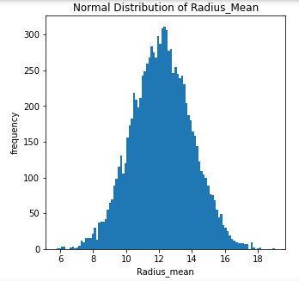
Gaussian distribution
As it can be seen from histogram most of the people are cumulated near to 12 that is mean of our normal distribution. Malignant tumors are distributed more towards right side and the benign tumors distributed on the left side of the graph. Here the average radius is 12.146524 and standard deviation is 1.780512. There are few people who are malignant, and their radius of cell is higher than 12. It can be 16-20. Also, there are few people who are benign, and their radius is lower than 12. It can be 6-8.

Slide 11
Scatter Plots
We can say that two variables are related with each other, if one of them gives information about others
Scatter plots are simplest way to check relationship between two variables
I have plotted radius vs area and radius vs perimeter.

Slide 12
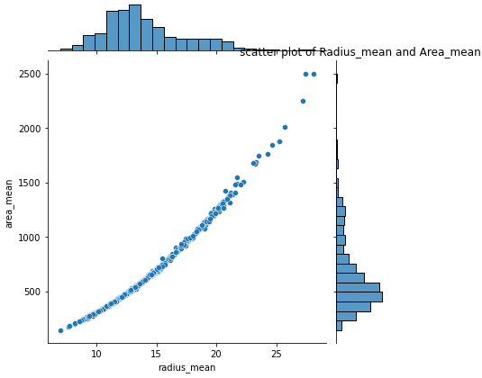
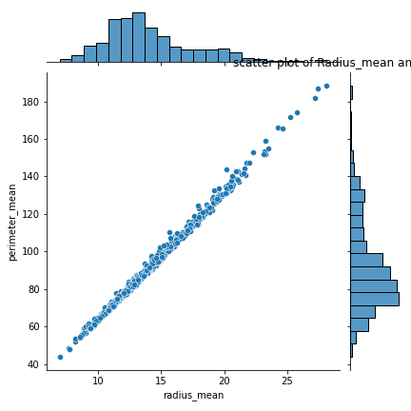
Scatter plots
From the above scatter plots, we can observe that
when radius mean increases, area mean also increases. Therefore, they are positively correlated with each other and area_mean is caused by radius_mean.
when radius mean increases, perimeter mean also increases. Therefore, they are positively correlated with each other and perimeter_mean is caused by radius_mean.

Slide 13
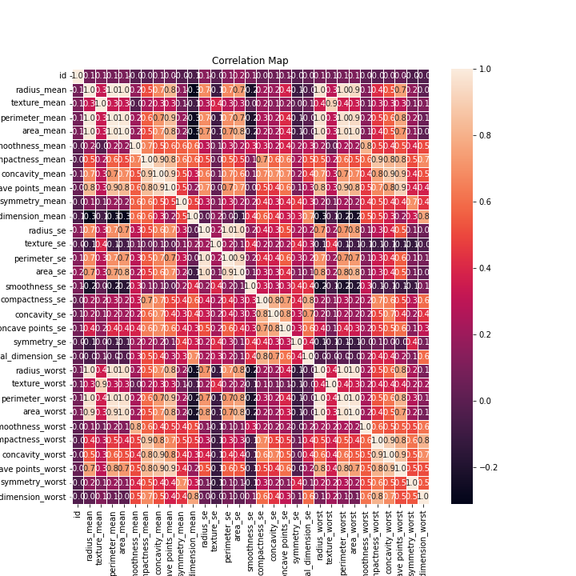
Correlation
Strength of the relationship between two variables.
This is the correlation or heat map for all the features of my project ranging values from -1 to 1
Meaning of 1 is two variable are positively correlated with each other.
As it can be seen in map heat figure radius_mean, perimeter_mean and area_mean are correlated with each other Compactness_mean, concavity_mean and concave points_mean are correlated with each other. Apart from these, radius_se, perimeter_se and area_se are correlated. radius_worst, perimeter_worst and area_worst are correlated Compactness_worst, concavity_worst and concave points_worst are correlated. Compactness_se, concavity_se and concave points_se are correlated. texture_mean and texture_worst are correlated. area_worst and area_mean are correlated.

Slide 14
covariance
Covariance is a measure of how likely two variables are to vary together.
Covariance is maximum when two vectors are identical.
If they are orthogonal, covariance is zero
If they point in opposite directions, covariance is negative.
I have calculated covariance between radius_mean and perimeter_mean, radius_mean and area_mean.
Covariance between radius mean and area mean: 1224.4
Covariance between radius mean and perimeter mean: 85.4

Slide 15
Pearson’s correlation
Division of covariance by standard deviation of variables
I have calculated pearson’s correlation between radius mean and area mean, radius mean and perimeter mean
Pearson’s correlation between area_mean and area_mean , perimeter_mean and perimeter_mean is 1 that means that they are same distribution
Also pearson correlation between area_mean and radius_mean is 0.98 that means that they are positively correlated with each other and relationship between them is very high.
Also pearson correlation between perimeter_mean and radius_mean is 0.99 that means, they are positively correlated with each other and relationship between them is very high.

Slide 16
Non-linear relationships
If relationship between distributions are non-linear, spearman's correlation tends to better estimate the strength of relationship.
To calculate spearman's correlation, we must first compute the rank of each item.
Spearman's correlation:
area_mean radius_mean
area_mean 1.000000 0.999602
radius_mean 0.999602 1.000000
Spearman's correlation is little higher than Pearson’s correlation

Slide 17
Classical hypothesis testing
I'm curious in the relationship between radius mean and area mean. My null hypothesis states that "the association between radius mean and area mean in tumor population is zero."To establish that radius mean and area mean are connected, we must first invalidate the null hypothesis.
Let’s find p-value (probability value)
p-value: 1.5253492492559045e-184
P value is almost zero so we can reject null hypothesis.

Slide 18
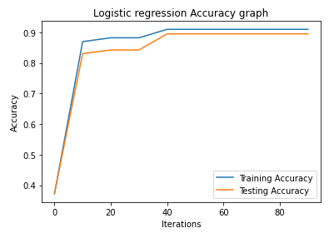
Logistic Regression model
We may safely hypothesize that the cancer diagnosis is dependent on the mean cell radius, mean perimeter, mean area, mean texture, and mean smoothness points based on the data in the histogram plots. Using those features, I have done a logistic regression analysis.
The model accuracy is 93%

Slide 19
Conclusion
62.7% are not affected by cancer, and 37.3% are affected by cancer.
Most of the tumors are benign and have low mean_radius.
Most of the tumors lie in size range of (12,15).
Radius_mean and texture mean for the malignant tumor are higher than for benign tumor.
compactness_mean and smoothness_mean both are higher for Benign tumors.
Spearman's correlation is a little higher than Pearson's correlation.
The logistic regression model accuracy is 93%.

Slide 20
References
Learning, U. C. I. M. (2016, September 25). Breast cancer wisconsin (Diagnostic) data set. Kaggle. Retrieved June 4, 2022, from https://www.kaggle.com/datasets/uciml/breast-cancer-wisconsin-data
kanncaa1. (2018, September 9). Statistical learning tutorial for beginners. Kaggle. Retrieved June 4, 2022, from https://www.kaggle.com/code/kanncaa1/statistical-learning-tutorial-for-beginners/notebook

