Slide 1


SMART INDIA HACKATHON 2026
TRUST WIPE
Problem Statement ID – SIH26149 Problem Statement Title - Design and Development of an Integrated Secure Data Erasure and Advanced File Recovery Tool for Digital Forensics and Data Sanitization Software Theme – Blockchain & Cybersecurity PS Category - Software Team Name - Innovatrix

Slide 2
TRUST WIPE – INTEGRATED SECURE DATA ERASURE & ADVANCED FILE RECOVERY TOOL FOR DIGITAL FORENSICS AND DATA SANITIZATION
Innovatrix
PROPOSED SOLUTION TrustWipe unifies secure data sanitization and digital forensics into one verifiable workflow.
TECH STACK
Frontend | React
Backend | Node.js
Database | MongoDB
Authentication | JWT
Cryptography | SHA-256
Signature | RSA
Communication | Socket.IO
SECURE WIPE
Device discovery & target selection
Multi-pass file sanitization
Real-time progress monitoring
SHA-256 verification
RSA certificate + QR validation
FORENSIC RECOVERY
Evidence acquisition & hashing
Metadata / filesystem scanning
Signature-based file carving
Deleted-file recovery
Chain of custody & forensic reports
AUDIT & COMPLIANCE
MongoDB audit records
PDF / Excel / compliance reports
Used for Auditing and Proof purpose for the organizations
INNOVATION
One platform to securely erase data, recover deleted evidence, and cryptographically prove every critical action.

Slide 3
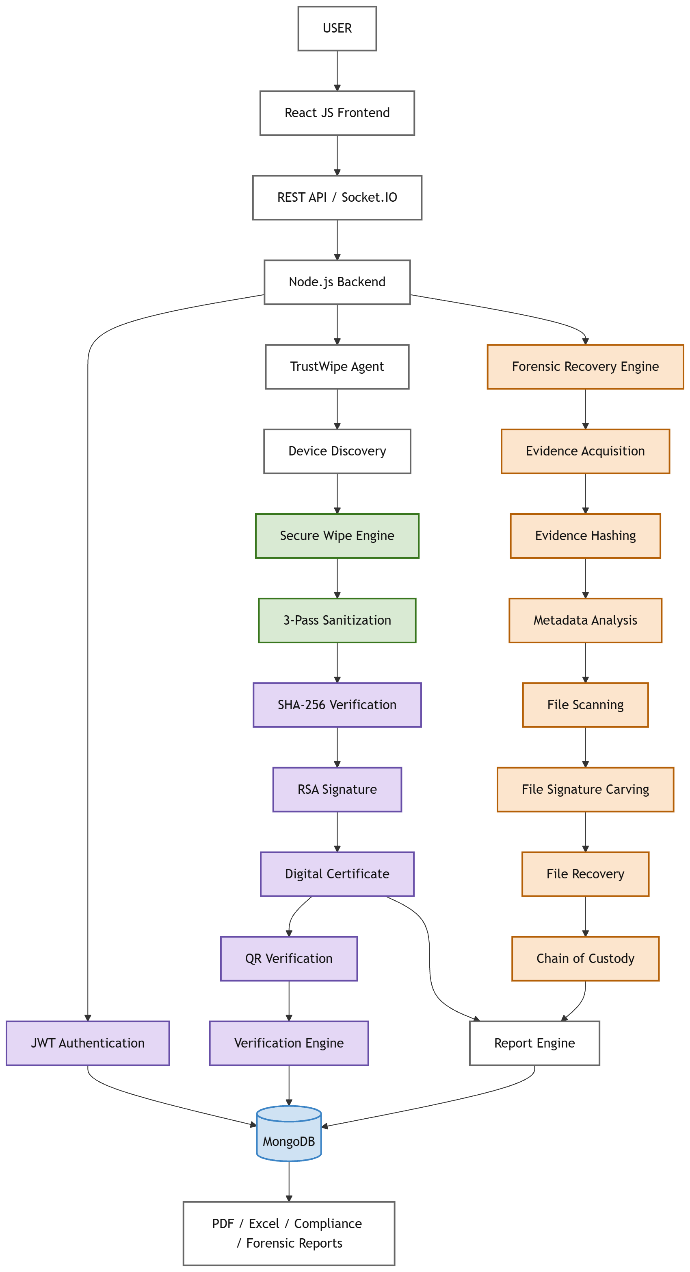
TECHNICAL APPROACH
Innovatrix
SYSTEM FLOW
1. Authentication — JWT-secured user access 2. Discovery & Acquisition — Detect devices / acquire forensic evidence 3. Wipe & Recovery Engine — 3-pass sanitization / scan, carve & recover 4. Verification & Certification — SHA-256 + RSA + QR verification 5. Audit & Reporting — MongoDB + chain of custody + PDF/Excel reports
6. Storage & Verification — MongoDB audit records; verify by ID / QR

Slide 4
FEASIBILITY AND VIABILITY
Innovatrix
FEASIBILITY
Proven Stack: React • Node.js • Python • MongoDB
Secure Core: JWT • SHA-256 • RSA
Agent-Based: Automated device discovery & wipe execution
Dual Engine: Sanitization + Forensic Recovery
Prototype Validated: Login • Discovery • Wipe • Verification • Certificate
CHALLENGES / RISKS
SSD Wear-Leveling — Physical-cell sanitization limitation
Device Diversity — Hardware-specific erase requirements
Recovery Limits — Overwritten/fragmented files
Evidence Integrity — Secure forensic preservation
Key Security — Protect certificates & private keys
.
MITIGATION / FUTURE PATH
Device-Aware Sanitization
Multi-Standard Support
Advanced File Recovery
Hardened Chain of Custody
Blockchain-Backed Audit Trail
AI-Powered Compliance
TARGET USERS
• Enterprises and government organizations • IT asset recycling/refurbishment companies • Data centers and educational institutions • Organizations handling confidential data
BUILDABLE NOW • SCALABLE NEXT • VERIFIABLE ALWAYS

Slide 5
IMPACT AND BENEFITS
Innovatrix
PROTOTYPE TEST RESULTS
User Login — PASS
Agent Registration — PASS
Drive Discovery — PASS
Start Wipe — PASS
Progress Monitoring — PASS
SHA-256 Verification — PASS
PDF Certificate — PASS
QR Verification — PASS
OVERALL RESULT
Authentication, device discovery, wiping, verification and certificate generation completed successfully in the tested workflow.
BENEFITS
SECURITY
Reduces the risk of sensitive data remaining on recycled devices.
VERIFIABLE PROOF
SHA-256 evidence + RSA-signed certificate provides traceable proof.
AUDITABILITY
Centralized MongoDB records support transparent disposal workflows.
OPERATIONAL EFFICIENCY
Automatic discovery and real-time monitoring simplify sanitization.
INNOVATION:
Trust Wipe converts data wiping from an invisible deletion process into a verifiable, auditable sanitization workflow using cryptographic evidence and digitally signed certificates.
Our current prototype focuses primarily on file-level sanitization and provides cryptographic evidence of the executed workflow. We recognize that SSD wear-leveling can require device-level secure erase or sanitize mechanisms, which is part of our planned enhancement.
TRUST:
Builds trust in safe reuse and recycling of IT assets, supporting responsible electronic waste reduction.

Slide 6
RESEARCH AND REFERENCES
Innovatrix
FUTURE RESEARCH DIRECTIONS
• DoD 5220.22-M and Gutmann wiping standards • Cloud-based certificate management • Blockchain-based certificate verification • AI-powered compliance monitoring • Mobile application for remote monitoring
REFERENCES
NIST SP 800-88 — Guidelines for Media Sanitization
SHA-256 / SHA-2 cryptographic hashing
RSA digital signatures
JWT authentication
MongoDB documentation
LIVE DEMO
https://trust-wipe-forensic-recovery.vercel.app/
GITHUB REPOSITORY https://github.com/MeenaTharshini/Trust_Wipe_Forensic_Recovery

