Slide 1
Agenda
Why DevOps?
DevOps Practices
Why DevOpsSec?

Slide 2


based on the works of
Stephanie.Herr@red-gate.com
@SQLStephanie @Redgate

Slide 3


Tapabrata “Topo” Pal
Engineering Fellow
Product Manager, Shared Continuous Delivery Tools Platform Community Manager, Hygieia Open Source DevOps Dashboard
tapabrata.pal@capitalone.com
@TopoPal
Past:
PhD in Semiconductor Physics
20 years of IT experience as Developer, Architect, System Engineer
Experience in Retail, Healthcare and Finance industries
@TopoPal

Slide 4
Agile Manifesto
Individuals and interactions over processes and tools
Working software over comprehensive documentation
Customer collaboration over contract negotiation
Responding to change over following a plan
http://agilemanifesto.org
Notes:
We are uncovering better ways of developing software by doing it and helping others do it.
Through this work we have come to value:
Individuals and interactions over processes and tools
Working software over comprehensive documentation
Customer collaboration over contract negotiation
Responding to change over following a plan
That is, while there is value in the items on the right, we value the items on the left more.

Slide 5
12 Principles behind the Agile Manifesto
http://agilemanifesto.org/principles.html
Notes:
Our highest priority is to satisfy the customer through early and continuous delivery of valuable software.
Welcome changing requirements, even late in development. Agile processes harness change for the customer's competitive advantage.
Deliver working software frequently, from a couple of weeks to a couple of months, with a preference to the shorter timescale.
Business people and developers must work together daily throughout the project.
Build projects around motivated individuals. Give them the environment and support they need, and trust them to get the job done.
The most efficient and effective method of conveying information to and within a development team is face-to-face conversation.
Working software is the primary measure of progress.
Agile processes promote sustainable development. The sponsors, developers, and users should be able to maintain a constant pace indefinitely.
Continuous attention to technical excellence and good design enhances agility.
Simplicity--the art of maximizing the amount of work not done--is essential.
The best architectures, requirements, and designs emerge from self-organizing teams.
At regular intervals, the team reflects on how to become more effective, then tunes and adjusts its behavior accordingly.

Slide 6
Agile Principles
Our highest priority is to satisfy the customer through early and continuous delivery of valuable software.
http://agilemanifesto.org/principles.html
Notes:
1. Continuous Delivery of value to the customer

Slide 7
Agile Principles
Deliver working software frequently, from a couple of weeks to a couple of months, with a preference to the shorter timescale.
http://agilemanifesto.org/principles.html
Notes:
Agile - thinking in weeks/months; DevOps – thinking in minutes

Slide 8
Agile Principles
Business people and developers must work together daily throughout the project.
http://agilemanifesto.org/principles.html
Notes:
4. No mention of Ops; DevOps extends this to break down the ops silo and have ops team members working with business people and devs

Slide 9
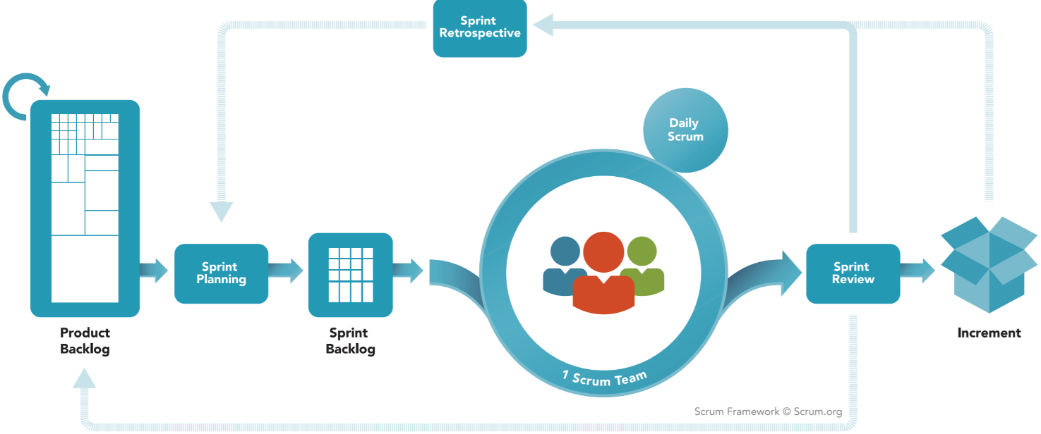
Scrum
https://www.scrum.org/Resources/What-is-Scrum
Notes:
Scrum is an Agile framework.
Very clear roles too:
Product Owner
Scrum Master
Dev Team
Certifications

Slide 10
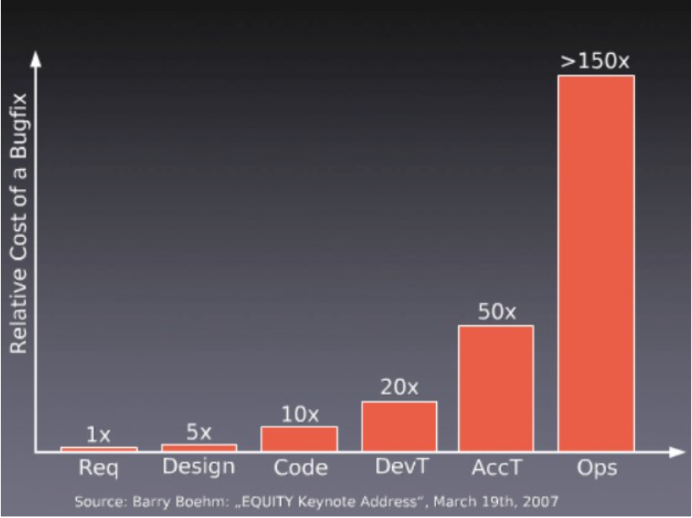
http://www.cardinalsolutions.com/blog/2015/05/assuring-quality-in-the-new-agile-world

Slide 11
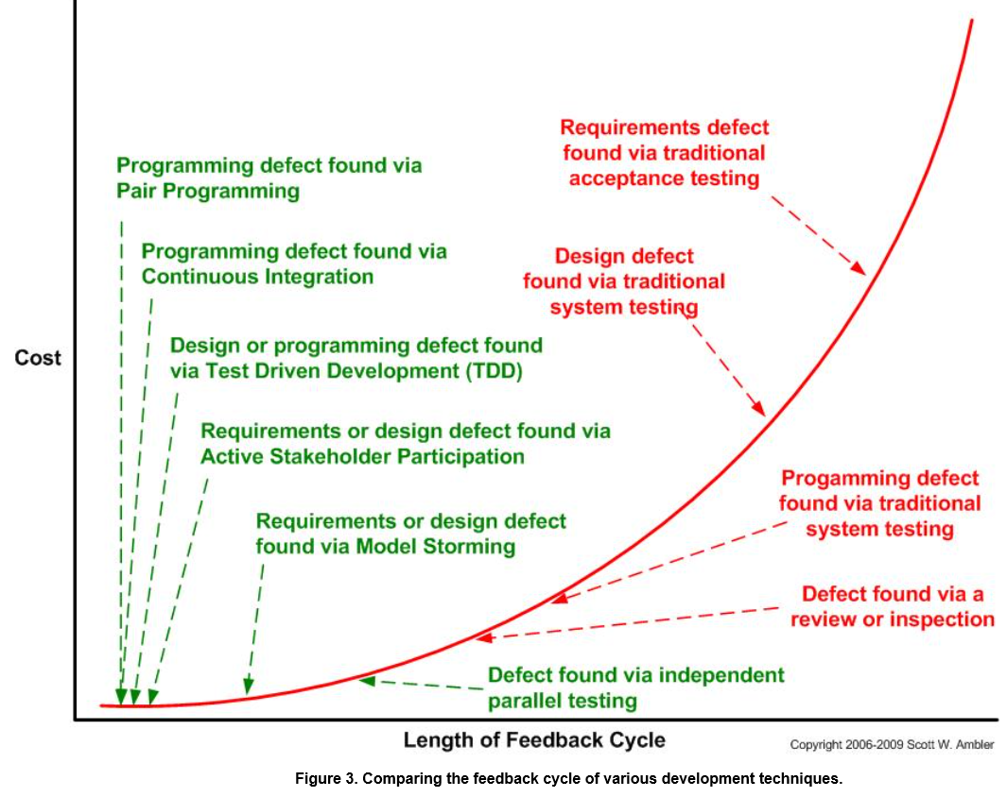
http://www.agilemodeling.com/essays/costOfChange.htm

Slide 12
Background
Agile
Cloud and PaaS
2007-2008
Patrick Debois → Agile Sys Admin GG
Infrastruct as code
2007
Ops = comp advantage
2007 – 2010
Lean
DevOps
2009
Velocity: 10+ deploys / day
2013
The Phoenix Project
2009
DevOpsDays
2010 – 2011 Tools / Gartner / Vendors
#DevOps
2010
Continuous Integration / Continuous Delivery
  http://itrevolution.com/the-convergence-of-devops
  https://www.ibm.com/developerworks/library/se-devops/part1
  http://itrevolution.com/the-history-of-devops
Notes:
Agile software development
2007 – Patrick Dubois, Consultant in Belgium, wanted to know about all areas of the sw dev lifecycle; working on project to upgrade data center = Dev very agile, Ops very structured
2007 - posts about Operations being a competitive advantage *
2008 – Agile Conf – Andrew Shafer BOF for “Agile Infrastructure” → Agile System Administration Google Group - bridge between dev & sys admin
Velocity 2009 – “10+ Deploys Per Day: Dev and Ops Cooperation” by John Allspaw and Paul Hammond, Flicker *
Oct 2009 – Patrick Dubois started DevOpsDays in Belgium for devs and sys admins → #DevOps on twitter
2010 – Continuous Delivery book published by Jez Humble and Dave Farley
2010/11 – Tools like Chef, Puppet, Logstach, Vagrant, SaltStack, Hudson, etc.
2011 – Gartner and Vendors started picking up on it
2013 – The Phoenix Project by Gene Kim, Kevin Behr, George Spafford
Practices: Lean, CI/CD * , Infrastructure as code **, Availability of cloud and platform as a service (PaaS) technologies **
Rhythm of agile dev; firefighting and unpredictability of traditional opps
Competitive advantage, especially for startups
2010 – DevOps Days, Sydney (Lindsay Holmwood)
2010 – DevOps Days, Mountain View, CA (Damon Edwards, Andrew Shafer, John Willis)
98 to date across the world
2007 – 2010 - Eric Reis blogged about lessons learned in his startup
http://www.information-age.com/devops-will-become-mainstream-among-global-2000-2016-gartner-123459119/
By 2016, DevOps will evolve from a niche strategy employed by large cloud providers to a mainstream strategy employed by 25% of Global 2000 organisations, analyst firm Gartner has predicted.
Although DevOps emphasises people and culture over tools and processes, implementation utilises technology. As a result, Gartner expects the total for DevOps tool sets to reach $2.3 billion in 2015, up 21.1% from $1.9 billion in 2014.
Gartner said that rather than being a market per se, DevOps is a philosophy; a cultural shift that merges operations with development and demands a linked tool chain of technologies to facilitate collaborative change.

Slide 13
What is DevOps?
Notes:
http://www.devopsdigest.com/17-ways-to-define-devops-4
No agreed definition
Word itself is a combination of Development and Operations
That’s not what is important

Slide 14
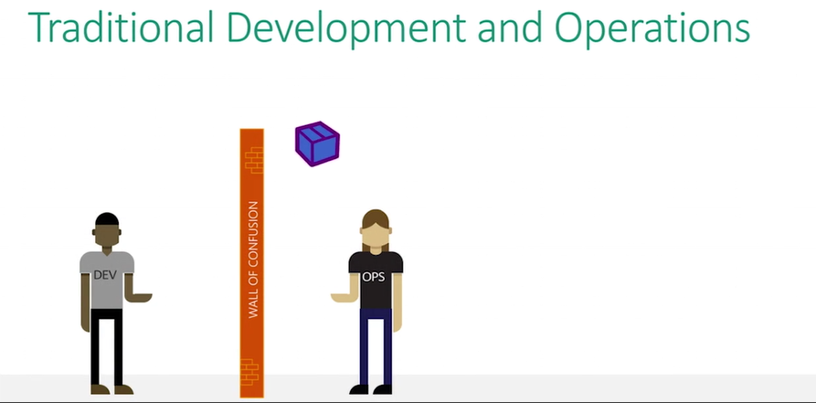
Ch9 – Microsoft – Introduction to DevOps
https://channel9.msdn.com/Series/DevOps-Fundamentals/Introduction-to-DevOps

Slide 15
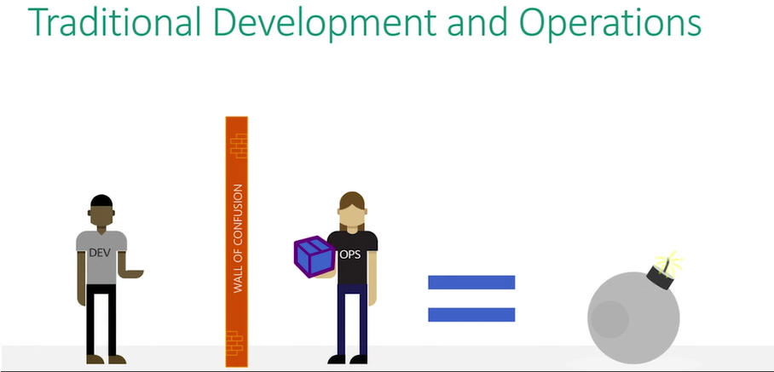
Ch9 – Microsoft – Introduction to DevOps
https://channel9.msdn.com/Series/DevOps-Fundamentals/Introduction-to-DevOps

Slide 16
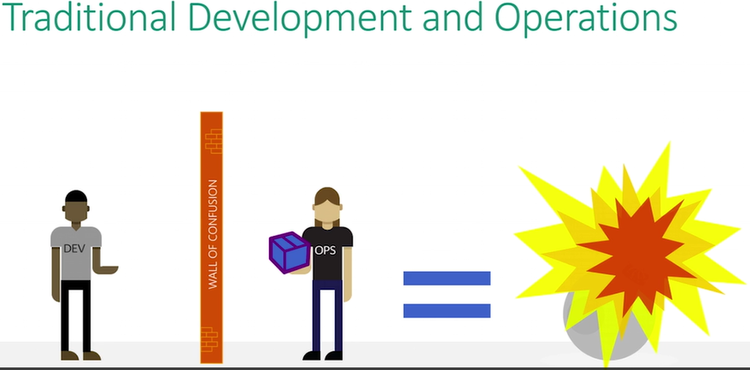
Ch9 – Microsoft – Introduction to DevOps
https://channel9.msdn.com/Series/DevOps-Fundamentals/Introduction-to-DevOps

Slide 17
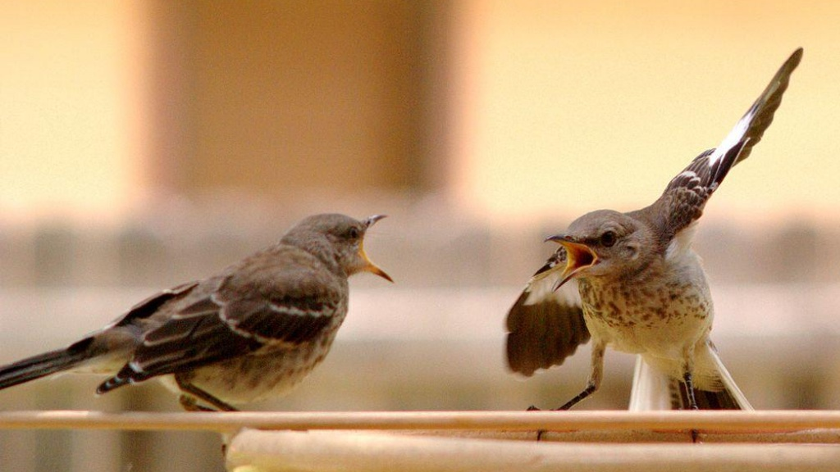
http://www.slideshare.net/GrantFritchey/building-an-automated-database-deployment-pipeline
https://commons.wikimedia.org/wiki/File:Mocking_Bird_Argument.jpg

Slide 18

http://www.slideshare.net/GrantFritchey/building-an-automated-database-deployment-pipeline
https://commons.wikimedia.org/wiki/File:Mocking_Bird_Argument.jpg

Slide 19
http://www.slideshare.net/GrantFritchey/building-an-automated-database-deployment-pipeline
https://commons.wikimedia.org/wiki/File:Mocking_Bird_Argument.jpg

Slide 20
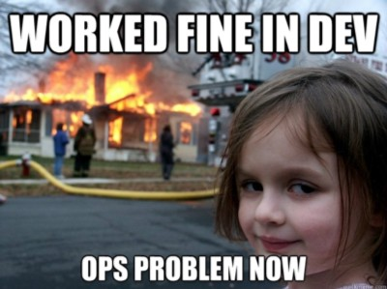
https://medium.com/point-nine-news/do-you-speak-devtools-73237550bf4f

Slide 21
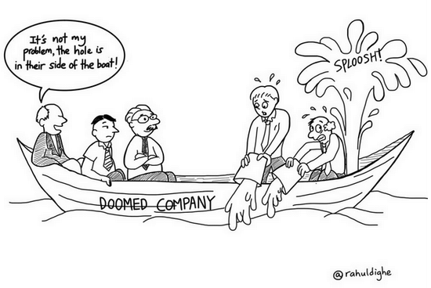
https://www.javacodegeeks.com/2015/12/devops-myth-efficiency-part.html

Slide 22

Surprise!
Broad Agreement on the Definition of DevOps
“DevOps exists to help the business win
Broad scope, but centered on IT
Foundations in Agile and Lean
Culture is very important
Feedback is fuel for innovation
Automation helps”
https://devops.com/2015/05/13/surprise-broad-agreement-on-the-definition-of-devops
Notes:
While everyone supplies slightly different words, the same working understanding of DevOps is nearly universal. Analysts, authors, industry, and community leaders all agree. The ideas are big and mutually supportive. In short:
https://www.infoq.com/news/2015/06/devops-definition

Slide 23
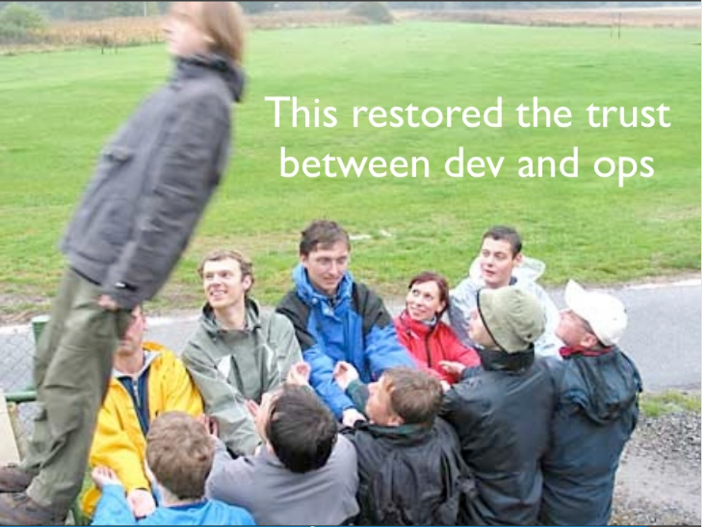
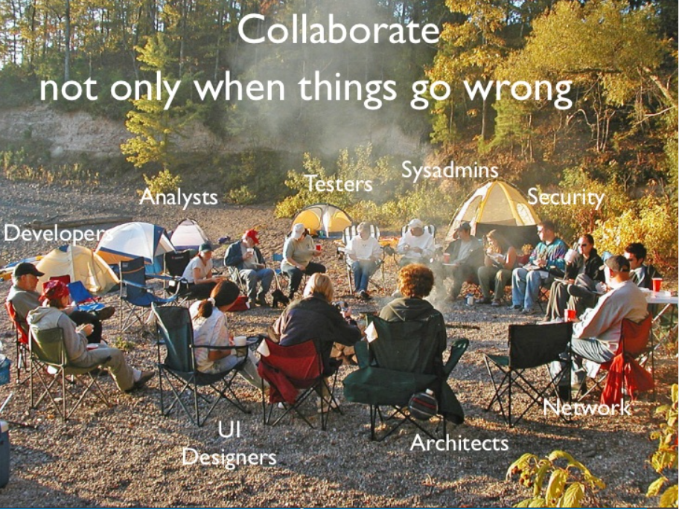
DevOps by Patrick Debois – Feb 2011
http://www.slideshare.net/jedi4ever/devops-paris-jug-2011

Slide 24
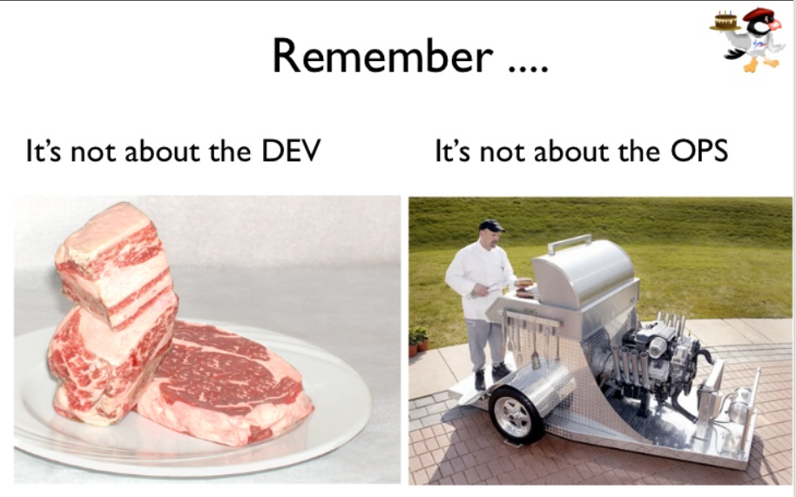
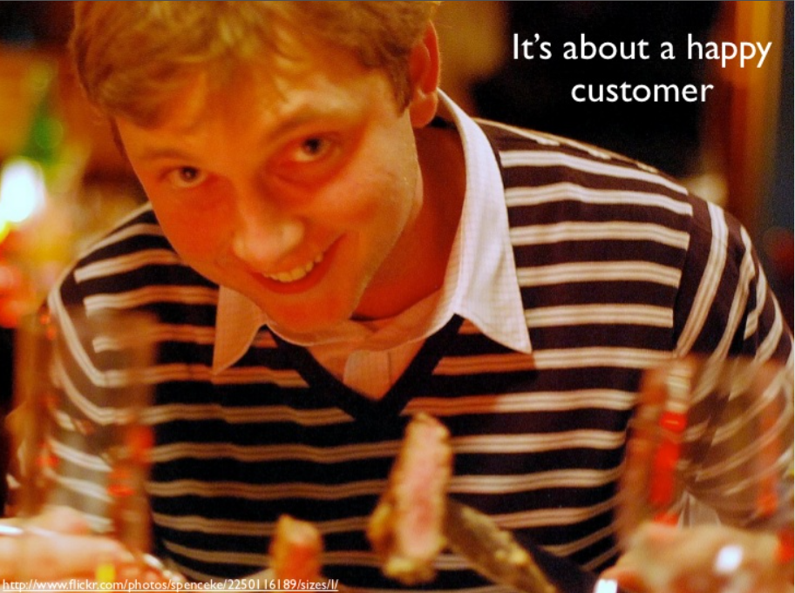
DevOps by Patrick Debois – Feb 2011
http://www.slideshare.net/jedi4ever/devops-paris-jug-2011

Slide 25
DevOps Values – CALMS
Culture
Automation
Lean
Measurement
Sharing
https://puppet.com/blog/devops-principles-for-it-managers
Notes:
Damon Edwards and John Willis described DevOps in 2010 in the first US based DevOpsDays in Mountain View, CA
http://devopsdictionary.com/wiki/CAMS
Culture
DevOps is mostly about breaking down barriers between teams. An enormous amount of time is wasted with tickets sitting in queues, or individuals writing handoff documentation for the person sitting right next to them. In pathological organizations it is unsafe to ask other people questions or to look for help outside of official channels. In healthy organizations, such behavior is rewarded and supported with inquiry into why existing processes fail. Fostering a safe environment for innovation and productivity is a key challenge for leadership and directly opposes our tribal managerial instincts.
Automation
Perhaps the most visible aspect of DevOps. Many people focus on the productivity gains (output per worker per hour) as the main reason to adopt DevOps. But automation is used not just to save time, but also prevent defects, create consistency, and enable self-service.
Measurement
How can you have continuous improvement without the ability to measure improvement? How do you know if an automation task is worthwhile? Basing decisions on data, rather than instinct, leads to an objective, blameless path of improvement. Data should be transparent, accessible to all, meaningful, and able to be visualized in an ad hoc manner.
Sharing
Key the success of DevOps at any organization is sharing the tools, discoveries, and lessons. By finding people with similar needs across the organization, new opportunities to collaborate can be discovered, duplicate work can be eliminated, and a powerful sense of engagement can be created among the staff. Outside the organization, sharing tools and code with people in the community helps get new features implemented in open source software quickly. Conference participation leaves staff feeling energized and informed about new ways to innovate.
https://www.infoq.com/news/2015/06/devops-definition
Culture – Own the change to drive collaboration and communication
Automation – Take manual steps out of your value chain
Lean – Use lean principles to enable higher cycle frequency
Metrics – Measure everything and use data to refine cycles
Sharing – Share experiences, successful or not, to enable others to learn
Damon Edwards and John Willis described DevOps in 2010 in the first US based DevOpsDays in Mountain View, CA
Culture
DevOps is a cultural undertaking, so it's about more than acquiring new tools and taking on new practices. It’s about setting expectations and priorities, and the fundamental beliefs that guide them. Our 2015 State of DevOps Report showed there's a strong link between culture and successful management practices, much of it coming out of lean management principles and a collaborative approach to problem solving. For DevOps to succeed, that collaboration has to take place both within and between teams.
Automation
Automation is a given in any team that has embraced DevOps; it’s just the way everything is done. Automating common and repetitive processes frees up time for higher-level work and opens up opportunities for innovations that wouldn’t be possible otherwise.
Measurement
Integrating feedback into the work is a fundamental part of agile and lean practices. For mature organizations, this means measuring everything that moves in production, and sharing those measurements with everyone involved in software development and delivery — not just the ops team, or just the devs. Measuring and reporting everything can seem overwhelming, though. So start with just the crucial measurements, one or two things that everyone agrees really matter. It could be deployment frequency, lead time to changes, mean time to recovery, change fail rate — whichever seems the most important to where your team is right now. Gathering and sharing these metrics will show you where you've got opportunities for quick wins — and these boost everyone's morale.
Sharing
Today’s organizations and software require teams of people with different skills and specialized knowledge. To work efficiently, it’s important to work well together, and sharing is how you get there. Expose metrics to everyone within your organization who might be interested. Keep things simple and clear — explain how these metrics affect software delivery and overall company performance. Sharing progress data will also help foster a more effective DevOps culture.
When identifying and making changes to how you and your team work, it’s useful to think about those changes in terms of culture, automation, measurement and sharing. Base your choices on maximizing opportunities in these areas, and you should find yourself well on your way to breaking down silos and improving your organization.
There's a lot more to DevOps thinking, planning and execution, and Gareth Rushgrove covers how to work with your operations team, the development team and higher-up managers in his paper, Get Started with DevOps: A Guide for IT Managers. Check it out for practical guidance, as well as DevOps philosophy.
http://blogs.forrester.com/eveline_oehrlich/15-03-02-devops_now_with_calmss
L – Lean – Jez Humble
S – Sourcing
https://www.diazhilterscheid.de/en/ready-for-cams-the-foundation-of-devops/
Also described as four pillars

Slide 26
The Three Ways:
The Principles Underpinning DevOps by Gene Kim
http://itrevolution.com/the-three-ways-principles-underpinning-devops
Notes:
Breaking down silos
We’re all in the same boat; think about the business value streams that are enabled by IT
- Requirements id-ed; Built in Dev, transitioned to Ops, deliver value to cust
RESULTS in BUILD QUALITY IN (never pass known defect downstream, never optimize only for local, understand entire system, it’s not just ops problem now)
CI and auto testing = bug found in Prod is 100xs more expensive to fix
- Systems feedback, monitoring
- Customer feedback
continual experimentation, taking risks and learning from failure; and understanding that repetition and practice is the prerequisite to mastery.
- Allocating time for the improvement of daily work
- Creating rituals that reward the team for taking risks
- Introducing faults into the system to increase resilience

Slide 27
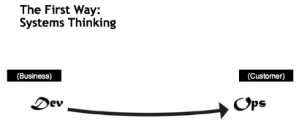
The Three Ways:
The Principles Underpinning DevOps by Gene Kim
http://itrevolution.com/the-three-ways-principles-underpinning-devops
Notes:
Breaking down silos
We’re all in the same boat; think about the business value streams that are enabled by IT
- Requirements id-ed; Built in Dev, transitioned to Ops, deliver value to cust
RESULTS in BUILD QUALITY IN (never pass known defect downstream, never optimize only for local, understand entire system, it’s not just ops problem now)
CI and auto testing = bug found in Prod is 100xs more expensive to fix
- Systems feedback, monitoring
- Customer feedback
continual experimentation, taking risks and learning from failure; and understanding that repetition and practice is the prerequisite to mastery.
- Allocating time for the improvement of daily work
- Creating rituals that reward the team for taking risks
- Introducing faults into the system to increase resilience

Slide 28
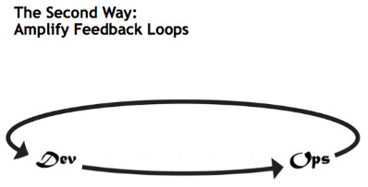
The Three Ways:
The Principles Underpinning DevOps by Gene Kim
http://itrevolution.com/the-three-ways-principles-underpinning-devops
Notes:
Breaking down silos
We’re all in the same boat; think about the business value streams that are enabled by IT
- Requirements id-ed; Built in Dev, transitioned to Ops, deliver value to cust
RESULTS in BUILD QUALITY IN (never pass known defect downstream, never optimize only for local, understand entire system, it’s not just ops problem now)
CI and auto testing = bug found in Prod is 100xs more expensive to fix
- Systems feedback, monitoring
- Customer feedback
continual experimentation, taking risks and learning from failure; and understanding that repetition and practice is the prerequisite to mastery.
- Allocating time for the improvement of daily work
- Creating rituals that reward the team for taking risks
- Introducing faults into the system to increase resilience

Slide 29
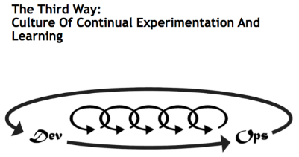
The Three Ways:
The Principles Underpinning DevOps by Gene Kim
http://itrevolution.com/the-three-ways-principles-underpinning-devops
Notes:
Breaking down silos
We’re all in the same boat; think about the business value streams that are enabled by IT
- Requirements id-ed; Built in Dev, transitioned to Ops, deliver value to cust
RESULTS in BUILD QUALITY IN (never pass known defect downstream, never optimize only for local, understand entire system, it’s not just ops problem now)
CI and auto testing = bug found in Prod is 100xs more expensive to fix
- Systems feedback, monitoring
- Customer feedback
continual experimentation, taking risks and learning from failure; and understanding that repetition and practice is the prerequisite to mastery.
- Allocating time for the improvement of daily work
- Creating rituals that reward the team for taking risks
- Introducing faults into the system to increase resilience

Slide 30
Why DevOps?

Slide 31
Benefits
Faster time-to-market/delivery times that improves ROI
Engaged, empowered cross-discipline teams
Stable/reliable operating environments
Early detection and faster correction of defects
Improved quality
http://www.gallop.net/blog/6-compelling-business-benefits-of-devops
https://www.infoq.com/articles/devops-lessons-microsoft
Notes:
HTTP://WWW.GALLOP.NET/BLOG/6-COMPELLING-BUSINESS-BENEFITS-OF-DEVOPS/#XRG3WFQGGBX9LY5L.99
Ensure faster time-to-market/delivery times that improves ROI. DevOps is basically the application of Agile principles, and thus the end result is faster development of software, ensuring more frequent delivery.
Improve collaboration between teams (Business / Dev / Ops) – aptly labelled the ‘War Room’– by improving the transparency required for effective decision making. Today, more than ever before, development teams need to break down their inter-departmental silos, and collaborate and communicate in a dynamic, round the clock environment. DevOps paves the way to improve business agility by providing the much need atmosphere of mutual collaboration, communication, and integration across globally collocated teams in an IT organization. The earlier set boundaries based on roles are getting blurred in such an encouraging DevOps atmosphere. All team members, together, are responsible for the quality and timelines of deliverables
image: http://www.gallop.net/blog/wp-content/uploads/2016/02/devops-img.jpg
Stable/reliable operating environments.
Early detection and faster correction of defects that helps provide the best services and robust features that must be delivered to customers
Continuous Release and Deployment, Continuous Testing, and Continuous Monitoring – Today’s software development practices require teams to continuously deliver quality software, reduced go-to-market timelines, and adaptation of shorter release cycles. DevOps, using its practices of Continuous Release and Deployment, Continuous Testing, and Continuous Monitoring, provides just that.
Time to focus – thus improving quality

Slide 32
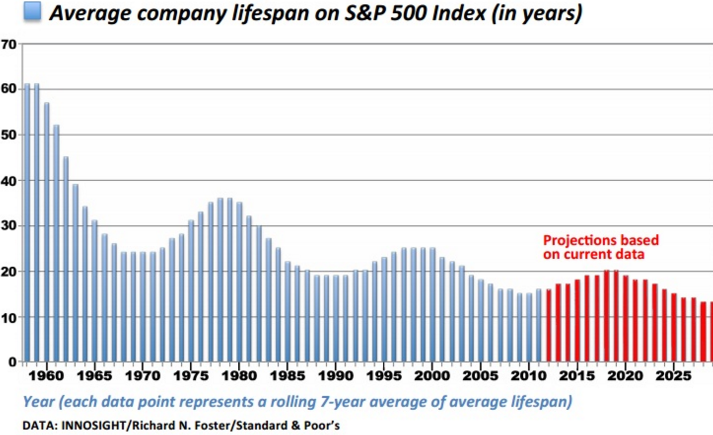
“Technology Is Wiping Out Companies Faster than Ever”
https://www.technologyreview.com/s/519226/technology-is-wiping-out-companies-faster-than-ever
Notes:
“creative destruction” - the process by which large companies eventually get crushed by innovations made elsewhere.
Life expectancy of a firm in the Fortune 500
1955 - ~60 years 2015 - <20 years and declining
“Milking the cash cow” no longer works
http://www.forbes.com/sites/stevedenning/2011/11/19/peggy-noonan-on-steve-jobs-and-why-big-companies-die/#18dcfce23e57
“Fifty years ago, “milking the cash cow” could go on for many decades. What’s different today is that globalization and the shift in power in the marketplace from buyer to seller is dramatically shortening the life expectancy of firms that are merely milking their cash cows. Half a century ago, the life expectancy of a firm in the Fortune 500 was around 75 years. Now it’s less than 15 years and declining even further.”

Slide 33
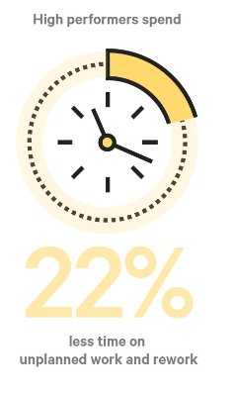
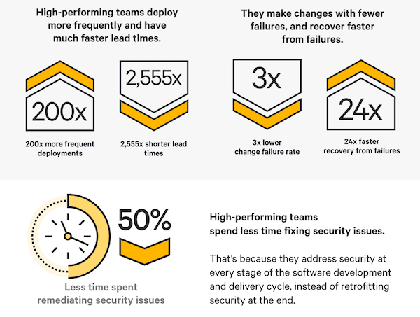
2016 State of DevOps Report
https://puppet.com/ resources/white-paper/ 2016-state-of-devops-report
Notes:
5th annual report
4,600 technical professionals
High IT Performers = deploy on demand, < 1 hr lead time, < 1 hr MTTR, < 15% change failure rate
lead time - how long does it take to go from code commit to code successfully running in production

Slide 34
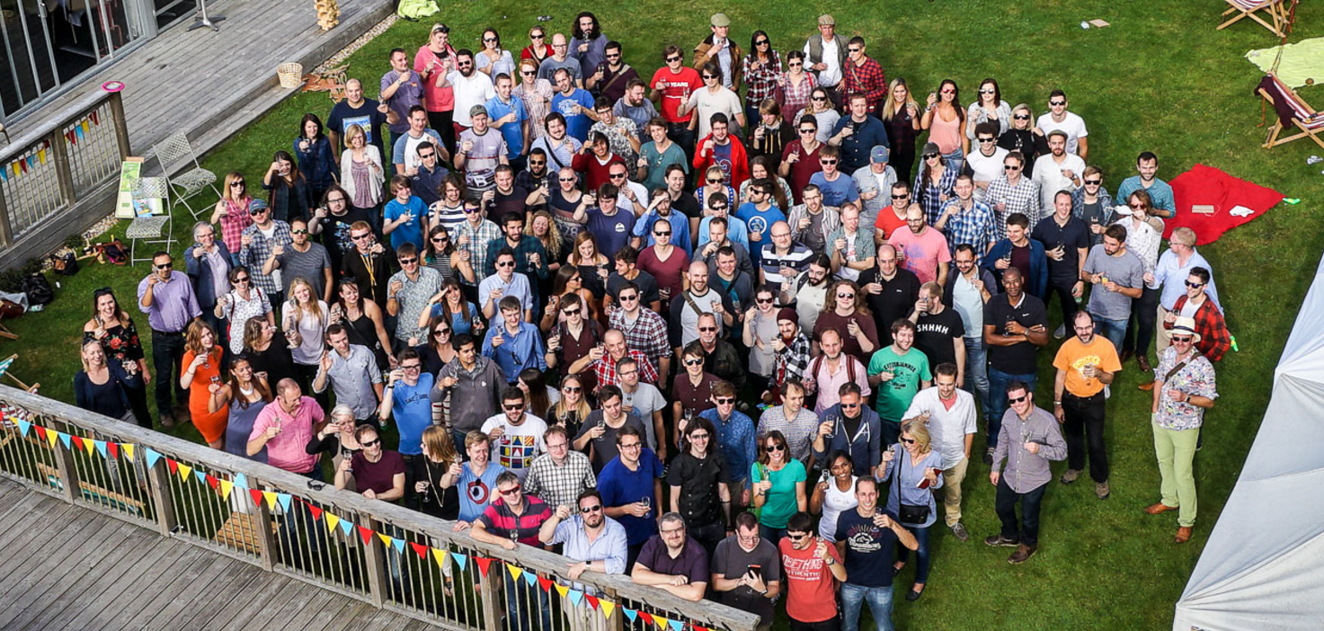
https://puppet.com/resources/white-paper/2016-state-of-devops-report
Notes:
2016 State of DevOps Report (cont.)
Employees in high-performing teams were 2.2 times more likely to recommend their organization as a great place to work.
Taking a lean approach to product development (for example, splitting work into small batches and implementing customer feedback) predicts higher IT performance and less deployment pain.
5th annual report
4,600 technical professionals
High IT Performers = deploy on demand, < 1 hr lead time, < 1 hr MTTR, < 15% change failure rate
lead time - how long does it take to go from code commit to code successfully running in production

Slide 35
DevOps
Practices

Slide 36
DevOps Practices
Automated Provisioning, Infrastructure as Code
Small frequent changes
Version Control
Continuous Integration (including automated testing)
Continuous Delivery / Release Management
Measuring metrics
Feature flags (develop on trunk), Canary Releases, Dark Launches
https://dzone.com/articles/devops-devops-principles
https://www.youtube.com/watch?v=LdOe18KhtT4
Notes:
DevOps = DevOps Principles + DevOps Practices - DZone DevOps
https://www.youtube.com/watch?v=LdOe18KhtT4 10+ deploys a day at Etsy – Velocity 2009

Slide 37
DevOps Measurements
Deployment frequency
Lead time for changes
Change failure rate
Mean time to recover (MTTR)
https://puppet.com/resources/white-paper/2016-state-of-devops-report
Notes:
Deployment frequency For the primary application or service you work on, how often does your organization deploy code?
Lead time for changes For the primary application or service you work on, what is your lead time for changes (i.e., how long does it take to go from code commit to code successfully running in production)?
Mean time to recover (MTTR) For the primary application or service you work on, how long does it generally take to restore service when a service incident occurs (e.g., unplanned outage, service impairment)?
Change failure rate For the primary application or service you work on, what percentage of the changes either result in degraded service or subsequently require remediation (e.g., lead to service impairment, service outage, require a hotfix, rollback, fix forward, patch)?

Slide 38
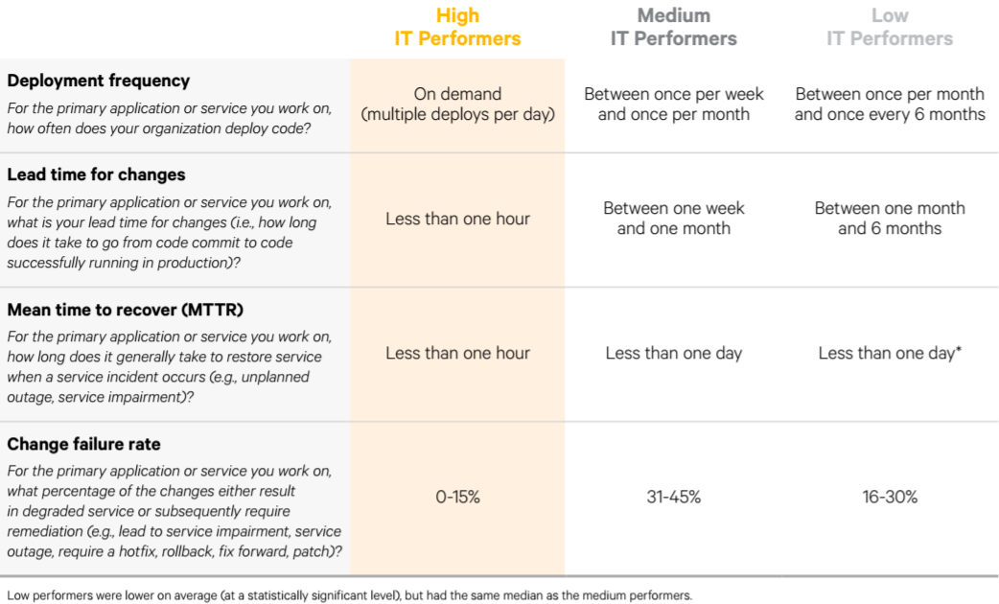
https://puppet.com/resources/white-paper/2016-state-of-devops-report

Slide 39
DevOps and Agile
Agile needs automation to really boost velocity
The gap between “potentially releasable” and “actually released” can be vast
Product Owner and stakeholder feedback is great but real customer feedback is the true test of value delivered
Application architecture matters
Small batch size is really important for fast feedback cycles and reducing release risk
Agile teams need DevOps practices, and DevOps needs Agile’s teaming model and connection to business value to drive better results
https://blog.scrum.org/devops-taught-agile-vice-versa

Slide 40
Anti-patterns
Management just saying we’re doing DevOps
Just changing job titles to DevOps
Just merging dev and ops teams or creating a separate DevOps team
Committing is done
My responsibility ends here
Devs blaming Ops; Ops blaming Devs
Ops not involved early
DevOps means Developers Managing Production
It’s not just automation or a tool (or set of tools)
https://theagileadmin.com/what-is-devops
https://dzone.com/articles/devops-anti-patterns-warning
https://blog.devopsguys.com/2013/02/20/twelve-devops-anti-patterns

Slide 41


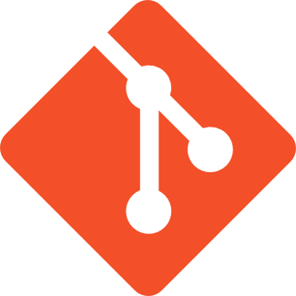

Delivery Pipeline
Development
Create table Orders
( OrderID int
, OrderDate datetime
, salesrep int
, customerid int
, status tnyint
)
Create procedure GetOrders
@o datetime
As
Begin
Select *
from orders
Where orderdate > @o
Dev
using System;
using System.Collections.Generic;
using System.Text;
using eBay.Service.Core.Sdk;
using eBay.Service.Core.Soap;
namespace Trading_Samples
{
class Program
{
static void Main(string[] args)
{
MakeGetOrders();
Console.ReadLine();
Notes:
Application code usually goes to a VCS

Slide 42

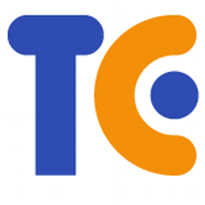
Delivery Pipeline
Development
Continuous Integration
Create table Orders
( OrderID int
, OrderDate datetime
, salesrep int
, customerid int
, status tnyint
)
Create procedure GetOrders
@o datetime
As
Begin
Select *
from orders
Where orderdate > @o
Dev
using System;
using System.Collections.Generic;
using System.Text;
using eBay.Service.Core.Sdk;
using eBay.Service.Core.Soap;
namespace Trading_Samples
{
class Program
{
static void Main(string[] args)
{
MakeGetOrders();
Console.ReadLine();
Build
Test
Commit
Publish
Notes:
Here the application usually kicks off a CI process

Slide 43

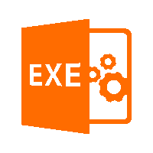
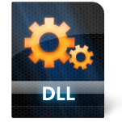
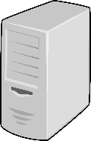

Delivery Pipeline
Development
Continuous Integration
Testing
Create table Orders
( OrderID int
, OrderDate datetime
, salesrep int
, customerid int
, status tnyint
)
Alter table Orders
Add status tinyint;
Create procedure GetOrders
…..
Create procedure GetOrders
@o datetime
As
Begin
Select *
from orders
Where orderdate > @o
Dev
QA
using System;
using System.Collections.Generic;
using System.Text;
using eBay.Service.Core.Sdk;
using eBay.Service.Core.Soap;
namespace Trading_Samples
{
class Program
{
static void Main(string[] args)
{
MakeGetOrders();
Console.ReadLine();
Build
Test
Commit
Publish
Notes:
Here the application usually kicks off a CI process

Slide 44
Delivery Pipeline
Development
Continuous Integration
Testing
Production
Create table Orders
( OrderID int
, OrderDate datetime
, salesrep int
, customerid int
, status tnyint
)
Alter table Orders
Add status tinyint;
Create procedure GetOrders
…..
Alter table Orders
Add status tinyint;
Create procedure GetOrders
…..
Create procedure GetOrders
@o datetime
As
Begin
Select *
from orders
Where orderdate > @o
Dev
QA
Prod
using System;
using System.Collections.Generic;
using System.Text;
using eBay.Service.Core.Sdk;
using eBay.Service.Core.Soap;
namespace Trading_Samples
{
class Program
{
static void Main(string[] args)
{
MakeGetOrders();
Console.ReadLine();
Build
Test
Commit
Publish
Notes:
Here the application usually kicks off a CI process

Slide 45
Delivery Pipeline
Development
Create table Orders
( OrderID int
, OrderDate datetime
, salesrep int
, customerid int
, status tnyint
)
Create procedure GetOrders
@o datetime
As
Begin
Select *
from orders
Where orderdate > @o
Dev
using System;
using System.Collections.Generic;
using System.Text;
using eBay.Service.Core.Sdk;
using eBay.Service.Core.Soap;
namespace Trading_Samples
{
class Program
{
static void Main(string[] args)
{
MakeGetOrders();
Console.ReadLine();
Notes:
Here the application usually kicks off a CI process

Slide 46
Delivery Pipeline
Development
Create table Orders
( OrderID int
, OrderDate datetime
, salesrep int
, customerid int
, status tnyint
)
Create procedure GetOrders
@o datetime
As
Begin
Select *
from orders
Where orderdate > @o
Dev
using System;
using System.Collections.Generic;
using System.Text;
using eBay.Service.Core.Sdk;
using eBay.Service.Core.Soap;
namespace Trading_Samples
{
class Program
{
static void Main(string[] args)
{
MakeGetOrders();
Console.ReadLine();
Notes:
Here the application usually kicks off a CI process

Slide 47
Delivery Pipeline
Development
Continuous Integration
Create table Orders
( OrderID int
, OrderDate datetime
, salesrep int
, customerid int
, status tnyint
)
Create procedure GetOrders
@o datetime
As
Begin
Select *
from orders
Where orderdate > @o
Dev
Build
Test
using System;
using System.Collections.Generic;
using System.Text;
using eBay.Service.Core.Sdk;
using eBay.Service.Core.Soap;
namespace Trading_Samples
{
class Program
{
static void Main(string[] args)
{
MakeGetOrders();
Console.ReadLine();
Commit
Publish
Notes:
Here the application usually kicks off a CI process

Slide 48
Delivery Pipeline
Development
Continuous Integration
Testing
Create table Orders
( OrderID int
, OrderDate datetime
, salesrep int
, customerid int
, status tnyint
)
Create procedure GetOrders
@o datetime
As
Begin
Select *
from orders
Where orderdate > @o
Dev
Alter table Orders
Add status tinyint;
Create procedure GetOrders
…..
QA
Build
Test
using System;
using System.Collections.Generic;
using System.Text;
using eBay.Service.Core.Sdk;
using eBay.Service.Core.Soap;
namespace Trading_Samples
{
class Program
{
static void Main(string[] args)
{
MakeGetOrders();
Console.ReadLine();
Commit
Publish
Notes:
Here the application usually kicks off a CI process

Slide 49

Delivery Pipeline
Development
Continuous Integration
Testing
Production
Create table Orders
( OrderID int
, OrderDate datetime
, salesrep int
, customerid int
, status tnyint
)
Dev
Alter table Orders
Add status tinyint;
Create procedure GetOrders
…..
Alter table Orders
Add status tinyint;
Create procedure GetOrders
…..
Create procedure GetOrders
@o datetime
As
Begin
Select *
from orders
Where orderdate > @o
QA
Prod
Build
Test
using System;
using System.Collections.Generic;
using System.Text;
using eBay.Service.Core.Sdk;
using eBay.Service.Core.Soap;
namespace Trading_Samples
{
class Program
{
static void Main(string[] args)
{
MakeGetOrders();
Console.ReadLine();
Commit
Publish
Notes:
Here the application usually kicks off a CI process

Slide 50
It won’t happen overnight
Changing your culture is hard
Five things your operations team doesn’t tell you about DevOps
- https://dzone.com/articles/five-things-your-operations-team-doesnt-tell-you-a
GOTO 2016: DevOps - The Good, The Bad, The Ugly - Jeff Smith
- https://www.youtube.com/watch?v=qLUt6bwNnks
Why DevOps is burning out Developers
- http://www.infoworld.com/article/3009004/devops/why-devops-is-burning-out-developers.html
Notes:
1. DevOps Is More for Dev Than for Ops
2. Ops Can Be More Agile Without Starting From Scratch
3. DevOps Isn’t Well Suited to Complex Production Environments
4. Implementing DevOps Can Make Things Worse Before Making Them Better
5. Open Source Isn’t Always as Important as Battle-tested
Containers
https://ondigitalmarketing.com/learn/odm/foundations/5-customer-segments-technology-adoption
Innovators (2.5%) – Innovators are the first individuals to adopt an innovation. Innovators are willing to take risks, youngest in age, have the highest social class, have great financial lucidity, very social and have closest contact to scientific sources and interaction with other innovators. Risk tolerance has them adopting technologies which may ultimately fail. Financial resources help absorb these failures. (Rogers 1962 5th ed, p. 282)
Early Adopters (13.5%) – This is the second fastest category of individuals who adopt an innovation. These individuals have the highest degree of opinion leadership among the other adopter categories. Early adopters are typically younger in age, have a higher social status, have more financial lucidity, advanced education, and are more socially forward than late adopters. More discrete in adoption choices than innovators. Realize judicious choice of adoption will help them maintain central communication position (Rogers 1962 5th ed, p. 283).
Early Majority (34%) – Individuals in this category adopt an innovation after a varying degree of time. This time of adoption is significantly longer than the innovators and early adopters. Early Majority tend to be slower in the adoption process, have above average social status, contact with early adopters, and seldom hold positions of opinion leadership in a system (Rogers 1962 5th ed, p. 283)
Late Majority (34%) – Individuals in this category will adopt an innovation after the average member of the society. These individuals approach an innovation with a high degree of skepticism and after the majority of society has adopted the innovation. Late Majority are typically skeptical about an innovation, have below average social status, very little financial lucidity, in contact with others in late majority and early majority, very little opinion leadership.
Laggards (16%) – Individuals in this category are the last to adopt an innovation. Unlike some of the previous categories, individuals in this category show little to no opinion leadership. These individuals typically have an aversion to change-agents and tend to be advanced in age. Laggards typically tend to be focused on “traditions”, likely to have lowest social status, lowest financial fluidity, be oldest of all other adopters, in contact with only family and close friends, very little to no opinion leadership.

Slide 51
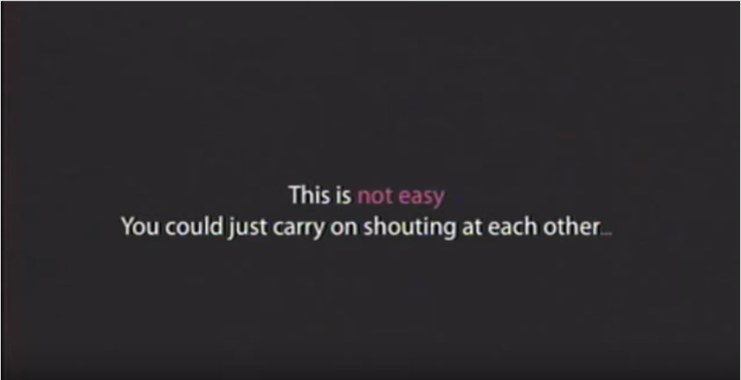
Velocity 2009 - John Allspaw and Paul Hammond, "10+ Deploys Per Day: Dev and Ops Coordination”
Notes:
Velocity 09: John Allspaw and Paul Hammond, "10+ Deploys Per Day at Flickr”

Slide 52
Conclusion

Slide 53
What about Security?

Slide 54
It is no good if it is not Secure

Slide 55



Three Pillars of DevOpsSec
Shift Left
Automate Everything
Dashboard Everything

Slide 56


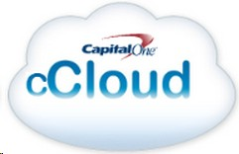

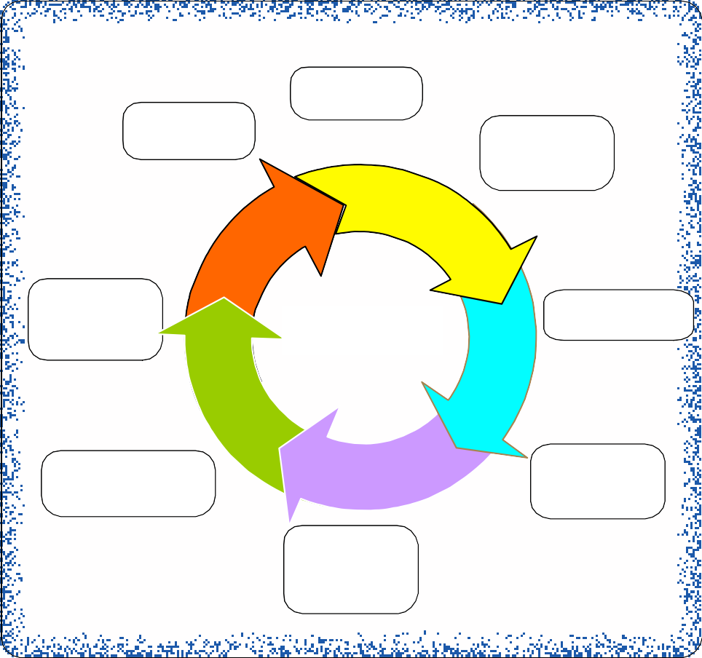

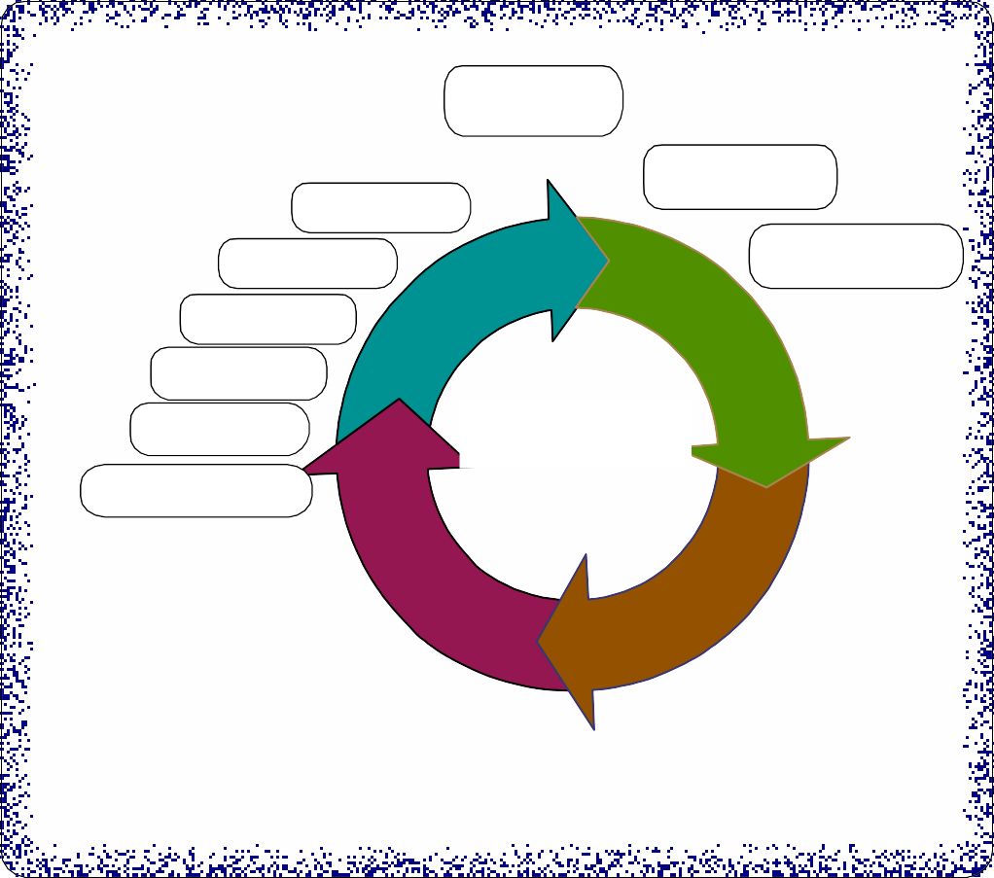





Infrastructure and Environment
IDE
Service Virtualization
Source Control
Defect Management
Test Mgmt
Service Test
Test Data Mgmt
Develop, Unit Test
Plan
UI Test
Develop
Request, Plan
Deploy
Device Test
Perf Test
Execute
Agile PM Tools
Continuous Integration
CI Tool
Continuous Deployment
Security Test
Continuous Testing
Build
Automated
Acceptance Test
Report Results
Monitor
Verify
Promote
Verify
Code Quality Check
Automated Tests
Binary Repository
Code Analysis
Unit/ Integration Test
Automated/Continuous Deployment
Dashboard/Feedback
End to End Traceability, Real time status of Code, Build, Deploy, Test, Application and Environment Health

Slide 57

Infrastructure and Environment
IDE
Service Virtualization
Source Control
Defect Management
Test Mgmt
Service Test
Test Data Mgmt
Develop, Unit Test
Plan
UI Test
Develop
Request, Plan
Deploy
Device Test
Perf Test
Execute
Agile PM Tools
Continuous Integration
CI Tool
Continuous Deployment
Security Test
Continuous Testing
Build
Automated
Acceptance Test
Report Results
Monitor
Verify
Promote
Verify
Code Quality Check
Automated Tests
Binary Repository
Code Analysis
Unit/ Integration Test
Automated/Continuous Deployment
Dashboard/Feedback
End to End Traceability, Real time status of Code, Build, Deploy, Test, Application and Environment Health

Slide 58









































Feedback
Delivery Pipeline: Automated, Continuous, Compliant
Flow
Code
Build
Deploy + Test Execution
Release Monitor
Infra
DEV
INT
QA
SEC
PERF
PROD
Infra
App
DEV
INT
QA
SEC
PERF
PROD
App
Test
DEV
INT
QA
SEC
PERF
PROD
Automated Audit and Security Controls at every step

Slide 59





Security during Coding
Code
IDE Security Plugins
Secure Coding Practices
Security BDD
Open Source Bill of Material
Infrastructure Code
Application Code
Test Code

Slide 60


Security during Building
Bill of Materials
Static Code Analysis
Static Security Analysis
Security BDD
Build

Slide 61

Security Testing
Application Security Testing
Penetration Testing
Data Security Testing
Configuration Security Testing
Deploy + Test Execution

Slide 62

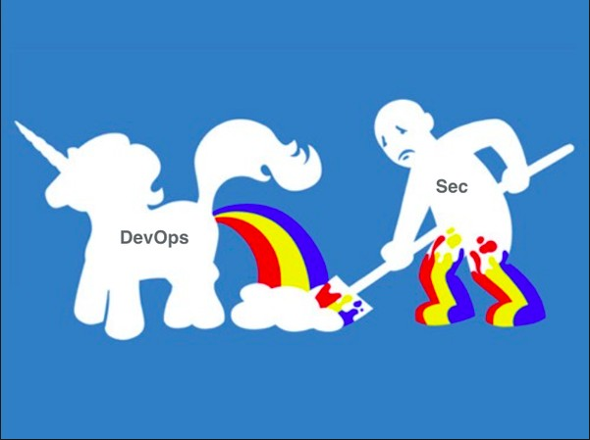


Security Shift-Left

