Slide 1
Blockchain
Composition of a Web 3.0 DApp
SHeeney

Slide 2
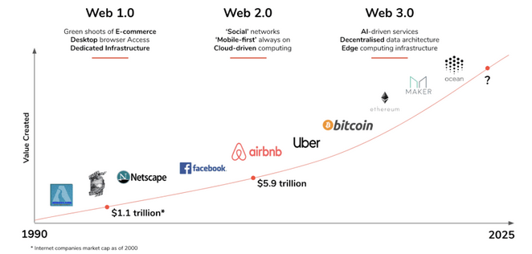
Evolution

Slide 3
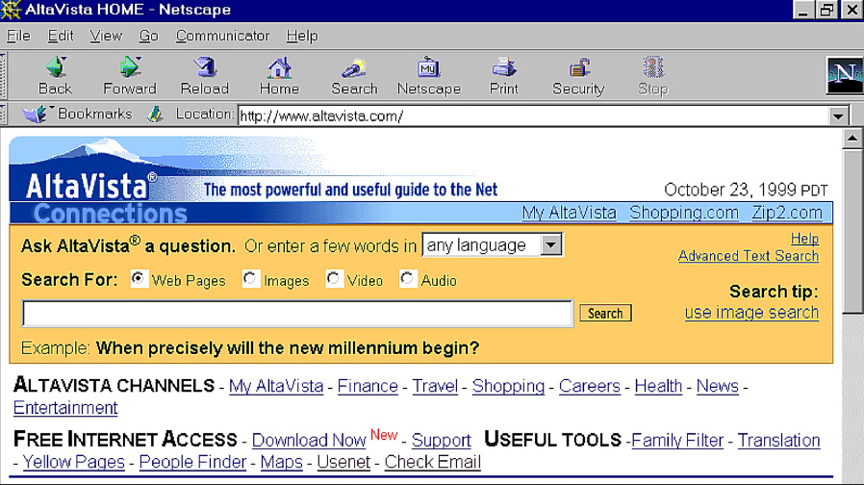

Slide 4
In the Beginning – And It was good
Web 1.0
Documents connected over a network connected with hyper-links
Web1 (1980s - early 2000’s) The first phase of the Internet, Web1, was mainly about providing the everyday consumer with online content and information.
As consumers could only read information or content online, and not yet interact with it, Web1 was incredibly static.
When you think about Web1, think Internet Explorer, Yahoo, or Netscape. While web1 was read-only, the companies we associate with web1 were built on open protocols (meaning pretty much any person or organization could build on the internet and know they were subject to the same rules as the next person or organization).

Slide 5
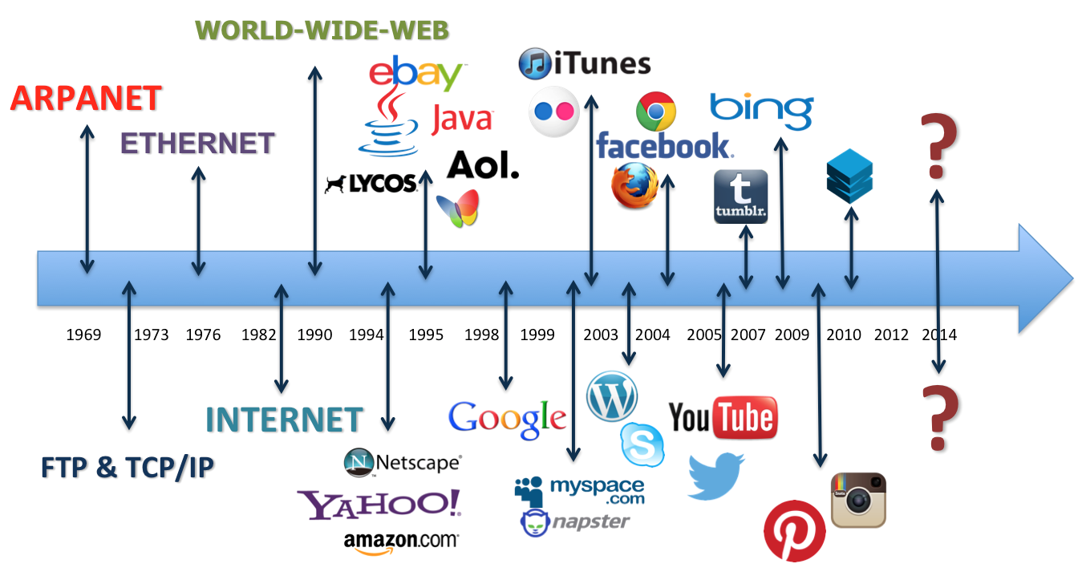

Slide 6
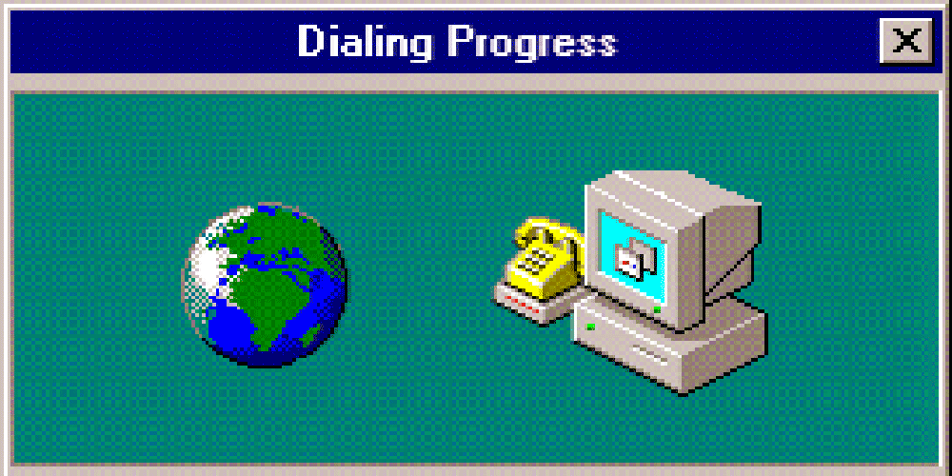

What is Web3
Web 1.0
Web 1.0 provided a static experience for users without the ability to create the content-rich sites we have today

Slide 7
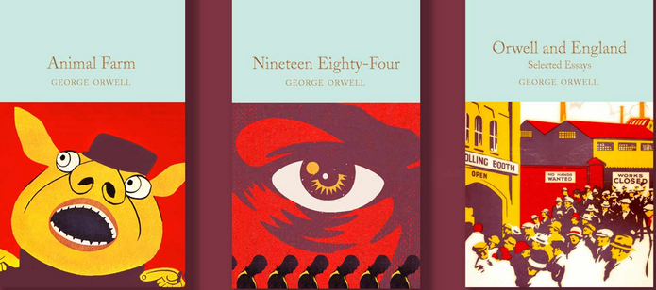
Web 2.0 – Current Era - Centralization
Web2 is the version of the internet most of us know and use today. Where Web1 was static and “read-only,” Web2 was “read-write,” and interactive. Under Web2, the internet became more usable: web2 was dynamic and users could consume, interact with, and create content on the internet themselves.
Along the way, the internet became largely dominated by the four behemoths we know today as Apple, Amazon, Facebook, and Google. Web2 also saw an explosion in the use of smartphones, and most of internet use was through mobile apps and hardware built by these companies. While this meant more people could participate in the internet, it also meant the internet was becoming increasingly controlled by the leading digital platforms.
Why is this a problem? In the centralized internet we know today, Apple can take a 30% cut on all paid-app downloads and in-app purchases, Twitter and Facebook can de-platform the POTUS, and the everyday consumer has less privacy, security, and control over their online information than ever before.

Slide 8
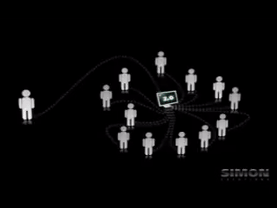
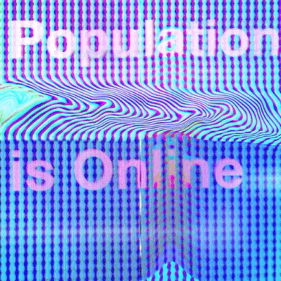
What is Web
Web 2.0
First came to fruition in 2004
More participation in the web through social media platforms
We are currently living in the era of web 2.0
Web 2.0 brought us together with social media and dynamic websites, but at the cost of centralization.

Slide 9
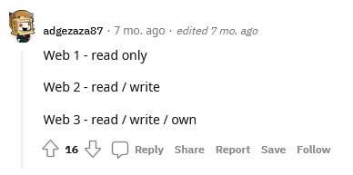
Web3
Web 3.0
Web3, the future internet we’re moving towards, is a decentralized internet. Under Web3, the internet is shared online and governed by the collective “we,” rather than owned by centralized entities.
The Web3 world is one that has open-source protocols at its foundation. Web3 is about rearchitecting internet services and products so that they benefit people rather than entities.
Web 3.0 looks to give us control of our online information and also create a semantic web. This means that machines will easily read and process user-generated content. Blockchain will provide the power for decentralization, free digital identities with crypto wallets, and open digital economies.

Slide 10
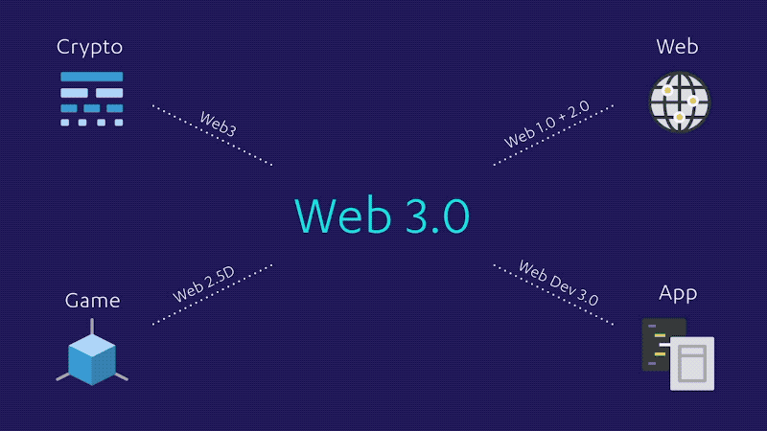

Slide 11
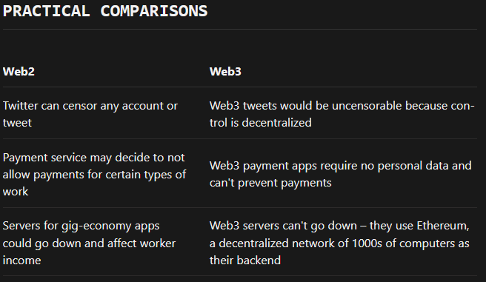
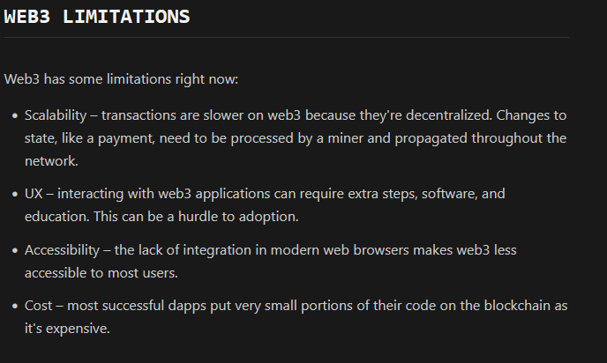
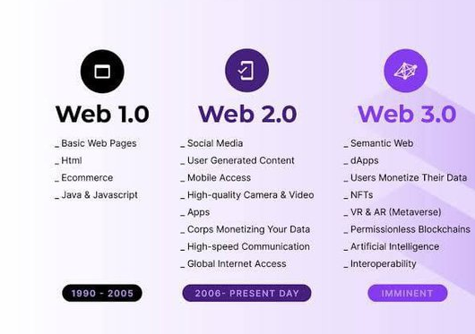
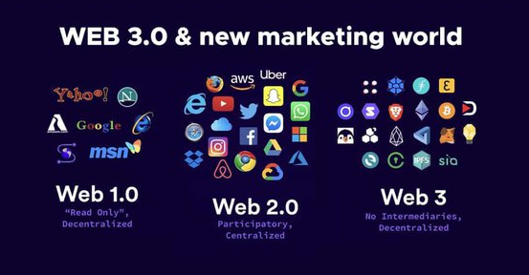
Versus
Notes:
https://ethereum.org/en/developers/docs/web2-vs-web3

Slide 12
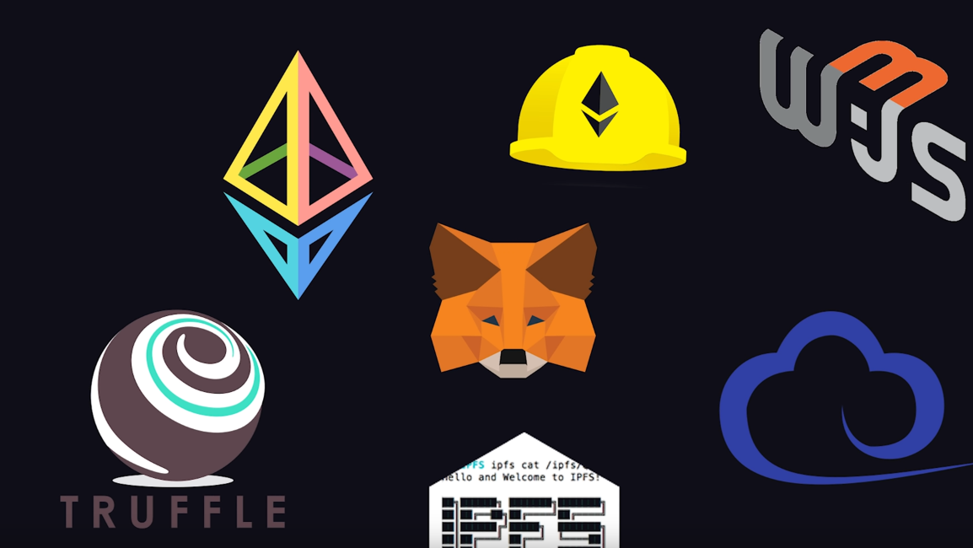

Slide 13
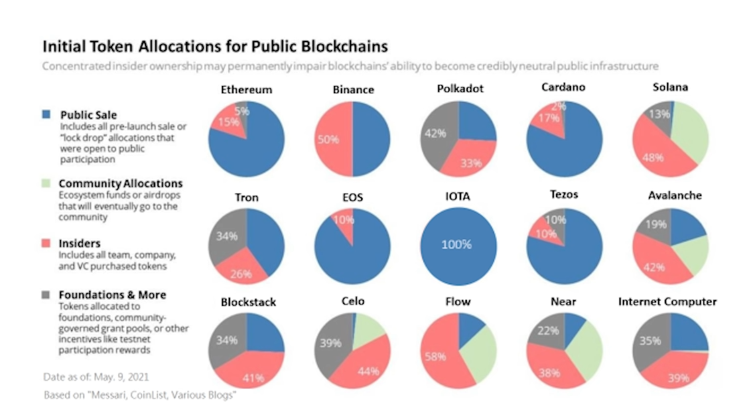

Slide 14
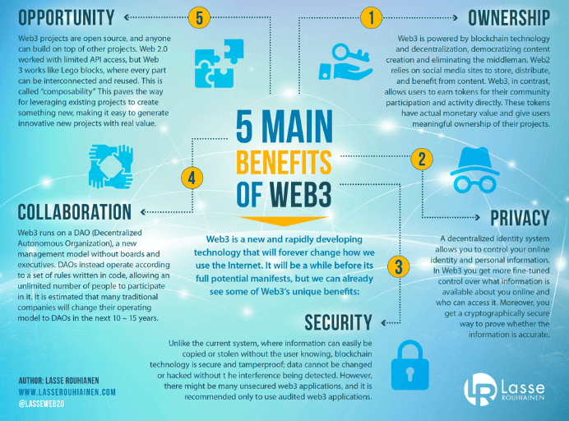
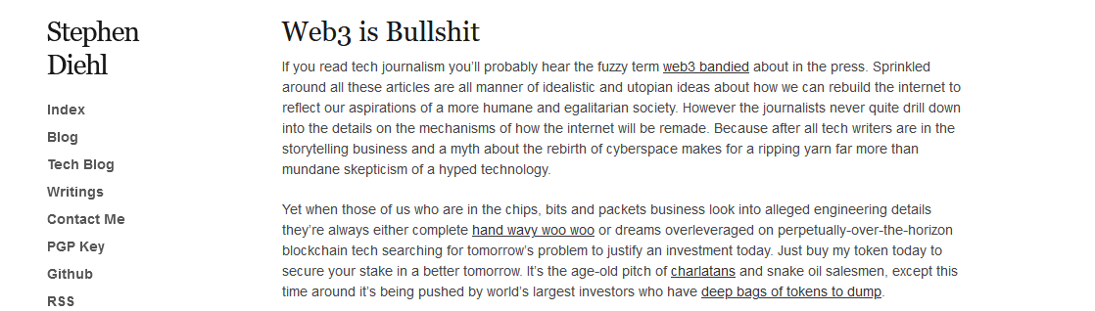
Critical Opinion – Both Side - Infancy
https://www.stephendiehl.com/blog/web3-bullshit.html
https://lasserouhiainen.com/5-main-benefits-of-web3-infographic/

Slide 15
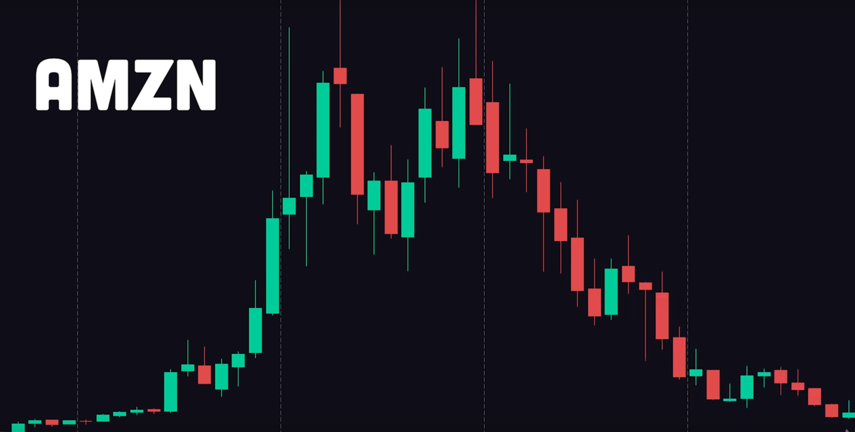
Dot Com Bubble

Slide 16
Web3
Web 3.0 (also known as Web3) is the next generation of Internet technology that heavily relies on machine learning, artificial intelligence (AI), and blockchain technology. The term was created by Gavin Wood, Polkadot's founder and the co-founder of Ethereum. While Web 2.0 focuses on user-created content hosted on centralized websites, Web 3.0 will give users more control of their online data.
The movement aims to create open, connected, intelligent websites and web apps with an improved machine-based understanding of data. Decentralization and digital economies also play an important role in Web 3.0, as they allow us to place value on the content created on the net. It's also important to understand that Web 3.0 is a changing concept. There is no single definition, and its exact meaning can differ from person to person.

Slide 17
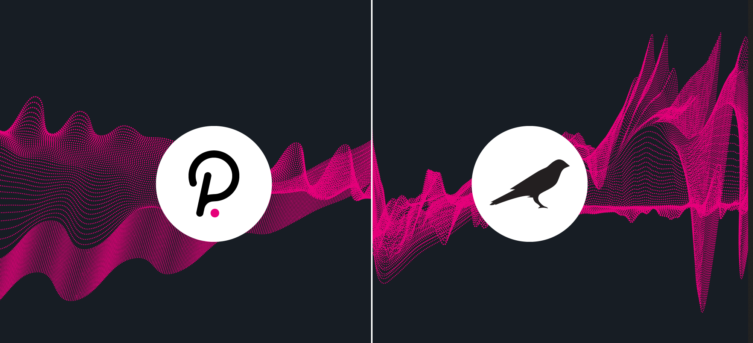
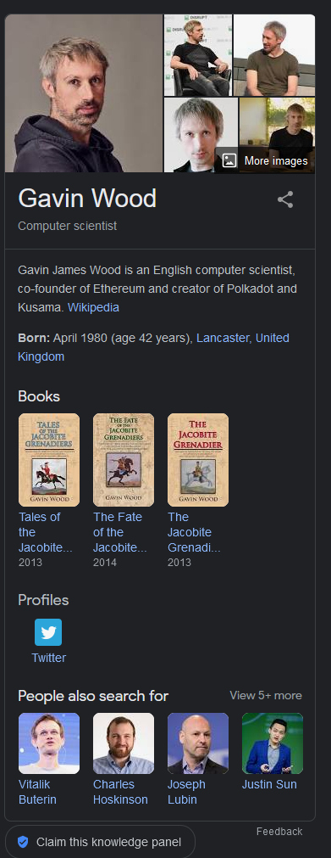
https://mobile.twitter.com/gavofyork
https://wiki.polkadot.network/docs/learn-kusama-vs-polkadot
https://parachains.info/
https://cointelegraph.com/blockchain-for-beginners/what-are-parachains-a-guide-to-polkadot-and-kusama-parachains

Slide 18
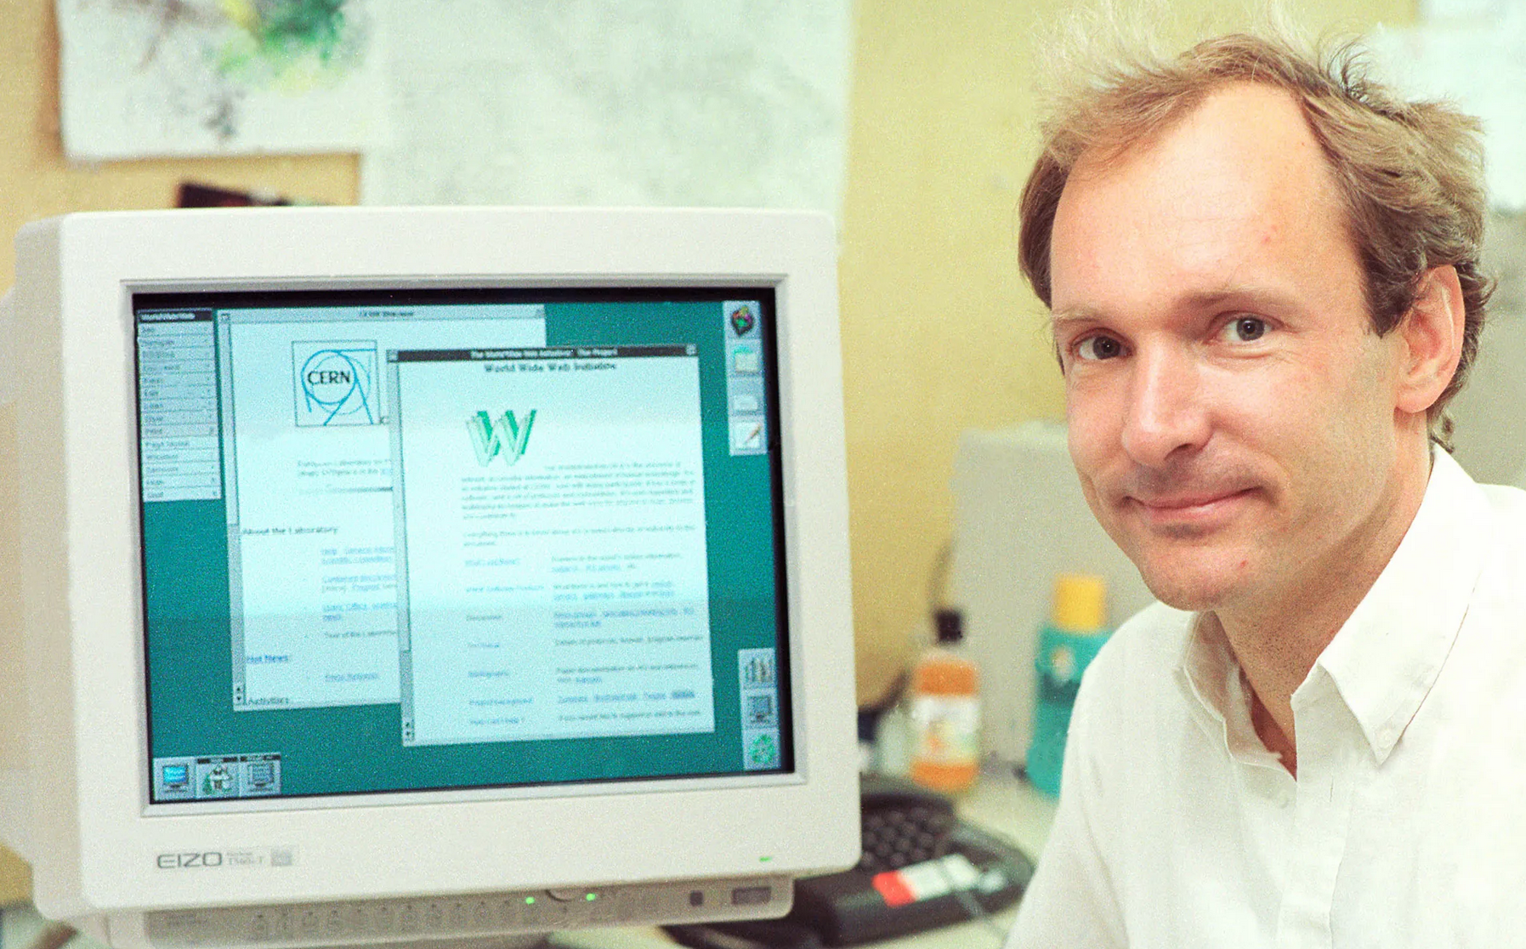
A Vision for the Future
“I have a dream for the Web [in which computers] become capable of analyzing all the data on the Web – the content, links, and transactions between people and computers. A "Semantic Web," which makes this possible, has yet to emerge, but when it does, the day-to-day mechanisms of trade, bureaucracy, and our daily lives will be handled by machines talking to machines.” - TBL

Slide 19

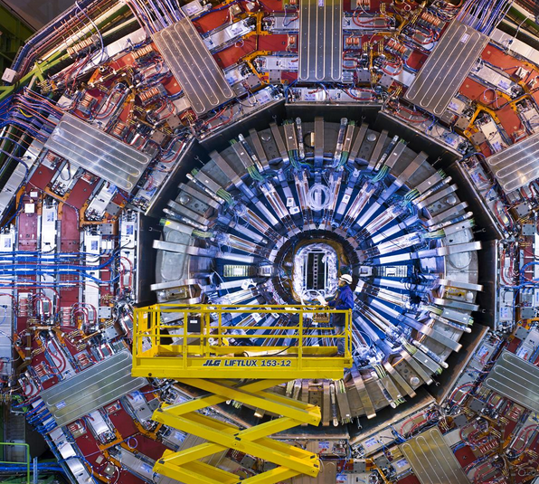
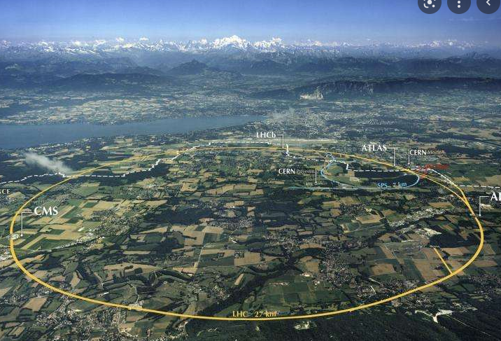
Cern
https://www.home.cern/

Slide 20
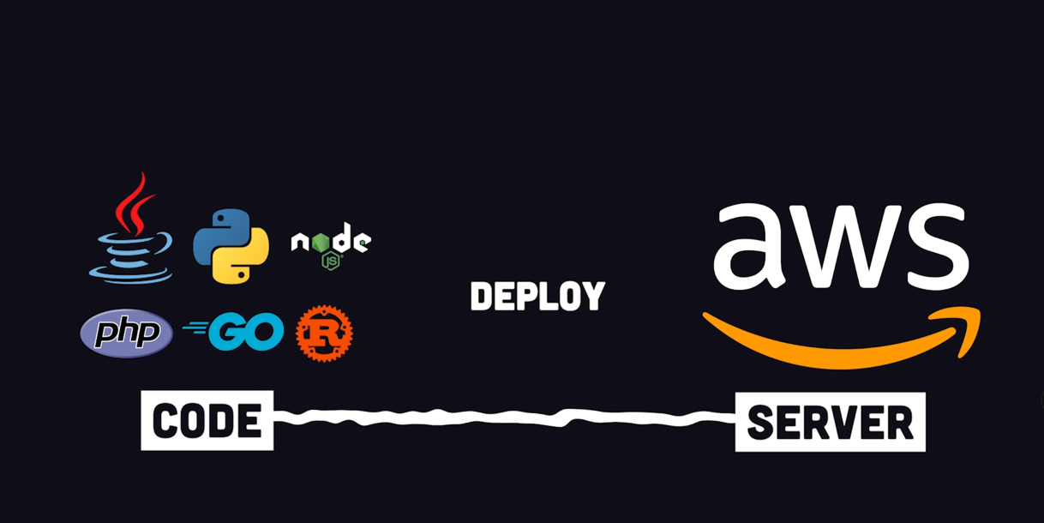
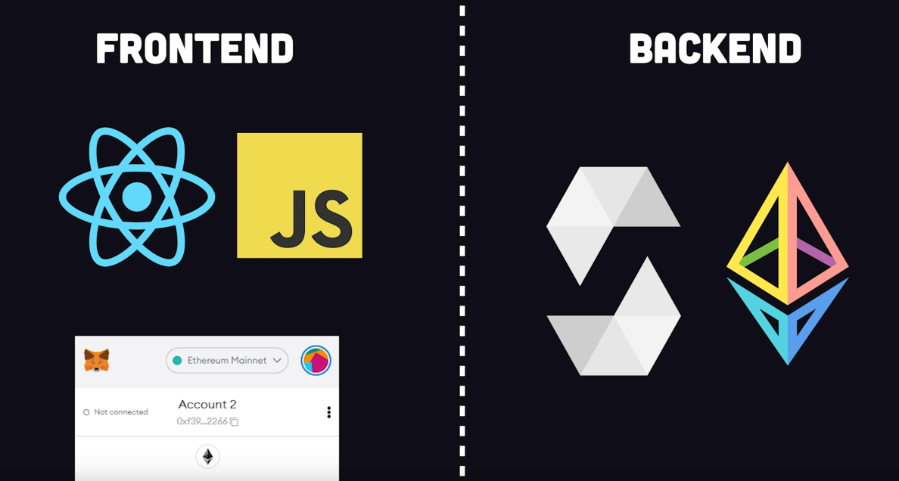
Old and New

Slide 21
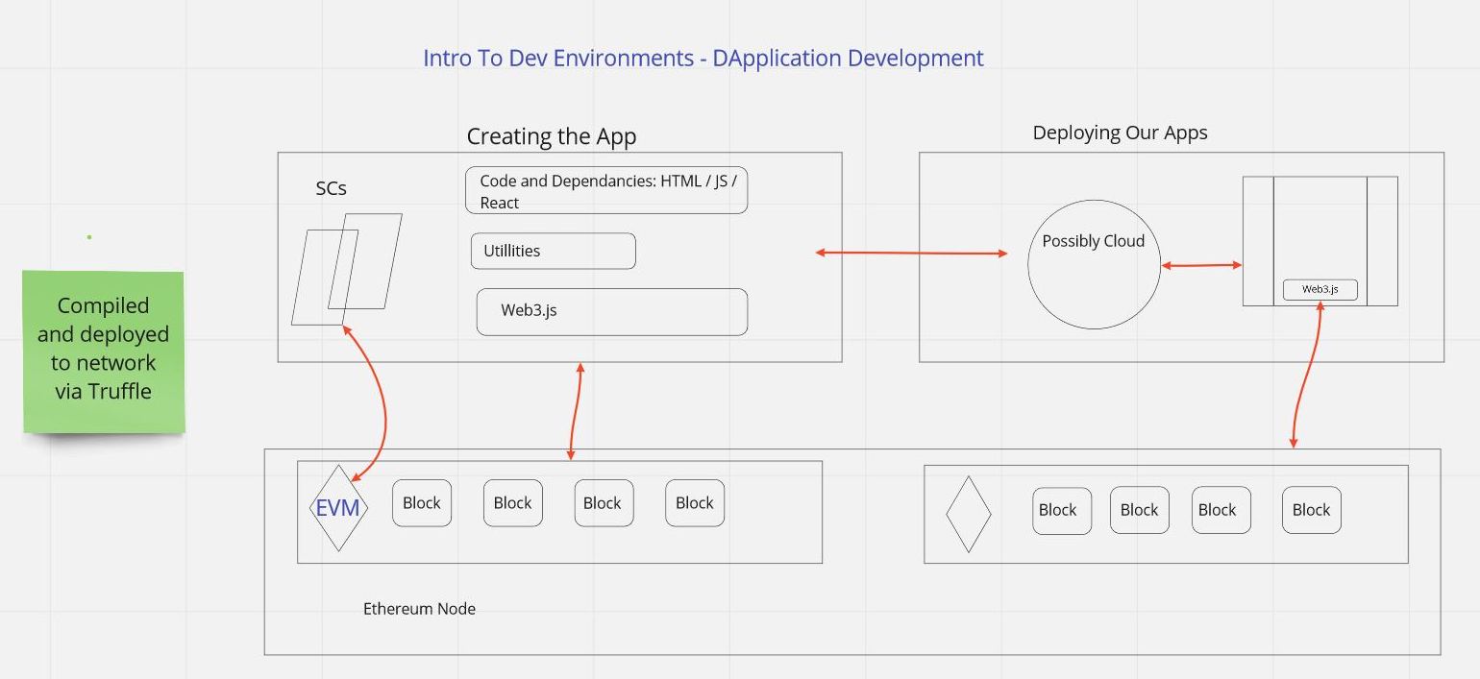
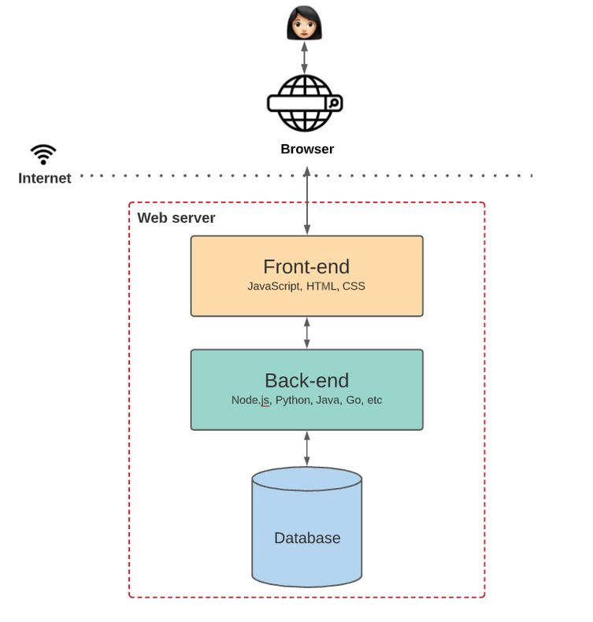
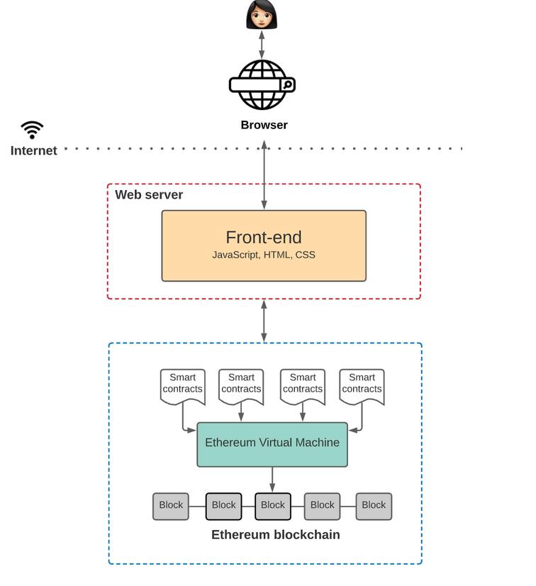
Architecture
https://www.preethikasireddy.com/post/the-architecture-of-a-web-3-0-application

Slide 22
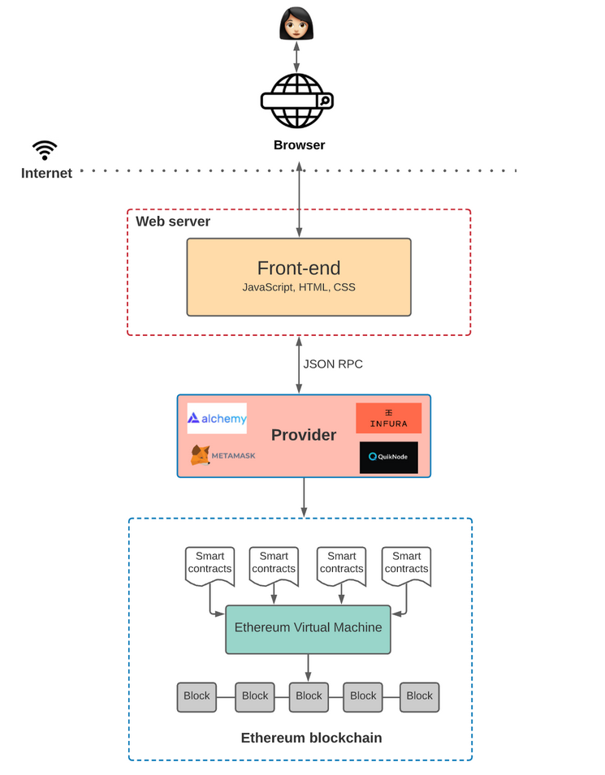
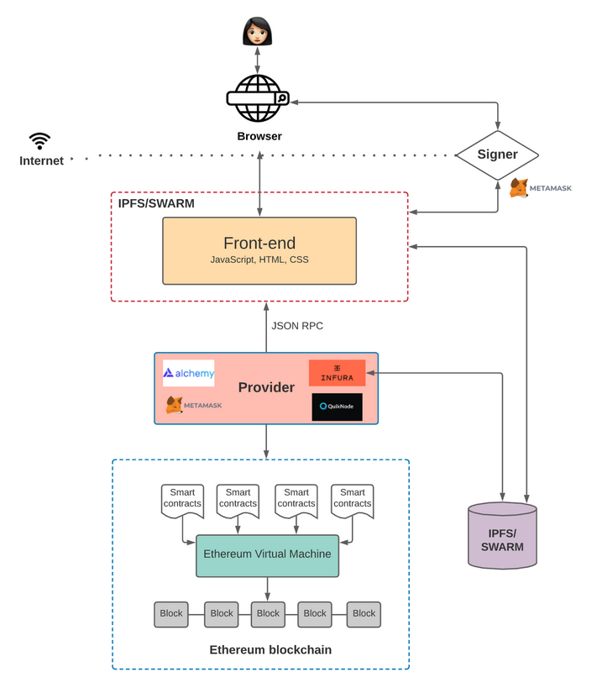
More Depth
https://www.preethikasireddy.com/post/the-architecture-of-a-web-3-0-application

Slide 23
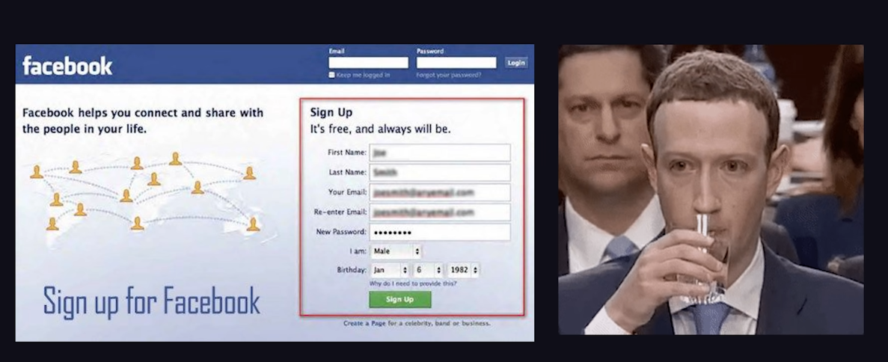
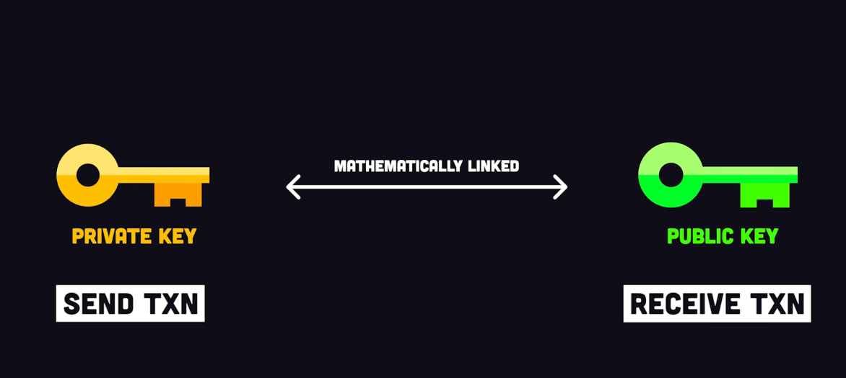
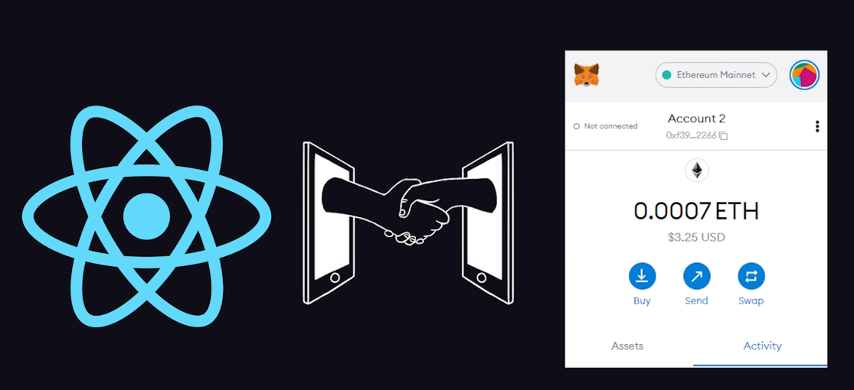
Own it

Slide 24
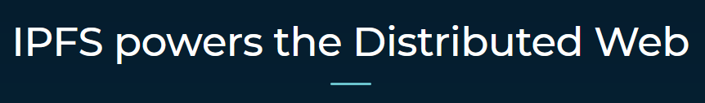
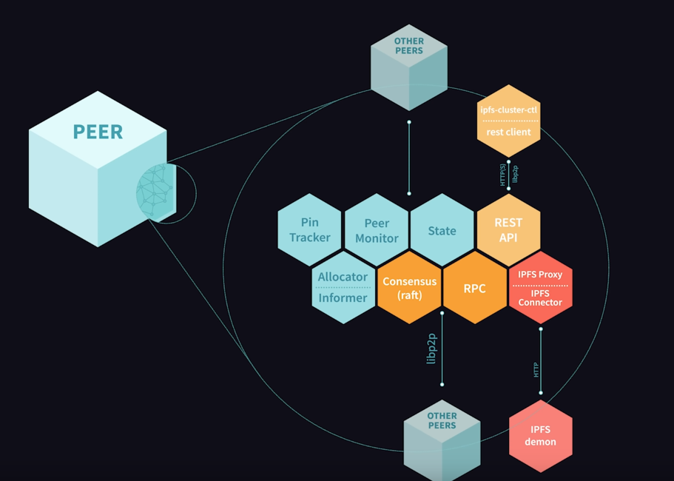


Backend & Storage
Truffle & Hardhat
Testing Networks
Accounts / Credits / Gas
Development Frameworks
https://hardhat.org/
https://trufflesuite.com/
IPFS https://ipfs.io/
The Peer of Peers
Think Torrent and Napster

Slide 25

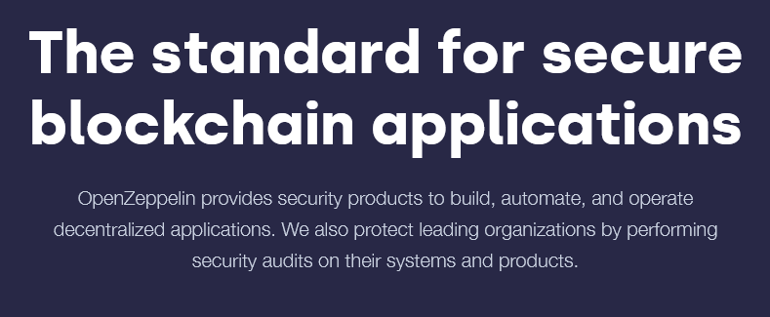
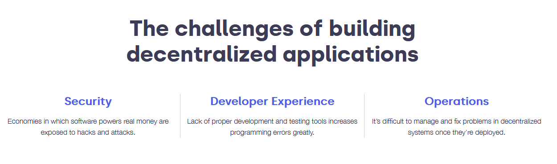
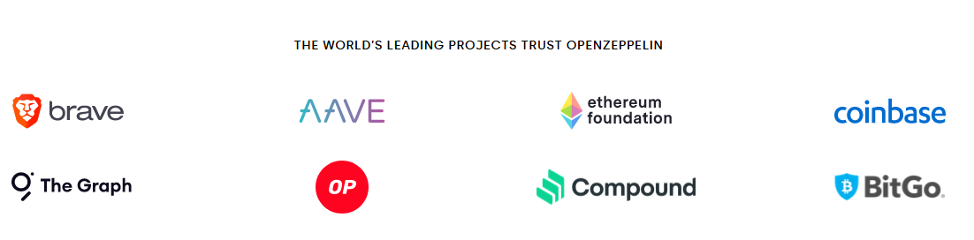
Open Zeppelin
Git Hub Repo :
https://github.com/OpenZeppelin/openzeppelin-contracts
Documentation:
https://docs.openzeppelin.com/
Site:
https://www.openzeppelin.com/

Slide 26
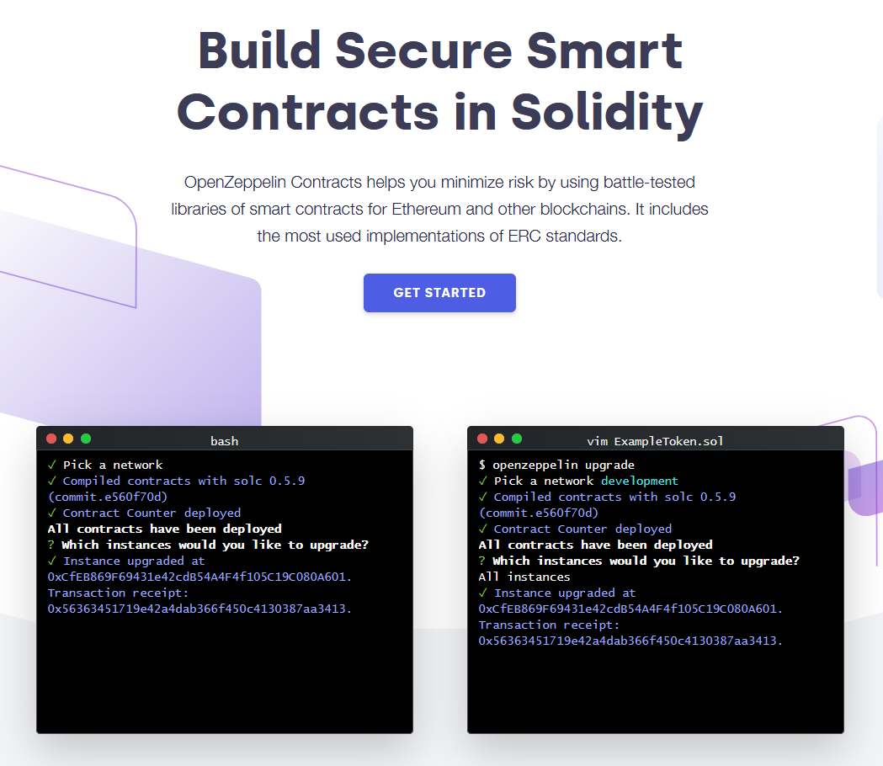
Open Zeppelin
Get Started:
https://docs.openzeppelin.com/contracts/4.x/
Try This :
https://docs.openzeppelin.com/learn/developing-smart-contracts

Slide 27

Investigation
https://www.youtube.com/c/HashLipsNFT - HashLips NFT
https://www.youtube.com/c/naderdabit - Nader Dabit

Slide 28
Further
https://www.channelnonfiction.com/web-3-0-semantic-technologies/
Web 3.0: Semantic Technologies
https://www.psl.com/feed-posts/web3-engineer-take
An Engineer's Hype-Free Observations on Web3 (and its Possibilities)
Sir Tim Berners-Lee, inventor of the World Wide Web, discusses the web’s future, which involves semantic searches more focused on links between things or allowing a way for machines to create more consequential meaning from all the words, phrases and images available online today. Google recently updated its search engine, project “Hummingbird,” to function more semantically. Google’s search today is more about things and less about strings (of words).

Slide 29
Sources
https://www.youtube.com/watch?v=wHTcrmhskto
https://www.stephendiehl.com/blog/web3-bullshit.html
https://lasserouhiainen.com/5-main-benefits-of-web3-infographic/
https://www.martechalliance.com/stories/whats-the-difference-between-web-1.0-web-2.0-and-web-3.0
https://dev.to/pragativerma18/evolution-of-web-42eh
https://academy.binance.com/en/articles/the-evolution-of-the-internet-web-3-0-explained
https://web3js.readthedocs.io/en/v1.2.9/getting-started.html
https://trufflesuite.com/tutorial/
https://www.youtube.com/watch?v=bIbmLgmEvM0
https://docs.google.com/document/d/1SWJw_NTyUvgdB_asRzsnVyKjciW8dZbeqQeUeWsEiQc/edit#

Slide 30
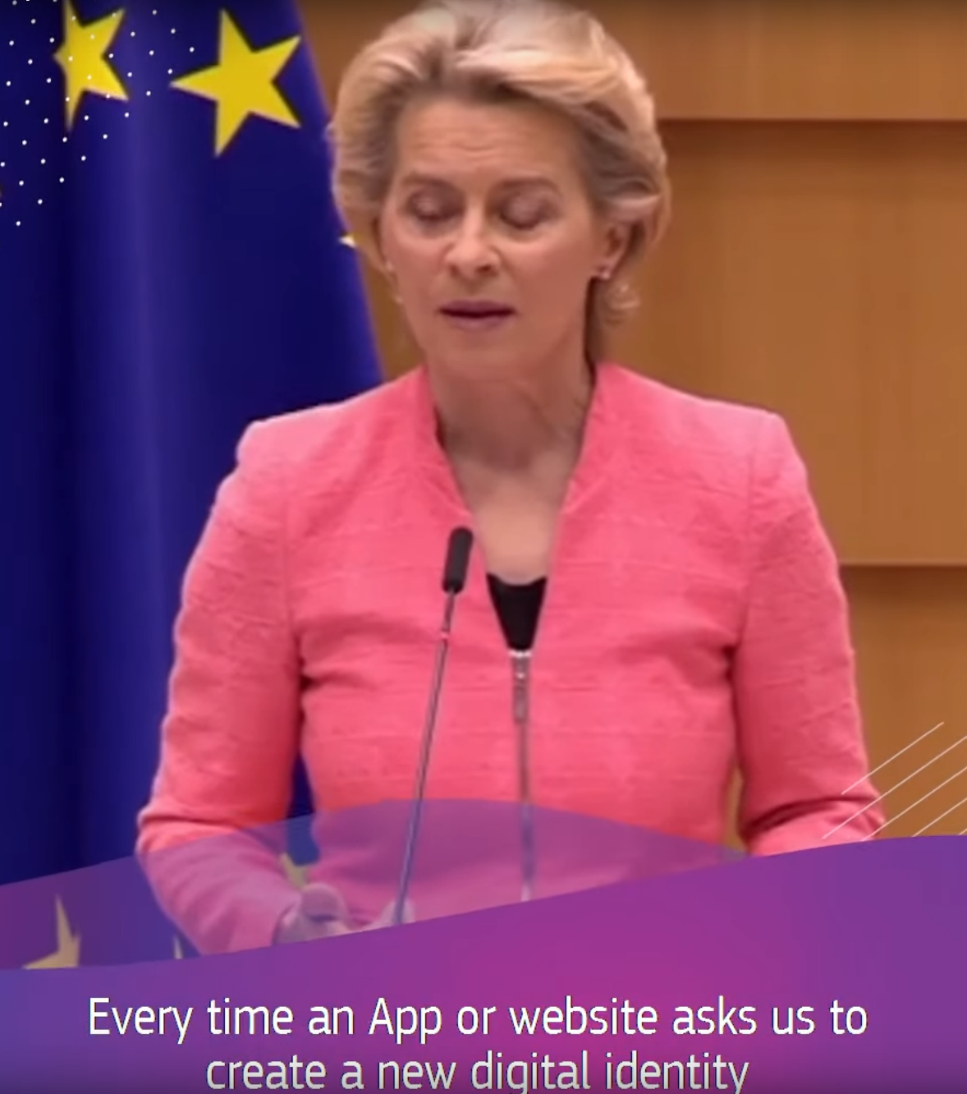
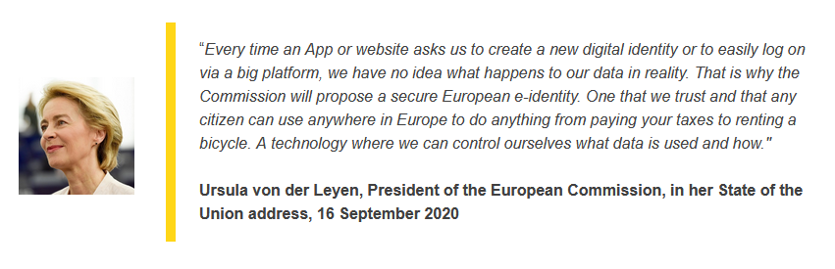
Web and the Image of the Future
https://www.youtube.com/watch?v=EFIs-oL1c4g
https://ec.europa.eu/info/strategy/priorities-2019-2024/europe-fit-digital-age/european-digital-identity_en

Slide 31
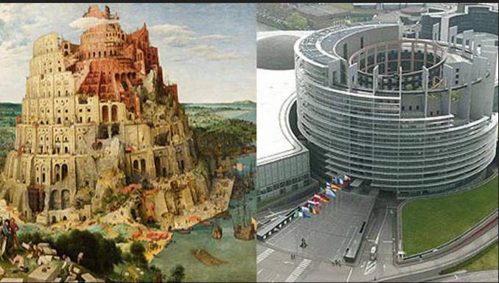
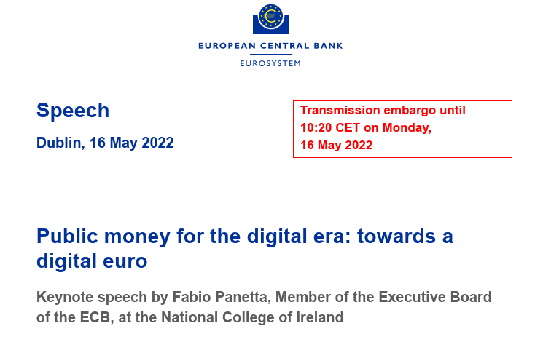
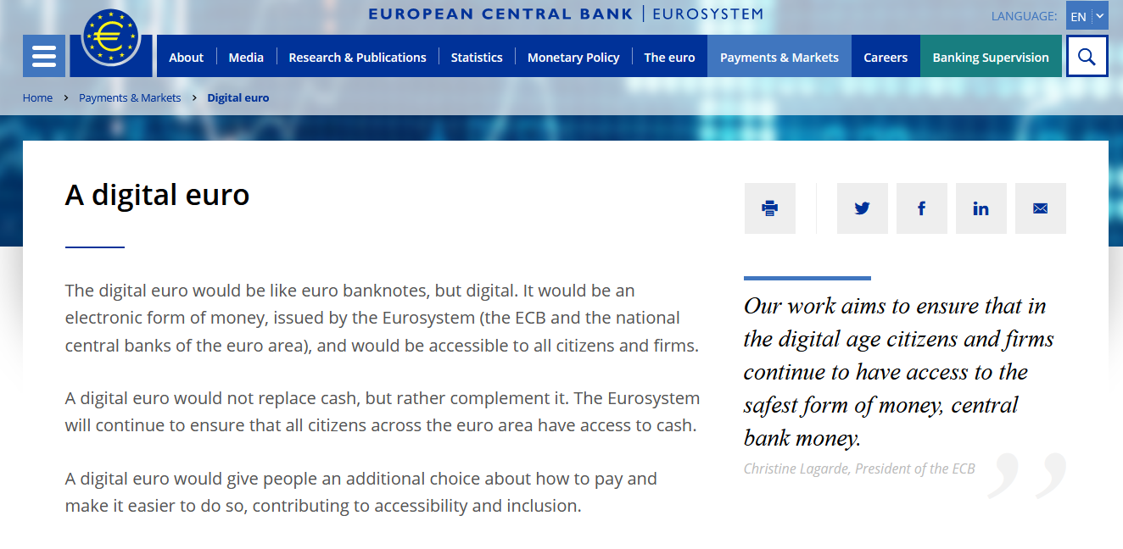

A new currency for a new identity
https://www.ecb.europa.eu/paym/digital_euro/html/index.en.html
Notes:
https://artsandculture.google.com/asset/the-tower-of-babel-pieter-bruegel-the-elder/bAGKOdJfvfAhYQ?hl=en

Slide 32
DEFI
Decentralized Finance

Slide 33
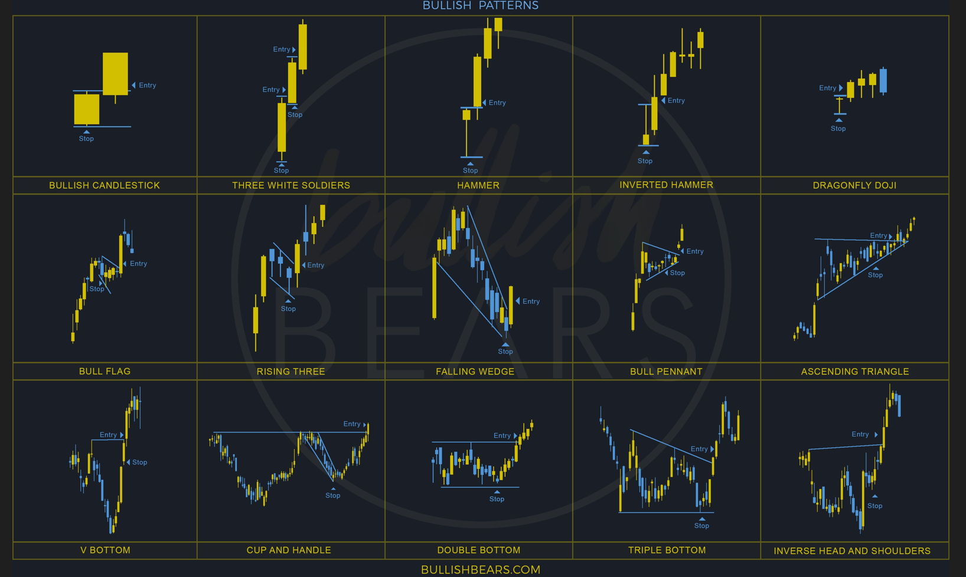
Notes:
All images taken from wallpapercave.com

Slide 34
Decentralization
An characteristic/attribute of having no centralized point
Discussed in great lengths regarding P2P systems , distributed systems
Has become extremely popular over the last 3 years

Slide 35
Financial Independence / Interdependence
Defi , allows individuals to engage in complex financial trading without the reliance upon a central financial body.
Smart Contracts dictate abilities , not laws or regulations
No KYC , Financial Background Checks, e.g Mortgage Approval.
There are a variety of types of Defi Engagement Available to individuals
The major pre-requisite for engagement in Defi , is simply holding blockchain assets.

Slide 36
KYC / KYB / Due Diligence
Recognised Standard within the financial services .
Any financial services business operating within the EU must abide by EU and State regulations regarding compliance
“Know your Customer / Business”
Designed to prevent money laundering, financing terrorism and other crimes involving money. It also refers to the policies, procedures, and technology used by banks and financial services companies to comply with KYC regulations.
Vital Requirement for Traditional financial Services.
Due Diligence – Checks / Balance Sheets / Financials etc
PP

Slide 37
Passive Income
The Ability to create Income without major commitments
There are risks associated
Fluctuations / Attacks / Traditional Financial Risks also

Slide 38
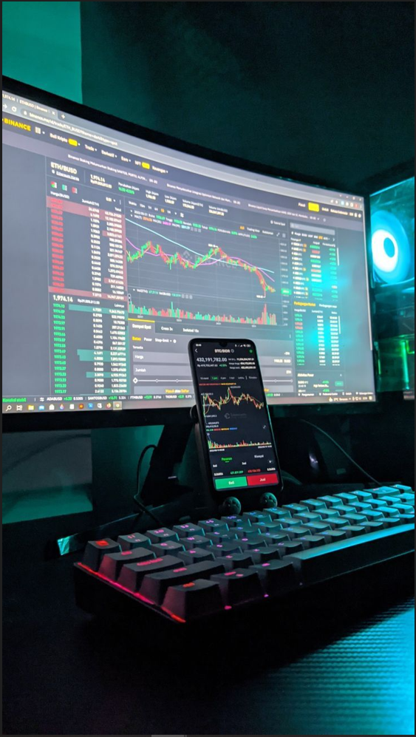
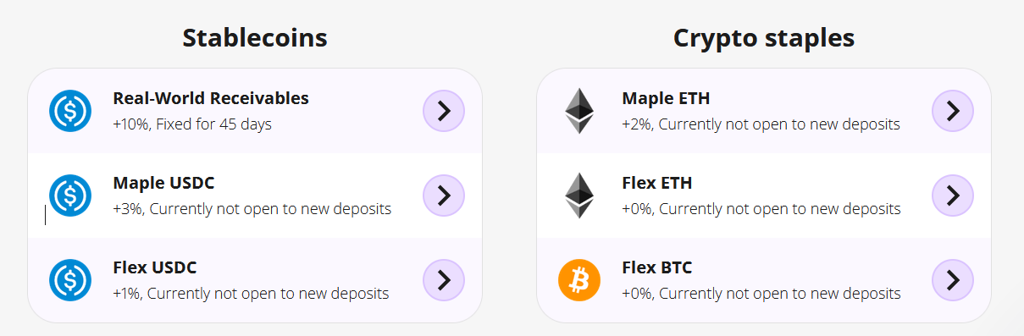
So what is Defi ?
The ability to Engage in complex Financial Trading's.
Primarily popular actions currently include :
Staking , Yielding , Swapping

Slide 39
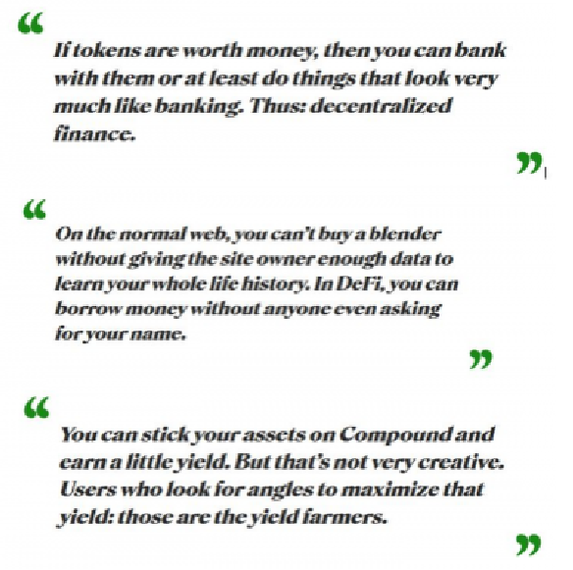

Slide 40
Staking
This is more obvious and clear now that staking has become mainstream within the Ethereum Network
Proof of Stake
Within the context of Defi , staking involves providing crypto assets to a network to ensure its security and to check transactions.
As a result , the staker receives a reward / compensation
Often times , a staker will receive tokens for the selected network,
The value of which may increase overtime. These tokens may then also be exchanged for other crypto assets.

Slide 41
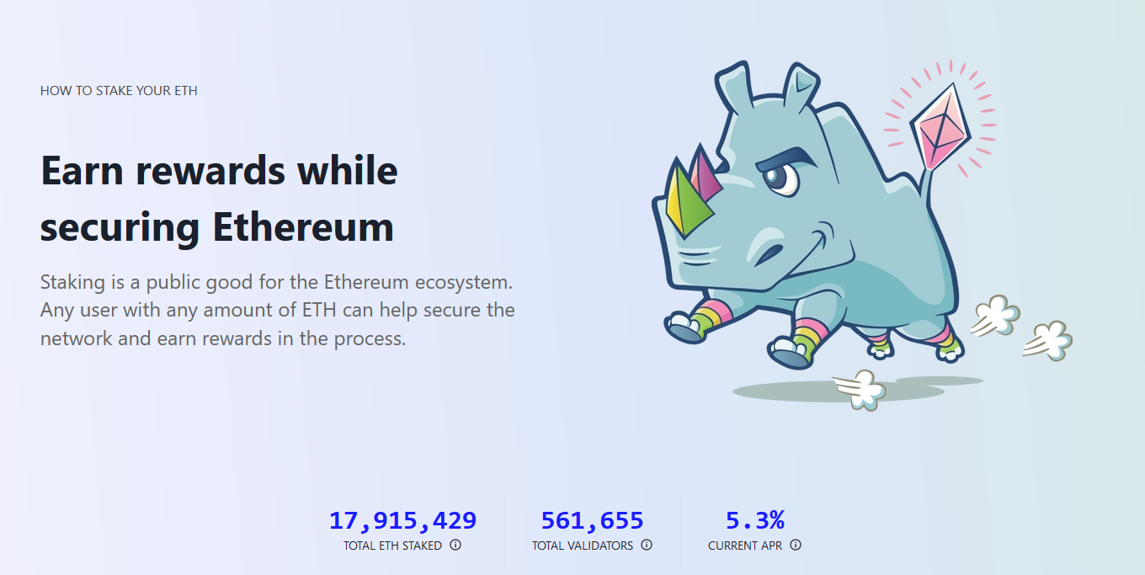
https://ethereum.org/en/staking/
Notes:
https://ethereum.org/en/staking/

Slide 42
Staking
Generally speaking, in order to participate in staking, a person needs to have a certain amount of coins and run a staking node. By communicating with the network, the investor’s staking node helps to validate transactions and create new blocks. As a “thank you” for the contribution to the network, the investor earns a share of the block rewards.
ERC-20 liquidity token represents your staked ETH
Good resource for more on Staking

Slide 43
Requirements for Staking
Users will need a computer with enough memory space to download both Ethereum blockchains — the old and new — as a minimum requirement. Ethereum 1.0 already has roughly 900 terabytes of data and is growing at a rate of about 1 gigabyte each day.
Validators must also keep their nodes connected to the blockchain at all times. As a result, a good internet connection is a must-have. After you've installed the validator software on your computer, you'll need to send at least 32 ETH to the Ethereum staking contract address.

Slide 44
Yielding
Yielding Differs from staking, in that rather than staking your crypto assets to the network.
You are actually loaning out your crypto assets to other individuals in the network.
As a result the “Yielder” then receives a percentage / rate for providing liquidity.
The term liquidity refers to exchanging or selling hard/digital assets for fiat currency. This is a common term and not specific to Defi.

Slide 45
Swaps
Recent TX : https://etherscan.io/tx/0xa96beb71d48205db34a1f852edd43cd9baf9ec3f9036d4dbf6da5d69f9900e8b
Swapping is also a popular activity within the Defi Arena
The ability to swap tokens.
Popular swap platforms:
Uni Swap
Sushi Swap

Slide 46
Live Defi Trades
https://coinlobster.com/combined-defi
https://messari.io/screener/defi-coins

Slide 47
Defi Platforms
Good Source of Further Info on Available Defi Services
https://defiprime.com/
https://aqru.io/
https://www.binance.com/en
https://www.youhodler.com/
https://www.kraken.com/

