Slide 1
🐦Flappy Bird - Python Game Project
Developed by Meenakshi
25MCI10231

Slide 2
Aim
To design and implement a simple interactive game using Python's Pygame library that demonstrates loops, functions, and event handling.

Slide 3
Introduction
The Flappy Bird game project is based on Python and Pygame. The game involves a bird navigating through pipes by avoiding collisions. It demonstrates the use of loops, functions, variables, and event-driven programming concepts in Python.

Slide 4
Objectives
- To understand event-driven programming.
- To implement functions and loops.
- To create graphical interfaces using Pygame.
- To handle user input and collision detection.
- To enhance logical thinking through game design.

Slide 5
Hardware & Software Requirements
- Processor: Dual Core or higher
- RAM: Minimum 4 GB
- OS: Windows/Linux/Mac
- Software: Python 3.8 or later
- Libraries: pygame, tkinter
- IDE: VS Code / PyCharm / IDLE

Slide 6
Project Outcomes
1. Learnt basics of game development.
2. Implemented loops and functions in Python.
3. Gained knowledge of event handling.
4. Designed an interactive GUI.
5. Improved problem-solving and logic.
6. Understood collision detection.
7. Practiced use of variables and conditions.
8. Enhanced understanding of graphics rendering.
9. Achieved smooth animation handling.
10. Created a functional Python game.

Slide 7
Benefits
- Enhances Python programming knowledge.
- Provides hands-on experience with GUI and event handling.
- Improves logic-building and debugging skills.
- Encourages creativity through visual design.
- Helps understand real-world applications of loops and functions.

Slide 8
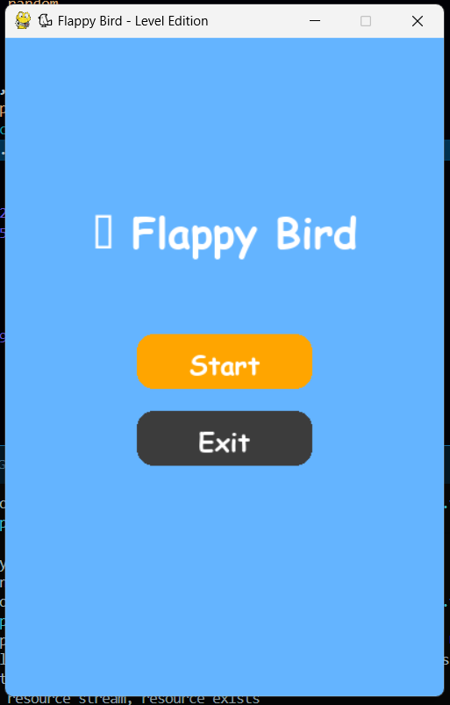
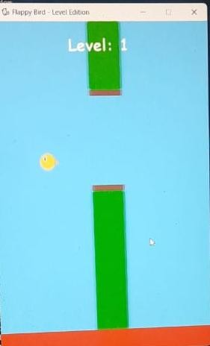
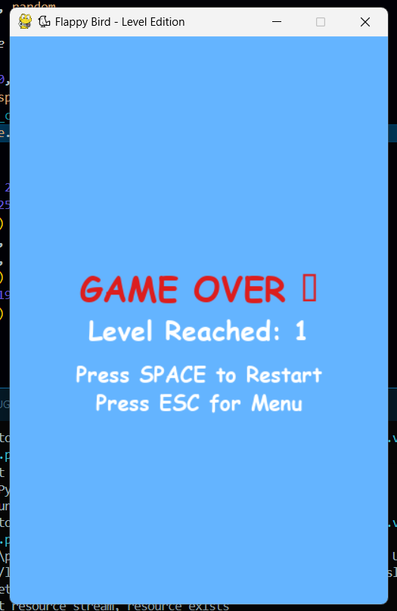
Output

Slide 9
Conclusion
The Flappy Bird project provides a strong foundation in Python programming concepts such as loops, functions, and event handling. It demonstrates how simple logic and graphical interfaces can be combined to create engaging interactive applications.

Slide 10
GitHub Repository
View full project source code here:
https://github.com/Meenakshi033/flippy-bird-game.git

