Slide 1

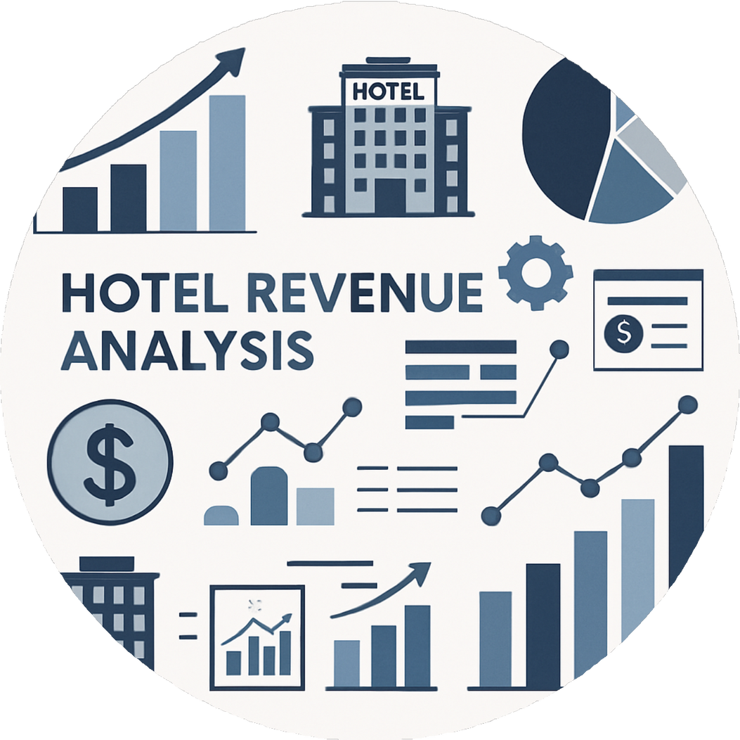
INFOSYS
HOTEL REVAI
AI driven Revenue Analysis for Hotel

Slide 2


INTRODUCTION
The hospitality industry faces challenges in managing revenue because of changing customer demand and market trends. To solve this, hotels are now using AI-driven solutions that can predict demand, adjust prices dynamically, and improve both profitability and guest satisfaction.
Revenue Challenges Traditional methods
Role of AI
AI helps hotels make smarter and faster decisions.
The hotel industry faces many challenges in managing revenue
Manual forecasting and fixed pricing limit flexibility.

Slide 3
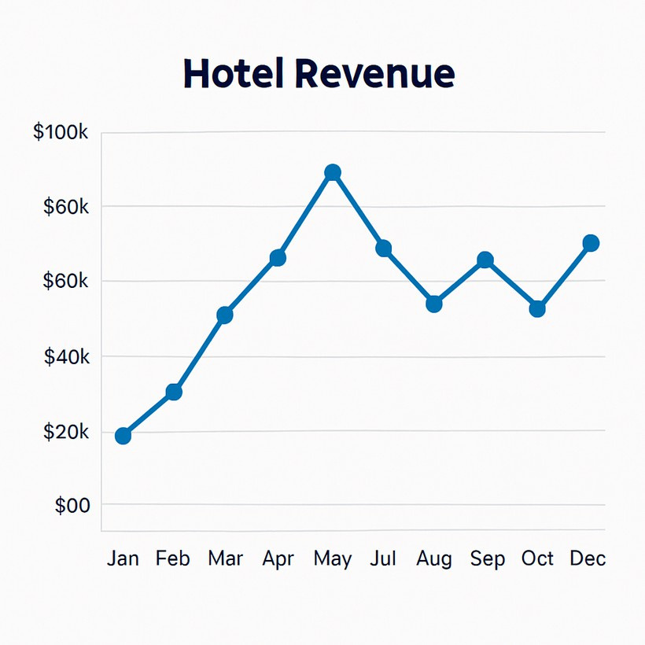
Problem Statement
THE MAIN OBJECTIVE OF OUR PROJECT IS TOO ANALYZE HOTEL REVENUE, BOOKING TRENDS, AND CUSTOMER BEHAVIOR USING DATA VISUALIZATION TOOLS LIKE POWER BI AND EXCEL.
Hotels face challenges in managing large amounts of booking and revenue data efficiently. Manual analysis limits their ability to identify key trends and predict demand accurately. HotelRevAI provides a data-driven solution that delivers clear insights for smarter decisions and improved profitability.

Slide 4
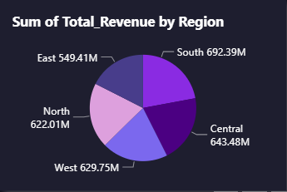

Better Solution
AI-powered revenue analysis platform
Uses artificial intelligence to analyze hotel data and improve revenue decisions.
Real-time dashboard and analytics
Provides live insights and visual reports for better business decisions.

Slide 5

KEY TECHNOLOGIES
  Improved Forecasting Accuracy
  AI models predict demand more precisely, reducing overbooking or empty rooms.
  Optimized Pricing Strategy
  Dynamic pricing ensures the best room rates for higher revenue and occupancy.
  Better Occupancy Management
  Helps maintain a balance between room availability and profitability.
  Data-driven Insights
  Provides clear analytics for smarter business and marketing decisions.
  Enhanced Guest Experience
  Uses personalized offers and feedback analysis to improve customer satisfaction.

Slide 6
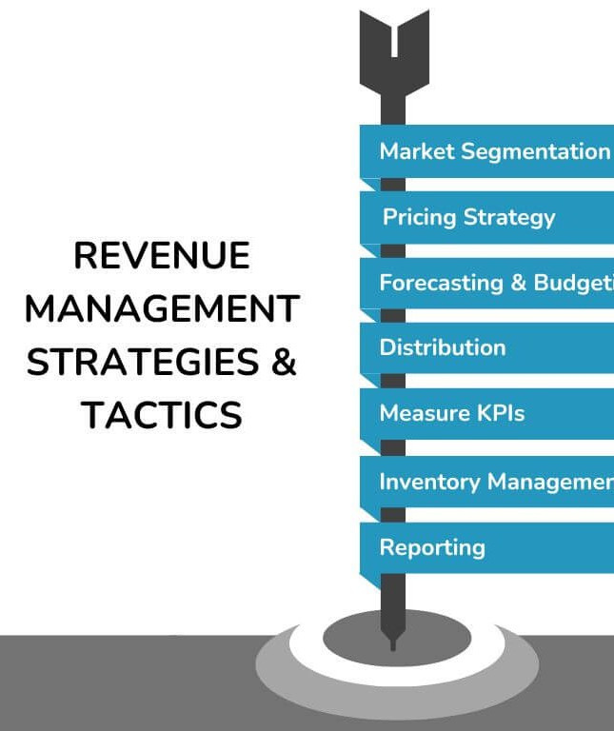
BENEFITS OF HOTEL
Better Occupancy Management
Data-Driven Competitive Insights Smart Pricing Optimization

Slide 7
USE CASE SCERNARIO
Business Hotels: Leverage predictive analytics to maximize weekday corporate bookings and optimize room pricing.
Resort Hotels: Use AI-driven forecasting to manage seasonal peaks and enhance off-season profitability.
Boutique Hotels: Apply sentiment analysis on reviews to boost guest satisfaction and deliver personalized offers.

Slide 8
INSIGHTS AND FINDINGS
ADVANTAGE
  Proven AI & Machine Learning Expertise — ensures accurate forecasting and intelligent decision-making.
  Deep Domain Knowledge in Hospitality — tailored specifically for hotel revenue challenges.
  Comprehensive End-to-End Solution — from model design to deployment and ongoing support.
  · Boutique and Budget hotels generate the highest revenue.
  · Corporate booking channels contribute the most to total revenue, followed by travel agents.
  · The Deluxe room type has the highest booking frequency.
  · The South and North regions show consistently strong revenue performance.
  · The Corporate customer type accounts for a larger share of the total revenue.

Slide 9

CONCLUSION
This analysis provides a comprehensive understanding of hotel performance metrics, allowing data-driven business strategies. The dashboards help management evaluate profitability, occupancy, and customer behaviour effectively. By leveraging these insights, hotels can improve demand forecasting, optimize pricing models, and maintain an ideal balance between occupancy and profit. The study emphasizes the importance of data analytics in enhancing the operational and financial efficiency of the hospitality industry.

