Slide 1
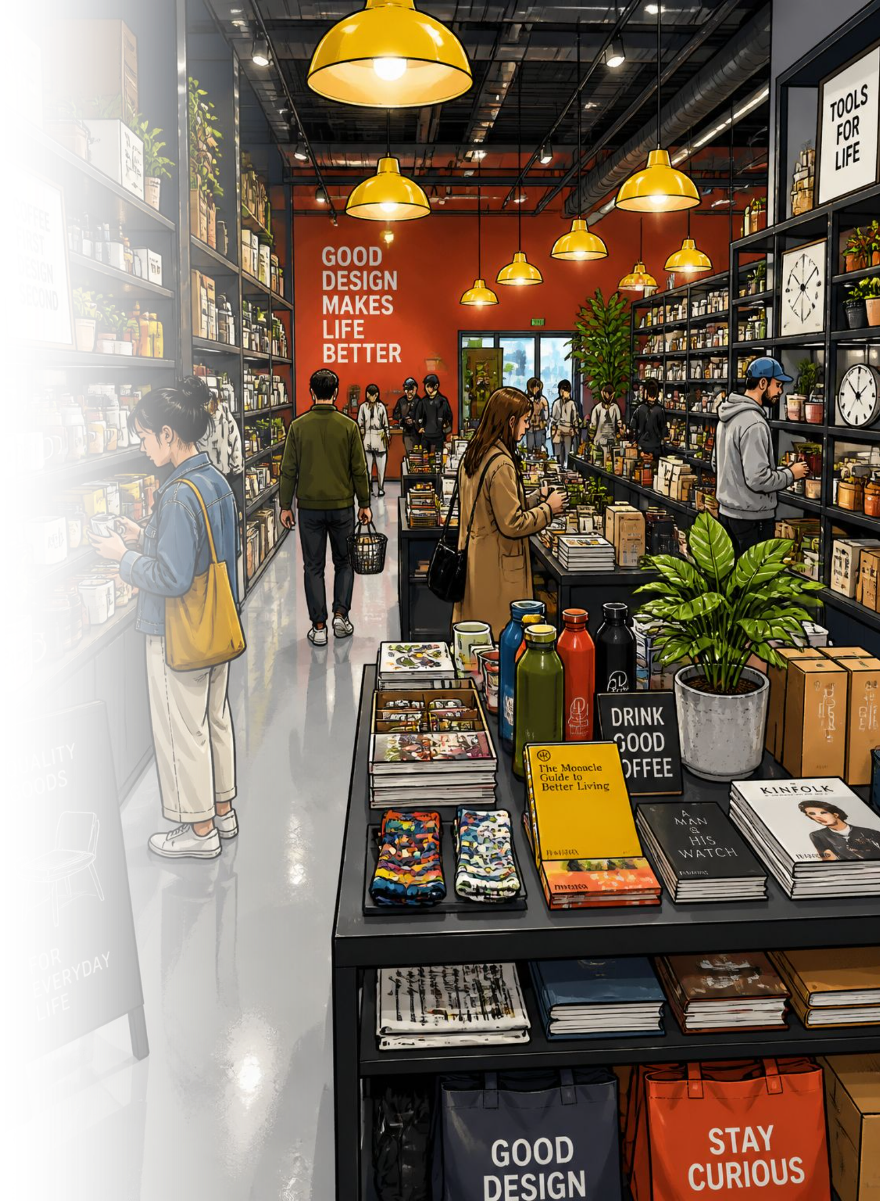
Customer Shopping Behavior Analysis
3,900 transactions · 18 features · Python · SQL · Power BI

Slide 2
Dataset at a Glance
3,900
18
Purchases
Features
37
$59.76
Missing Values
Avg Purchase
Review Rating column
Demographics, purchase details, shopping behavior — loaded into PostgreSQL for analysis.

Slide 3
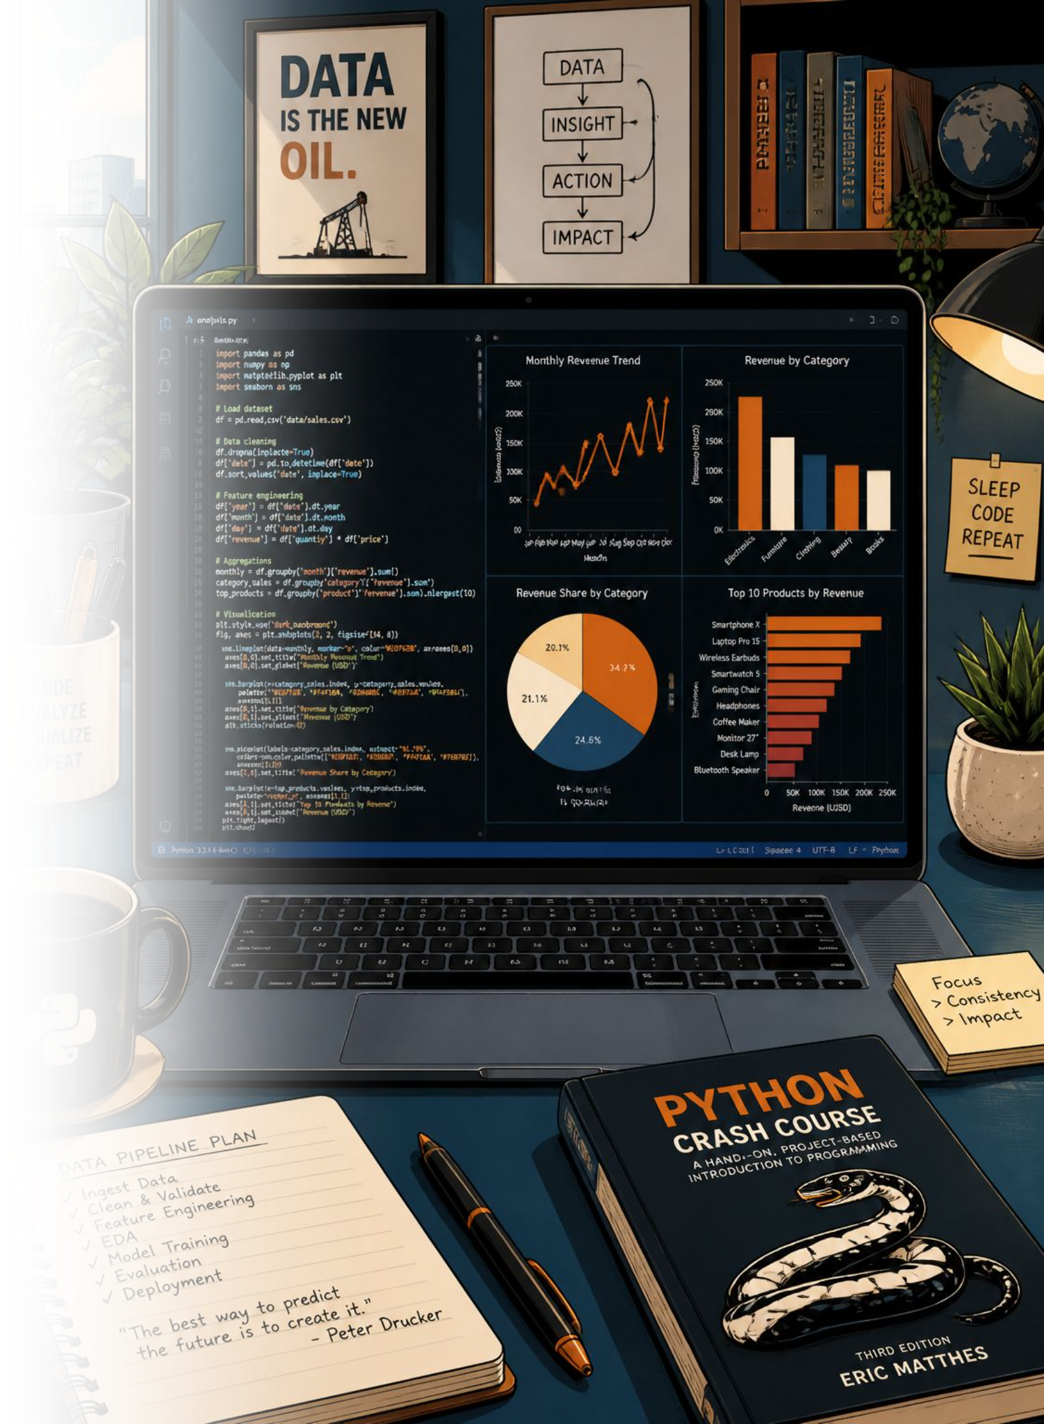
Data Preparation in Python
01
Load & Explore
pandas, df.info(), .describe()
02
Clean
Imputed Review Rating by category median
03
Engineer
age_group, purchase_frequency_days
04
Load to DB
Connected to MySQL

Slide 4
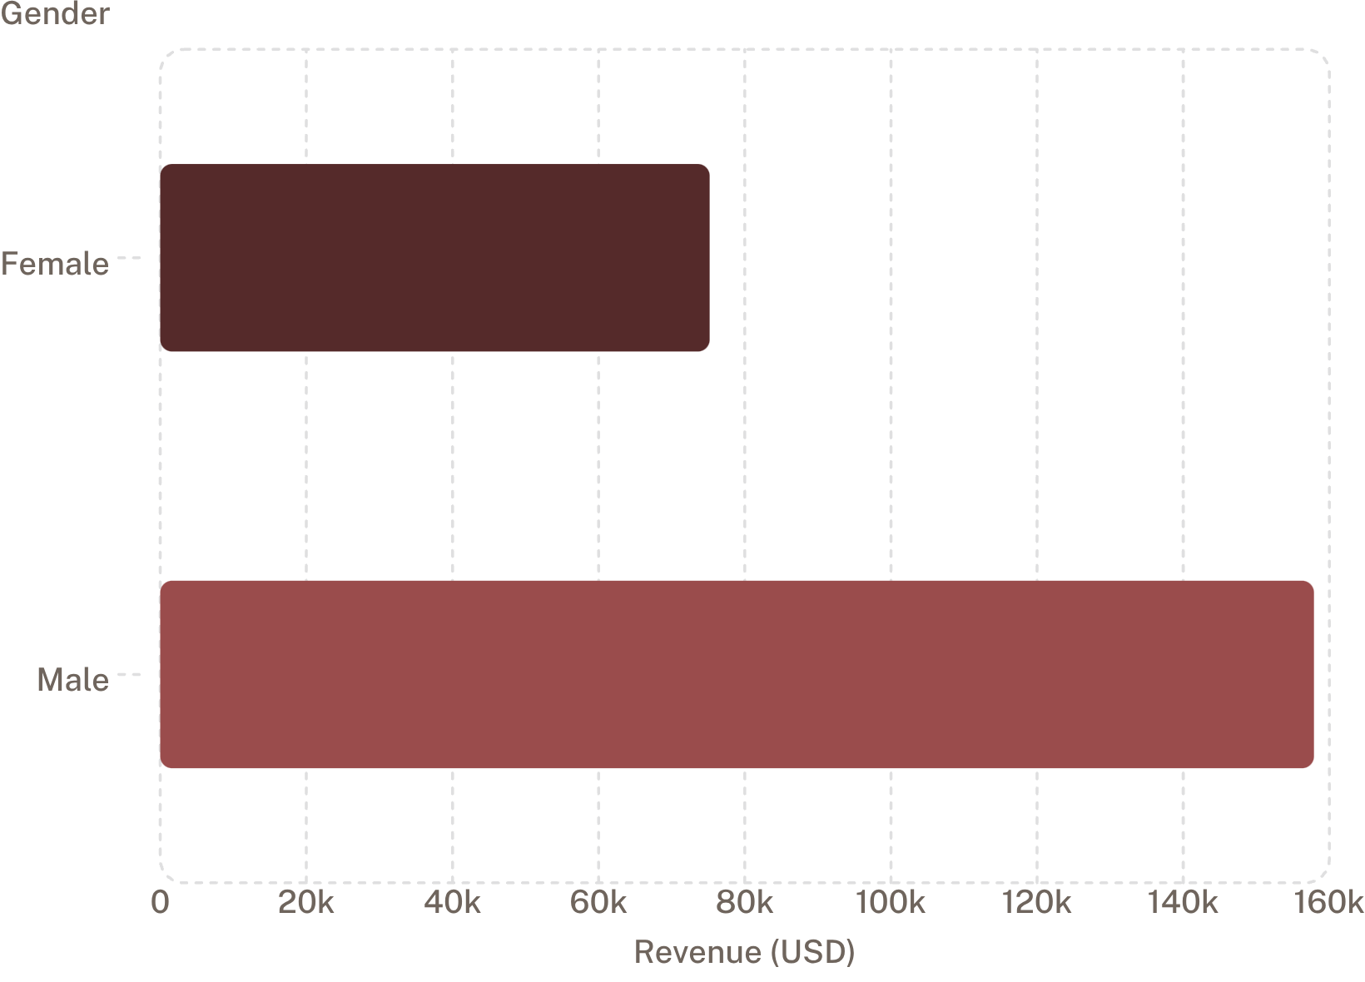
Revenue by Gender
Male customers drive 2× revenue
Male: $157,890 vs. Female: $75,191
68% of customers are male — a key demographic to target.

Slide 5
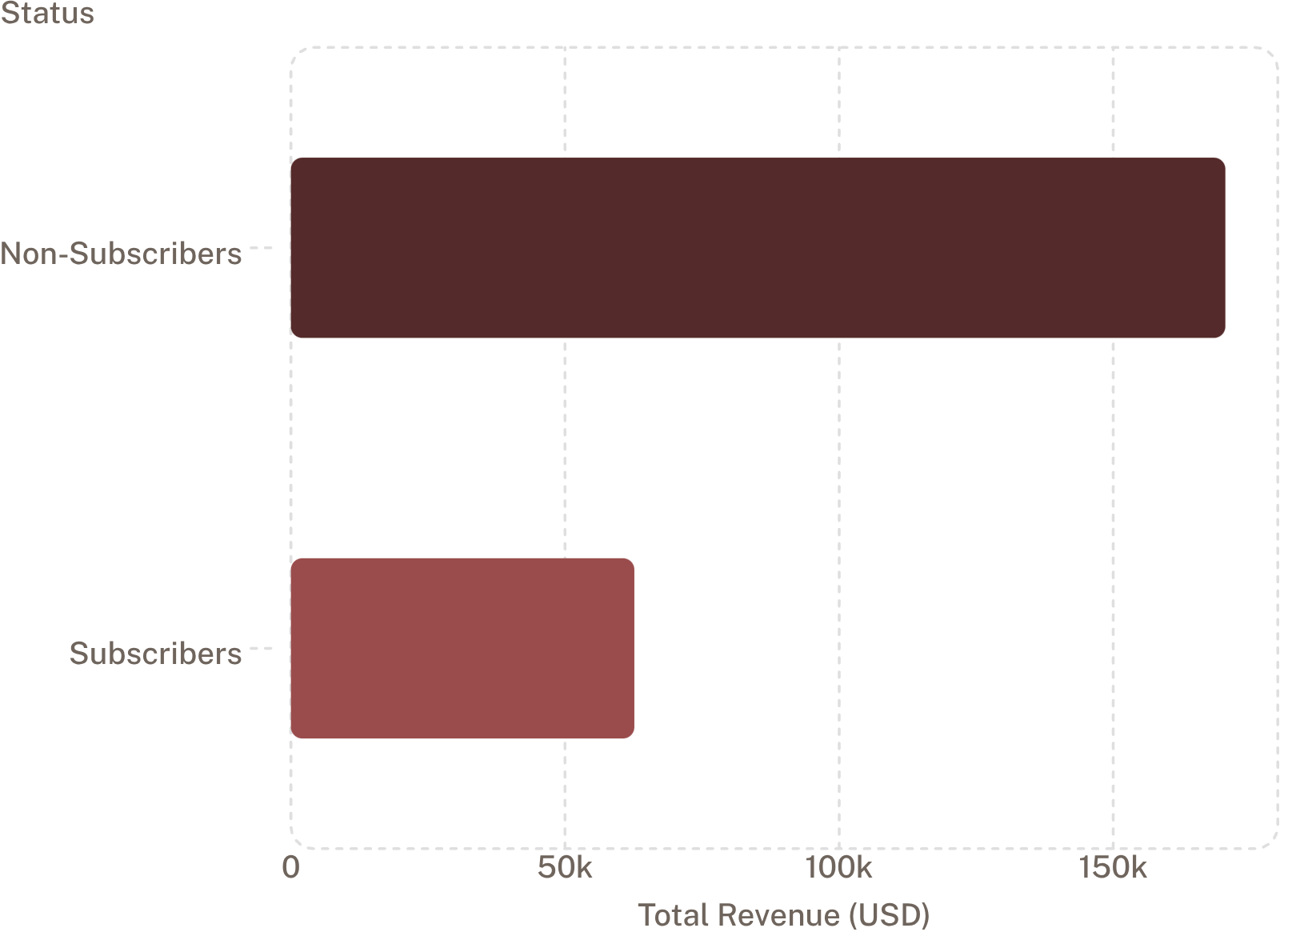

Subscribers vs. Non-Subscribers
73% are non-subscribers
Non-subscribers generate $170K vs. subscribers $62K
Only 27% subscribed — significant growth opportunity.
Repeat buyers: 2,518 non-subscribers vs. 958 subscribers

Slide 6
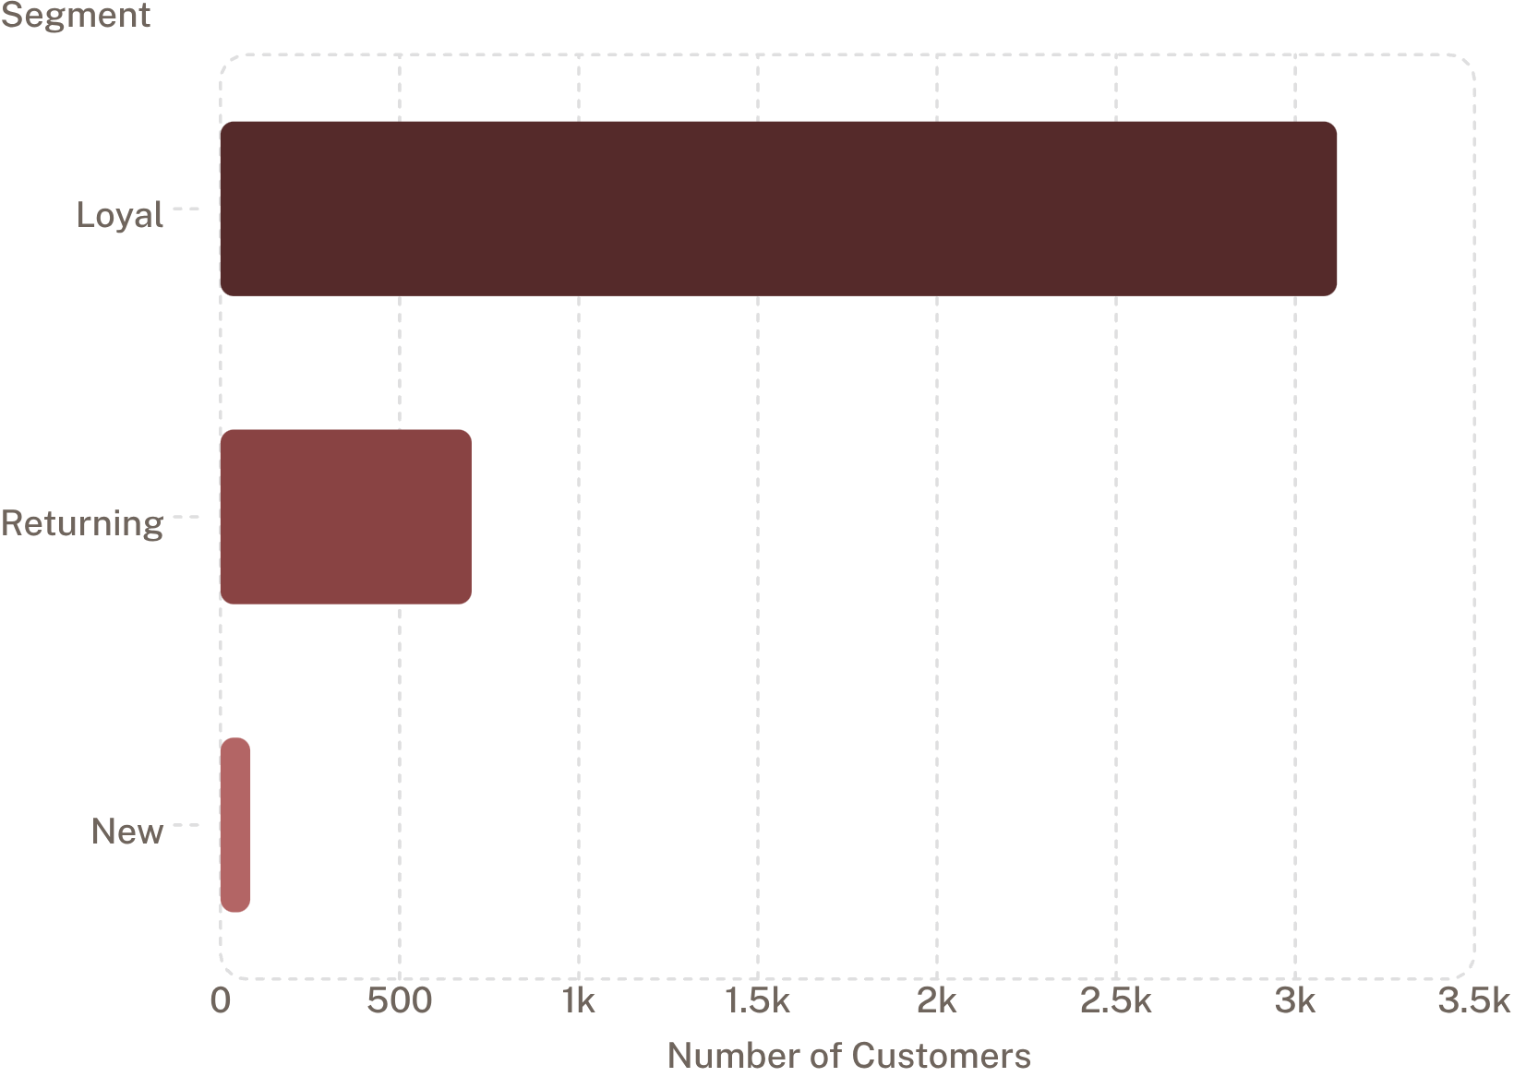
Customer Segmentation
Loyal customers dominate
80% classified as Loyal — strong retention base.
Only 83 New customers — acquisition needs focus.

Slide 7
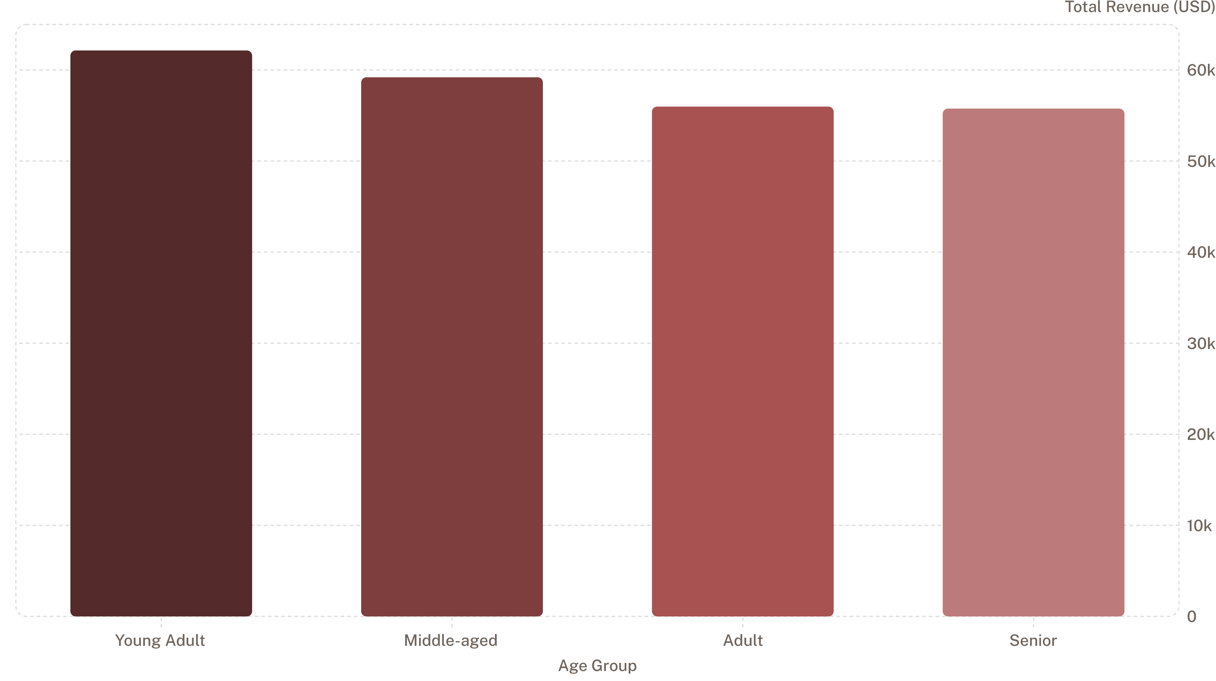
Revenue by Age Group
Young Adults lead revenue — prioritize this segment in marketing campaigns.

Slide 8
Top Products & Discount Patterns
Top 5 by Rating
Highest Discount Rates
Product
Rating
Product
Discount %
Gloves
3.86
Hat
50%
Sandals
3.84
Sneakers
49.66%
Boots
3.82
Coat
49.07%
Hat
3.80
Sweater
48.17%
Skirt
3.78
Pants
47.37%

Slide 9
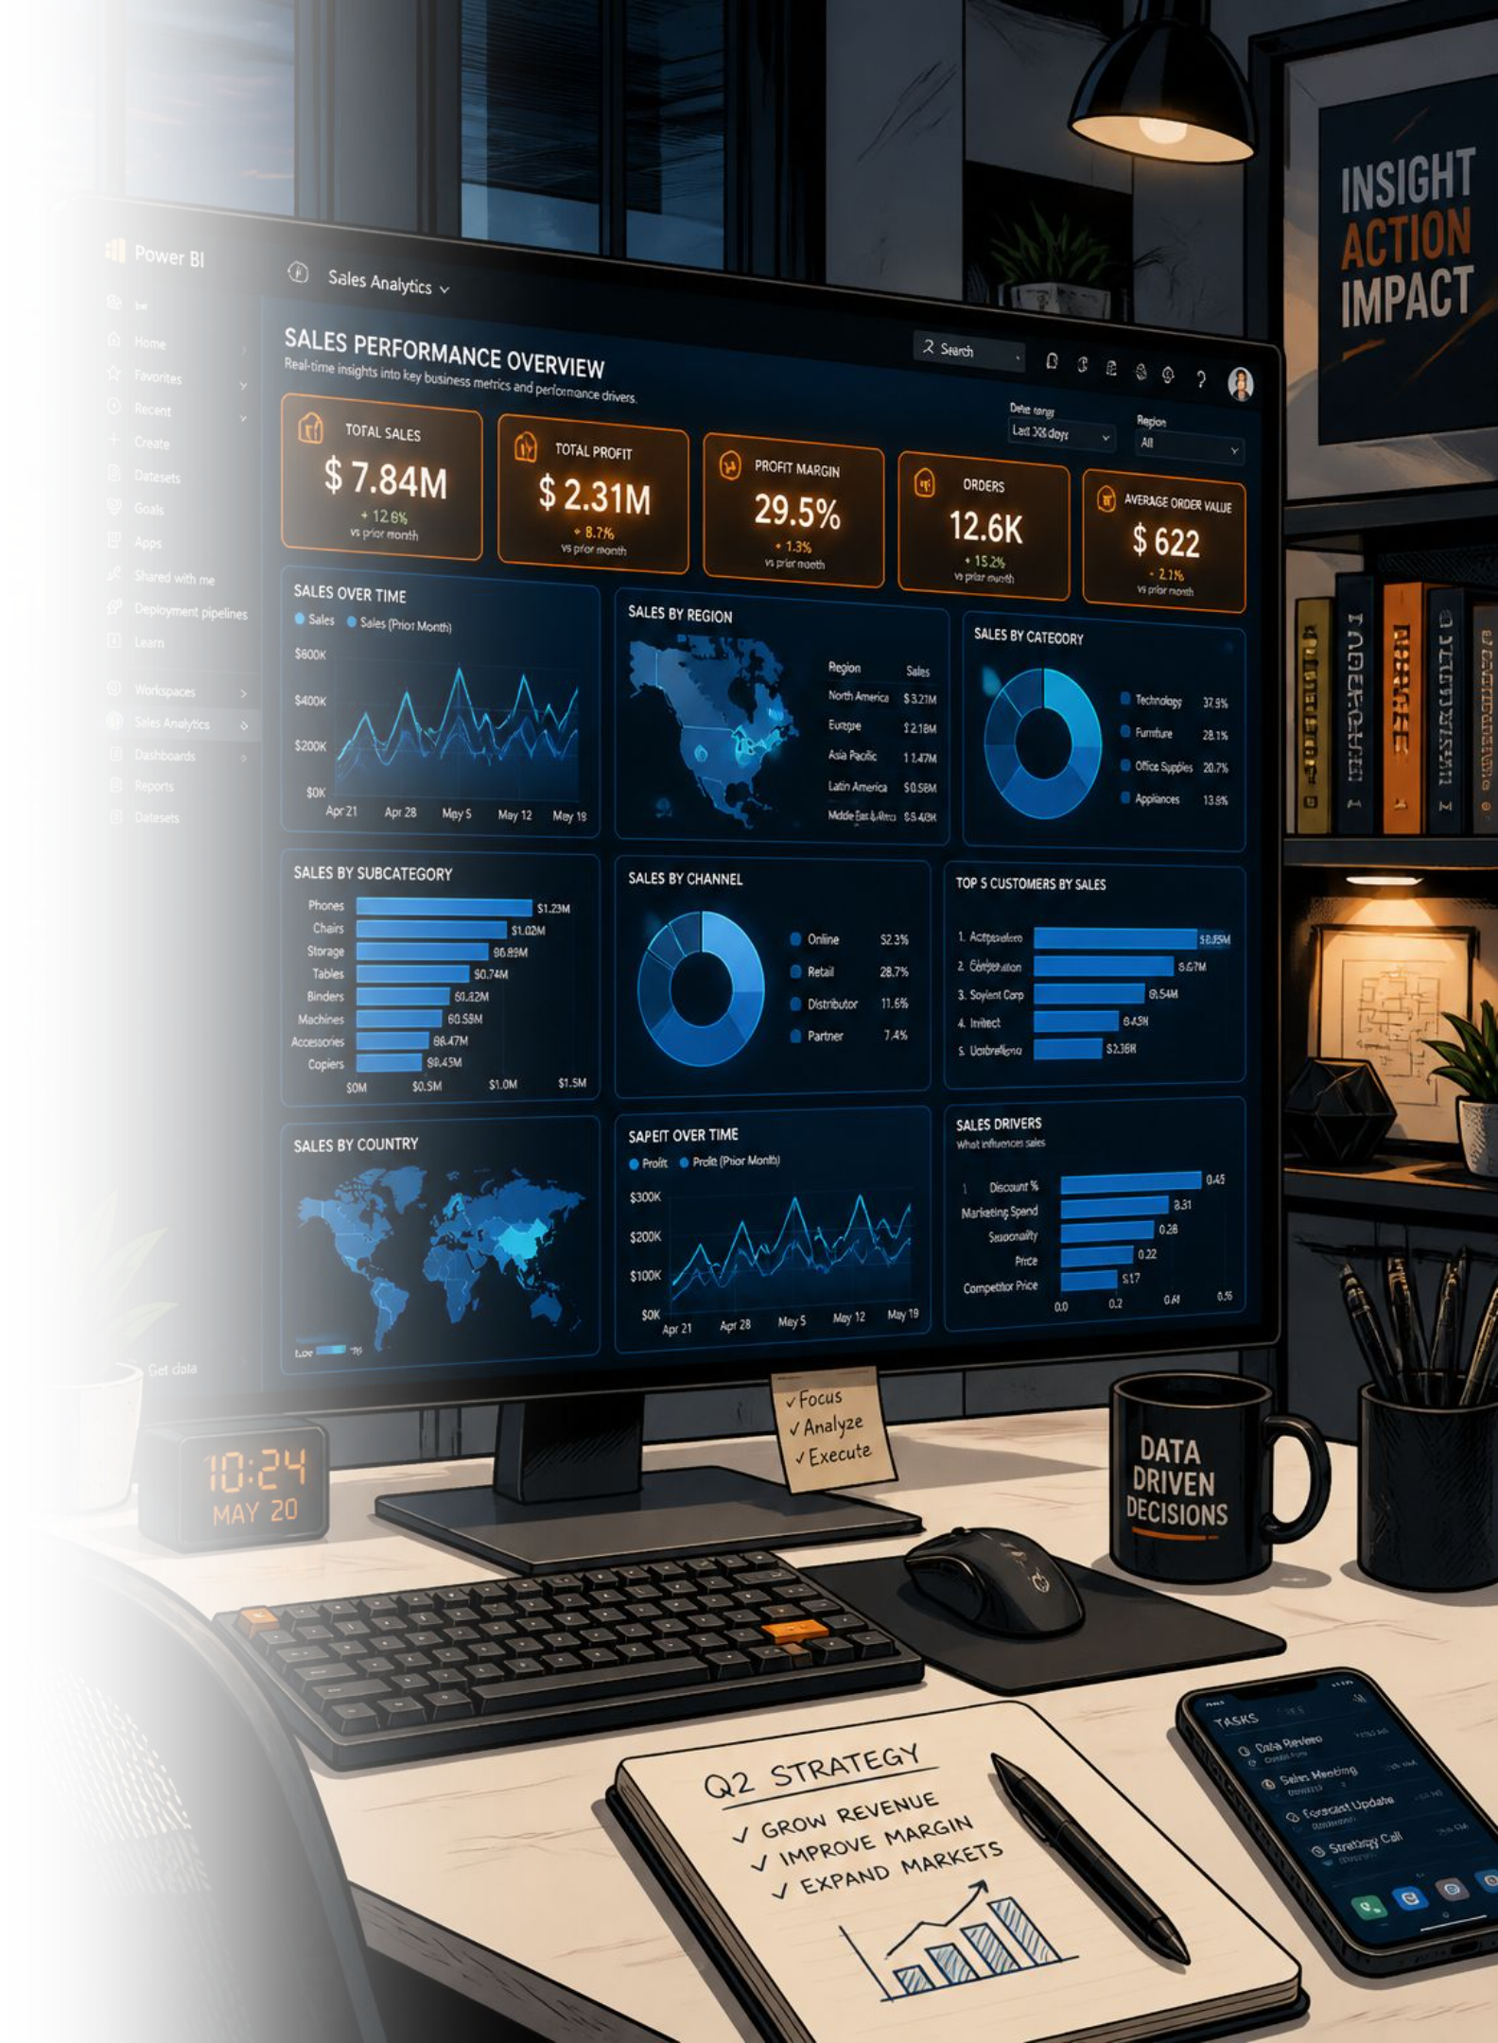
Power BI Dashboard
3.9K
Customers
$59.76
Avg Purchase
3.75
Avg Rating
Interactive filters: Gender, Category, Shipping Type, Age Group — Revenue & Sales views.

Slide 10





Business Recommendations
Boost Subscriptions
Promote exclusive subscriber benefits
Loyalty Programs
Reward repeat buyers → Loyal segment
Review Discount Policy
Balance sales lift vs. margins
Targeted Marketing
Focus on Young Adults & express-shipping users

