Slide 1

Git | KIP 2020 Assignment
Revert
Durgesh Gupta
Kuldeepak Gupta
Meenakshi Goyal
Vishal Gupta
Yash Gupta
Group - 10

Slide 2
Getting and Creating Projects
init
Create an empty Git repository or reinitialize an existing one.
This also creates a .git file which git uses to track all the changes. Deleting this will erase everything.
clone
Clone a repository into a new directory

Slide 3
Git Revert
In Git, the term revert is used to revert some changes. The git revert command is used to apply revert operation. It is an undo type command. However, it is not a traditional undo alternative. It does not delete any data in this process; instead, it will create a new change with the opposite effect and thereby undo the specified commit. Generally, git revert is a commit.
Syntax-
git revert [--[no-]edit] [-n] [-m parent-number] [-s] [- S[<keyid>]] <commit>…​
git revert (--continue | --skip | --abort | --quit)

Slide 4
Git Revert Options:
Options | Descriptions
<commit>… | Commits to revert.
-e --edit | With this option, git revert will let you edit the commit message prior to committing the revert.
-m parent-number --mainline parent-number | This option specifies the parent number (starting from 1) of the mainline and allows revert to reverse the change relative to the specified parent.
--no-edit | With this option, git revert will not start the commit message editor.
--cleanup=<mode> | This option determines how the commit message will be cleaned up before being passed on to the commit machinery.
-n --no-commit | This flag applies the changes necessary to revert the named commits to your working tree and the index, but does not make the commits.

Slide 5
Git Revert to Previous Commit
To get revert to previous commit first check for the commit reference and then revert back as –
$ git log
$ git revert < commit reference >
Git Revert Merge
To get revert the merge first check for the commit reference and then revert back as –
$ git log
$ git revert <commit reference> -m 1

Slide 6
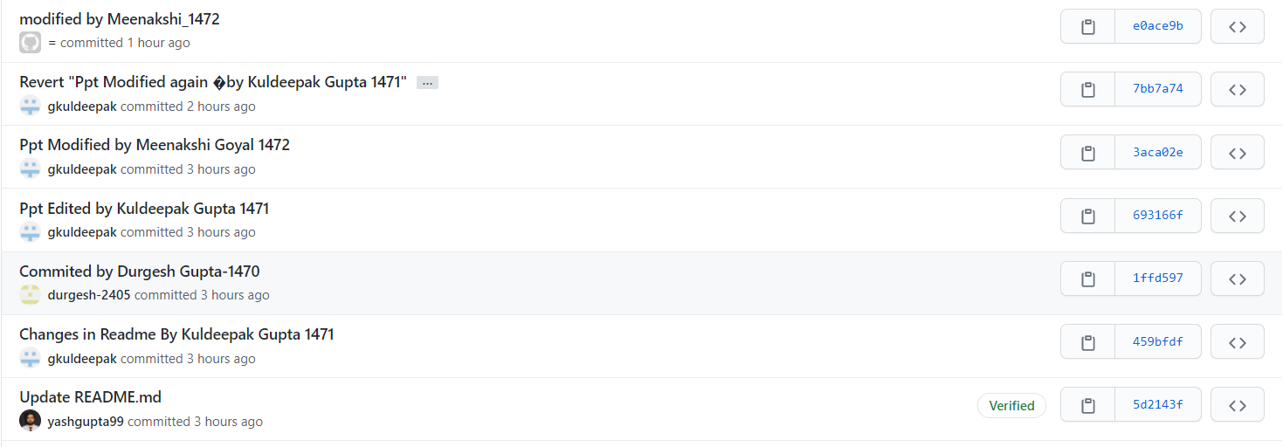
Git Revert Live example in our remote repo:

Slide 7
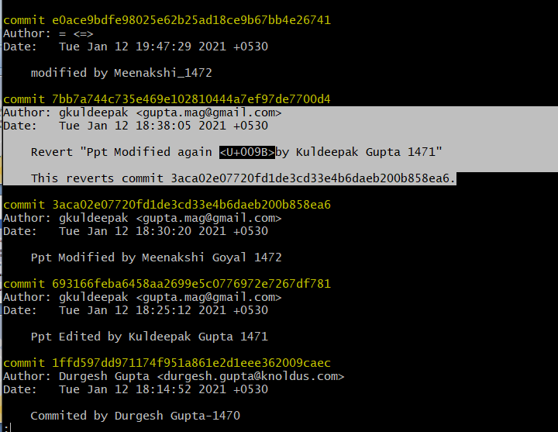
Git Revert Live example in local repo:

Slide 8


