Slide 1
TCP/IP - Mini Project Performance of Kavach TCAS System
Meenakshi S, Bhanumathi K, Ananya P.

Slide 2

Objective:
To estimate the distance between RFID tag installations when trains approach from opposite directions.
To estimate the latency from sensing to dashboard.
To estimate the reliability of the system under packet errors.
To compare latencies for a few connection scenarios.
To ensure only data from the specific trains are accepted to the server network.
To ensure the system is fail-safe

Slide 3

System Model
Case 1: Heads on Collision Scenario
(T1 and T2 heading opposite direction.)
Case 2: Rear end Collision Scenario
(T1 and T2 heading same direction.)
Case 1: Heads on Collision Scenario
(T1 and T2 heading opposite direction.)
Case 3: Collision Scenario – Either one is stationary

Slide 4
Assumptions taken:
Both trains are moving in 100 Kmph speed.
It is a single-track scenario i.e.; no loop line track is present. RFID are put accordingly.
There is one centralized server.
There are two trains acting as clients.
Server is previously aware of the trains running on that track.
The server shall continuously send information to the connected trains.

Slide 5
Latency Comparison (approx. Averaged)
T1 <-> Server | T2 <-> Server | T1 <-> Server <-> T2 | T1 <-> T2
9.150 ms | 5.195 ms | 34.32 ms | 13.6 ms

Slide 6
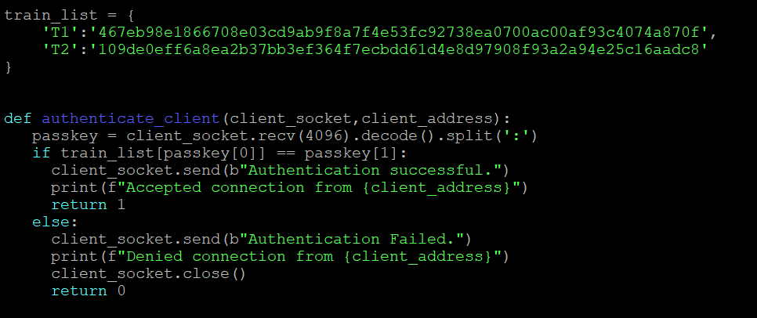
Specific Trains Authentication
Client tries to connect with a pre-determined encrypted key-value pair to get them authenticated.
A hash table consisting of all permitted key-values are stored in server and used for authentication.

Slide 7
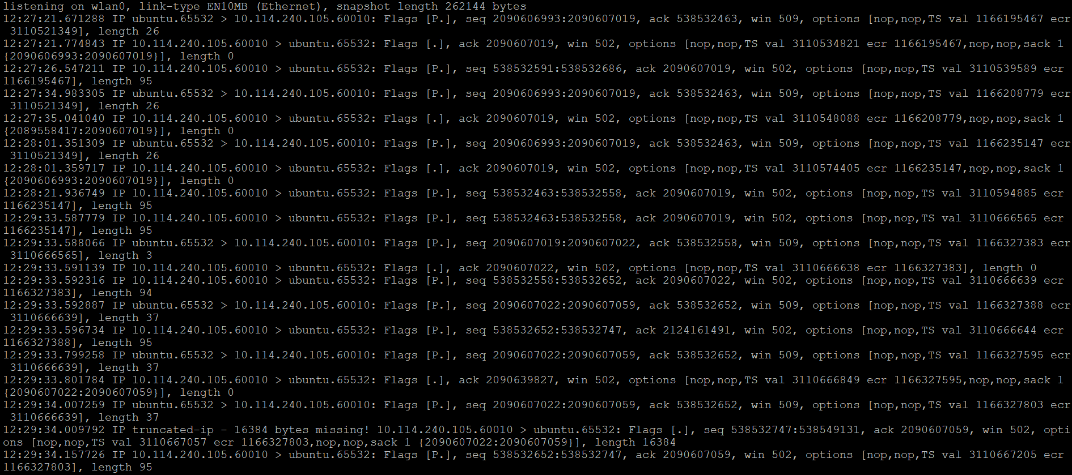
Packet Error Emulation: Solution – NO DELAY

Slide 8
Disconnection and Reconnection
If either of the clients get disconnected, the connection remains intact for the remaining client.
At the client end, disconnection is noticed as soon as no ACK is received from server.
If server gets disconnected, then the trains can establish direct connection from the available IPs stored in previous data received.
Connection can be re-established without any disruption.
If reconnecting time exceeds 8 seconds, the server will declare connection failure to encourage emergency intervention.

