Slide 1
YOGA POSE DETECTION USING MEDIAPIPE

Slide 2

INTRODUCTION OF TOOL
MediaPipe is a Framework for building machine learning pipelines for processing time-series data like video, audio, etc.
Cross-platform Framework
Detect body postures and landmarks.
Holistic model .
Applications such as sign language detection, drowsiness detection, etc.

Slide 3
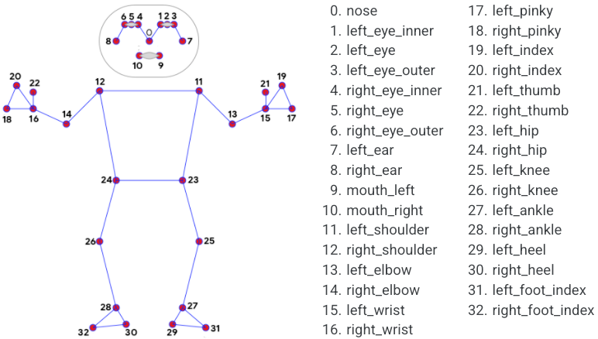
LICENSES OF THE TOOL
Apache 2.0, fully extensible, and customizable.

Slide 4
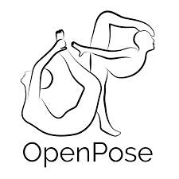

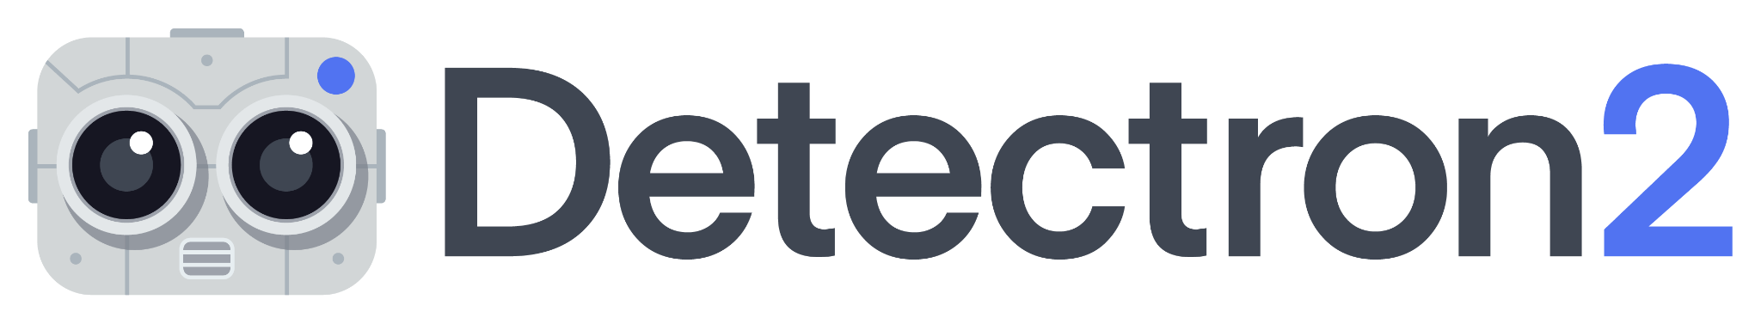
ALTERNATIVES FOR THE TOOL
OpenPose
AlphaPose
Detectron2
TensorFlow

Slide 5
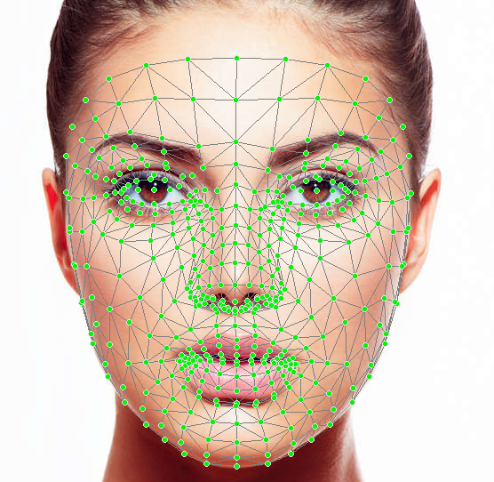
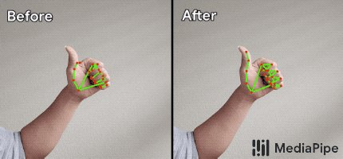
ADVANTAGES OF USING THE TOOL
End-to - end Acceleration
Build Once, Deploy anywhere.
Open Source Free.
Ready-to-use Solutions

Slide 6
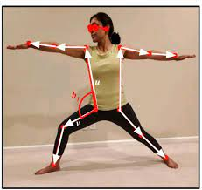
PROBLEM STATEMENT FOR PROJECT
Developing an application for yoga pose detection and correction . The primary goal of Yoga pose detection and correction application should provide standard and correct yoga postures using computer vision . Analyze human poses to detect and correct yoga poses to benefit humans to achieve a healthier life in their homely environment.

Slide 7
THANK YOU

