Slide 1

APPLIED ANALYTICS
23MEE371

Slide 2
Group Members
Kapilash S – CB.EN.U4MEE20014
Meenakshisundram G – CB.EN.U4MEE20025
Karthik Krishna J P – CB.EN.U4MEE20115

Slide 3
Problem Definition
By utilizing this sensor dataset, build a model capable of predicting the amount of heat lost by electric motors during their normal operation.

Slide 4
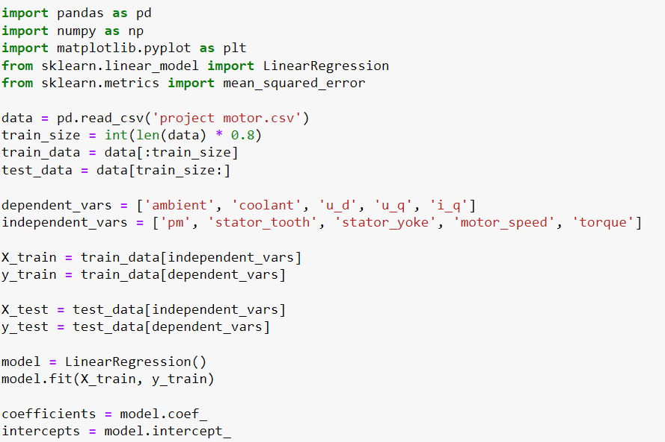
Code

Slide 5
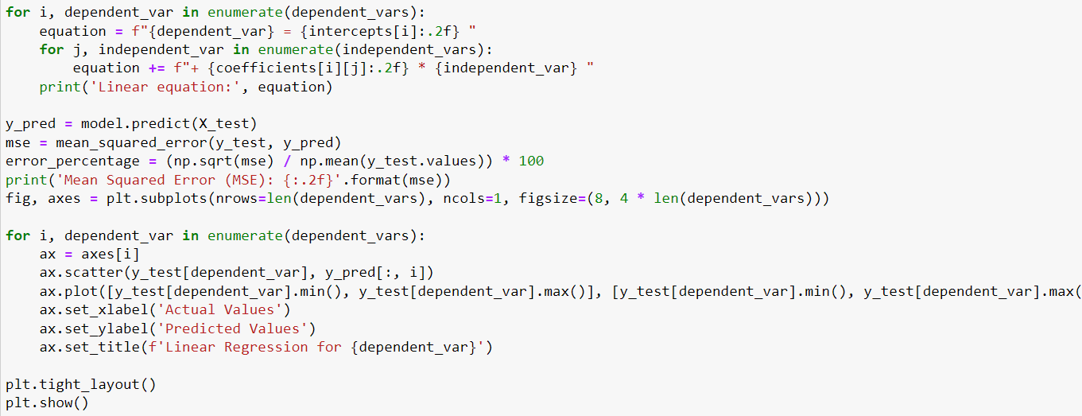
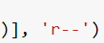
CODE

Slide 6
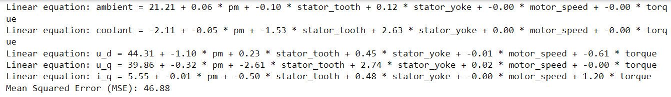
Output

Slide 7
Graphs Plotted using MATPLOTLIB

Slide 8
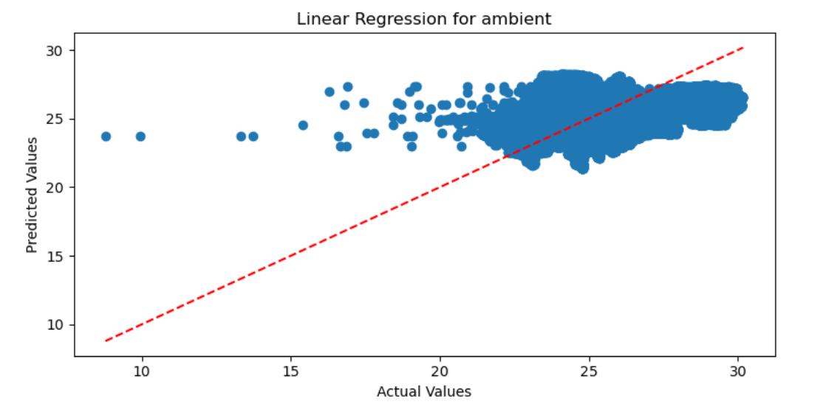
Linear Regression for Ambient

Slide 9
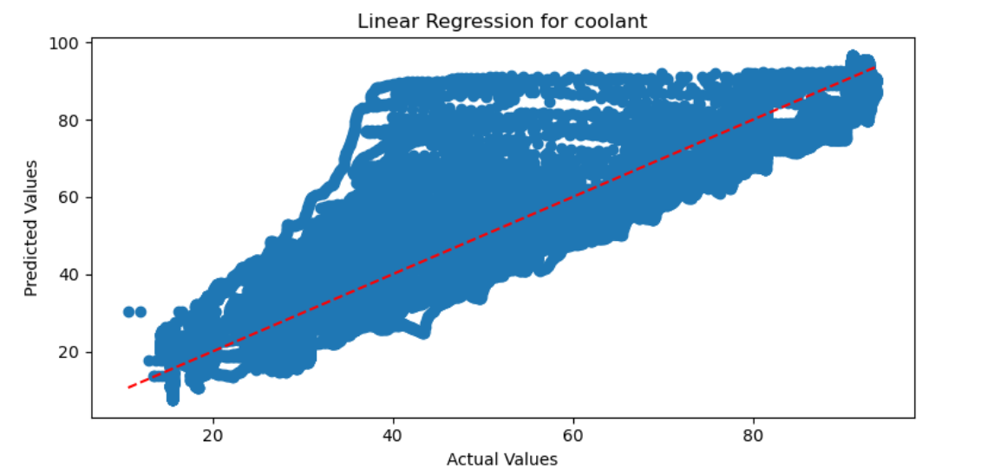
Linear Regression for Coolant

Slide 10
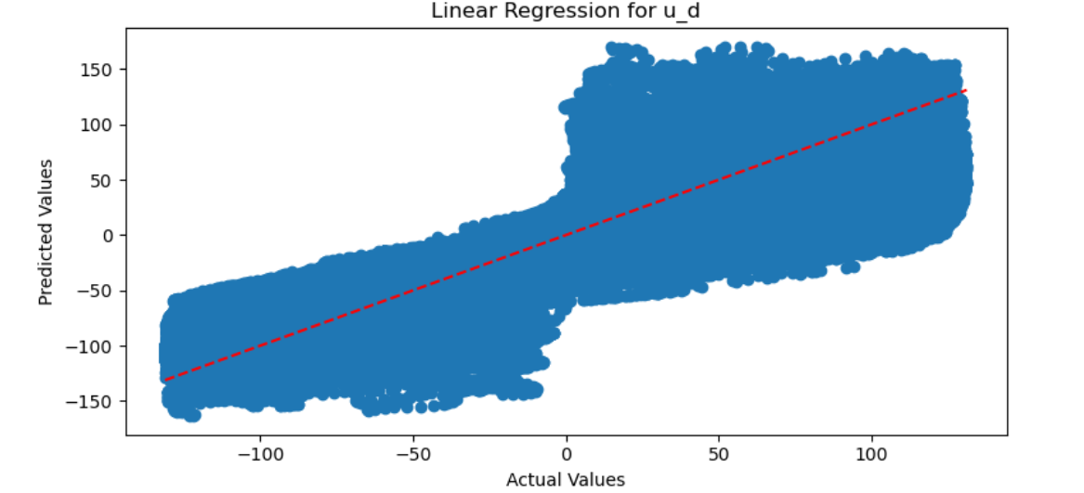
Linear Regression for u_d

Slide 11
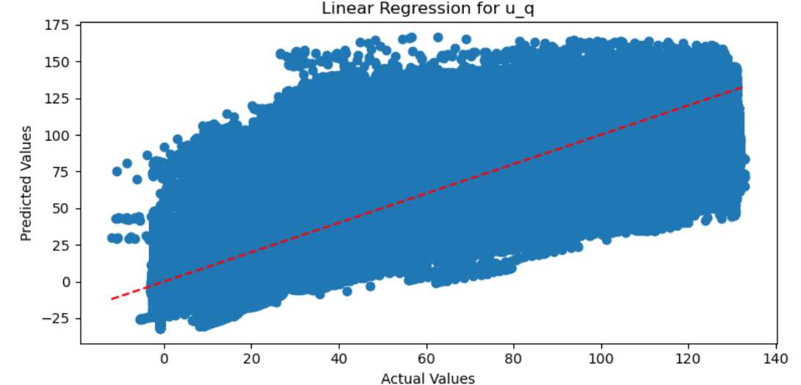
Linear Regression for U_q

Slide 12
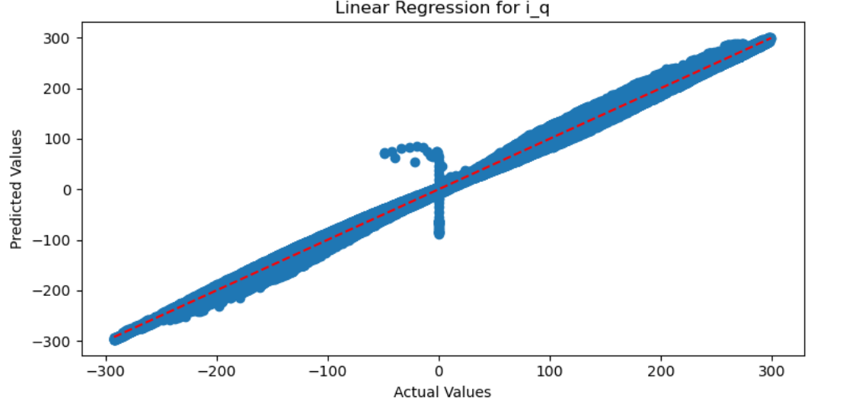
Linear Regression for I_Q

Slide 13
Graphs Plotted using EXCEL DASHBOARD

Slide 14
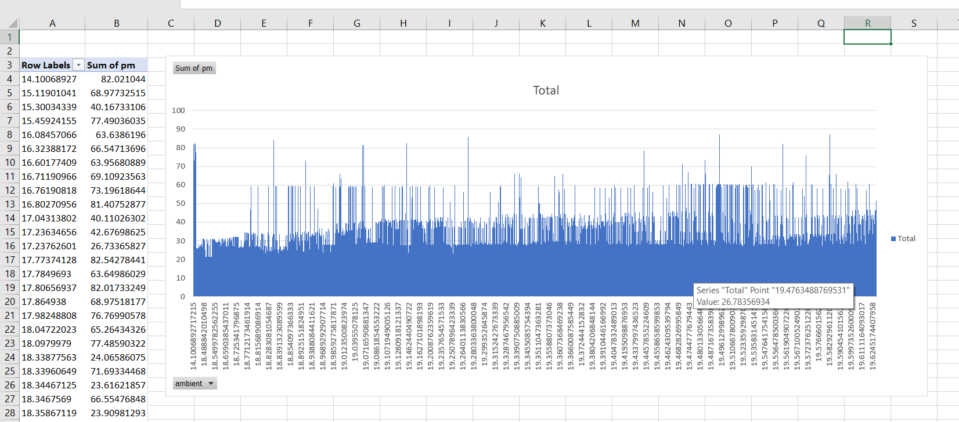
ambient vs pm

Slide 15
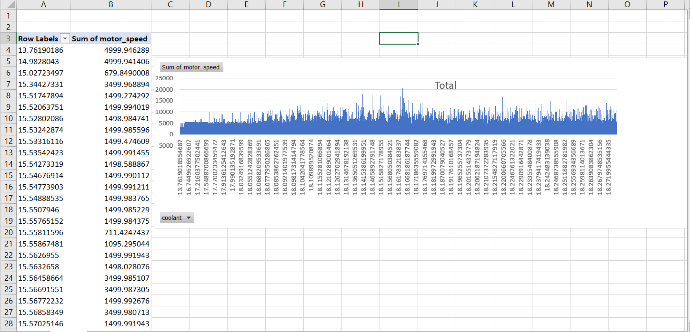
Coolant vs motor speed

Slide 16
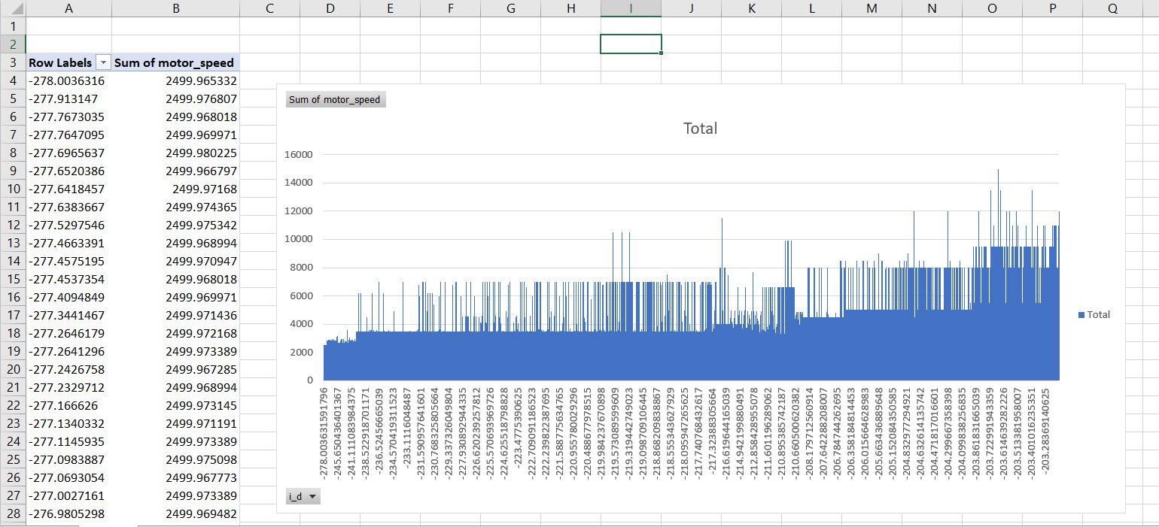
Current vs Motor speed

Slide 17
THANK YOU

