Slide 1
ParkiStep Twin
A patient-specific digital twin for forecasting freezing-of-gait episodes in Parkinson's disease
Research prototype - not a medical device
Team: [PENDING - to be supplied] | [PENDING - to be supplied]

Slide 2
The healthcare problem: freezing of gait
• Freezing of gait (FoG): a sudden, brief inability to step forward in Parkinson's disease - a common cause of falls
• Episodes are short, irregular and vary strongly between people and tasks
• Detecting a freeze that has already started is easier than forecasting its onset
• An advance warning could, in principle, give a person or a cueing system time to react - whether it helps is not shown here
• ParkiStep asks a narrower, testable question: how much onset information is in a short window of wearable data?
Research prototype - not a medical device. Outputs are experimental model scores.
2

Slide 3
Proposed solution: a continuously updating patient digital twin
Historical context
Dynamic stream
Clinical record per participant
(age, disease duration, Hoehn & Yahr, UPDRS-III, FoG-Q, MoCA, FES-I, PDQ-8; missing stays missing)
Wearable accelerometer + gyroscope observations replayed one sample at a time with a rolling buffer
Forecast + policy
Inspectable history
Trained model scores the next-H-seconds onset risk; a configurable warning policy turns scores into warnings
State, predictions and warnings are kept and shown in a dashboard, then compared with the annotations afterwards
Research prototype - not a medical device. Outputs are experimental model scores.
3

Slide 4
Why a digital twin? Combining slow context with fast signals
• The sensor window describes the last 2 seconds of movement; the clinical record describes the person
• A twin keeps both in one patient-specific state and updates it as data arrive
• Experiment: does adding the clinical record improve forecasts?
  - Answer so far: the paired participant bootstrap cannot distinguish clinical+sensor from sensor-only (every model and horizon)
  - Only 22 clinical profiles exist to learn from - a null result is expected, and not evidence that clinical data are useless
• The twin architecture is therefore demonstrated; a benefit from fusion is not
Research prototype - not a medical device. Outputs are experimental model scores.
4

Slide 5
Data sources: FoG-STAR (CC BY 4.0)
Stream | What it contains (from the dataset audit)
Wearable sensors | 329,027 samples at 60 Hz; 24 channels = 4 body positions (ankleL, ankleR, back, wrist) x accelerometer + gyroscope
Recordings | 106 recordings from 22 participants; structured laboratory tasks
Annotations | 101 FoG episodes from video (10 fps) in 16 participants; 9 run to the end of a recording
Clinical record | 9 fields per participant; 4 fields have missing values and 2 have out-of-documented-range values (kept, flagged)
Audit status | PASS_WITH_WARNINGS - every warning re-derived independently from the raw files (Phase 6)
Source: Borzì, L. et al. (2026) Sci Data 13, 305, doi:10.1038/s41597-026-06645-1 - zenodo.org/records/17838806. The dataset is not redistributed in the repository.
Research prototype - not a medical device. Outputs are experimental model scores.
5

Slide 6
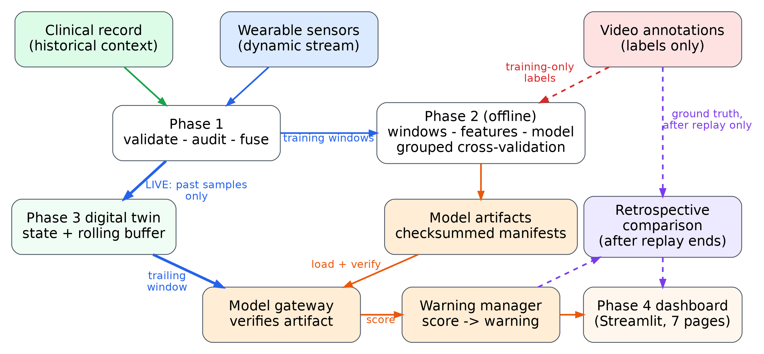
Architecture (as implemented)
blue: live sensor data (past only)
green: clinical context
orange: model artifacts / outputs
red dashed: training-only labels
purple dashed: retrospective evaluation
Simplified from the complete diagram (docs/phase6/architecture.pdf, vector). Future labels never enter live prediction.
Research prototype - not a medical device. Outputs are experimental model scores.
6

Slide 7
AI/ML methodology
• Target: does an annotated FoG episode START within the next H seconds? (H = 1, 3, 5 s evaluated)
• Input: only the trailing 2.0 s of sensor data, anchored every 0.2 s - never the future
• Windows that contain or follow an ongoing episode are excluded; futures not fully observed are censored
• Features: 516 sensor statistics (time-domain, frequency bands, cross-sensor); clinical fields added for the fusion experiment
• Models: logistic regression, random forest, and two dummy baselines (prior, random)
• Eligible windows: 18,877 at 3 s, of which 7.2% are positive - a heavily imbalanced problem
Research prototype - not a medical device. Outputs are experimental model scores.
7

Slide 8
Data fusion: clinical + sensor vs sensor only (3 s horizon)
Model | Inputs | Avg. precision | Event sensitivity [95% CI] | False alerts / h [95% CI]
logistic | sensor only | 0.157 | 0.09 [0.00, 0.23] (7/75) | 31.1 [5.1, 73.8]
logistic | clinical + sensor | 0.161 | 0.03 [0.00, 0.07] (2/75) | 10.0 [1.8, 24.0]
random forest | sensor only | 0.134 | 0.21 [0.04, 0.35] (16/75) | 74.3 [24.2, 123.9]
random forest | clinical + sensor | 0.147 | 0.11 [0.01, 0.24] (8/75) | 58.8 [8.4, 123.0]
• Prevalence (chance level for average precision) at 3 s: 0.062
• Paired participant bootstrap (Phase 2 report, section 4): no distinguishable difference for any model or horizon
Research prototype - not a medical device. Outputs are experimental model scores.
8

Slide 9
The digital-twin engine
State + rolling buffer
Model gateway
Per-patient state with a bounded buffer; observations are validated (timestamps, duplicates, order, missing channels) before use
Loads an artifact only after SHA-256, schema, horizon and threshold checks; never substitutes another model
Warning manager
History + persistence
Threshold, persistence and merge rules; explicit READY / STALE / unavailable states - a missing forecast is never shown as zero risk
Predictions, warnings and events kept in memory; optional SQLite store with rollback on failure
Research prototype - not a medical device. Outputs are experimental model scores.
9

Slide 10
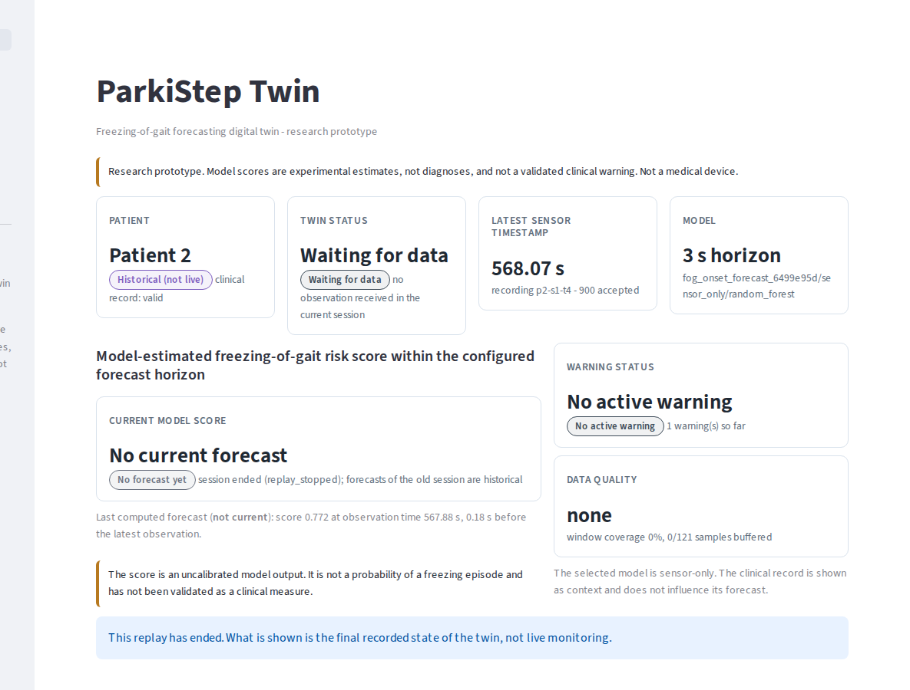
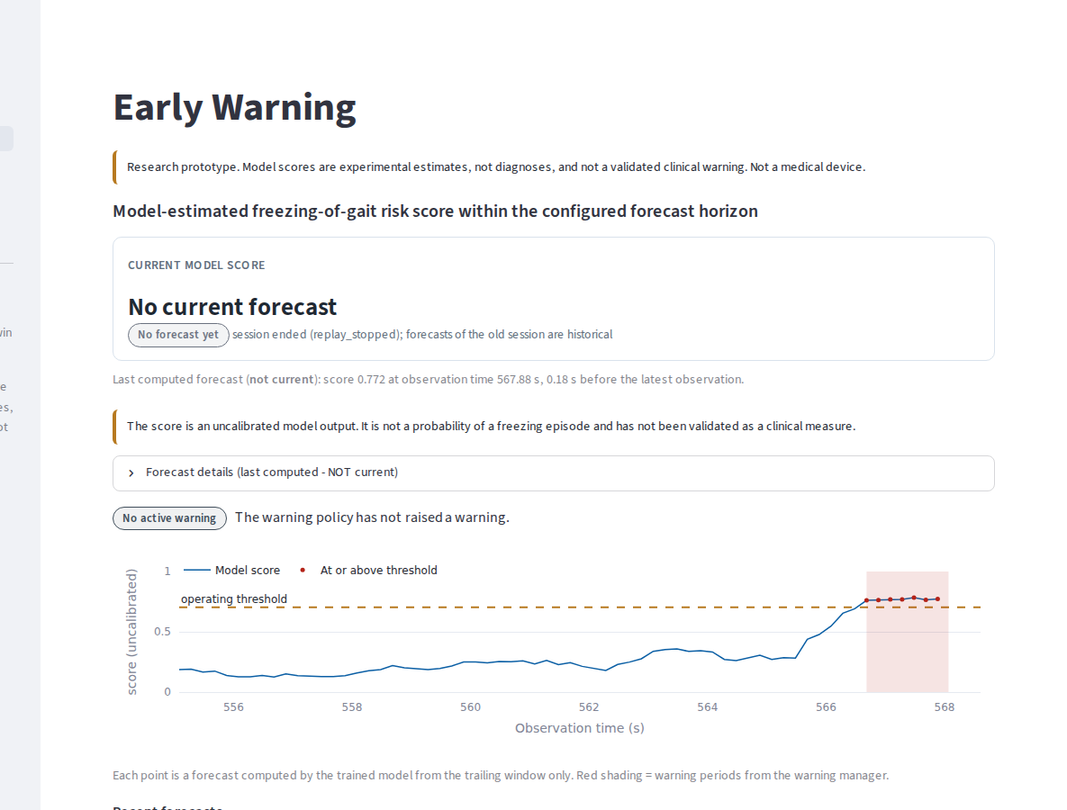
Dashboard (1/2): Overview and Early Warning
Overview: patient, twin state, forecast, warning, data quality
Early Warning: forecast history, threshold and warning periods
Real screenshots from scripts/p6_visual_review.py: Patient 2, recording p2-s1-t4, replay stopped after a few seconds (state after Stop). Seven pages in total.
Research prototype - not a medical device. Outputs are experimental model scores.
10

Slide 11
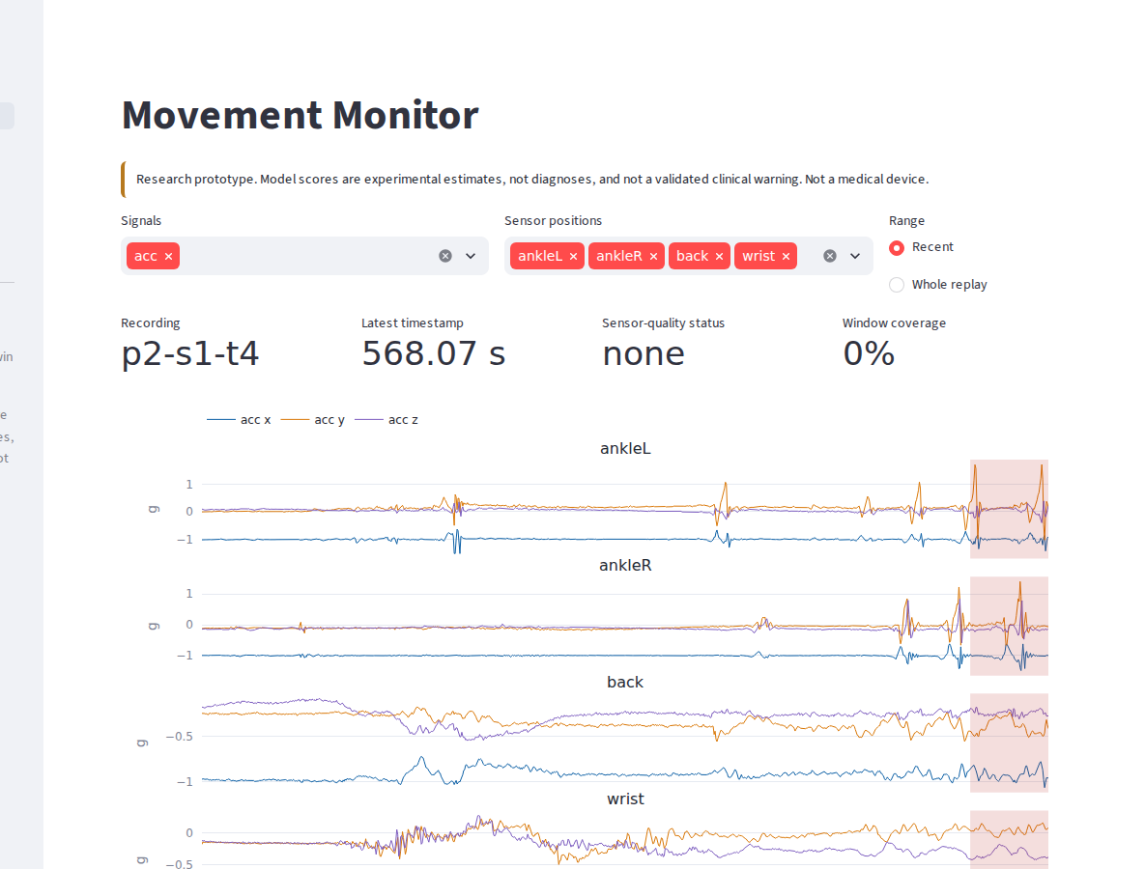
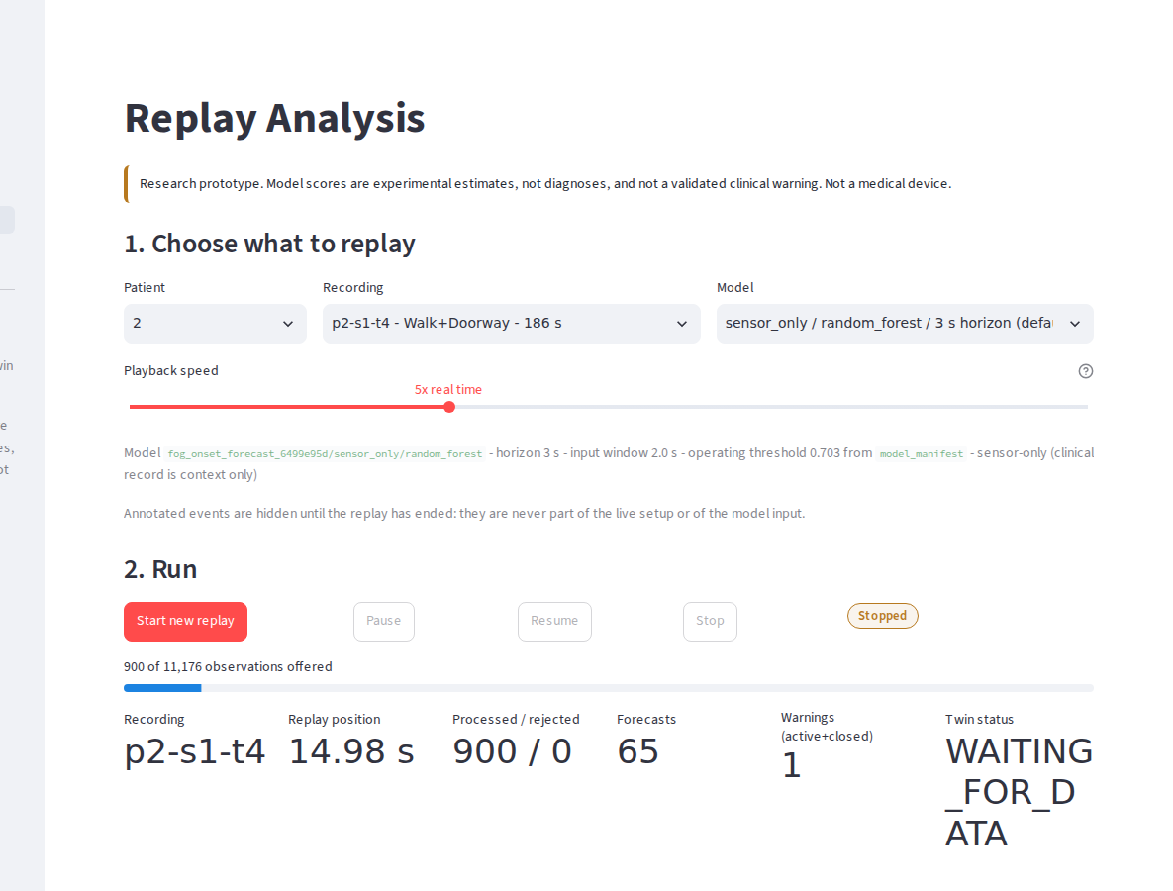
Dashboard (2/2): Movement Monitor and Replay Analysis
Movement Monitor: observed channels with warning periods
Replay Analysis: replay controls and retrospective analysis
Real screenshots from scripts/p6_visual_review.py: Patient 2, recording p2-s1-t4, replay stopped after a few seconds (state after Stop). Seven pages in total.
Research prototype - not a medical device. Outputs are experimental model scores.
11

Slide 12
Demonstration workflow: replaying a real recording
• 1. Launch: streamlit run app/Home.py
• 2. Replay Analysis: choose patient, one of that patient's recordings, model and speed
• 3. Start: the recording is fed to the twin sample by sample - annotations withheld
• 4. Watch signals, scores and warnings update; Pause / Resume / Stop at any time, other pages follow live
• 5. When the replay ends the annotations appear: detections, false warnings, lead times - labelled in-sample
Research prototype - not a medical device. Outputs are experimental model scores.
12

Slide 13
Evaluation methodology and leakage prevention
• Participant-grouped 5-fold cross-validation: no person is in both training and test folds
• Operating threshold chosen only on the training participants (false-alert budget 30 / hour)
• Events matched strictly: a warning counts only if it fires BEFORE the annotated onset and within the horizon; alerts after onset never count
• Annotations are withheld from the live twin and used only for labels (offline) and for scoring after a replay ends
• Uncertainty: 300 participant bootstrap resamples, 95% percentile intervals
• Saved final models were fitted on all participants -> dashboard replays are in-sample demonstrations
Research prototype - not a medical device. Outputs are experimental model scores.
13

Slide 14
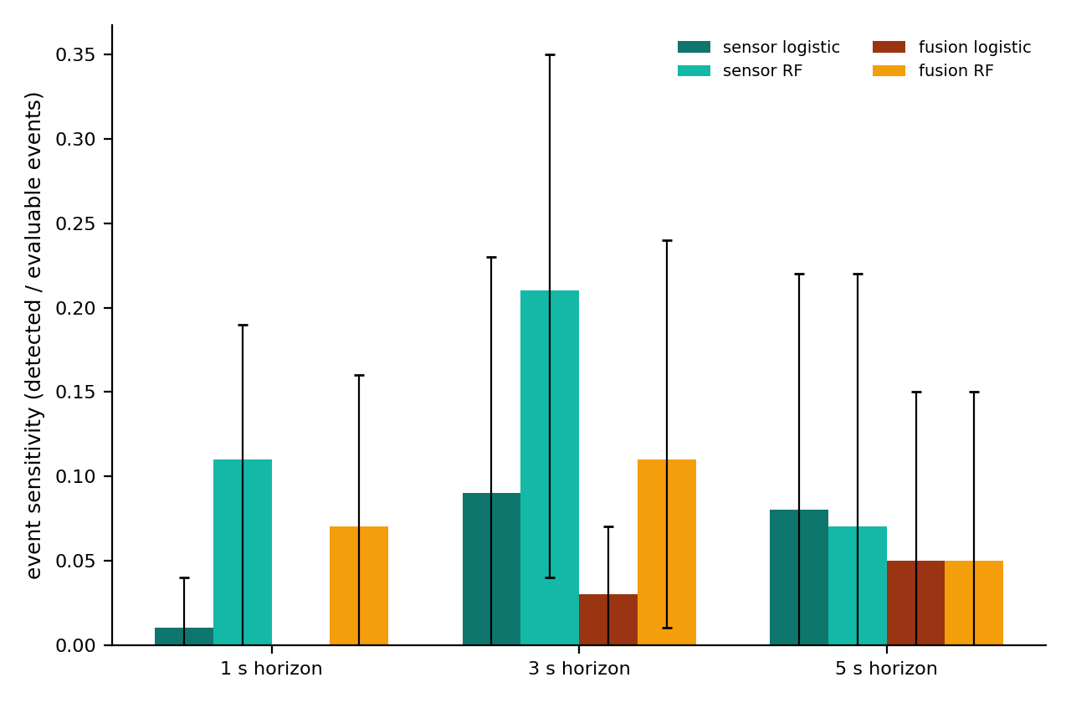
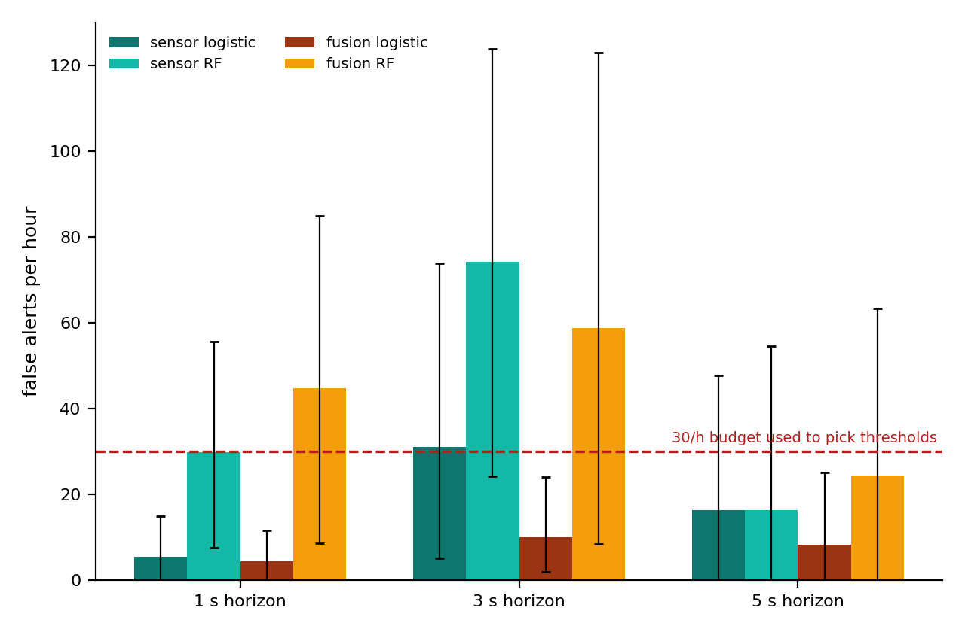
Results: out-of-sample, participant-grouped
Default dashboard model (sensor-only random forest, 3 s): sensitivity 0.21 (16/75; CI 0.04-0.35), 74.3 false alerts/h (CI 24.2-123.9), median lead 1.65 s, ROC-AUC 0.704. Error bars: 95% participant-bootstrap intervals.
Research prototype - not a medical device. Outputs are experimental model scores.
14

Slide 15
Failure cases and lessons
• Event sensitivity is low (at most 0.21) and the intervals are wide - the model finds few onsets
• Where it alerts, it alerts often: 74 false alerts/h for the default model - far above the 30/h budget used for threshold selection, so the threshold did not transfer to new participants
• Average precision is above chance but modest; probability scores are uncalibrated
• Clinical fusion showed no measurable gain with 22 profiles
• Some recordings give no forecast at all (sensor-quality gate); the UI says why instead of showing a score
• Lesson: 22 people and ~1 hour of scored time cannot support a clinical claim; the value of the project is the transparent pipeline
Research prototype - not a medical device. Outputs are experimental model scores.
15

Slide 16
Reliability and verification (Phase 6 re-verification)
Check | Result (generated report in reports/phase6/)
Full regression, real data + real model | 331 tests: 331 passed, 0 failed, 0 skipped
Model artifacts | 24/24 pass SHA-256 + schema + real inference (tamper control detected)
Replay metrics, recomputed independently | 0 discrepancies vs saved analysis (13 metrics)
Browser failure paths (real Chromium) | 7/7 scenarios, 68 checks
Multi-patient browser test | 3 patients, 6 recordings, 47/47 checks
Soak test | 94 cycles in 244 s; memory slope 0.32 MB/cycle - short run, not proof of no leak
Viewport review | 42/42 page-viewport automated checks; a sample of 7 screenshots reviewed by hand (listed in PHASE5_FINAL_VERIFICATION.md)
Research prototype - not a medical device. Outputs are experimental model scores.
16

Slide 17
Privacy, licensing and responsible use
• Only a published, permitted open dataset (CC BY 4.0) is used; it is not redistributed in the repository and no secrets are committed
• Replays are playback of recorded data - no live patient is monitored
• Source code: MIT (copyright holder to be confirmed by the owner); dataset and libraries keep their own licences (THIRD_PARTY_NOTICES.md)
• Trained models derive from the dataset: their redistribution terms must be confirmed before publication
• Outputs are research scores - not diagnoses, not validated warnings, not for treatment or safety-critical use
Research prototype - not a medical device. Outputs are experimental model scores.
17

Slide 18
Future work (not implemented)
• More participants and free-living recordings to test generalisation beyond laboratory tasks
• Probability calibration and thresholds evaluated per participant, to bring false alerts under control
• Personalisation: patient-specific baselines inside the twin
• Prospective clinical evaluation with clinician input before any claim about outcomes
• Live wearable ingestion (the engine already consumes observations one at a time)
Research prototype - not a medical device. Outputs are experimental model scores.
18

Slide 19
Conclusion
• Demonstrated: an end-to-end, reproducible, inspectable pipeline - data audit, leakage-safe forecasting, a checksum-gated digital twin, and a dashboard that shows failures honestly
• Not demonstrated: clinically useful forecasting - sensitivity is low, false alerts are frequent, and fusion adds nothing measurable
• The honest outcome is a transparent research baseline others can reproduce and improve
Research prototype - not a medical device. Outputs are experimental model scores.
19

Slide 20
Repository and resources
Item | Value
Public repository | [PENDING - available after publication]
Demonstration video | [PENDING - not yet recorded]
Team | [PENDING - to be supplied]
Members | [PENDING - to be supplied]
Dataset | FoG-STAR, zenodo.org/records/17838806 (CC BY 4.0)
Citation | Borzì, L. et al. (2026) Sci Data 13, 305, doi:10.1038/s41597-026-06645-1
Research prototype - not a medical device. Outputs are experimental model scores.
20

