Slide 1
AI LAB
GROUP 30
ABHISHEK 120050008
PINTU 120050018
JAYESH 120050022

Slide 2
LAB 1 : A* Algorithm
Used open and closed lists
Did parent pointer redirection
Verified better heuristic performs better
Compared displaced tiles and manhattan distance heuristics
Created our own heuristic
Designed a non-reachability test

Slide 3
LAB 2 : Monotone Restriction and Bidirectional A*
Applied monotone restriction
Implemented bidirectional A*
This performed better than A*

Slide 4
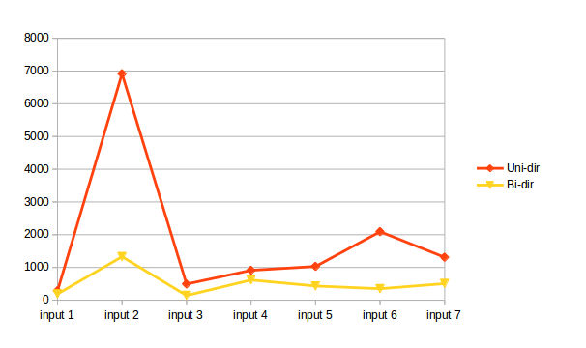
A* Algorithm Graphs (No. of expanded nodes)

Slide 5
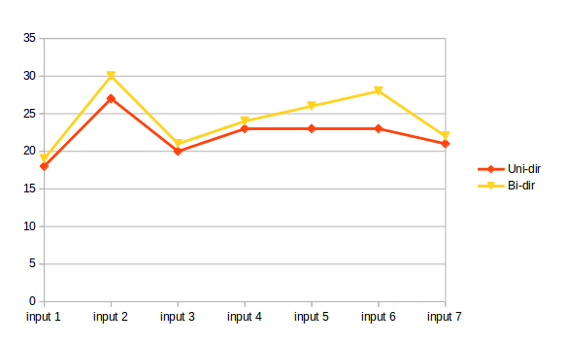
A* Algorithm Graphs (Path Length)

Slide 6
LAB 2 : Monotone Restriction and Bidirectional A*
Our own heuristic :-
RMS of manhattan distance and no. of displaced tiles
We chose this value because it’s less than h* (since both of them are less than h*) and it’s larger than the average.

Slide 7
LAB 2 : Test Cases and Observations
We ran A* on 5 different test cases i.e. from 5 different start states :-
1 2 3 5 7 4 0 8 6
7 5 3 8 2 1 0 6 4
1 4 2 5 8 3 0 6 7
1 5 8 3 4 0 6 7 2
1 5 0 8 3 4 6 7 2
The following slides show the output for manhattan, displaced tiles and our own heuristic (RMS)

Slide 8
LAB 2 : Manhattan Outputs
The outputs for the 5 cases mentioned before are :-
No. of nodes expanded = 31
No. of steps = 10
No. of nodes expanded = 391
No. of steps = 20
No. of nodes expanded = 707
No. of steps = 20
No. of nodes expanded = 2530
No. of steps = 25
No. of nodes expanded = 128
No. of steps = 18

Slide 9
LAB 2 : RMS Outputs
The outputs for the 5 cases mentioned before are :-
No. of nodes expanded = 32
No. of steps = 10
No. of nodes expanded = 816
No. of steps = 20
No. of nodes expanded = 1146
No. of steps = 20
No. of nodes expanded = 5057
No. of steps = 25
No. of nodes expanded = 270
No. of steps = 18

Slide 10
LAB 2 : Displaced Tiles Outputs
The outputs for the 5 cases mentioned before are :-
No. of nodes expanded = 52
No. of steps = 10
No. of nodes expanded = 3254
No. of steps = 20
No. of nodes expanded = 3654
No. of steps = 20
No. of nodes expanded = 29896
No. of steps = 25
No. of nodes expanded = 1351
No. of steps = 18

Slide 11
LAB 2 : Observations
As we can see the best heuristic from the 3 is Manhattan.
Our heuristic (RMS) performs better than Displaced tiles but poorer than Manhattan
The worst heuristic is Displaced Tiles

Slide 12
LAB 3 : Theorem Prover
Input : well formed formula in PL
Output : Yes/No depending on whether input is a theorem or not
Used syntactic method (without truth table)
Applied 1st principle, 2nd principle and deduction theorem
Displayed the path of the proof if output was Yes

Slide 13
LAB 4 : Digital Circuit Simulator
Used prolog to implement AND, OR, NAND, NOR gates
Made 2 files, general.pl and circuit.pl
General.pl had circuit independent knowledge
Circuit.pl had circuit specific knowledge
Defined prolog predicates : points/terminals, connection etc.
Goal was verify(gate,inputs,output)
Also implemented a check function to check for break in circuit

Slide 14
LAB 5 : HMM based G->P
This is a generative approach
Trained with data obtained from cmu-dict
Performed 5-fold cross validation
Accuracy was found to be 76.3%

Slide 15
LAB 5 : HMM based G->P
Calculated the Confusion Matrix, i.e. which phoneme is being confused with which other phoneme
Calculated the per Grapheme Accuracy
Calculated the per Phoneme Accuracy
We observed a very bad accuracy for vowels and the letter 'Y' whereas the accuracy for other characters came out to be 81.9%

Slide 16
LAB 5 : HMM based P->G
Trained with data obtained from cmu-dict
Performed 5-fold cross validation
Accuracy was found to be 64.3%

Slide 17
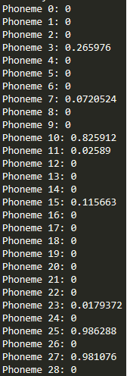
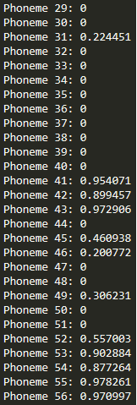
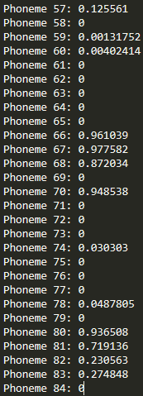
LAB 5 : Per Phoneme Accuracy
There are a total of 84 phonemes
The following are the per phoneme accuracies :-

Slide 18
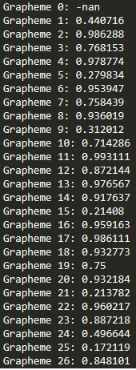
LAB 5 : Per Grapheme Accuracy
There are a total of 26 graphemes
The following are the per grapheme accuracies :-

Slide 19
LAB 5 : Observations about per grapheme and per phoneme accuracies
Since a majority of the phonemes do not occur in the training data set i.e. the one having equal number of graphemes and phonemes, so a lot of the per phoneme accuracies are 0.
The phoneme 0 is the start state “^” and the phonemes 1 to 84 are the ones in the file cmudict-0.7b.symbols
The per grapheme accuracies of vowels i.e. A(1), E(5), I(9), O(15), U(21) are considerably low then the others. If we remove these and then check the accuracy then the accuracy jumps to 0.819876 i.e. almost 82%
Also an unusual finding was that the accuracy of letter Y i.e. grapheme 25 is very low.

Slide 20

LAB 5 : Confusion Matrix
The confusion matrix was formed by assuming a threshold of 200 i.e. only those phonemes who were being mismatched more than 200 times with other phonemes were considered. The following matrix was obtained. In the matrix, the 1st column is the generated phoneme, the 2nd column is the expected phoneme, and the third column is the number of mismatches :

Slide 21
LAB 5 : Confusion Matrix Observations
As we can see the most confused phoneme is AH0 i.e. phoneme 10.

Slide 22
LAB 6 : Perceptron
Implemented Perceptron Training Algorithm to train a perceptron on a given truth table.
Implemented the sigmoid function

Slide 23
LAB 7 : Neural Net
This is a discriminative approach for the G->P problem
We used 3 layers for our approach
Input layer has 140 neurons
Output layer has 196 neurons
We used 1 hidden layer having average number of neurons
First we trained this on the parallel corpus until error < threshold
Then we gave input and checked accuracy by matching against predicted output
Our accuracy came around ~10%

