Slide 1
FINAL PROJECT
NAME: Meenatchi S
NM ID: au513121104021
DEPT: BE CSE III-Year

Slide 2
PROJECT TITLE
PHOTO-TO-SKETCH AUTOENCODER
( Transforming pixels to strokes, unveiling beauty in lines)

Slide 3
AGENDA
PROBLEM STATEMENT
PROJECT OVERVIEW
END USERS
SOLUTION AND ITS VALUE PROPOSITION
WOW IN SOLUTION
MODELLING
RESULTS

Slide 4
PROBLEM STATEMENT
To Create a convolutional autoencoder model to transform photographs into sketches. Utilize deep learning techniques to bridge the gap between photo and sketch domains. Evaluate model performance through metrics and visual inspection of results.

Slide 5
PROJECT OVERVIEW
Problem Identification
Data Preprocessing
Model Architecture
Training and Evaluation
Result Visualization
Develop a photo-to-sketch conversion system using convolutional autoencoders.
Preprocess and augment image data to enhance model training diversity.
Design a convolutional autoencoder with encoder-decoder components for feature extraction and generation.
Train the model on the augmented dataset with appropriate loss functions and optimizers and assess model performance using evaluation metrics such as loss and accuracy.
Display the effectiveness of the model by showcasing converted sketches from original photos..

Slide 6
END USERS
Artists and Designers
Utilize the system as a creative tool to generate sketches from photographs for artistic inspiration and design projects.
Photographers
Transform photographs into sketches to offer clients unique and customizable artistic outputs, enriching their portfolio.
Educators and Students
Digital Content Creators
Incorporate the system into educational curriculums to teach image processing techniques and foster creativity in digital arts.
Integrate the tool into multimedia workflows to enhance visual storytelling by adding artistic elements to videos, animations, and digital content.

Slide 7
SOLUTION
VALUE PROPOSITION
The photo-to-sketch system employs convolutional autoencoders for accurate photo-to-sketch transformation through robust preprocessing and comprehensive evaluation.
Efficiently transforms photos into sketches, fostering creativity and enhancing visual storytelling through accurate and customizable outputs.

Slide 8
WOW IN SOLUTION
Problem Identification
Revealing the artistry hidden within photographs through innovative AI-driven sketch generation.
Data Preprocessing
Harnessing the power of augmentation to enrich our dataset, paving the way for robust model training.
Model Architecture
Crafting a neural network masterpiece with convolutional layers and LeakyReLU activations, sculpting photo-to-sketch transformations
Training and Evaluation
Navigating the creative landscape with precision using Mean Absolute Error loss and Adam optimizer, achieving stunning results."
Result Visualization
Bringing the magic of AI to life through captivating displays of original photos, their corresponding sketches, and flawlessly predicted images

Slide 9
MODELLING
Train model with training data
Adjust model architecture and parameters
Test for generalization on unseen data
Visualize model predictions and ground truth
Conclude findings and plan future steps

Slide 10
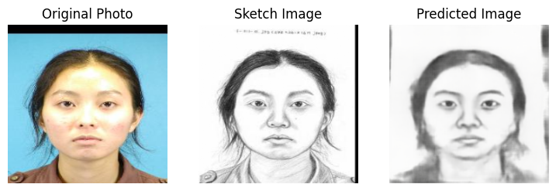
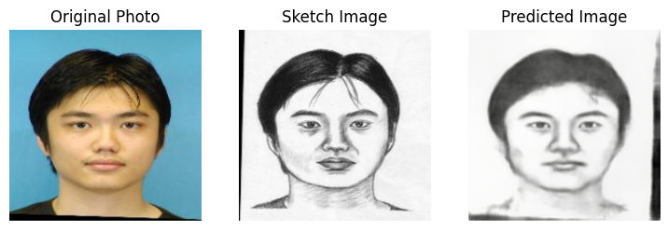
RESULT

Slide 11
THANK YOU!

