Slide 1


CASE STUDY : 04
Air Quality Prediction in Urban Areas

Slide 2
Team:
1. M. MEENATCHI - S4F_CP_TEAM_21409 - TEAM LEADER
2. J. SUHANA - S4F_CP_TEAM_21409 - TEAM MEMBER
3. P. GAYATHRI - S4F_CP_TEAM_21409 - TEAM MEMBER
4. S. LAVANYA - S4F_CP_TEAM_21409 - TEAM MEMBER

Slide 3
Content
Abstract
Problem Statement
Objective
Data Collection and Preparation
Proposed Solution (Methodology)
Model Performance Evaluation
Screenshots / Demonstration (video)
Future Scope
Conclusion
Notes:
Abstract
Problem Statement (Clearly define the challenge)
Objective (State your project's goal)
Background and Research (Discuss existing solutions, trends, and gaps)
Data Collection and Preparation (Focus on data sources, cleaning, and augmentation)
Proposed Solution (Methodology)
Model Architecture (e.g., CNN, U-Net, YOLOv5)
Key Techniques (e.g., Transfer Learning, Image Augmentation)
Model Performance Evaluation
Metrics (Accuracy, Precision, Recall, IoU, etc.)
Graphs (Confusion Matrix, ROC Curve, etc.)
Screenshots / Demonstration (Visual proof of system functionality)
Future Scope (Improvements, scalability, and integration ideas)
Conclusion (Summarize results and impact)
Q&A Session

Slide 4
Abstract
This case study examines the use of machine learning to predict air quality levels in urban environments, highlighting the challenges of air pollution and the potential of AI to offer timely insights. By utilizing comprehensive datasets, including air quality readings, traffic information, and weather data, the study aims to create a predictive model for the Air Quality Index (AQI). It also explores how this model can be integrated into urban management systems for more effective decision-making.

Slide 5
Problem Statement
Air pollution presents a significant threat to public health and the environment in cities. Traditional methods of monitoring air quality are inadequate because of limited sensor coverage and a lack of real-time data. There is an urgent demand for advanced predictive models that can leverage available data to accurately predict air quality levels.

Slide 6
Objective
The main goal of this study is to create a machine learning model that can forecast air quality indices (AQI) for urban areas up to 24 hours ahead. Additionally, the study aims to investigate how this model can be integrated into current traffic management systems to support strategies for reducing pollution.

Slide 7
Data Collection and Preparation
The dataset includes three years' worth of air quality data (PM2.5, PM10, NO2, CO), along with related traffic information and weather conditions. Data preprocessing will involve addressing missing values, normalizing the data, and selecting key features to ensure the model is trained using the most relevant variables.

Slide 8
Proposed Solution (Methodology)
The approach involves choosing suitable machine learning algorithms, such as Random Forest, Gradient Boosting, or Neural Networks, to forecast AQI. The model will be trained on historical data, utilizing cross-validation methods to prevent overfitting. Hyperparameter optimization will be performed to enhance the model's performance.

Slide 9
Model Performance Evaluation
The model's performance will be assessed using metrics like Mean Absolute Error (MAE), Root Mean Squared Error (RMSE), and R-squared values. A comparison of various algorithms will be provided to determine which one delivers the most accurate AQI predictions.

Slide 10
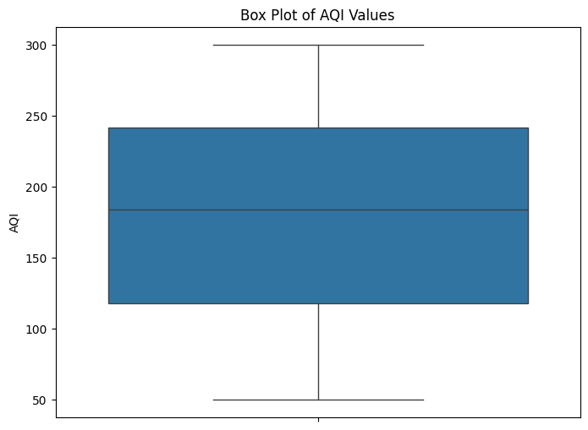
Screenshots / Demonstration (video)
GITHUB LINK: https://github.com/Meenatchi2005/AI-and-green-skills-case-study-4

Slide 11
Future Scope
Future research will focus on integrating the predictive model with traffic management systems to support real-time decision-making and reduce pollution. Furthermore, the study will explore the possibility of incorporating socioeconomic data to enhance air quality predictions.

Slide 12
Case study 4:Questions
1. How can machine learning models be used to predict air quality levels?
Machine learning models can predict air quality by examining past data (such as pollutant levels, weather, and traffic) and recognizing patterns. Once trained, the model can forecast future AQI levels using input factors like weather predictions and current pollutant concentrations.
2. Which features in the dataset are likely to have the most significant impact on air quality?
Key factors include:
Pollutant concentrations (PM2.5, PM10, CO, NO2, SO2, ozone)
Weather variables (temperature, humidity, wind speed)
Traffic information (vehicle count, congestion levels)
Time of day and seasonal patterns
Industrial activities
Geographic elements (location, terrain)

Slide 13
3. Build a model to predict AQI for the next 24 hours.
from sklearn.ensemble import RandomForestRegressor
from sklearn.model_selection import train_test_split
import pandas as pd
# Load data
data = pd.read_csv('air_quality_data.csv')
# Features and target
features = data[['PM2.5', 'PM10', 'NO2', 'CO', 'Temperature', 'Humidity', 'Traffic_Density']]
target = data['AQI']
# Train-test split
X_train, X_test, y_train, y_test = train_test_split(features, target, test_size=0.2, random_state=42)
# Model training
model = RandomForestRegressor()
model.fit(X_train, y_train)
# Prediction for next 24 hours
predicted_aqi = model.predict(X_test)

Slide 14
4. How can this model be integrated with a city's traffic management system to reduce pollution?
The AQI prediction model can be integrated with traffic systems, enabling real-time traffic management to alleviate congestion in areas with high pollution. It can adjust traffic signal timings to reduce idling and encourage environmentally friendly transportation options, such as public transit or carpooling, based on predicted pollution levels.
5. Discuss the role of AI in mitigating air pollution in developing countries.
AI can assist by offering affordable pollution monitoring, improving traffic and public transportation efficiency, suggesting energy-saving practices, controlling industrial emissions, and enabling data-driven policies to reduce pollution. These capabilities are especially valuable for developing countries with limited resources.

Slide 15
Conclusion
This case study emphasizes the essential role of AI in improving air quality prediction in urban environments. By utilizing machine learning, cities can take proactive measures to tackle air pollution, leading to better public health and environmental sustainability.

