Slide 1
Chapter 5 – System Modeling
Lecture 1

Slide 2
Topics covered
Context models
Interaction models
Behavioral models
Object Model

Slide 3
System modeling
System modeling is the process of developing abstract models of a system, with each model presenting a different view or perspective of that system.
System modeling has now come to mean representing a system using some kind of graphical notation, which is now almost always based on notations in the Unified Modeling Language (UML).
System modelling helps the analyst to understand the functionality of the system and models are used to communicate with customers.

Slide 4
Existing and planned system models
Models of the existing system are used during requirements engineering. They help clarify what the existing system does and can be used as a basis for discussing its strengths and weaknesses. These then lead to requirements for the new system.
Models of the new system are used during requirements engineering to help explain the proposed requirements to other system stakeholders. Engineers use these models to discuss design proposals and to document the system for implementation.
In a model-driven engineering process, it is possible to generate a complete or partial system implementation from the system model.

Slide 5
System perspectives
An external perspective, where you model the context or environment of the system.
An interaction perspective, where you model the interactions between a system and its environment, or between the components of a system.
A structural perspective, where you model the organization of a system or the structure of the data that is processed by the system.
A behavioral perspective, where you model the dynamic behavior of the system and how it responds to events.

Slide 6
UML diagram types
Activity diagrams, which show the activities involved in a process or in data processing .
Use case diagrams, which show the interactions between a system and its environment.
Sequence diagrams, which show interactions between actors and the system and between system components.
Class diagrams, which show the object classes in the system and the associations between these classes.
State diagrams, which show how the system reacts to
internal and external events.

Slide 7
Use of graphical models
As a means of facilitating discussion about an existing or proposed system
Incomplete and incorrect models are OK as their role is to support discussion.
As a way of documenting an existing system
Models should be an accurate representation of the system but
need not be complete.
As a detailed system description that can be used to generate a system implementation
Models have to be both correct and complete.

Slide 8
Context models
Context models are used to illustrate the operational context of a system - they show what lies outside the system boundaries.
Social and organisational concerns may affect the decision on where to position system boundaries.
Architectural models show the system and its
relationship with other systems.

Slide 9
System boundaries
System boundaries are established to define what is inside and what is outside the system.
They show other systems that are used or depend on the system being developed.
The position of the system boundary has a profound effect on the system requirements.
Defining a system boundary is a political judgment
There may be pressures to develop system boundaries that increase / decrease the influence or workload of different parts of an organization.

Slide 10
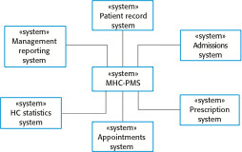
The context of the MHC-PMS

Slide 11
Process perspective
Context models simply show the other systems in the environment, not how the system being developed is used in that environment.
Process models reveal how the system being developed is used in broader business processes.
UML activity diagrams may be used to define business
process models.

Slide 12
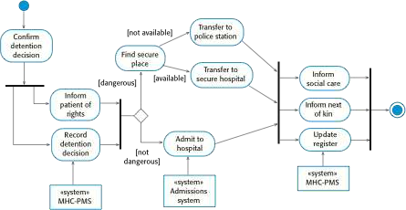
Process model of involuntary detention

Slide 13
Interaction models
Modeling user interaction is important as it helps to identify user requirements.
Modeling system-to-system interaction highlights the communication problems that may arise.
Modeling component interaction helps us understand if a proposed system structure is likely to deliver the required system performance and dependability.
Use case diagrams and sequence diagrams may be used for interaction modeling.

Slide 14
Use case modeling
Use cases were developed originally to support requirements elicitation and now incorporated into the UML.
Each use case represents a discrete task that involves external interaction with a system.
Actors in a use case may be people or other systems.
Represented diagramatically to provide an overview of the use case and in a more detailed textual form.

Slide 15

Transfer-data use case
A use case in the MHC-PMS

Slide 16
Tabular description of the ‘Transfer data’ use-
case
MHC-PMS: Transfer data
Actors | Medical receptionist, patient records system (PRS)
Description | A receptionist may transfer data from the MHC-PMS to a general patient record database that is maintained by a health authority. The information transferred may either be updated personal information (address, phone number, etc.) or a summary of the patient’s diagnosis and treatment.
Data | Patient’s personal information, treatment summary
Stimulus | User command issued by medical receptionist
Response | Confirmation that PRS has been updated
Comments | The receptionist must have appropriate security permissions to access the patient information and the PRS.

Slide 17
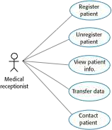
Use cases in the MHC-PMS involving the role
‘Medical Receptionist’

Slide 18
Sequence diagrams
Sequence diagrams are part of the UML and are used to model the interactions between the actors and the objects within a system.
A sequence diagram shows the sequence of interactions that take place during a particular use case or use case instance.
The objects and actors involved are listed along the top of the diagram, with a dotted line drawn vertically from these.
Interactions between objects are indicated by annotated
arrows.

Slide 19
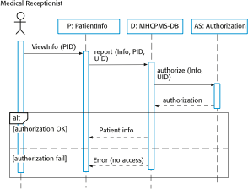
Sequence diagram for View patient information

Slide 20
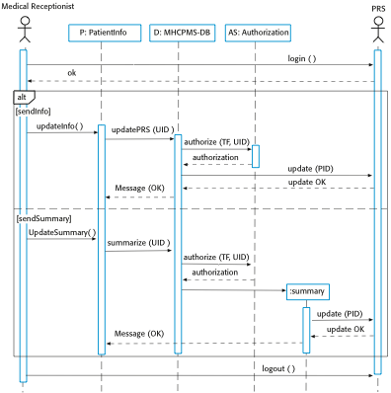
Sequence diagram for Transfer Data

Slide 21
Key points
A model is an abstract view of a system that ignores system details. Complementary system models can be developed to show the system’s context, interactions, structure and behavior.
Context models show how a system that is being modeled is positioned in an environment with other systems and processes.
Use case diagrams and sequence diagrams are used to describe the interactions between users and systems in the system being designed. Use cases describe interactions between a system and external actors; sequence diagrams add more information to these by showing interactions between system objects.
Structural models show the organization and architecture of a system. Class diagrams are used to define the static structure of classes in a system and their associations.

Slide 22
Chapter 5 – System Modeling
Lecture 2

Slide 23
Behavioral models
Behavioral models are models of the dynamic behavior of a system as it is executing. They show what happens or what is supposed to happen when a system responds to a stimulus from its environment.
You can think of these stimuli as being of two types:
Data Some data arrives that has to be processed by the system.
Events Some event happens that triggers system processing. Events may have associated data, although this is not always the case.

Slide 24
DFD

Slide 25
Data-driven modeling
Many business systems are data-processing systems that are primarily driven by data. They are controlled by the data input to the system, with relatively little external event processing.
Data-driven models show the sequence of actions involved in processing input data and generating an associated output.
They are particularly useful during the analysis of requirements as they can be used to show end-to-end processing in a system.

Slide 26
Event-driven modeling
Real-time systems are often event-driven, with minimal data processing. For example, a landline phone
switching system responds to events such as ‘receiver off hook’ bygenerating a dial tone.
Event-driven modeling shows how a system responds to external and internal events.
It is based on the assumption that a system has a finite number of states and that events (stimuli) may cause a transition from one state to another.

Slide 27
State machine models
These model the behaviour of the system in response to external and internal events.
They show the system’s responses to stimuli so are often used for modelling real-time systems.
State machine models show system states as nodes and events as arcs between these nodes. When an event occurs, the system moves from one state to another.
Statecharts are an integral part of the UML and are used to represent state machine models.

Slide 28
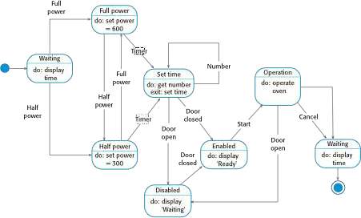
State diagram of a microwave oven

Slide 29
States and stimuli for the microwave oven (a)
State | Description
Waiting | The oven is waiting for input. The display shows the current time.
Half power | The oven power is set to 300 watts. The display shows ‘Half power’.
Full power | The oven power is set to 600 watts. The display shows ‘Full power’.
Set time | The cooking time is set to the user’s input value. The display shows the cooking time selected and is updated as the time is set.
Disabled | Oven operation is disabled for safety. Interior oven light is on. Display shows ‘Not ready’.
Enabled | Oven operation is enabled. Interior oven light is off. Display shows ‘Ready to cook’.
Operation | Oven in operation. Interior oven light is on. Display shows the timer countdown. On completion of cooking, the buzzer is sounded for five seconds. Oven light is on. Display shows ‘Cooking complete’ while buzzer is sounding.

Slide 30
States and stimuli for the microwave oven (b)
Stimulus | Description
Half power | The user has pressed the half-power button.
Full power | The user has pressed the full-power button.
Timer | The user has pressed one of the timer buttons.
Number | The user has pressed a numeric key.
Door open | The oven door switch is not closed.
Door closed | The oven door switch is closed.
Start | The user has pressed the Start button.
Cancel | The user has pressed the Cancel button.

Slide 31
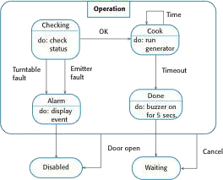
Microwave oven operation

Slide 32
Key points
Behavioral models are used to describe the dynamic behavior of an executing system. This behavior can be modeled from the perspective of the data processed by the system, or by the events that stimulate responses from a system.
Activity diagrams may be used to model the processing of data, where each activity represents one process step.
State diagrams are used to model a system’s behavior in response to internal or external events.
Model-driven engineering is an approach to software development in which a system is represented as a set of models that can be automatically transformed to executable code.

Slide 33
Data dictionary entries

Slide 34
8.4. Object models
Object models describe the system in terms of object classes and their associations.
An object class is an abstraction over a set of objects with common attributes and the services (operations) provided by each object.
Various object models may be produced
Inheritance models;
Aggregation models;
Interaction models.

Slide 35
Object models
Natural ways of reflecting the real-world entities manipulated by the system
More abstract entities are more difficult to model using this approach
Object class identification is recognised as a difficult process requiring a deep understanding of the application domain
Object classes reflecting domain entities are reusable across systems

Slide 36
Inheritance models
Organise the domain object classes into a hierarchy.
Classes at the top of the hierarchy reflect the common features of all classes.
Object classes inherit their attributes and services from one or more super-classes. these may then be specialised as necessary.
Class hierarchy design can be a difficult process if duplication in different branches is to be avoided.

Slide 37
Object models and the UML
The UML is a standard representation devised by the developers of widely used object-oriented analysis and design methods.
It has become an effective standard for object-oriented modelling.
Notation
Object classes are rectangles with the name at the top, attributes in the middle section and operations in the bottom section;
Relationships between object classes (known as associations) are shown as lines linking objects;
Inheritance is referred to as generalisation and is shown ‘upwards’ rather than ‘downwards’ in a hierarchy.

Slide 38
Library class hierarchy

Slide 39
User class hierarchy

Slide 40
Multiple inheritance
Rather than inheriting the attributes and services from a single parent class, a system which supports multiple inheritance allows object classes to inherit from several super-classes.
This can lead to semantic conflicts where attributes/services with the same name in different super-classes have different semantics.
Multiple inheritance makes class hierarchy reorganisation more complex.

Slide 41
Multiple inheritance

Slide 42
Object aggregation
An aggregation model shows how classes that are collections are composed of other classes.
Aggregation models are similar to the part-of relationship in semantic data models.

Slide 43
Object aggregation

Slide 44
Object behaviour modelling
A behavioural model shows the interactions between objects to produce some particular system behaviour that is specified as a use-case.
Sequence diagrams (or collaboration diagrams) in the UML are used to model interaction between objects.

Slide 45
Function modeling and Information flow
Data Flow Diagram
Data Dictionary

Slide 46
Data Flow Diagram
Data-flow diagrams (DFDs) are system models that show a functional perspective where each transformation
represents a single function or process. DFDs are used to show how data flows through a sequence of processing
steps. For example, a processing step could be the filtering of duplicate records in a customer database. The data
is transformed at each step before moving on to the next stage. These processing steps or transformations
represent software processes or functions where data-flow diagrams are used to document a software design.

Slide 47
A data flow diagram (DFD) maps out the flow of information for any process or system. It uses defined symbols like rectangles, circles and arrows, plus short text labels, to show data inputs, outputs, storage points and the routes between each destination.
Data flowcharts can range from simple, even hand-drawn process overviews, to in-depth, multi-level DFDs that dig progressively deeper into how the data is handled.

Slide 48
Data flow diagrams
A DFD shows flow of data through the system
Views system as transforming inputs to outputs
DFD captures how transformation occurs from input to output as data moves through the transforms
DFD
Transforms represented by named circles/bubbles
Bubbles connected by arrows on which named data travels
A rectangle represents a source or sink and is originator/consumer of data (often outside the system)

Slide 49
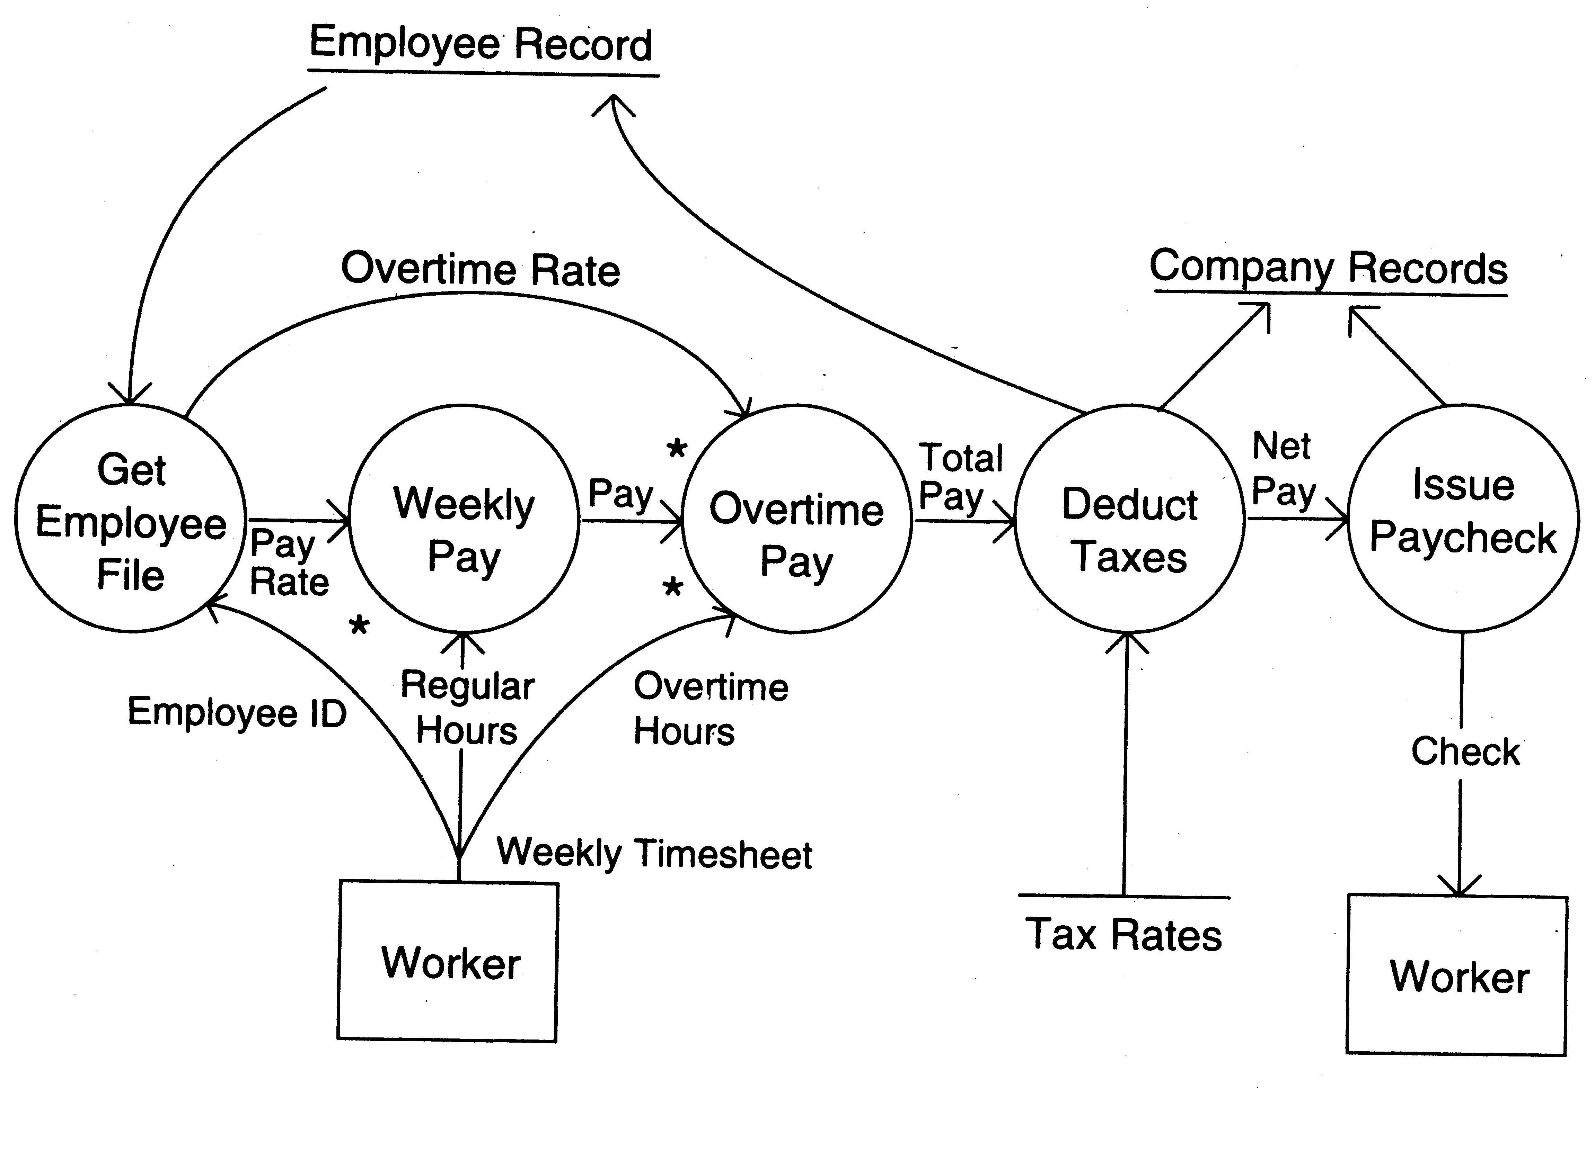
DFD Example

Slide 50
DFD Conventions
External files shown as labeled straight lines
Need for multiple data flows by a process represented by * (means and)
OR relationship represented by +
All processes and arrows should be named
Processes should represent transforms, arrows should represent some data

Slide 51
Data flow diagrams…
Focus on what transforms happen , how they are done is not important
Usually major inputs/outputs shown, minor are ignored in this modeling
No loops , conditional thinking , …
DFD is NOT a control chart, no algorithmic design/thinking
Sink/Source , external files

Slide 52
Drawing a DFD for a system
Identify inputs, outputs, sources, sinks for the system
Work your way consistently from inputs to outputs, and identify a few high-level transforms to capture full transformation
If get stuck, reverse direction
When high-level transforms defined, then refine each transform with more detailed transformations

Slide 53
Leveled DFDs
DFD of a system may be very large
Can organize it hierarchically
Start with a top level DFD with a few bubbles
then draw DFD for each bubble
Preserve I/O when “ exploding” a bubble so consistency preserved
Makes drawing the leveled DFD a top-down refinement process, and allows modeling of large and complex systems

Slide 54
Data Dictionary
In a DFD arrows are labeled with data items
Data dictionary defines data flows in a DFD
Shows structure of data; structure becomes more visible when exploding
Can use regular expressions to express the structure of data

Slide 55
Data Dictionary Example
For the timesheet DFD
Weekly_timesheet = employee_name + id + [regular_hrs + overtime_hrs]*
Pay_rate = [hourly | daily | weekly] + dollar_amt
Employee_name = last + first + middle
Id = digit + digit + digit + digit

Slide 56
DFD drawing – common errors
Unlabeled data flows
Missing data flows
Consistency not maintained during refinement
Missing processes
Too detailed or too abstract
Contains some control information

Slide 57
Data dictionaries
Data dictionaries are lists of all of the names used in the system models. Descriptions of the entities, relationships and attributes are also included.
Advantages
Support name management and avoid duplication;
Store of organisational knowledge linking analysis, design and implementation;
Many CASE workbenches support data dictionaries.

Slide 58
Data dictionary entries

