Slide 1

PYTHON
-

Slide 2
Python History and Versions
Python laid its foundation in the late 1980s.
The implementation of Python was started in December 1989 by Guido Van Rossum at CWI(Centrum Wiskunde & Informatica) in Netherland.
In February 1991, Guido Van Rossum published the code (labeled version 0.9.0) to alt.sources.
In 1994, Python 1.0 was released with new features like lambda, map, filter, and reduce.
Python 2.0 added new features such as list comprehensions, garbage collection systems.

Slide 3
Python History and Versions
On December 3, 2008, Python 3.0 (also called "Py3K") was released. It was designed to rectify the fundamental flaw of the language.
Python 3.8. 5, documentation released on 20 July 2020.
Python 3.9. 0, documentation released on 5th Oct 2020.
ABC programming language is said to be the predecessor of Python language, which was capable of Exception Handling and interfacing with the Amoeba Operating System.
The following programming languages influence
Python:ABC language.
Modula-3

Slide 4
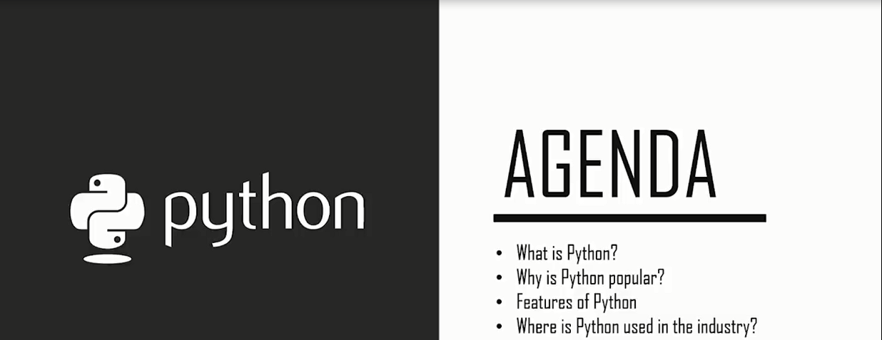
Agenda

Slide 5
What is Python
Python is a general purpose, dynamic, high-level, and interpreted programming language.
It supports Object Oriented programming approach to develop applications. It is simple and easy to learn and provides lots of high-level data structures.
Python is easy to learn yet powerful and versatile scripting language, which makes it attractive for Application Development.
Python's syntax and dynamic typing with its interpreted nature make it an ideal language for scripting and rapid application development.
Python supports multiple programming pattern, including object-oriented, imperative, and functional or procedural programming styles.

Slide 6
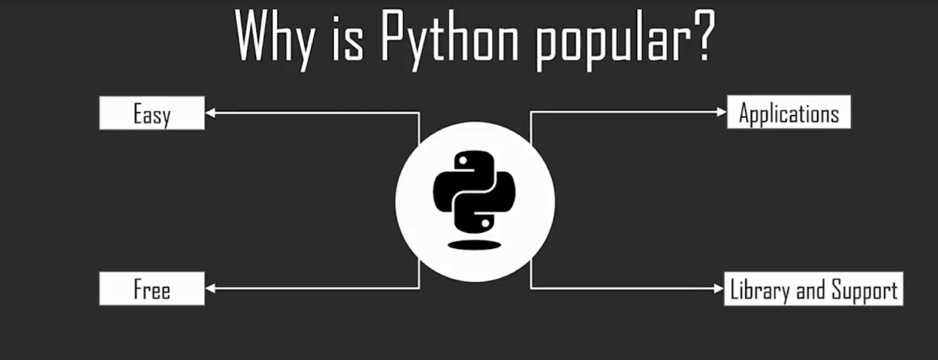
Why is Python popular?

Slide 7
Python Features
Easy to Learn and Use:
Python is easy to learn as compared to other programming languages.
Expressive Language:
Python can perform complex tasks using a few lines of code.
Interpreted Language :
Python is an interpreted language; it means the Python program is executed one line at a time.
Cross-platform Language:
Python can run equally on different platforms such as Windows, Linux, UNIX, and Macintosh, etc.
Free and Open Source :
Python is freely available for everyone. It is freely available on its official website www.python.org.

Slide 8
Object-Oriented Language
Python supports object-oriented language and concepts of classes and objects come into existence.
Extensible
It implies that other languages such as C/C++ can be used to compile the code and thus it can be used further in our Python code.
Large Standard Library
It provides a vast range of libraries for the various fields such as machine learning, web developer, and also for the scripting.
GUI Programming Support
Graphical User Interface is used for the developing Desktop application.
Integrated
It can be easily integrated with languages like C, C++, and JAVA, etc.
Dynamic Memory Allocation
In Python, we don't need to specify the data-type of the variable.

Slide 9

Guido van Rossum

Slide 10





Where is Python used in the industry?

Slide 11
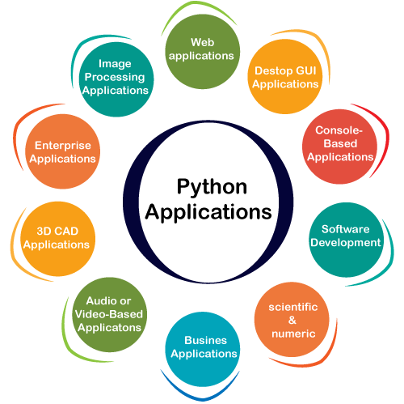
Python Applications

Slide 12
Python Applications
Web Applications
We can use Python to develop web applications. Python provides many useful frameworks, and these are given below:
Django and Pyramid framework(Use for heavy applications)
Flask and Bottle (Micro-framework)
Plone and Django CMS (Advance Content management)
Desktop GUI Applications
The GUI stands for the Graphical User Interface
Some popular GUI libraries are given below.
Tkinter or Tk
Kivy

Slide 13
Python Applications
Console-based Application
Console-based applications run from the command-line or shell.
Software Development
Python is useful for the software development process.
Scientific and Numeric
This is the era of Artificial intelligence where the machine can perform the task the same as the human.
Business Applications
Business Applications differ from standard applications. E-commerce and ERP are an example of a business application.

Slide 14
Audio or Video-based Applications
Audio or Video-based Applications
Python is flexible to perform multiple tasks and can be used to create multimedia applications.
Image Processing Application
Python contains many libraries that are used to work with the image.

Slide 15
Variables
A variable is an entity that can hold a value as in every language, a variable is the name of a memory location.
Python is dynamically typed.
That is, you don’t declare variables to be a specific type
A variable has the type that corresponds to the value you assign to it.
Variable names begin with a letter or an underscore and can contain letters, numbers, and underscores
Example:
>>>age = 25

Slide 16
Naming Rules
The first character of the variable must be an alphabet or underscore ( _ ).
All the characters except the first character may be an alphabet of lower-case(a-z), upper-case (A-Z), underscore, or digit (0-9).
Identifier name must not contain any white-space, or special character (!, @, #, %, ^, &, *).
Identifier name must not be similar to any keyword defined in the language.
Identifier names are case sensitive; for example, my name, and MyName is not the same.
Examples of valid identifiers: a123, _n, n_9, etc.
Examples of invalid identifiers: 1a, n%4, n 9, etc.
Declaring Variable and Assigning Values Python does not bind us to declare a variable before using it in the application. It allows us to create a variable at the required time.

Slide 17
Example :
name = "Devansh"
age = 20
marks = 80.50
print(name)
print(age)
print(marks)
Output: Output:
Devansh
20
80.5

Slide 18
Example
name = "A"
Name = "B"
naMe = "C"
NAME = "D"
n_a_m_e = "E"
_name = "F"
name_ = "G"
_name_ = "H"
na56me = "I"
print(name,Name,naMe,NAME,n_a_m_e, NAME, n_a_m_e, _name, name_,_name, na56me)
Output:
A B C D E D E F G F I

Slide 19
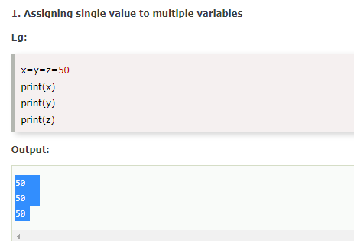
Multiple Assignment
Python allows us to assign a value to multiple variables in a single statement, which is also known as multiple assignments.
We can apply multiple assignments in two ways, either by assigning a single value to multiple variables or assigning multiple values to multiple variables. Consider the following example.
1. Assigning single value to multiple variables

Slide 20
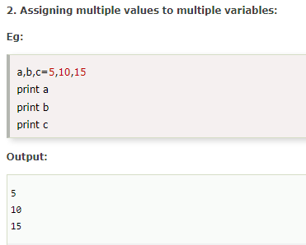
2. Assigning multiple values to multiple variables:

Slide 21
Basic Fundamentals
This section contains the fundamentals of Python, such as:
i)Tokens and their types.
ii) Comments
a)Tokens:
The tokens can be defined as a punctuator mark, reserved words, and each word in a statement.
The token is the smallest unit inside the given program.
There are following tokens in Python:
Keywords: break, class, continue, elif ,if
Identifiers: a name used to identify a variable, function, class, module or other object.
Literals: a notation for representing a fixed value in source code
Operators: Arithmetic operators, Assignment operators,Comparison operators,Logical operators,Identity operators,Bitwise operators

Slide 22
Data Types
Variables can hold values, and every value has a data-type
Python is a dynamically typed language; hence we do not need to define the type of the variable while declaring it.
a=5
Python enables us to check the type of the variable used in the program. Python provides us the type() function, which returns the type of the variable passed.

Slide 23
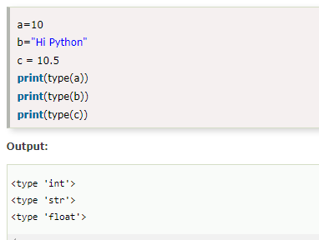
Example

Slide 24
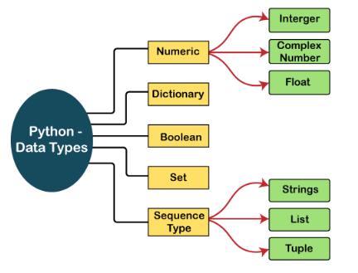
Standard datatypes
A variable can hold different types of values. For example, a person's name must be stored as a string whereas its id must be stored as an integer.
Python provides various standard data types that define the storage method on each of them. The data types defined in Python are given below.
Numbers
Dictionary
Boolean
Set
Sequence Type

Slide 25
Numbers
Python supports three types of numeric data.
Int - Integer value can be any length such as integers 10, 2, 29, -20, -150 etc. Python has no restriction on the length of an integer. Its value belongs to int
Float - Float is used to store floating-point numbers like 1.9, 9.902, 15.2, etc. It is accurate upto 15 decimal points.
complex - A complex number contains an ordered pair, i.e., x + iy where x and y denote the real and imaginary parts, respectively. The complex numbers like 2.14j, 2.0 + 2.3j, etc.

Slide 26
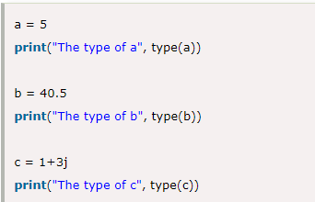
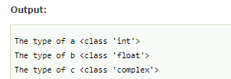
Numbers
Number stores numeric values. The integer, float, and complex values belong to a Python Numbers data-type. Python provides the type() function to know the data-type of the variable.

Slide 27
Sequence Type
Sequences allow you to store multiple values in an organized and efficient fashion
String
The string can be defined as the sequence of characters represented in the quotation marks. In Python, we can use single, double, or triple quotes to define a string.
In the case of string handling, the operator + is used to concatenate two strings as the operation "hello"+" python" returns "hello python".
The operator * is known as a repetition operator as the operation "Python" *2 returns 'Python Python'.
Use triple quotes to create a multiline string
It is the simplest method to let a long string split into different lines. You will need to enclose it with a pair of Triple quotes, one at the start and second in the end.
Like most programming languages, Python allows to index from the zeroth position in Strings.

Slide 28
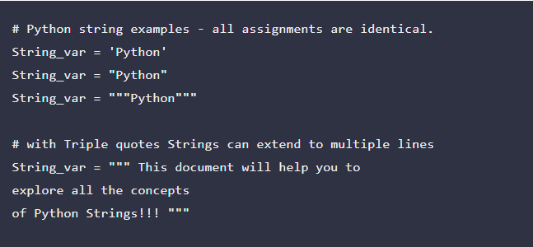
String Example :1

Slide 29
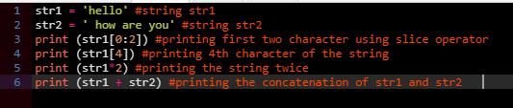
Example : 2

Slide 30
List
Python Lists are similar to arrays in C. However, the list can contain data of different types. The items stored in the list are separated with a comma (,) and enclosed within square brackets [].
A list can also be both homogenous as well as heterogeneous
Next, every element rests at some position (i.e., index) in the list. The index can be used later to locate a particular item.
We can use slice [:] operators to access the data of the list. The concatenation operator (+) and repetition operator (*) works with the list in the same way as they were working with the strings.
The most commonly used data structure in Python is List.
Python list is a container like an array that holds an ordered sequence of objects.

Slide 31
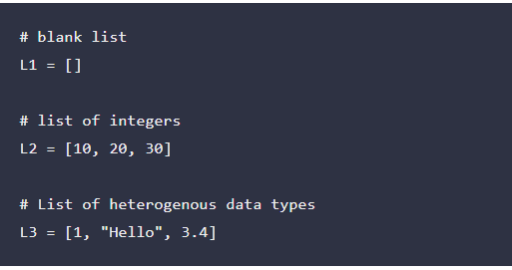
LIST -EXAMPLE

Slide 32
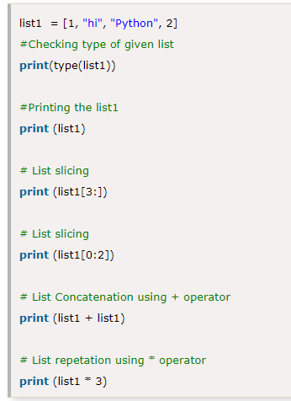
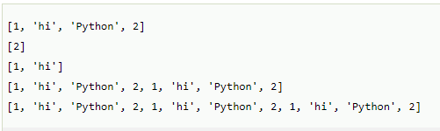
Example on list
OUTPUT

Slide 33
TUPLE
A Python tuple is a collection type data structure which is immutable by design and holds a sequence of heterogeneous elements. It functions almost like a Python list but with the following distinctions.
Tuples store a fixed set of elements and don’t allow changes whereas the list has the provision to update its content.
The list uses square brackets for opening and closing whereas, and a tuple has got parentheses for the enclosure.
A tuple is similar to the list in many ways. Like lists, tuples also contain the collection of the items of different data types. The items of the tuple are separated with a comma (,) .
A tuple is a read-only data structure as we can't modify the size and value of the items of a tuple.

Slide 34
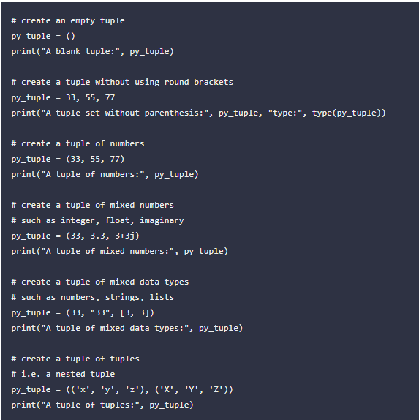
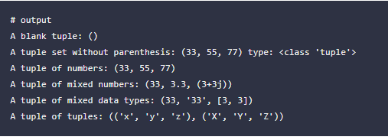

Slide 35
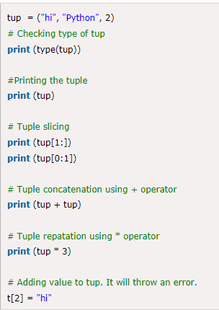
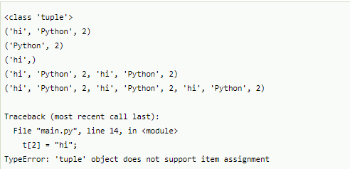
Tuple - Example

Slide 36
Dictionary
Dictionary is an unordered set of a key-value pair of items.
It is like an associative array or a hash table where each key stores a specific value.
The items in the dictionary are separated with the comma (,) and enclosed in the curly braces {}.

Slide 37
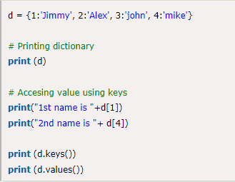
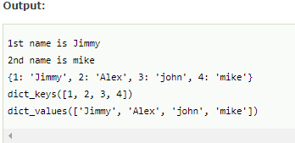
Dictionary Example

Slide 38
Boolean
Boolean type provides two built-in values, True and False
It denotes by the class bool.
True can be represented by any non-zero value or 'T' whereas false can be represented by the 0 or 'F'.

Slide 39


Boolean Example

Slide 40
Set
A set is a collection which is unordered and unindexed. In Python, sets are written with curly brackets.
Example
Create a Set:
thisset = {"apple", "banana", "cherry"}
print(thisset)

Slide 41
Access Items
You cannot access items in a set by referring to an index or a key.
But you can loop through the set items using a for loop, or ask if a specified value is present in a set, by using the in keyword.
thisset = {"apple", "banana", "cherry"} print(thisset

Slide 42
thisset = {"apple", "banana", "cherry"} print("banana" in thisset)
Add Items
To add one item to a set use the add() method.
To add more than one item to a set use the update() method.

Slide 43
thisset = {"apple", "banana", "cherry"} thisset.add("orange") print(thisset)
thisset = {"apple", "banana", "cherry"} thisset.update(["orange", "mango", "grapes"]) print(thisset)

Slide 44
Get the Length of a Set
To determine how many items a set has, use the len() method.
Example
Get the number of items in a set:
thisset = {"apple", "banana", "cherry"} print(len(thisset))

Slide 45
Expressions
An expression is a combination of values, variables, and operators.
A value all by itself is considered an expression, and so is a variable, so the following are all legal expressions
Examples
17
x
x + 17
If you type an expression in interactive mode, the interpreter evaluates it and displays the result:
Examples
>>> 1 + 1
2

Slide 46
Statements
Python Statement
Instructions that a Python interpreter can execute are called statements. For example, a = 1 is an assignment statement. if statement, for statement, while statement, etc. are other kinds of statements which will be discussed later.
Multi-line statement
In Python, the end of a statement is marked by a newline character. But we can make a statement extend over multiple lines with the line continuation character (\). For example:
print(“Hello \
World”)

Slide 47
Statements
This is an explicit line continuation. In Python, line continuation is implied inside parentheses ( ), brackets [ ], and braces { }. For instance, we can implement the above multi-line statement as:
a = (1 + 2 + 3 +
4 + 5 + 6 +
7 + 8 + 9)
Here, the surrounding parentheses ( ) do the line continuation implicitly. Same is the case with [ ] and { }. For example:
colors = ['red',
'blue',
'green']
We can also put multiple statements in a single line using semicolons, as follows:
a = 1; b = 2; c = 3

Slide 48
User – I/O Operations
Python allows for user input.
The method is a bit different in Python 3.6 than Python 2.7.
Python 3.6 uses the input() method.
Python 2.7 uses the raw input() method.
Python stops executing when it comes to the input() function, and continues when the user has given some input.
input ( ) : This function first takes the input from the user and then evaluates the expression, which means Python automatically identifies whether user entered a string or a number or list. If the input provided is not correct then either syntax error or exception is raised by python.

Slide 49
User – I/O Operations
How the input function works in Python :
When input() function executes program flow will be stopped until the user has given an input.
The text or message display on the output screen to ask a user to enter input value is optional i.e. the prompt, will be printed on the screen is optional.
Whatever you enter as input, input function convert it into a string. if you enter an integer value still input() function convert it into a string. You need to explicitly convert it into an integer in your code using typecasting

Slide 50
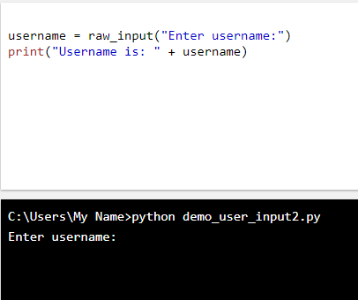
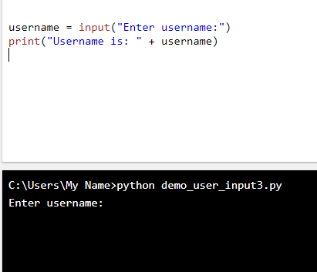
User – I/O Operations
Python 3.6
Python 2.7

Slide 51
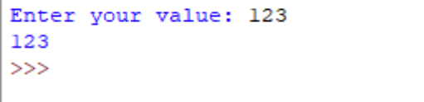
User – I/O Operations Example 1
Program
Output
# Python program showing
# a use of input()
val = input("Enter your value: ")
print(val)

Slide 52
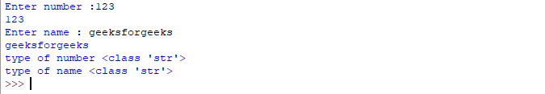
User – I/O Operations Example 2
Program
Output
# Program to check input
# type in Python
num = input ("Enter number :")
print(num)
name1 = input("Enter name : ")
print(name1)
# Printing type of input value
print ("type of number", type(num))
print ("type of name", type(name1))

Slide 53
Python Operators
The operator can be defined as a symbol which is responsible for a particular operation between two operands.
Arithmetic operators
Comparison operators
Assignment Operators
Logical Operators
Bitwise Operators
Membership Operators
Identity Operators

Slide 54
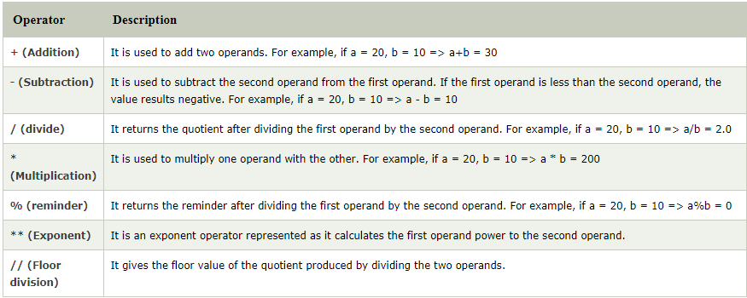
Arithmetic operators

Slide 55
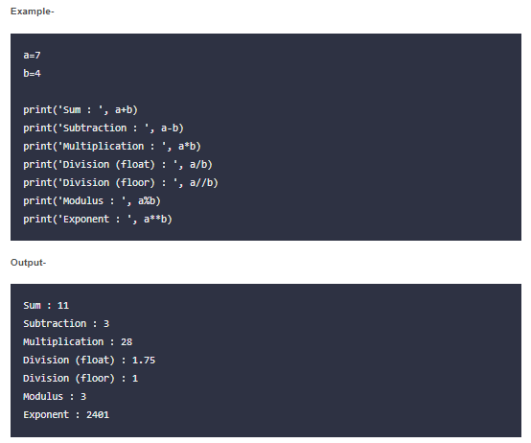
Example

Slide 56
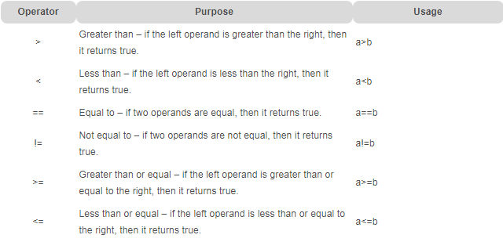
Comparison operator
Comparison operators are used to comparing the value of the two operands and returns Boolean true or false accordingly. The comparison operators are described in the following table.

Slide 57
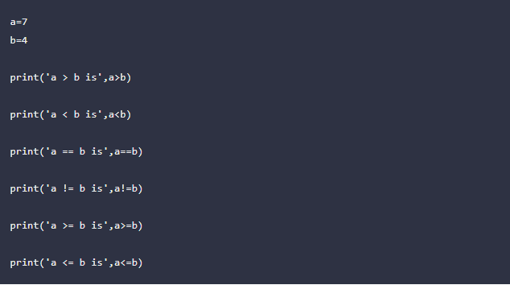
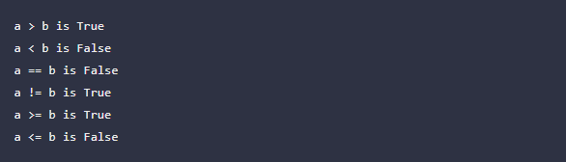
Example
Output

Slide 58
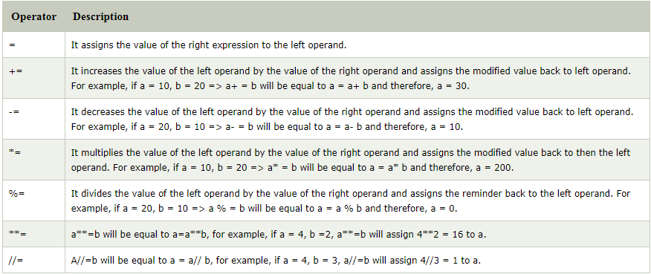
Assignment Operators
The assignment operators are used to assign the value of the right expression to the left operand.

Slide 59
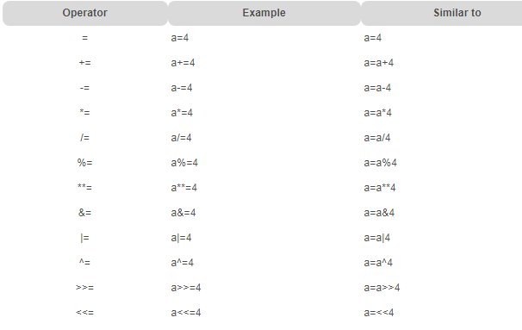
Example

Slide 60
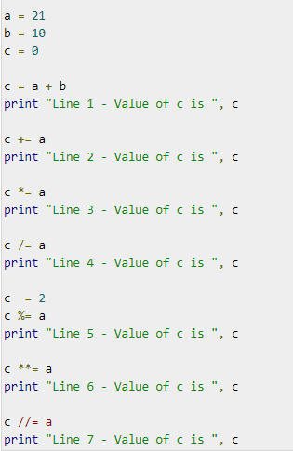
Example for Assignment Operator

Slide 61
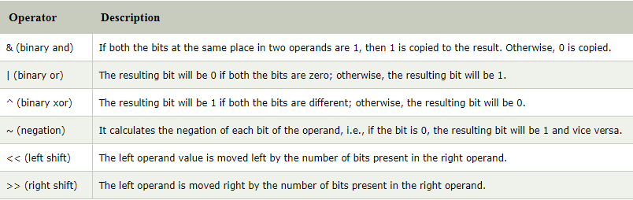
Bitwise Operator
The bitwise operators perform bit by bit operation on the values of the two operands.

Slide 62
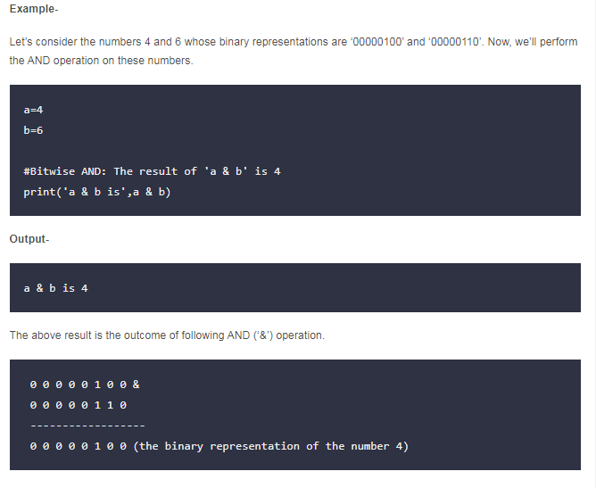

Slide 63
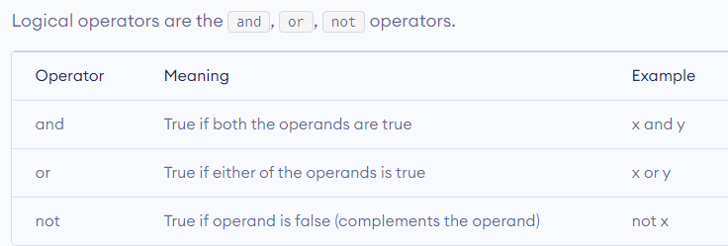
Logical Operators
The logical operators are used primarily in the expression evaluation to make a decision. Python supports the following logical operators.

Slide 64
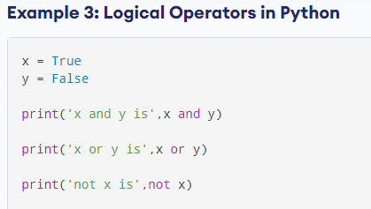
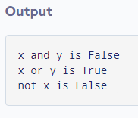

Slide 65
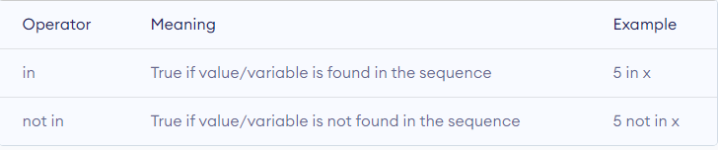
Membership Operator
Python membership operators are used to check the membership of value inside a Python data structure. If the value is present in the data structure, then the resulting value is true otherwise it returns false.

Slide 66
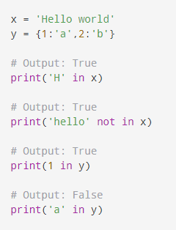
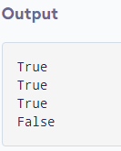
Example

Slide 67
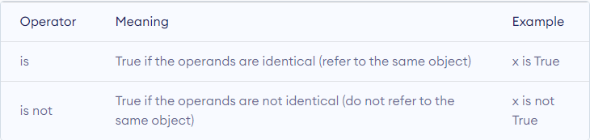
Identity Operators
The identity operators are used to decide whether an element certain class or type.

Slide 68
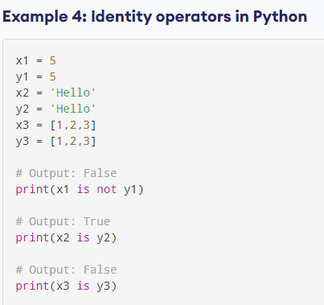
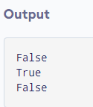

Slide 69
PYTHON COMMENTS
Python Comment is an essential tool for the programmers.
Comments are generally used to explain the code. We can easily understand the code if it has a proper explanation.
In the other programming language such as C++, It provides the // for single-lined comment and /*.... */ for multiple-lined comment, but Python provides the single-lined Python comment.
To apply the comment in the code we use the hash(#) at the beginning of the statement or code.
Let's understand the following example.
# This is the print statement
print("Hello Python")

Slide 70
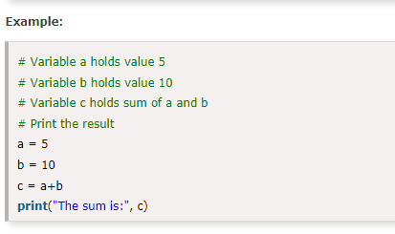
Multiline Python Comment
We must use the hash(#) at the beginning of every line of code to apply the multiline Python comment. Consider the following example.
We can also use the triple quotes ('''''') for multiline comment. The triple quotes are also used to string formatting

Slide 71
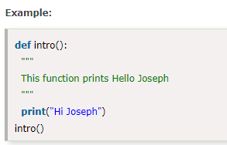
Docstrings Python Comment
The docstring comment is mostly used in the module, function, class or method.

Slide 72
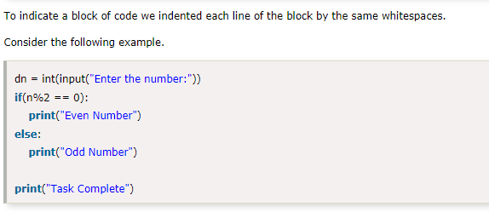
Python Indentations
Whitespaces are used as indentation in Python.
Indentation uses at the beginning of the code and ends with the unintended line. That same line indentation defines the block of the code (body of a function, loop, etc.)
Generally, four whitespaces are used as the indentation. The amount of indentation depends on user, but it must be consistent throughout that block.

Slide 73
CONTROL STATEMENTS

Slide 74
Indentation in Python
For the ease of programming and to achieve simplicity, python doesn't allow the use of parentheses for the block level code. In Python, indentation is used to declare a block. If two statements are at the same indentation level, then they are the part of the same block.
Generally, four spaces are given to indent the statements which are a typical amount of indentation in python.
Indentation is the most used part of the python language since it declares the block of code. All the statements of one block are intended at the same level indentation. We will see how the actual indentation takes place in decision making and other stuff in python.

Slide 75
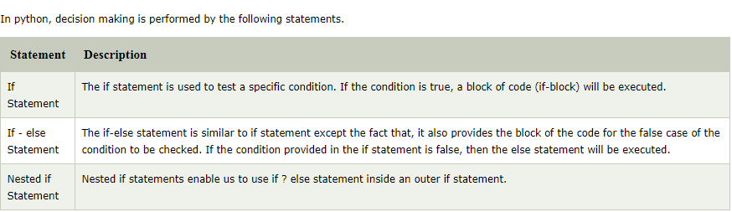
Python If –Else Statements

Slide 76
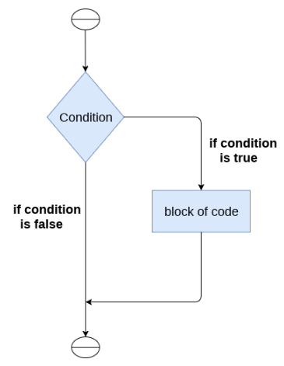
If - Statement
The if statement is used to test a particular condition and if the condition is true, it executes a block of code known as if-block.
The condition of if statement can be any valid logical expression which can be either evaluated to true or false.

Slide 77
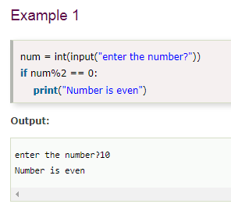

Syntax and Example

Slide 78
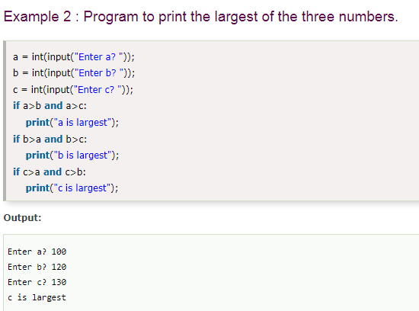
Example 2 : Program to print the largest of the three numbers.

Slide 79

If-Else Statement
The if-else statement provides an else block combined with the if statement which is executed in the false case of the condition.
If the condition is true, then the if-block is executed. Otherwise, the else-block is executed.

Slide 80


Syntax and Example

Slide 81

Example 2: Program to check whether a number is even or not.

Slide 82

The elif statement
The elif statement enables us to check multiple conditions and execute the specific block of statements depending upon the true condition among them.

Slide 83


Syntax and Example

Slide 84

Elif - Example

Slide 85

Iteration
The flow of the programs written in any programming language is sequential by default.
The execution of a specific code may need to be repeated several numbers of times.
For this purpose, The programming languages provide various types of loops which are capable of repeating some specific code several numbers of times.

Slide 86


Slide 87


For -Loop
The for loop in Python is used to iterate the statements or a part of the program several times. It is frequently used to traverse the data structures like list, tuple, or dictionary.

Slide 88

Example-1: Iterating string using for loop

Slide 89

Example- 2: Program to print the table of the given number .

Slide 90

Example-4: Program to print the sum of the given list.

Slide 91

For loop Using range() function
The range() function
The range() function is used to generate the sequence of the numbers.
The start represents the beginning of the iteration.
The stop represents that the loop will iterate till stop-1. The range(1,5) will generate numbers 1 to 4 iterations. It is optional.
The step size is used to skip the specific numbers from the iteration. It is optional to use. By default, the step size is 1. It is optional.

Slide 92


Slide 93

We can also use the range() function with sequence of numbers. The len() function is combined with range() function which iterate through a sequence using indexing. Consider the following example.

Slide 94

Nested for loop in python
Python allows us to nest any number of for loops inside a for loop. The inner loop is executed n number of times for every iteration of the outer loop. The syntax is given below.

Slide 95

While Loop
The Python while loop allows a part of the code to be executed until the given condition returns false.
It is also known as a pre-tested loop.
It can be viewed as a repeating if statement.
When we don't know the number of iterations then the while loop is most effective to use.
The syntax is given below.

Slide 96

While loop

Slide 97


Slide 98


Slide 99

Infinite while loop
If the condition is given in the while loop never becomes false, then the while loop will never terminate, and it turns into the infinite while loop.
Any non-zero value in the while loop indicates an always-true condition, whereas zero indicates the always-false condition. This type of approach is useful if we want our program to run continuously in the loop without any disturbance.

Slide 100

Using else with while loop
Python allows us to use the else statement with the while loop also. The else block is executed when the condition given in the while statement becomes false.

Slide 101


Slide 102

Python break statement
The break is a keyword in python which is used to bring the program control out of the loop. The break statement breaks the loops one by one, i.e., in the case of nested loops, it breaks the inner loop first and then proceeds to outer loops.
The syntax of the break is given below.

Slide 103


Slide 104


Python continue Statement
The continue statement in Python is used to bring the program control to the beginning of the loop. The continue statement skips the remaining lines of code inside the loop and start with the next iteration.

Slide 105
Pass Statement
The pass statement is a null operation since nothing happens when it is executed. It is used in the cases where a statement is syntactically needed but we don't want to use any executable statement at its place.
For example, it can be used while overriding a parent class method in the subclass but don't want to give its specific implementation in the subclass.
Pass is also used where the code will be written somewhere but not yet written in the program file. Consider the following example.

Slide 106
Example
for i in range(1, 11): if(i%2==0): pass else: print(i)

Slide 107
Python Function
Functions are the most important aspect of an application. A function can be defined as the organized block of reusable code, which can be called whenever required.
Python allows us to divide a large program into the basic building blocks known as a function. The function contains the set of programming statements enclosed by {}. A function can be called multiple times to provide reusability and modularity to the Python program.
The Function helps to programmer to break the program into the smaller part. It organizes the code very effectively and avoids the repetition of the code. As the program grows, function makes the program more organized.
Python provide us various inbuilt functions like range() or print(). Although, the user can create its functions, which can be called user-defined functions.

Slide 108

There are mainly two types of functions.
User-define functions - The user-defined functions are those define by the user to perform the specific task.
Built-in functions - The built-in functions are those functions that are pre-defined in Python

Slide 109
Python Built-in Functions
The Python built-in functions are defined as the functions whose functionality is pre-defined in Python.
Python abs() Function
The python abs() function is used to return the absolute value of a number. It takes only one argument, a number whose absolute value is to be returned. The argument can be an integer and floating-point number. If the argument is a complex number, then, abs() returns its magnitude.
Python all() Function
The python all() function accepts an iterable object (such as list, dictionary, etc.). It returns true if all items in passed iterable are true. Otherwise, it returns False. If the iterable object is empty, the all() function returns True.
Python bin() Function
The python bin() function is used to return the binary representation of a specified integer. A result always starts with the prefix 0b.

Slide 110
Python sum() Function
As the name says, python sum() function is used to get the sum of numbers of an iterable, i.e., list.
Python any() Function
The python any() function returns true if any item in an iterable is true. Otherwise, it returns False.
Python eval() Function
The python eval() function parses the expression passed to it and runs python expression(code) within the program.
Python float()
The python float() function returns a floating-point number from a number or string.

Slide 111

Function Calling
In Python, after the function is created, we can call it from another function. A function must be defined before the function call; otherwise, the Python interpreter gives an error. To call the function, use the function name followed by the parentheses.

Slide 112

The return statement
The return statement is used at the end of the function and returns the result of the function. It terminates the function execution and transfers the result where the function is called. The return statement cannot be used outside of the function.
It can contain the expression which gets evaluated and value is returned to the caller function. If the return statement has no expression or does not exist itself in the function then it returns the None object.

Slide 113


Slide 114


Slide 115

Arguments in function
The arguments are types of information which can be passed into the function. The arguments are specified in the parentheses. We can pass any number of arguments, but they must be separate them with a comma.

Slide 116

Default Arguments
Python allows us to initialize the arguments at the function definition. If the value of any of the arguments is not provided at the time of function call, then that argument can be initialized with the value given in the definition even if the argument is not specified at the function call.

Slide 117
Fruitful Function
A function that yields a return value.
In a fruitful function the return statement includes an expression.
Syntax: def area(radius):
return pi * radius**2

Slide 118
Void functions
Void functions are created and used just like value-returning functions except they do not return a value after the function executes.
Void functions use the keyword "void."
A void function performs a task, and then control returns back to the caller but, it does not return a value.

Slide 119


Slide 120
Recursion
Python also accepts function recursion, which means a defined function can call itself.
Recursion is a common mathematical and programming concept. It means that a function calls itself. This has the benefit of meaning that you can loop through data to reach a result.

Slide 121


Slide 122
LOCAL and GLOBAL Variables
There are two types of variables: global variables and local variables.
LOCAL VARIABLES:
we can access the local variable only within the function it is defined.
If you are trying to call local variable outside its scope will through an Error.

Slide 123
def sum(x,y):
sum = x + y
return sum
print(sum(5, 10))
The variables x and y will only work/used inside the function sum() and they don’t exist outside of the function.

Slide 124
GLOBAL VARIABLE
we can call global variable anywhere in the program including functions defined in the program.
A global variable can be used anywhere in the program as its scope is the entire program.
z = 25
def func():
global z
print(z)
z=20
func()
print(z)

Slide 125
PYTHON MODULE
What is a Module?
A python module can be defined as a python program file which contains a python code including python functions, class, or variables.
Example
In this example, we will create a module named as file.py which contains a function func that contains a code to print some message on the console.
Let's create the module named as file.py.
def displayMsg(name)
print("Hi "+name);
Here, we need to include this module into our main module to call the method displayMsg() defined in the module named file.

Slide 126
Loading the module in our python code
We need to load the module in our python code to use its functionality. Python provides two types of statements as defined below.
The import statement
The from-import statement

Slide 127
The import statement
The import statement is used to import all the functionality of one module into another.
We can import multiple modules with a single import statement, but a module is loaded once regardless of the number of times, it has been imported into our file.
The syntax to use the import statement is
import module1,module2,........ module n

Slide 128
Hence, if we need to call the function displayMsg() defined in the file file.py, we have to import that file as a module into our module as shown in the example below.
Example:
import file;
name = input("Enter the name?")
file.displayMsg(name)
O/P
Enter the name?
John
Hi John

Slide 129
The from-import statement
Instead of importing the whole module into the namespace, python provides the flexibility to import only the specific attributes of a module.
This can be done by using from? import statement.
The syntax to use the from-import statement is
from < modulename> import <name 1>, <name 2>..,<name n>

Slide 130
calculation.py:
#place the code in the calculation.py
def summation(a,b):
return a+b
def multiplication(a,b):
return a*b;
def divide(a,b):
return a/b;
Main.py:
from calculation import summation
#it will import only the summation() from calculation.py
a = int(input("Enter the first number"))
b = int(input("Enter the second number"))
print("Sum = ",summation(a,b)) #we do not need to specify the module name while accessing summation()
O/P
Enter the first number10
Enter the second number20
Sum = 30

