Slide 1
UNIT II
Lambda

Slide 2
CONTENTS
map() function
Strings, indexing, Slicing
Built-in String methods
Lists
Dictionaries
Tuples
Files: Opening the file – modes: read, write, append
Reading from and writing to a file, closing, deleting a file

Slide 3
map() function
The map() function executes a specified function for each item in an iterable.
The item is sent to the function as a parameter.

Slide 4
Syntax
map(function,iterables)
Parameter Values
function: Required. The function to execute for each item.
iterable: Required. A sequence, collection or an iterator object.
We can send as many iterables as we like

Slide 5
Example
def myfunc(a,b) : return a + b
x = map(myfunc, (‘apple’, ‘banana’, ‘cherry’), (‘orange’, ‘lemon’, ‘grapes’))
print(x)
#convert the map into a list, for readability:
print(list(x))
OUTPUT
[‘appleorange’ , ‘bananalemon’ , ‘cherrygrapes’]

Slide 6
def myfunc(n): return len(n)
x = map(myfunc, (‘apple’ , ‘banana’ , ‘cherry’ ))
print(x)
print(list(x))
OUTPUT
[‘5’ , ‘6’ , ‘6’]

Slide 7
def add(n):
return n + n
Num = (1,2,3,4)
Res = map(add,Num) print(list(Res))
OUTPUT
[2, 4, 6, 8]

Slide 8
#List of strings
L = [‘sat’ , ‘bat’ , ‘cat’ , ‘mat’]
#map can listify the list of strings Test = list(map(list, L))
print(Test)
OUTPUT
[[‘s’ , ‘a’ , ‘t’], [‘b’, ‘a’, ‘t’], [‘m’, ‘a’, ‘t’]]

Slide 9
Strings
Python string is the collection of the characters surrounded by single quotes, double quotes, or triple quotes. The computer does not understand the characters, internally, it stores manipulated character as the combination of 0s and 1s.
Each character is encoded in the ASCII or Unicode character.

Slide 10
Creating String in Python
We can create a string by enclosing the characters in single quotes or double quotes. Python also provides triple-quotes to represent the string, but it is generally used for multiline string or docstrings.

Slide 11
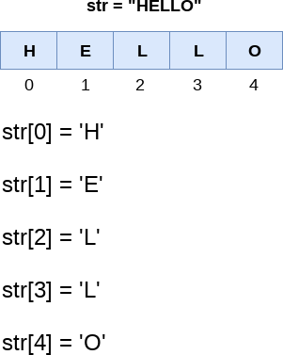
String indexing and splitting
The indexing of Python strings starts from 0. For example, the string
“HELLO” is indexed as given below figure.

Slide 12
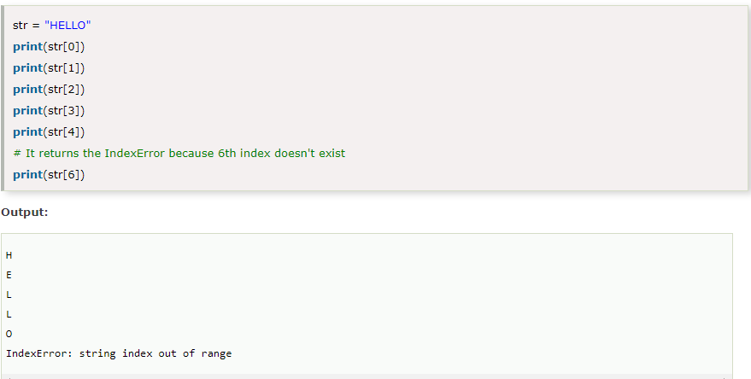
Example

Slide 13
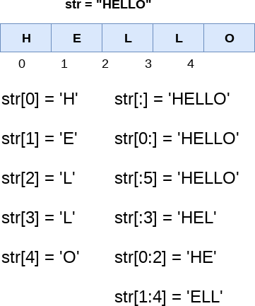
The slice operator [] is used to access the individual characters of the string. However, we can use the : (colon) operator in Python to access the substring from the given string. Consider the example.

Slide 14
Here, we must notice that the upper range given in the slice operator is always exclusive i.e., if str = 'HELLO' is given, then str[1:3] will always include str[1] = 'E', str[2] = 'L' and nothing else.

Slide 15
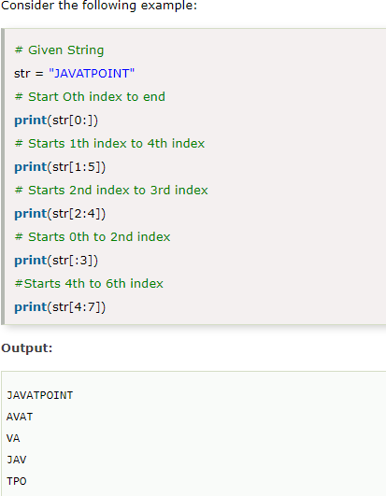

Slide 16
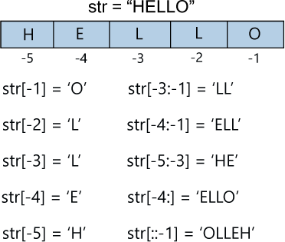
We can do the negative slicing in the string; it starts from the rightmost character, which is indicated as -1. The second rightmost index indicates -2, and so on. Consider the following image.

Slide 17
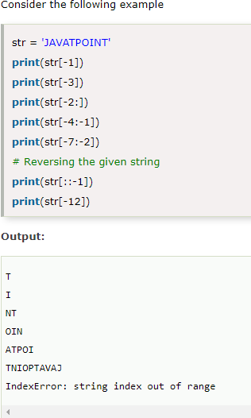
Example

Slide 18
String Slicing
It is used for obtaining a substring from the given string.
It can be done in two ways:
slice( ) constructor
Extending indexing

Slide 19
slice( ) constructor
It creates a slice object representing the set of indices specified by range(start,stop,step).
Syntax: slice(stop)
slice(start,stop,step)
start-Starting index where slicing of object starts
stop-Ending index where the slicing of object stops
step-It is an optional argument that determines the increment between each index for slicing
Return Type-Returns a sliced object containing elements in given range only

Slide 20
Example
String = ‘ASTRING’
S1 = slice(3)
S2 = slice(1,5,2)
S3 = slice(-1,-12,-2)
print(“String slicing”) print(String[s1]) print(String[s2]) print(String[s3])
OUTPUT
String slicing AST
SR
GITA

Slide 21
Extending indexing
Indexing syntax can be used as a substitute for the slice object.
Syntax
String[start:end:step]

Slide 22
Example
String = ‘ASTRING’ print(String[ :3]) print(String[1:5:2]) print(String[-1:-12:-2])
print(“\nReverse String”)
print(String[: :-1])
OUTPUT
AST SR GITA
Reverse String
GNIRTSA

Slide 23
Built-in String methods
Method | Description
capitalize() | Converts the first character to upper case
isalpha() | Returns True if all characters in string are in alphabet
islower() | Returns True if all characters in the string are lower case
isupper() | Returns True if all characters in the string are upper case
lower() | Converts a string into lower case
replace() | Returns a string where a specified value is replaced with a specified value
split() | Splits the string at the specified separator and returns a list

Slide 24
Method | Description
upper() | Converts a string into upper case
count() | Returns occurrences of substring in string
find() | Returns the index of first occurrence of substring
index() | Returns index of substring
join() | Returns a concatenated string
partition() | Returns a Tuple
len() | Returns the length of a string

Slide 25
Example
a = “Hello World”
print(len(a))
OUTPUT
13
a = “Hello World”
print(a.strip()) #removes whitespace from beginning or end
a = “Hello World”
print(a.lower())
Hello World
hello world

Slide 26
a = “Hello World”
print(a.upper())
OUTPUT
HELLO WORLD
a = “Hello World”
print(a.replace(“H”, “J”))
JELLO WORLD
a = “Hello World”
print(a.split(“ ”))
[‘Hello’, ‘World’]

Slide 27
Lists
List is a collections of elements which is ordered and changeable.
In Python, lists are written with square brackets.
Example- L = [1,2,3,4] is a list.
Elements are stored in the list separated by commas.
Lists can store elements of different types.

Slide 28
Accessing elements from a list
List index
We can use the index operator ‘[ ]’ to access an item ina list. In Python, indices start at 0.
Example- my_list = [‘p’, ‘r’, ‘o’, ‘b’, ‘e’]
print(my_list[0]) print(my_list[2]) print(my_list[4])
# Output: p # Output:o # Output:e

Slide 29
Negative indexing
Python allows negative indexing for its sequences.
The index of -1 refers to the last item, -2 refers to the second last item and so on.
Example- my_list = [‘p’, ‘r’, ‘o’, ’b’, ’e’]
print(my_list[-1]) print(my_list[-5])
# outputs e #outputs p

Slide 30
A list within another list is called as nested list.
A list that contains no elements is called an empty list.
Example-
cheese = [‘Cheddar’, ‘Edam’, ‘Gouda’]
numbers = [42, 123] empty = [ ]
print(cheeses, numbers, empty)
Output- [‘Cheddar’, ‘Edam’, ‘Gouda’] [42, 123] [ ]

Slide 31
Lists are mutable
Lists can be changed.
When the bracket operator appears on the left side of an assignment, it identifies the element of list which is to be assigned.
Example-
numbers = [42, 123]
numbers[1] = 5 numbers
[42, 5] #Output

Slide 32
The ‘in’ operator also works on lists
Example-
cheeses = [‘cheddar’, ‘edam’, ‘gouda’] ‘edam’ in cheeses
True #Output ‘brie’ in cheeses False #Output

Slide 33
Traversing a list
The most common way of traversing elements of a list is with a for loop.
Example-
for cheese in cheeses: print(cheese)
It is needed to read elements of the list.

Slide 34
If we want to write or update the elements, we need the indices.
We have to use built-in functions “range” and “len”.
Example-
for i in range(len(numbers)): numbers[i] = numbers[i] * 2
This loop traverses the list and updates each element.
“len” returns the number of elements in the list. “range” returns a list of indices from 0 to n-1.
In nested list, list within it is taken as an element.

Slide 35
Example- [1,[2,3],4,[5],[6,7,8]] contains 5 elements with [2,3], [5], [6,7,8] taken as individual elements.

Slide 36
List Operations
The + operator concatenates lists:
>>> a = [1,2,3]
>>> b = [4,5,6]
>>> c = a + b
>>> c [1,2,3,4,5,6]

Slide 37
List Slices
The slice operator also works on lists:
>>> t = [‘a’, ’b’, ’c’, ‘d’, ‘e’, ‘f’]
>>> t[1:3]
[ ‘b’, ‘c’ ]
>>> t[ :4]
[‘a’, ‘b’, ‘c’, ‘d’]
>>> t[3: ]
[‘d’, ‘e’, ‘f’ ]

Slide 38
If first index is removed, the slice starts at the beginning.
If second index is removed, the slice goes to the end.
If both indices are removed, the slice is a copy of the whole list
>>> t[ : ]
[‘a’, ‘b’, ‘c’, ‘d’, ‘e’, ‘f’ ]

Slide 39
A slice operator on the left side of an assignment can update multiple elements.
>>> t = [‘a’, ‘b’, ‘c’, ‘d’, ‘e’, ‘f’ ]
>>> t[1:3] = [‘x’, ‘y’]
>>> t
[‘a’, ‘x’, ‘y’, ‘d’, ‘e’, ‘f’ ]

Slide 40
List Methods
Python provides methods that operate on lists.
>>> t = [‘a’, ‘b’, ‘c’ ]
>>> t.append(‘d’)
>>> t
[‘a’, ‘b’, ‘c’, ‘d’ ]

Slide 41
We can extend a list by taking a list as an argument and appends all of the elements.
>>> t1 = [‘a’, ‘b’, ‘c’]
>>> t2 = [‘d’, ‘e’]
>>> t1.extend(t2)
>>> t1
[‘a’, ‘b’, ‘c’, ‘d’, ‘e’]
It leaves t2 unmodified.

Slide 42
‘sort’ arranges the elements of the list from low to high.
>>> t = [‘d’, ‘c’, ‘e’, ‘b’, ‘a’]
>>> t.sort()
>>> t
[‘a’, ‘b’, ‘c’, ‘d’, ‘e’]
Most list methods are void. They modify the list and return ‘None’.

Slide 43
Dictionaries

Slide 44
Definition
A dictionary contains a collection of indices and a collection of values.
The collection of indices are called keys.
Each key is associated with a single value.
The association of a key and a value is called a key-value pair or an item.

Slide 45
The function “dict” creates a new dictionary with no items
The curly braces { } represent an empty dictionary.
To add items to the dictionary, we can use square brackets:
>>> a[‘one’] = ‘uno’
This line creates an item that maps from the key ‘one’ to the value ‘uno’ in the dictionary ‘a’.
If we print the dictionary, we will see a key-value pair with a colon between the key and value:
>>> a
{ ‘one’ : ‘uno’}

Slide 46
We can create a new dictionary with multiple items:
>>> a = { ‘one’ : ‘uno’ , ‘two’ : ‘dos’ , ‘three’ : ‘tres’}
If we print this dictionary,
>>> a
{‘one’ : ‘uno’ , ‘three’ : ‘tres’ , ‘two’ : ‘dos’}
The order of the key-value pairs is not the same.
We can use the keys to look up the corresponding values:
>>> a[‘two’] ‘dos’
The key ‘two’ always maps to the value ‘dos’. So, the order of the items doesn’t matter.

Slide 47
If the key is not in the dictionary, we get an exception.
>>> a[‘four’]
KeyError : ‘four’
The “len” function works on dictionaries. It returns the number of key-value pairs.
>>> len(a) 3
The “in” operator works on dictionaries. It tells whether something appears as a key in
the dictionary.
>>> ‘one’ in a
True
>>> ‘uno’ in a # appearing as a value is not good enough
False

Slide 48
To see whether something appears as a value in a dictionary, we use
the method “values()”.
This method returns a collection of values and use the “in” operator.
>>> vals = a.values()
>>> ‘uno’ in vals True

Slide 49
Dictionary as a Collection of Counters
Using dictionaries, there is no need to count the occurrences of each of the letters.
We can make room for the letters that appear.
Example:
def histogram(s): d = dict()
for c in s:
if c not in d:
d[c] = 1
else:
d[c] += 1
return d

Slide 50
The name of the function is “histogram” which is a collection of counters.
The first line of the function creates an empty dictionary.
The for loop traverses the string.
Each time through the loop, if the character ‘c’ is not in the dictionary, a new item is created with key ‘c’ and the initial value 1.
If ‘c’ is already in the dictionary, d[c] is incremented.
>>> h = histogram(‘brontosaurus’)
>>> h
{‘a’ : 1, ‘b’ : 1, ‘o’ : 2, ‘n’ : 1, ‘s’ : 2, ‘r’ : 2, ‘u’ : 2, ‘t’ : 1}
The histogram indicates that the letters ‘a’ and ‘b’ appear once, ‘o’ appears
twice and so on.

Slide 51
Dictionaries have a method called “get” that takes a key and a default value.
If the key appears in the dictionary, “get” returns the corresponding value,
otherwise it returns the default value.
Example:
>>> h = histogram(‘a’)
>>> h
{‘a’ : 1}
>>> h.get(‘a’, 0)
1
>>> h.get(‘b’, 0)
0

Slide 52
Looping and Dictionaries
If a dictionary is used in a “for” statement, it traverses the keys of the dictionary.
Example: “print_hist” prints each key and the corresponding value
def print_hist(h): for c in h:
print(c,h[c])
Output
>>> h = histogram(‘parrot’)
>>> print_hist(h) a 1
p 1
r 2
t 1
o 1
The keys have no particular order.

Slide 53
To traverse the keys in sorted order, we can use built-in function “sorted”.
Example:
>>> for key in sorted(h):
. . .
a 1
o 1
p 1
r 2
t 1
print(key, h[key])

Slide 54
Reverse Lookup
Given a dictionary “d” and a key “k”, it is easy to find the corresponding value v =
d[k]. This operation is called a lookup.
In reverse lookup, value is given and key is to be found.
Example:
def reverse_lookup(d,v): for k in d:
if d[k] == v: return k
raise LookupError()
The raise statement causes an exception.
In above example, it causes a “lookupError”, which is a built-in exception used to
indicate that a lookup operation failed.

Slide 55
If we get to the end of the loop, that is if ‘v’ doesn’t appear in the
dictionary as a value, so we raise an exception.
Example:
>>> h = histogram(‘parrot’)
>>> k = reverse_lookup(h,2)
>>> k
‘r’
When an exception is raised, it prints a traceback and an error message.

Slide 56
The raise statement can take a detailed error message as an optional argument.
Example:
>>> raise LookupError(‘value does not appear in the dictionary’)
Traceback (most recent call last):
File “<stdin>”, line 1, in ?
LookupError: value does not appear in the dictionary

Slide 57
Tuples
A tuple is a sequence of values.
The values can be any type and they are indexed by integers.
Tuples are immutable.
A tuple is a comma-separated list of values:
>>> t = ‘a’, ‘b’, ‘c’, ‘d’, ‘e’
It can also be represented as:
>>> t = (‘a’, ‘b’, ‘c’, ‘d’, ‘e’)

Slide 58
To create a tuple with a single element, we have to include a final comma:
>>> t1 = ‘a’,
>>> type(t1)
<class ‘tuple’>
A value in parentheses is not a tuple:
>>> t2 = (‘a’)
>>> type(t2)
<class ‘str’>

Slide 59
Another way to create a tuple is the built-in function “tuple”. With no
argument, it creates an empty tuple:
>>> t = tuple()
>> t ()
If the argument is a sequence(string, list or tuple), the result is a tuple with the elements of the sequence:
>>> t = tuple(‘lupins’)
>>> t
(‘l’, ‘u’, ‘p’, ‘i’, ‘n’, ‘s’)

Slide 60
Most list operations also work on tuples. The bracket operator indexes an element:
>>> t = (‘a’, ‘b’, ‘c’, ‘d’, ‘e’)
>>> t[0]
‘a’
Slice operator selects a range of elements:
>>> t[1:3]
(‘b’, ‘c’)

Slide 61
If we try to modify one of the elements of the tuple, we get an error:
>>> t[0] = ‘A’
TypeError: object doesn’t support item assignment
We can replace one tuple with another:
>>> t = (‘A’,) + t[1: ]
>>> t
(‘A’, ‘b’, ‘c’, ‘d’, ‘e’)
This statement makes a new tuple and then makes ‘t’ refer to it.

Slide 62
The relational operators work with tuples.
Python starts by comparing the first element.
If they are equal,it goes on to the next elements, and so on, until it finds elements that differ.
Subsequent elements are not considered.
>>> (0,1,2) < (0,3,4)
True
>>>(0,1,2000000) < (0,3,4)
True

Slide 63
Tuple Assignment
In tuple assignment, the left side is a tuple of variables, the right side is a tuple of expressions.
Each value is assigned to its respective variable.
All the expressions on the right side are evaluated before any of the assignments.
The number of variables on the left and the number of values on the right must be same:
>>> a,b = 1,2,3
ValueError: too many values to unpack

Slide 64
The right side of the assignment can be any kind of sequence(string, list or tuple).
For example, to split an email address into a user name and a domain, we can
write:
>>> addr = ‘monty@python.org’
>>> uname, domain = addr.split(‘@’)
The return value from “split” is a list with two elements, the first element is assigned to “uname”, the second to “domain”:
>>> uname
‘monty’
>>> domain
‘python.org’

Slide 65
Tuples as Return Values
A function returning a value as a tuple is same as returning multiple values.
For example, if we want to divide two integers and compute the quotient and remainder, compute them both at the same time.
The built-in function “divmod” takes two arguments and returns a
tuple of two values: the quotient and remainder.
We can store the result as a tuple:
>>> t = divmod(7,3)
>>> t (2,1)

Slide 66
We can use tuple assignment to store the elements separately:
>>> quot, rem = divmod(7,3)
>>> quot 2
>>> rem 1
An example of a function that returns a tuple:
def min_max(t):
return min(t), max(t)
“max” and “min” are built-in functions that find the largest and smallest elements of a sequence.
“min_max” computes both and returns a tuple of two values.

Slide 67
Variable-Length Argument Tuples
Functions can take a variable number of arguments.
A parameter that begins with * gathers arguments into a tuple.
For example, “printall” takes any number of arguments and prints them:
def printall(*args): print(args)
The gather parameter can have any name, but “args” is conventional.
Here is the working of function:
>>> printall(1,2.0,‘3’)
(1,2.0,‘3’)

Slide 68
The complement of gather is “scatter”.
If we have a sequence of values and we want to pass it to a function as multiple arguments, we can use the * operator.
For example, “divmod” takes exactly two arguments. It doesn’t work with a
tuple:
>>> t = (7,3)
>>> divmod(t)
TypeError: divmod expected 2 arguments, got 1
But, if we scatter the tuple, it works:
>>> divmod(*t) (2,1)

Slide 69
Many of the built-in functions use variable-length argument tuples.
For example, “max” and “min” can take any number of arguments:
>>> max(1,2,3) 3
“sum” function does not take multiple arguments:
>>> sum(1,2,3)
TypeError: sum expected at most 2 arguments, got 3

Slide 70
Files
Files are named locations on disk to store related information. They are used to permanently store data in a non-volatile memory (e.g. hard disk).
Since Random Access Memory (RAM) is volatile (which loses its data when
the computer is turned off), we use files for future use of the data by permanently storing them.
When we want to read from or write to a file, we need to open it first.
When we are done, it needs to be closed so that the resources that are tied with the file are freed.
Hence, in Python, a file operation takes place in the following order:
Open a file
Read or write (perform operation)
Close the file

Slide 71
Creating a new file
The new file can be created by using one of the following access modes with the function open().
x: it creates a new file with the specified name. It causes an error a file exists with the same name.
a: It creates a new file with the specified name if no such file exists. It appends the content to the file if the file already exists with the specified name.
w: It creates a new file with the specified name if no such file exists. It overwrites the existing file.
Consider the following example.

Slide 72
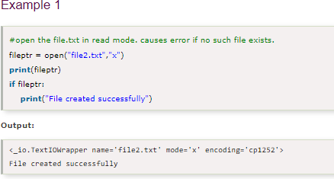

Slide 73

Opening Files in Python
Python provides an open() function that accepts two arguments, file name and access mode in which the file is accessed. The function returns a file object which can be used to perform various operations like reading, writing, etc.

Slide 74
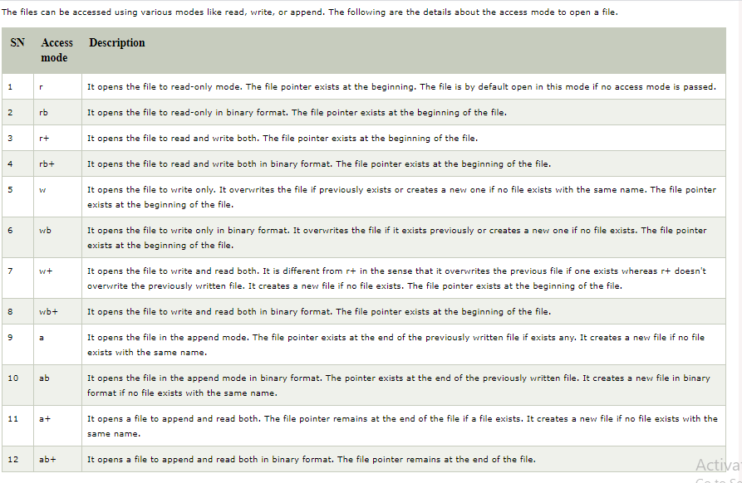

Slide 75
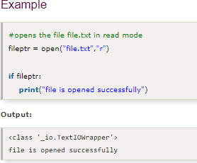

Slide 76

The close() method
Once all the operations are done on the file, we must close it through our Python script using the close() method. Any unwritten information gets destroyed once the close() method is called on a file object.
We can perform any operation on the file externally using the file system which is the currently opened in Python; hence it is good practice to close the file once all the operations are done.
The syntax to use the close() method is given below.

Slide 77
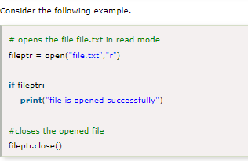

Slide 78
Writing the file
To write some text to a file, we need to open the file using the open method with one of the following access modes.
w: It will overwrite the file if any file exists. The file pointer is at the beginning of the file.
a: It will append the existing file. The file pointer is at the end of the file. It creates a new file if no file exists.

Slide 79
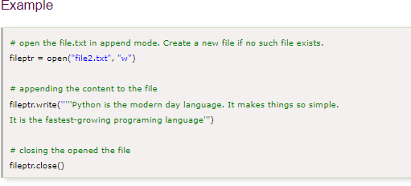


Slide 80

Reading a File
To read a file using the Python script, the Python provides
the read() method. The read() method reads a string from the file. It can read the data in the text as well as a binary format.
The syntax of the read() method is given below.
Here, the count is the number of bytes to be read from the file starting from the beginning of the file. If the count is not specified, then it may read the content of the file until the end.

Slide 81
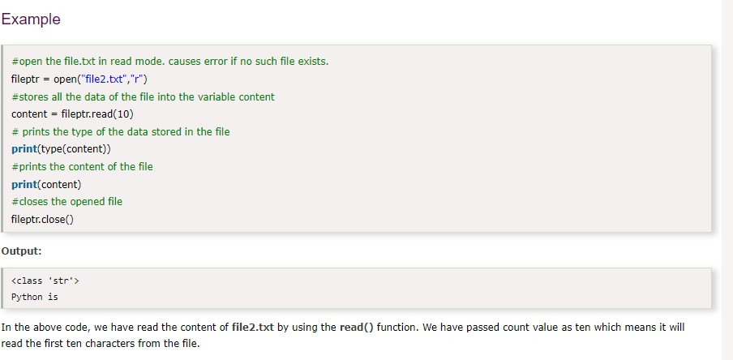

Slide 82
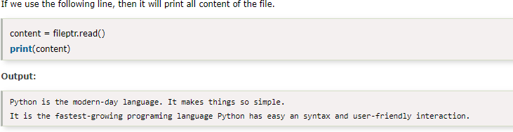

Slide 83
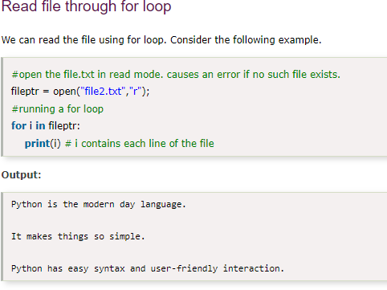

Slide 84
Read Lines of the file
Python facilitates to read the file line by line by using a
function readline() method. The readline() method reads the lines of the file from the beginning, i.e., if we use the readline() method two times, then we can get the first two lines of the file.
Consider the following example which contains a function readline() that reads the first line of our
file "file2.txt" containing three lines. Consider the following example.

Slide 85
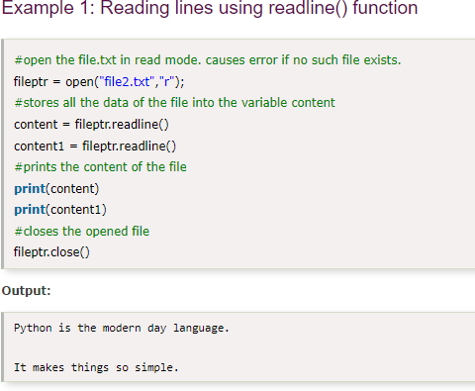

Slide 86
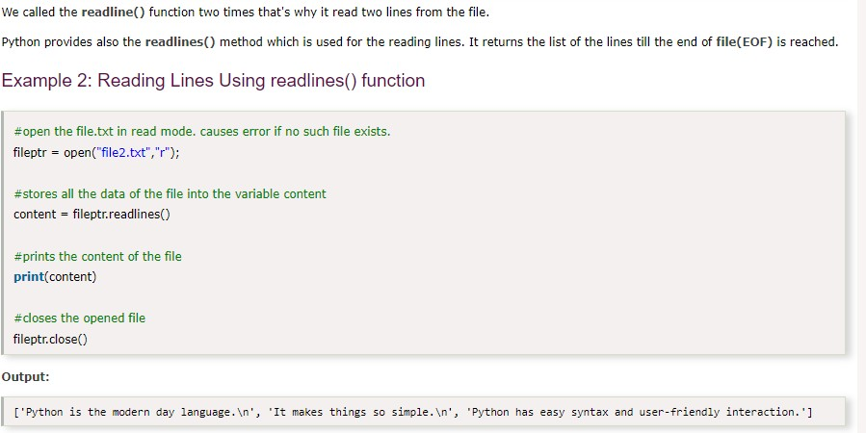

Slide 87
Delete a File
To delete a file, you must import the OS module, and run its os.remove() function:
Example
Remove the file "demofile.txt":
import os os.remove("demofile.txt")

Slide 88
Check if File exist:
To avoid getting an error, you might want to check if the file exists before you try to delete it:
Example
Check if file exists, then delete it:
import os
if os.path.exists("demofile.txt"): os.remove("demofile.txt")
else:
print("The file does not exist")

