Slide 1


GlobalMart Sales Insights and Strategic Recommendations
“Unlocking Opportunities for Growth and Efficiency”
Presented By: Meenaxi Bhadhouriya Position: Data Analyst Date: 15/04/2025
Overview of Presentation Objectives
Analyze sales performance to derive actionable insights
Explore key market trends, sales metrics, and improvement areas
Provide strategic recommendations for growth
Key Insights and Strategic Recommendations
🛍 Understand Sales Performance: Identify growth opportunities
📊 Leverage Data-Driven Insights: Guide strategic decisions
🤝 Enhance Engagement: Optimize customer satisfaction and processes

Slide 2
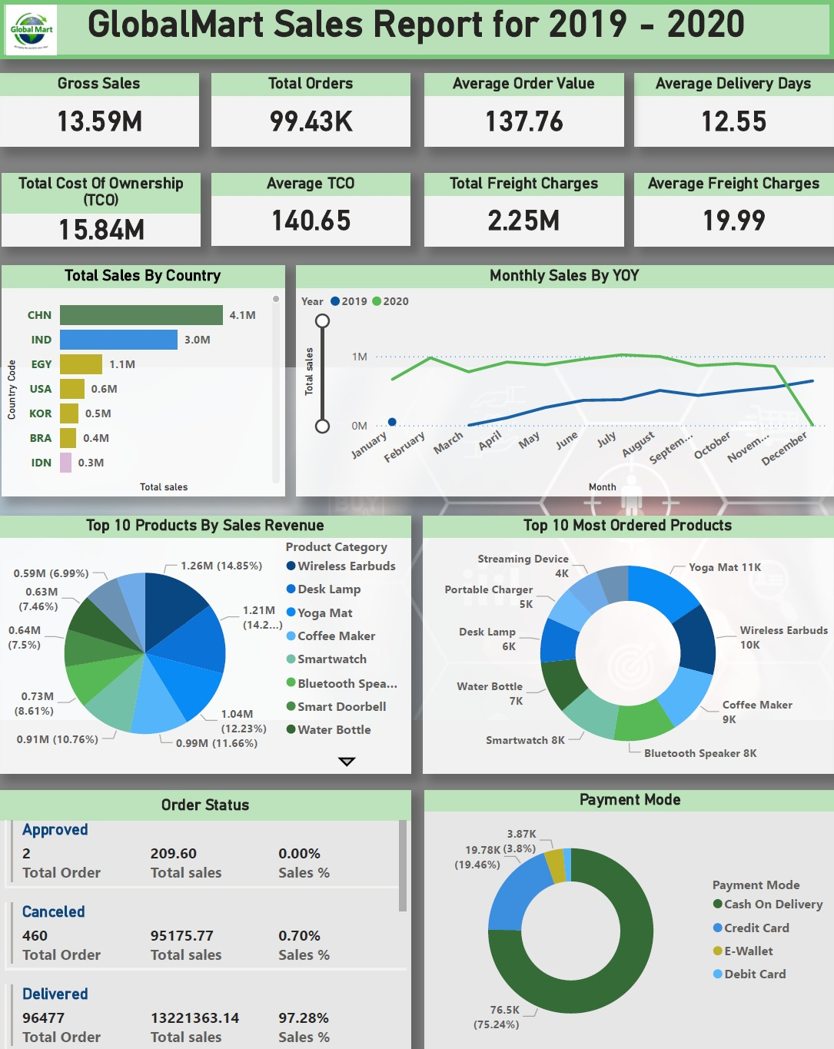
Objective and Scope
Datasets Analyzed:
Sales trends (2019–2020)
Order metrics: Analyzing delivery performance, and delivery times to identify operational bottlenecks
Payment behaviors (COD, credit cards, e-wallets)
Regional sales performance
Purpose
Understand growth drivers and challenges
Provide actionable strategies to improve efficiency and sales

Slide 3
Data Cleaning & Preparation Process
Data Profiling & Fill Missing Data
Remove Insignificant Data
Standardise Data Types
Merging Queries
Populate missing country codes by cross-referencing available data.
Analyze data quality and perform necessary transformations.
Exclude irrelevant 2018, 2021 data from the dataset.
Remove redundant columns from Customer, Orders, and Order Items tables.
Delete records with undefined payment modes.
Promote headers for clarity.
Standardized date formats for consistency in delivery time analysis.
Standardize column values for consistency.
Rename column names for better understanding.
Combine Country Code table with Customer Data table.
Merge Product and Order Items tables to fetch product names in Order Payments.
Merge Customers and Orders tables to include country codes in the Order table
Why Data Cleaning Is Important:
Ensures reliable results and actionable insights

Slide 4
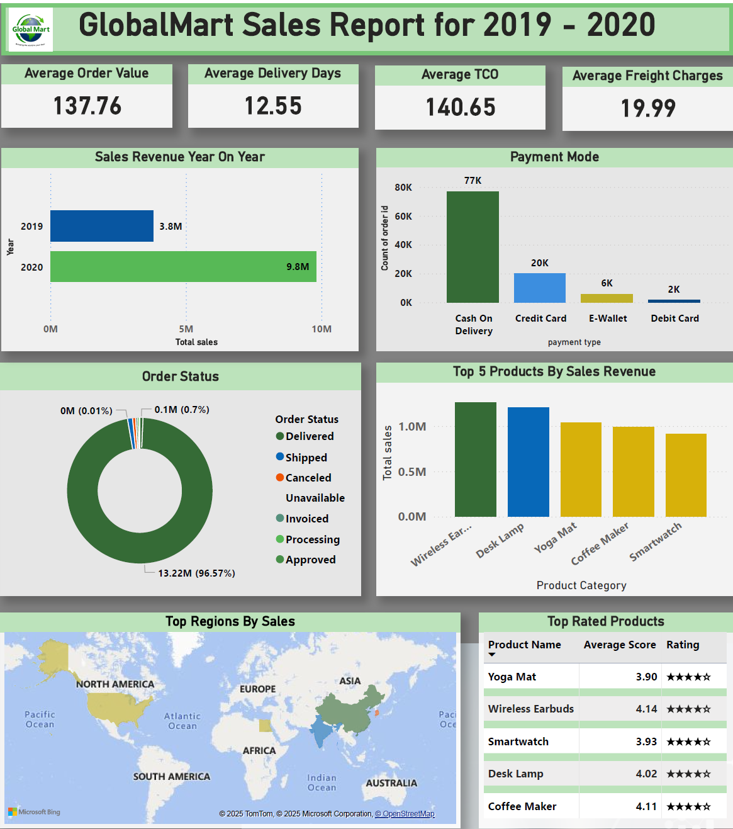
Key Insights from Analysis
Sales Growth: Revenue increased by 158.58% from 3.79M (2019) to 9.80M (2020). Revenue Growth: YOY revenue increase, indicating overall business health.
Order Metrics:
96.57% successful deliveries
Average Delivery Time: 12.55 days (needs improvement)
Average Order Value (AOV): 137.76
Average Cost To Customer: 140.65
Average Freight Charges: 19.99 (needs to be reduced)
Payment Distribution:
COD: 76.79%, E-wallet: 5.56% (low adoption)
Top Regions:
Highest revenue from China, India, Egypt and the USA
Top Products By Sales Revenue
Wireless Earbuds, Desk Lamp, Yoga Mat, Coffee Maker, Smartwatch
Top Rated Products (Avg. rating: 4.02/5)
Wireless Earbuds, Coffee Maker, Desk Lamp, SmartWatch,Yoga Mat

Slide 5



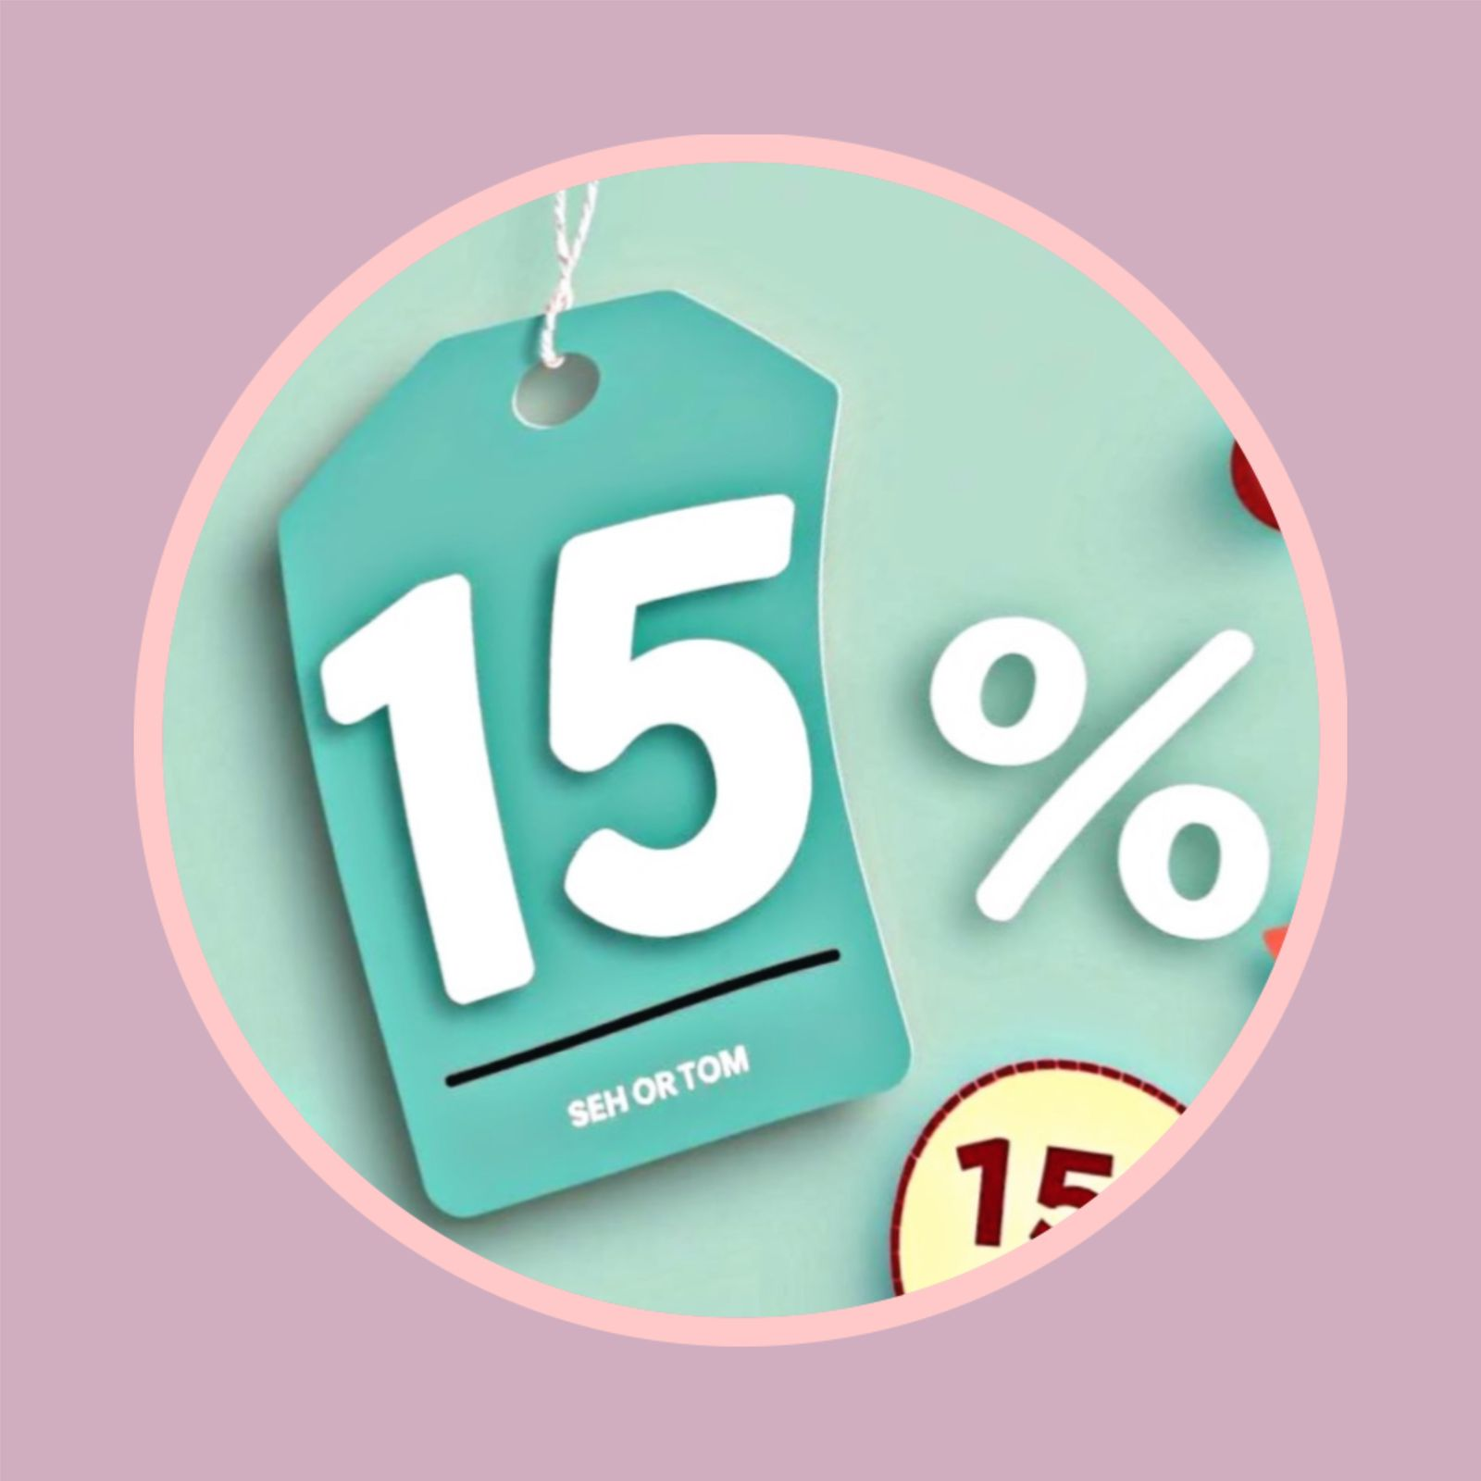

Strategic Recommendations for Growth
Expected Outcome
Lower costs, better margins
Faster payments, higher adoption
Improved customer satisfaction
Higher average order value
Enhanced customer retention
Reduce Shipping Costs:
Consolidate shipments and negotiate better freight terms
Establish regional warehouses in high-demand locations
Promote Digital Payments:
Offer incentives for credit card and e-wallet usage
Educate customers on the convenience and benefits
Shorten Delivery Times:
Use route optimization tools and partner with express delivery providers
Increase AOV Through Incentives:
Implement free shipping thresholds and provide bulk discounts
Discount Structures: Implement tiered discount systems based on purchase volume or customer loyalty
Market Expansion Strategies:
Establish a stronger presence in areas with growing demand, and introduce new product lines

Slide 6

Summary and Next Steps
Key findings: Sales growth, challenges, and opportunities.
Suggested strategies: Shipping cost reduction, payment promotion, faster delivery, and bulk order incentives.
Next Steps:
Implement pilot tests for free shipping thresholds and digital payment offers
Immediate actions include negotiating freight terms, setting up regional warehouses, and launching customer incentives for digital payments
"These strategies set GlobalMart on a path for sustained growth and improved customer satisfaction."

