Slide 1
InsightForge Auto Report
Generated via Insight Engine

Slide 2
Key Insights
Overall activity rate: 50.4% of events are active (1).
Category 'tech_gadgets' – activity rate 55.6% across 302 events.
Category 'health_beauty' – activity rate 52.5% across 301 events.
Category 'home_decor' – activity rate 52.2% across 274 events.
Category 'food' is weaker – activity rate 50.0% across 310 events.
Category 'books' is weaker – activity rate 45.7% across 282 events.
Category 'electronics' is weaker – activity rate 45.5% across 290 events.
Keyword 'skincare' – activity rate 74.4% over 43 events.
Keyword 'sweater' – activity rate 64.9% over 37 events.
Keyword 'bike' – activity rate 63.9% over 36 events.
Keyword 'wireless speaker' – activity rate 61.9% over 42 events.
Keyword 'mirror' – activity rate 61.8% over 34 events.

Slide 3
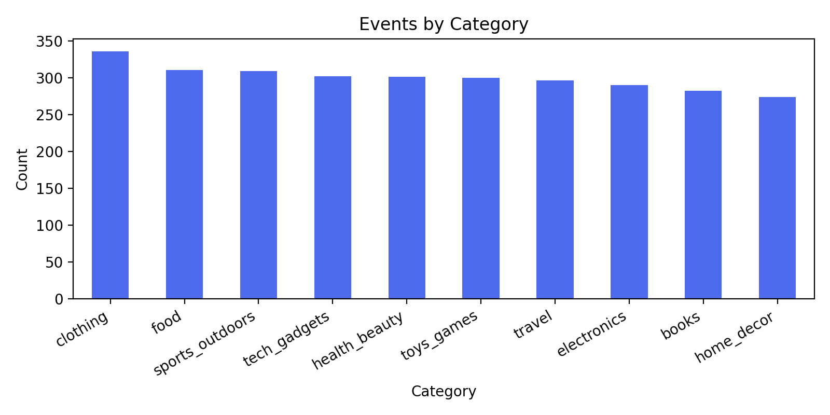
Events By Category

Slide 4
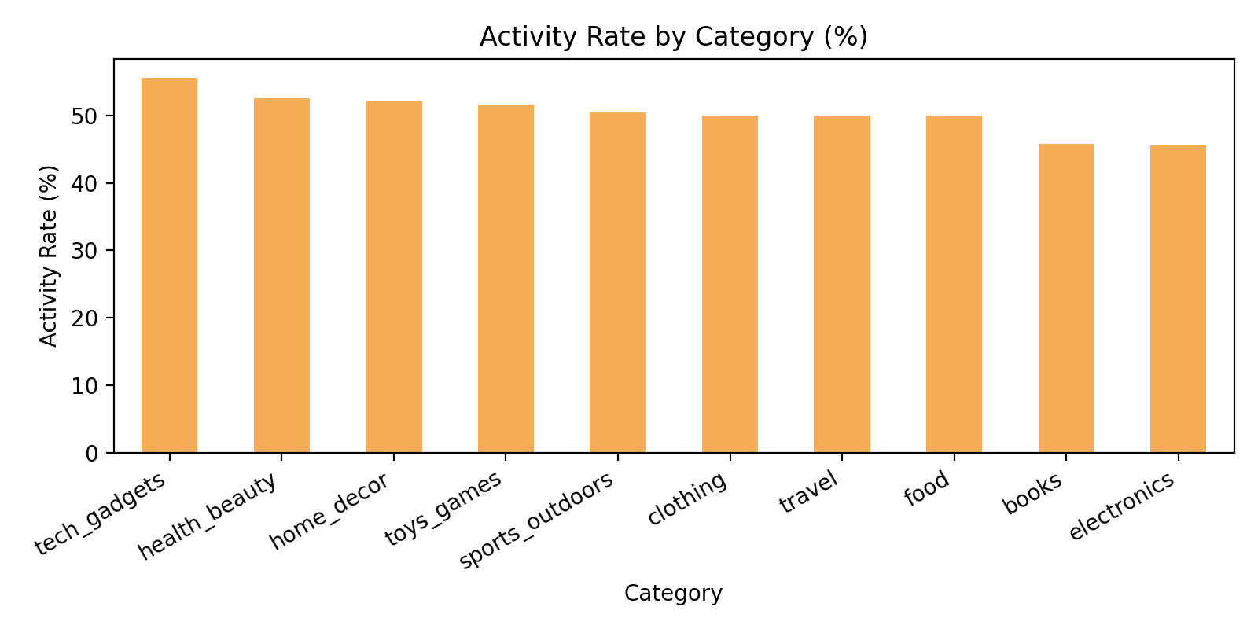
Activity Rate By Category

Slide 5
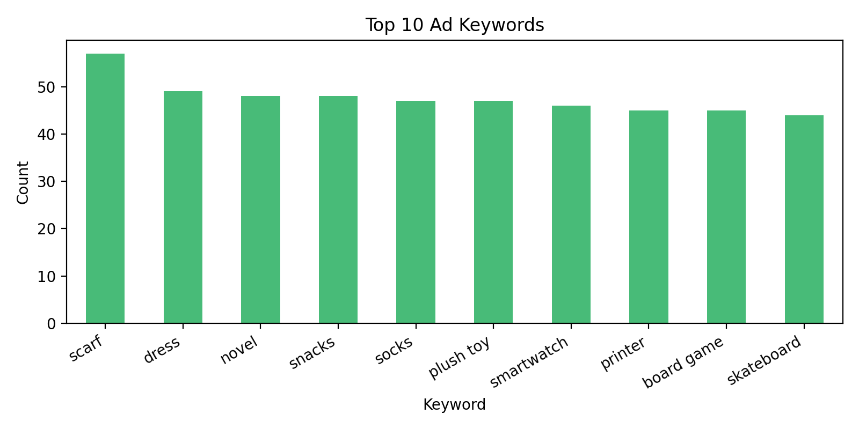
Top Ad Keywords

Slide 6
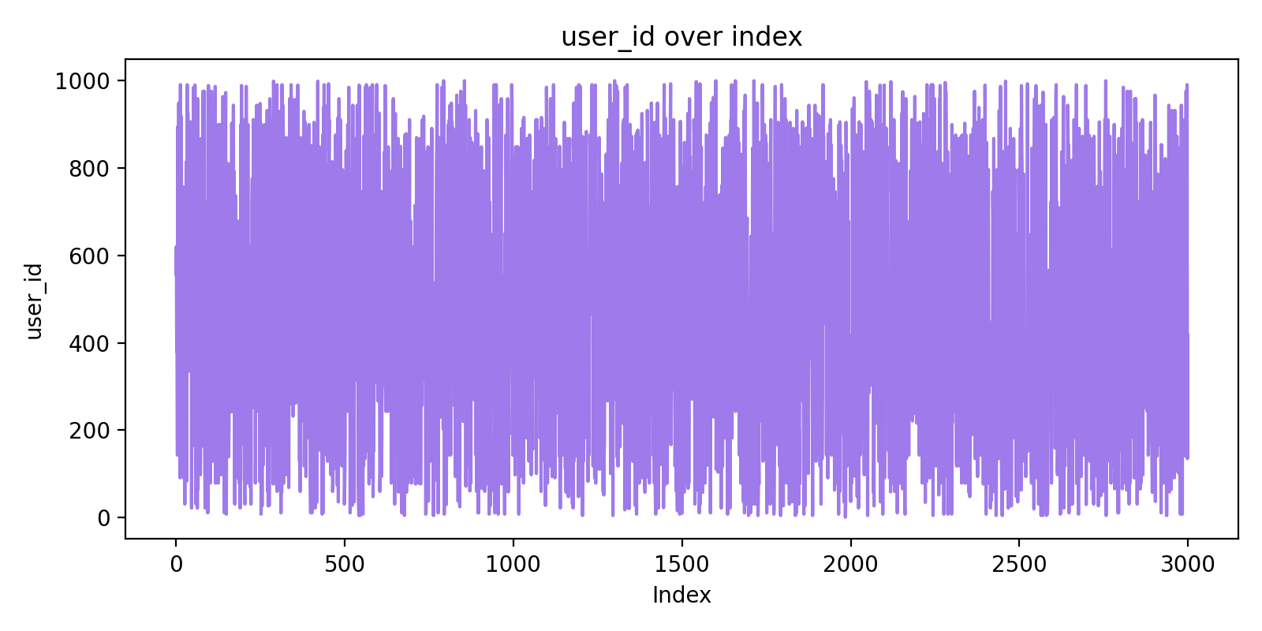
User Id Over Index

