Slide 1
Case Study
Meenu SS

Slide 2
Methodology
01
Exploratory Data Analysis
Univariate & Bivariate Analysis
Got an overview of ‘how data looks like’
Identified best performing countries in terms of revenue
02
Data Aggregation
Aggregated data
Defined Quarters - Q1 through Q4 (refer python codes)
Calculated quarterly revenue for each customer
03
Data Wrangling
Calculated revenue for first 5 Quarters,first 6 Quarters,last 2 Quarters and last Quarter
Calculated Average quarterly revenue for first 5 Quarters & last 2 Quarters to identify downtraders
Data Wrangling
Calculated percentage change in Average revenue per customer for last 2 Quarters & first 5 Quarters
pct_change = (average revenue for last 2Q - average revenue for first5 Q)/average revenue for last 2Q
04
Customer Segmentation
Lost Customers - Customers who did not generate revenue in the last Quarter
Down-traders - Customers’ whose average revenue generated in last 2 quarters is less than 20% or more than average revenue generated through first 5 Quarters
On the verge customers - Customers’ whose average revenue generated in last 2 quarters is greater than 20% or more than average revenue generated through first 5 Quarters
Newly Acquired - Customers acquired in the last 2 quarters
Growth Customers - Customers whose average revenue for last 2 quarters grew over first 5 quarters
Customer Segmentation
Notes:
agg.loc[(agg['First 5 Q Revenue']==0.00) & (agg['Last 2 Q Revenue']!=0.00),'Segment'] = 'Newly Acquired'
agg.loc[(agg['Last 6 Q Revenue']!=0.00) & (agg['Last Q Revenue']==0.00),'Segment'] = 'Lost Customer'
agg.loc[(agg['pct_chng'] < agg['pct_chng'].median()),'Segment'] = 'Down-Trader'
agg.loc[(agg['pct_chng'] > 0.00),'Segment'] = 'Growth Customers'
agg.loc[(agg['Segment'].isnull()) & (agg['pct_chng'] >= -20),'Segment'] = "'On the verge' Customers"
agg.loc[(agg['Segment'].isnull()) & (agg['pct_chng'] <= -20),'Segment'] = "Down-Trader"

Slide 3
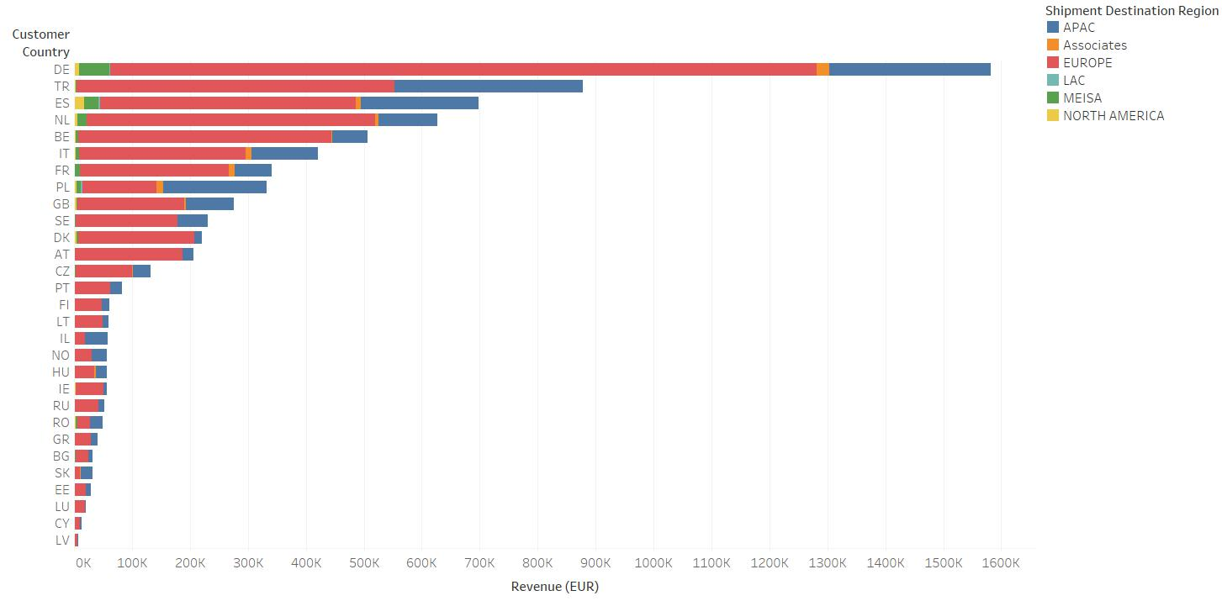
Customer Country - Revenue

Slide 4
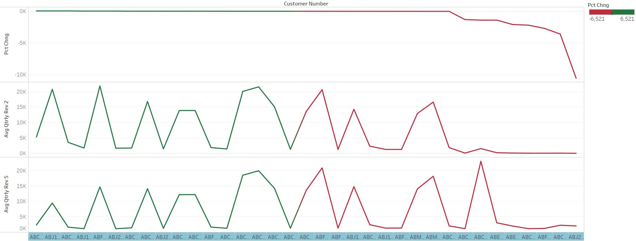
Quarterly Revenue - Pct Change

Slide 5
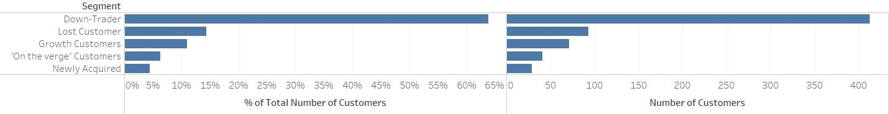
Customer Segment Stats
Down-traders - 413 (63.83%)
Lost Customer - 93 (14.37%)
Growth Customers - 71 (10.97%)
On the verge Customers - 41 (6.31%)
Newly Acquired - 29 (4.48%)

Slide 6
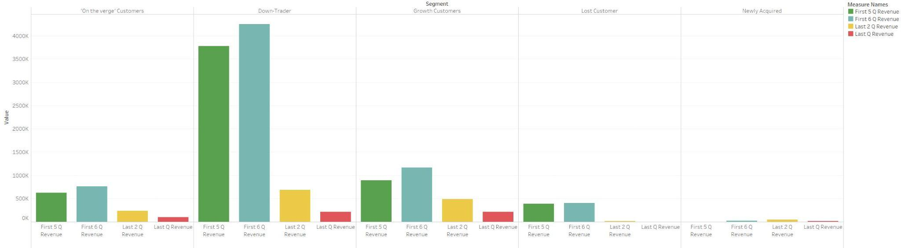
Revenue Analysis
Lost Customers - Customers who did not generate revenue in the last Quarter
Down-traders - Customers whose average revenue generated in last 2 quarters is less than 20% or more than average revenue generated through first 5 Quarters
On the verge customers - Customers’ whose average revenue generated in last 2 quarters is greater than 20% or more than average revenue generated through first 5 Quarters
Newly Acquired - Customers acquired in the last 2 quarters
Growth Customers - Customers whose average revenue for last 2 quarters grew over first 5 quarters

Slide 7
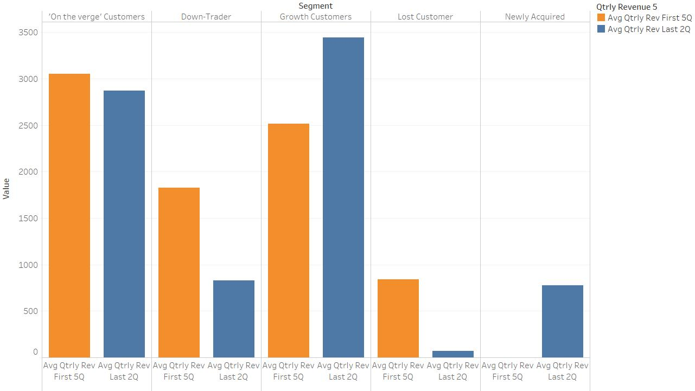
Avg. Revenue Analysis

Slide 8
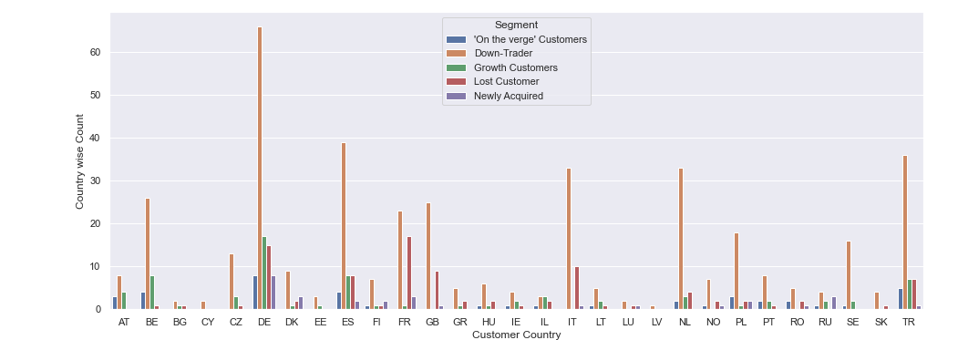
Country Wise Analysis

Slide 9
Recommendations
Messaging(email) should be different for different segments
Retarget lost customers through different media channels.For ex: Display ads
Efforts to be made for customer loyalty & retention (Loyalty programs)

