Slide 1

AI-Powered Mental Health Monitoring
developed at
AccioJob Private Limited - Gurgaon
Under The Guidance Of
Internal Guide
Dr. Hina Chokshi
External Guide
Mr. Gaurav Choudhary
Developed By
Meenu Tomar (2305102120008)
Submitted To:
Department of MCA
Faculty of IT & Computer Science,
PARUL University

Slide 2

Certificate
This is to certify that Ms. Km Meenu Tomar, Enrollment No.2305102120008 student of M.sc-IT has satisfactorily completed the
Major Project on “AI-Powerd Mental Health Moniting System” at Acciojob as fulfillment of M.sc-IT Semester IV.
Seat No. _______________ Date of Submission: ____________
_______________ _______________ ___________
Internal Guide Project Coordinator Director - MCA
Department of MCA
Faculty of IT & Computer Science
Parul University, Vadodara

Slide 3
About Department
About Department of MCA
Parul University is a legitimate university established under Gujarat Private University Act 2009, after legislation passed by the Government of Gujarat on 26th March 2015 giving University status to Parul Group of Institutes functioning under the aegis of Parul Arogya Seva Mandal Trust.
Faculty of IT and Computer Science, Parul University has materialized as one of the prime IT education providers at global level. Various departments under Faculty of IT and Computer Science strive in preparing IT-industry ready professionals by means of various skill development courses, vocational courses, co-curricular & extra-curricular activities, industry visits and expert lectures.
The Department of Master of Computer Application at Parul University emphasizes on building professionals in the domain of computer applications by providing necessary environment by means of facilitating suitable blend of technical and non-technical learning experience. The department cultivates students in various curricular, co-curricular and extra-curricular activities in order to produce future system analysts, system designers, system programmers, application programmers, testing professionals, system managers, project managers, researchers and other leading positions in systems/IT department.

Slide 4
Index
1. Home Slide
2. Certificate
3. Index
4. About Department of MCA
5. Project Profile
6. Requirement Analysis
7. Design
8. Implementation
9. Testing
10. Future Enhancement
11. Bibliography
12. Thank You Slide

Slide 5
Project Profile
Project Definition:
RoboMH--AI Powered Mental Health Monitoring System
Project Description:
The AI-Powered Mental Health Monitoring System is designed to assess individuals' mental health conditions through facial expressions, speech tone, and textual sentiment analysis. The system provides real-time feedback and assists users and therapists in identifying signs of depression, anxiety, and stress using AI-driven models.
Problem Statements:
Mental health is a crucial aspect of well-being, yet many individuals struggle to access timely diagnosis and support. AI-driven mental health analysis offers an automated, objective, and accessible solution.
This project integrates computer vision, speech processing, and NLP models to create a multimodal system that can detect emotional distress and support early mental health intervention.

Slide 6
Requirement Analysis
Medical Session Management
Tracking and management of sessions
Progress Report
Authentication and Security
Mental health discussions are very personal to user.
Session data must be accessible only to related user.
Chat Feature
Sentiment Analysis
Emotion Detection
Real-time consultant availability
History management
Downloadable Session for User
Mental health progress chart showcasing milestones
Analytical Score
Summary
Score
Insights
Row-level security management

Slide 7
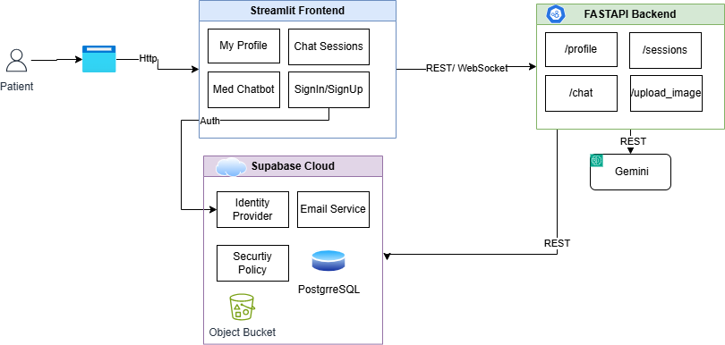
Design
Frontend using Streamlit
REST APIs using FASTAPI
Supabase Cloud Managed
Identity and Access Management
Database
Security Policy
Email Service
Gemini LLM for Text Generation

Slide 8
Data Collection
Facial Expressions: FER2013 dataset Dizvik dataset. (Images)
Anger
Voice Tone: RAVDESS dataset. (Audio)
Calm
Text Messages: Sentiment140 dataset (Tweets)
Positive
Happiness
Sadness.
Happy,
Angry.
Neutral
Negative

Slide 9
Implementation
Frontend developed using Streamlit
Backend API built using FastAPI
User authentication & database managed via Supabase
AI-powered chatbot using Gemini API for responses
Secure and scalable architecture for real-time interactions

Slide 10
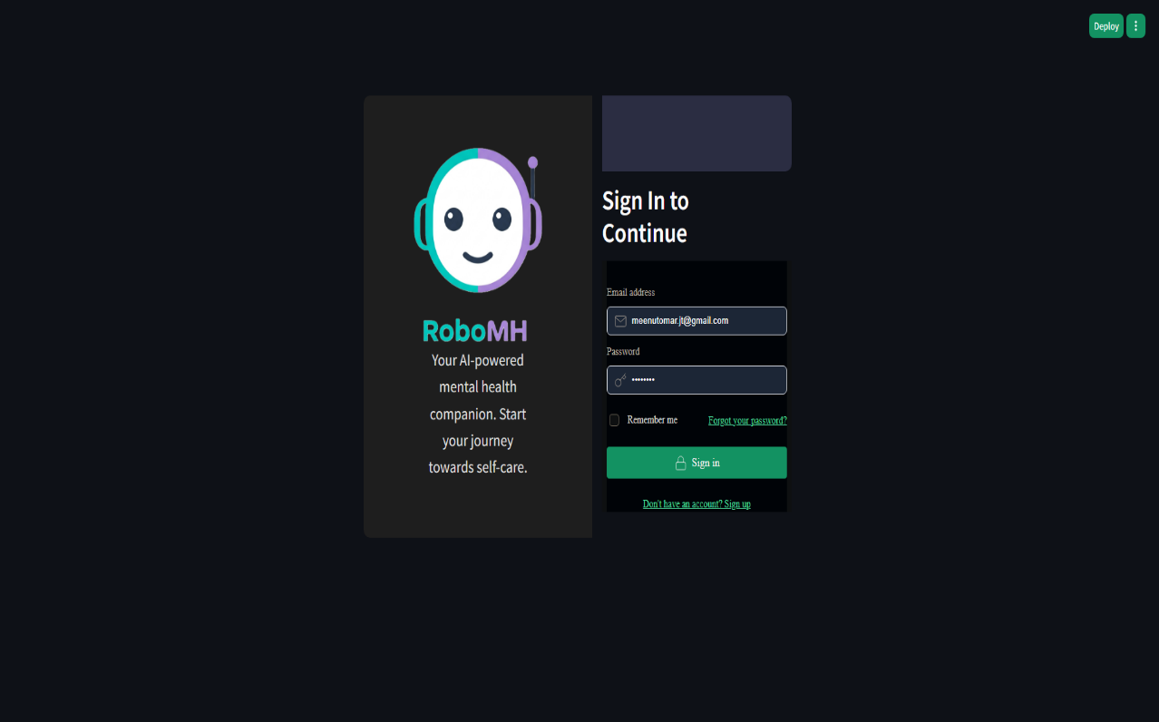
Sign Up Page Layout
This is the Sign Up page where user will fill details to register to explore the application. After registering, user will be able to login and can start the chat session.

Slide 11
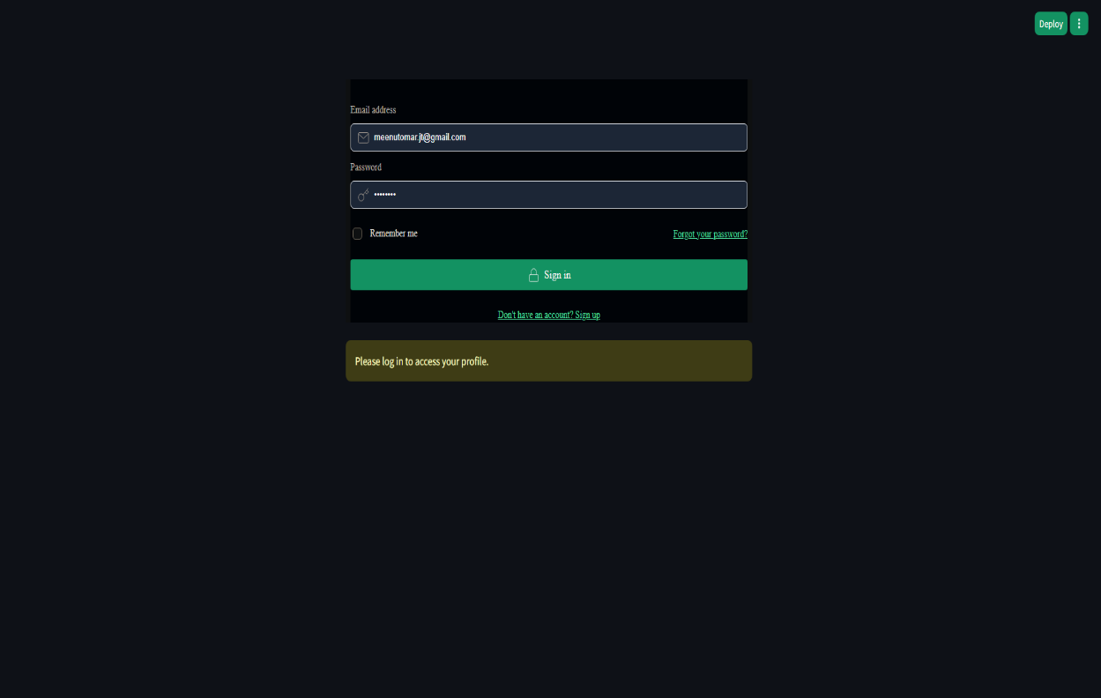
Sign In Page Layout
This is the Sign In page where user will fill login credentials to start the chat session

Slide 12
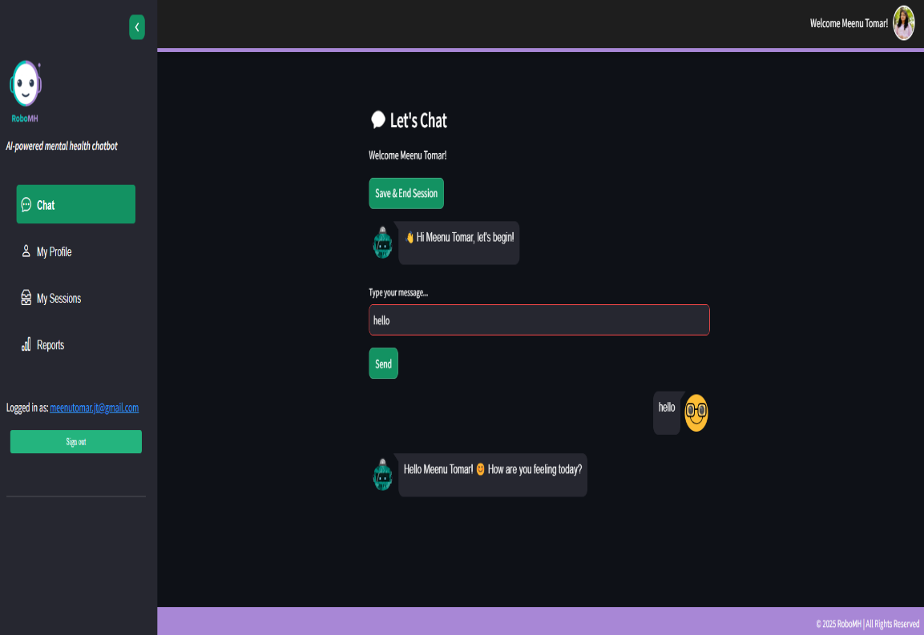
Medical Chat Session
This is the chat page where user can start chat within the application.
User can enter the text how the user is feeling.

Slide 13
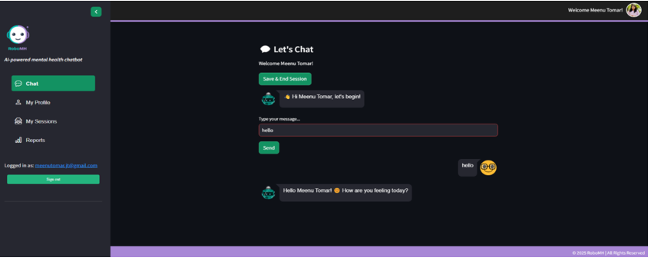
Medical Chat Session
Real-time chat session with medical chat bot.
Bot detects emotion in real-time and respond back to the user by understanding sentiment.
Save and End session will save the session for reference and initiates analytics on real-time

Slide 14
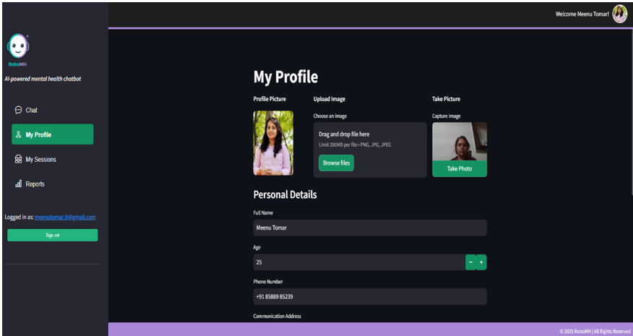
My Profile
Allows user to add/update their profile data
Provision to upload profile image using live image capture
Upload Image

Slide 15
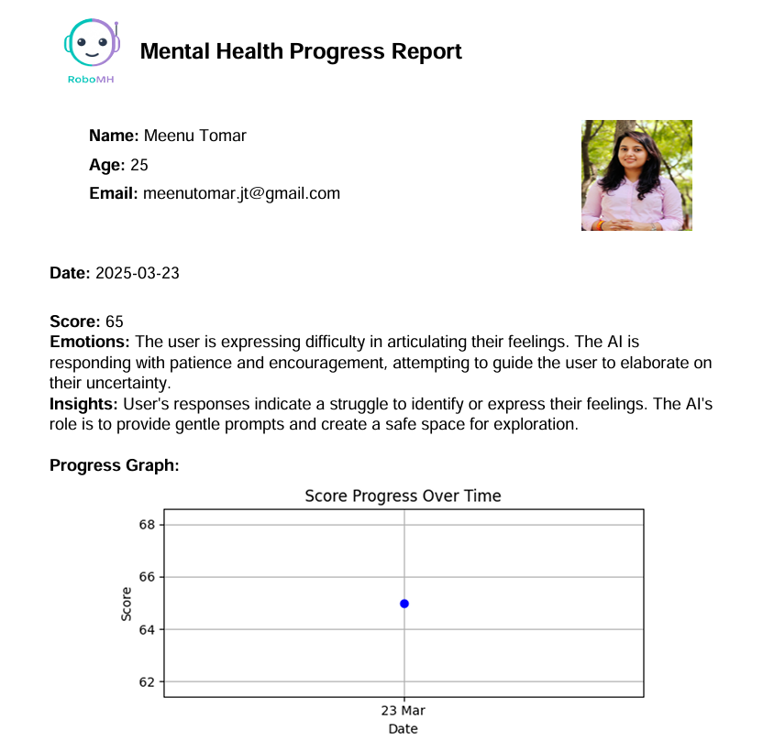
Reports:

Slide 16
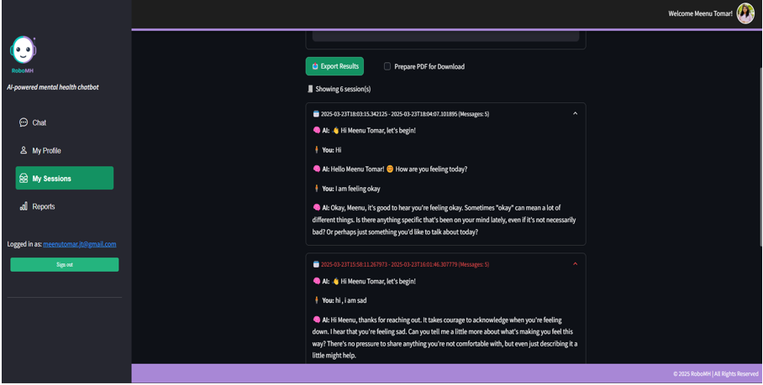
Reports:
We can generate our chat session by using the dedicated button given in the application

Slide 17
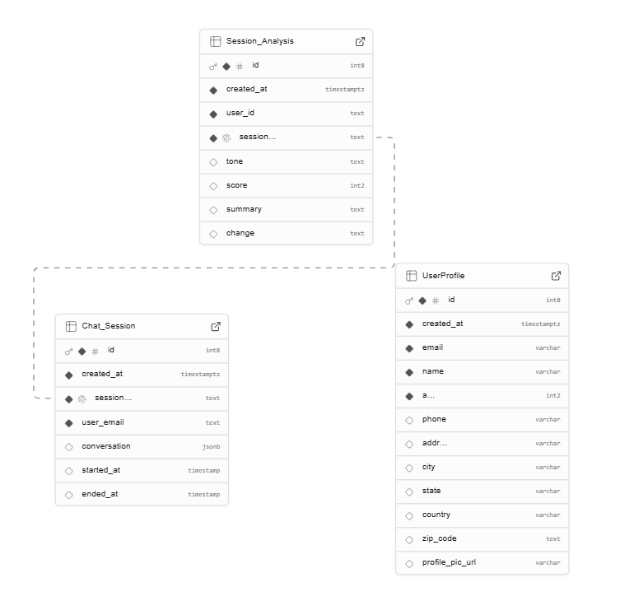
Data Table
UserProfile
Stores user profile information like name, age, address, etc.
Session_Analysis
Contains analytical information about chat conducted
Chat_Session
Record gets updated with the latest score after comparison with previous scores and insights.
Records user’s chat session details.
Contains history of users all chat sessions.

Slide 18
Testing
Unit Testing
Integration Testing
Load Testing
Security Testing
Individual modules tested separately
Ensuring smooth data flow
Performance under multiple requests
User authentication & data privacy

Slide 19
Future Enhancements
Mobile app version for better accessibility
Integration with wearable health devices
Advanced AI analytics for personalized recommendations
Multi-language support for wider reach

Slide 20
Bibliography
Documentation on FastAPI & Streamlit
Supabase authentication & security guidelines
Research papers on AI in mental health
Gemini API documentation
Dizvik Dataset & fer2013

Slide 21

Thank You

