Slide 1
Data Preprocessing

Slide 2
Why data preprocessing
Today’s real-world databases are noisy, contain missing values and inconsistent due to their huge size.
A good preprocess data before learning not only “improve the quality of learning results” but also “ease the learning process”.
There are a number a data preprocessing techniques
  Data Cleaning:- Remove noise, correct inconsistencies
  Data Integration:- Merge data from multiple sources
  Data Transformation:- Improve distance measurements
  Data Reduction:- Eliminate redundant features

Slide 3
Data Cleaning
Data cleaning routines
  Missing values.
  Identify outliers.
  Correct inconsistencies.
Missing values:-
  You can note that many tuples have no recorded value for several attributes, such as country, Refund.
TID | Refund | Country | Taxable Income | Cheat
1 | Yes | USA | 125K | No
2 |  | UK | 100K | No
3 | No | Australia | 70K | No
4 |  |  | 120K | No
5 | No | NZL | 95K | Yes
6 | No | USA | 60K | No
7 | Yes | UK | 220K | No
8 | No |  | 85K | Yes
9 | No | UK |  | No
10 | No |  |  | Yes

Slide 4
Missing values Techniques
Ignore the record:-
  This is usually done when the class label is missing.
Use the attribute mean to fill in the missing value:-
  For example, take the average value of income attribute. Use this value to replace the missing value for income.
Use the attribute Median to fill in the missing value:-
  The main difference between Mean and Median is that Median is robust to noise.
Use classification rules to fill in the missing value:-
  This can be determined with decision tree, neural network, Bayesian Modeling.

Slide 5
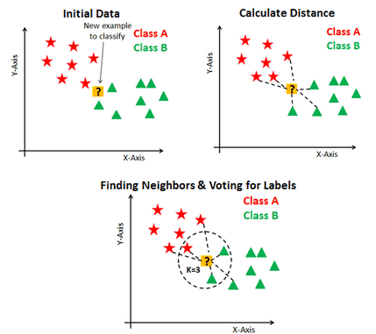
Missing values Techniques (cont)
K Nearest Neighbors
  KNN is a supervised learning algorithm where the missing values are replaced based on nearest K neighbor. Neighbors are determined based on distance measure.
  Once K neighbors are determined then we can use mean or median for missing value of continuous
  attribute.

Slide 6
Noisy Data
Noise is a random error or variance in a measured variable.
Incorrect attribute values may be due to
  faulty data collection tools
  data entry problems
  data transmission problems

Slide 7
Noisy Data (Clustering)
Outliers may be detected by clustering, where similar values are organized into groups or “clusters”.
Values which falls outside of the set of clusters may be considered outliers.

Slide 8
Data Integration
Data integration:
  Combines data from multiple sources into a coherent store as in data warehousing.
    Sources may include
      Databases
      Data cubes
      Flat files
Problem(1): Schema integration
  Entity identification problem: How we can sure that customer_id in one database, and cust_number in another refer to the same entity.
Problem(2): Detecting and resolving data value conflicts
  For the same entity, attribute values from different sources are different
  possible reasons: different representations, different scales, e.g., Price in dollars vs. Price in Rupees.

Slide 9
Handling Redundant Data in Data Integration
Redundant data occur often when integration of multiple databases
  The same attribute may have different names in different databases e.g., customer_id and customer_number.
  One attribute may be a “derived” attribute in another table,
Technique:
  Redundant data may be able to be detected by correlation analysis.

Slide 10
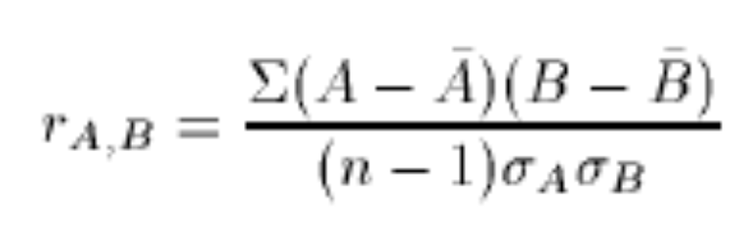
Handling Redundant Data in Data Integration
Correlation between two attributes can be checked by:-
Resulting value > 0, then A and B are positively correlated. If A increase B will also increase. A or B can be removed
Resulting value = 0, then A and B are independent.
Resulting value < 0, then A and B are negatively correlated. If the value of A increases, the value B will decrease.

Slide 11
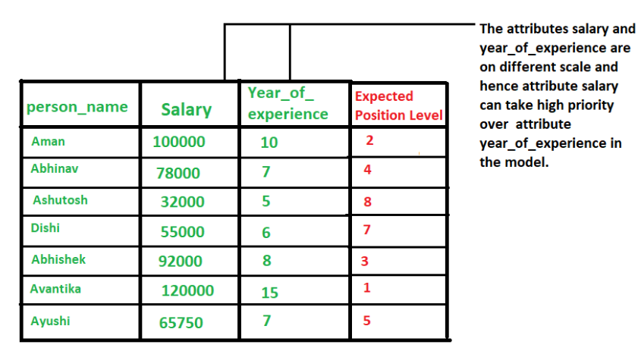
Data Transformation: Data Normalization
The goal of normalization is to transform features to be on a similar scale. All integer attributes are normalized, so that their values fall within a small specified, such as 0 to 1.0 or -1.0 to 1.0.
Normalization is particularly useful for classification algorithms or distance measurements such as nearest-neighbor classification and clustering.

Slide 12
Data Normalization
min-max normalization
  Example:- Suppose that the minimum and maximum values for the attribute income are 12,000 and 98,000. By min-max normalization, a value of 73,600 for income is transformed to
    ((73,000-12,000)/(98,000-12,000)) (1.0-0) + 0 = 0.716

Slide 13
Data Normalization
z-score normalization
  This method of normalization is useful when the actual minimum and maximum of any attribute are unknown.
  Or when outliers which dominate the min-max normalization.
Decimal scaling normalization
Where j is the smallest integer such that Max(| |)<1

