Slide 1
Categorical to Numerical Encoding Methods

Slide 2
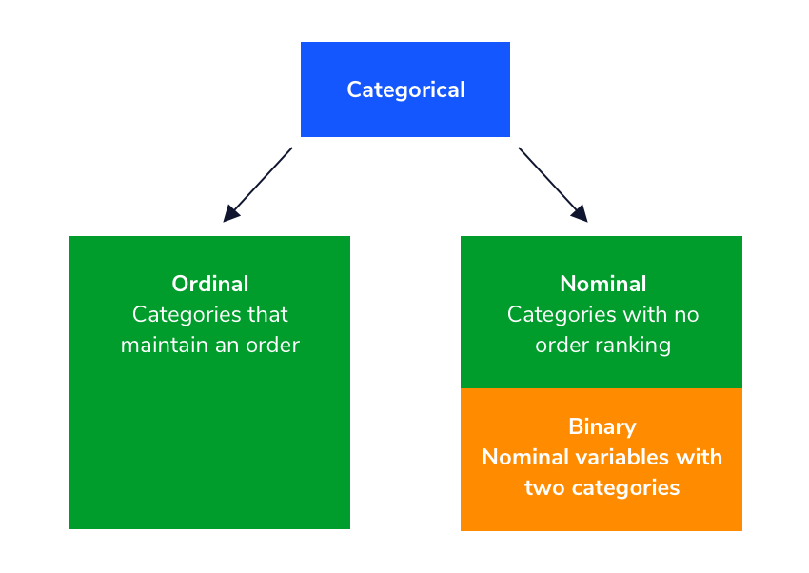
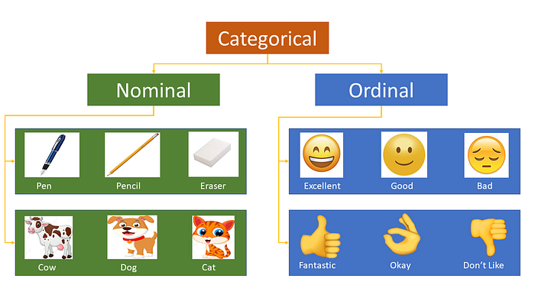
Categorical variables
Categorical variables can be divided into two categories: Nominal (No order) and Ordinal (some order).

Slide 3
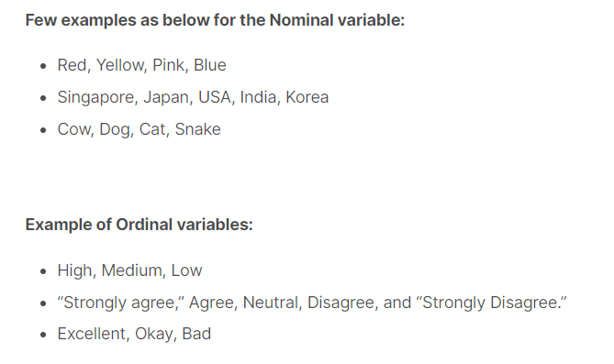
Categorical variables
Most of the Machine learning algorithms cannot handle categorical variables unless we convert them to numerical values.

Slide 4
Categorical variables
There are many ways to encode these categorical variables as numbers
One Hot Encoding
Ordinal Encoding
Label Encoding

Slide 5
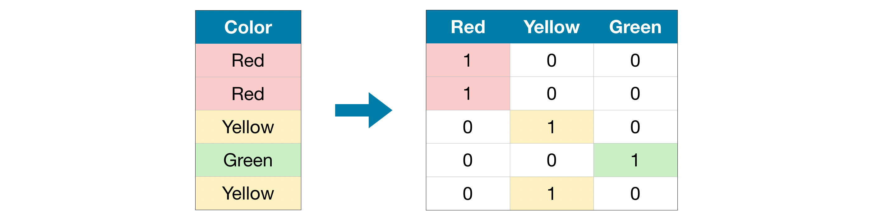
One Hot Encoding

Slide 6
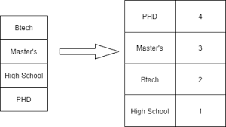

Ordinal Encoding
Used only for input or X columns

Slide 7
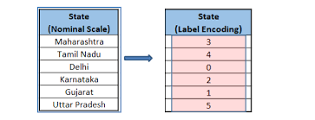
Label Encoding
Used only for output or Y columns

Slide 8
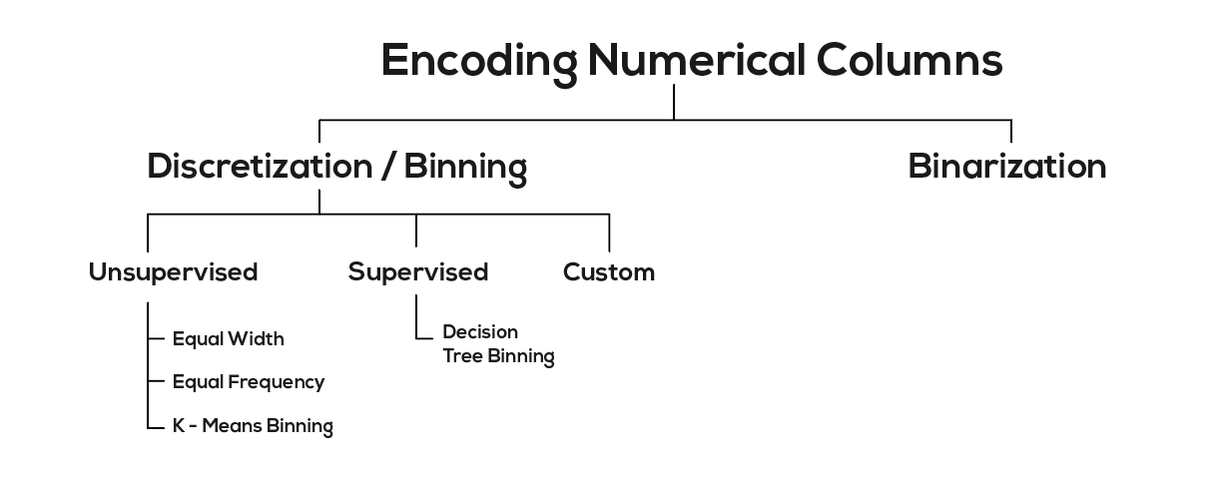

Slide 9
Encoding in Pandas and Scikit-Learn
https://www.turing.com/kb/convert-categorical-data-in-pandas-and-scikit-learn
https://www.kaggle.com/code/aimack/how-to-encode-numerical-categorical-data

