Slide 1
What is Machine learning in simple words?
Machine learning is a branch of artificial intelligence (AI) and computer science that focuses on the use of data and algorithms to imitate the way that humans learn.

Slide 2
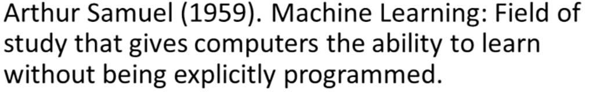
What is Machine learning in simple words?

Slide 3
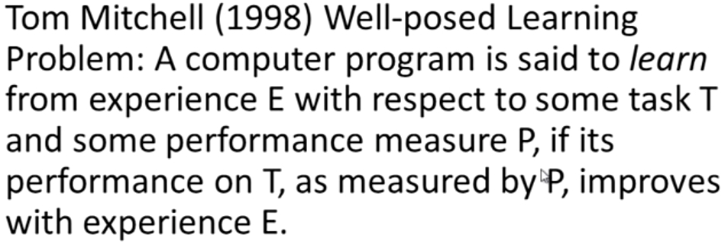
What is Machine learning in simple words?

Slide 4
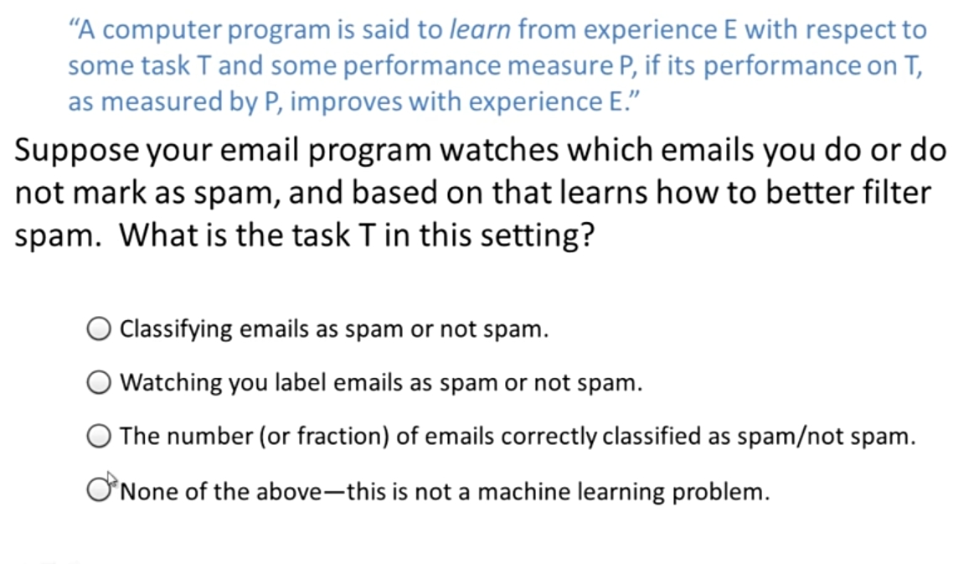
What is Machine learning in simple words?

Slide 5
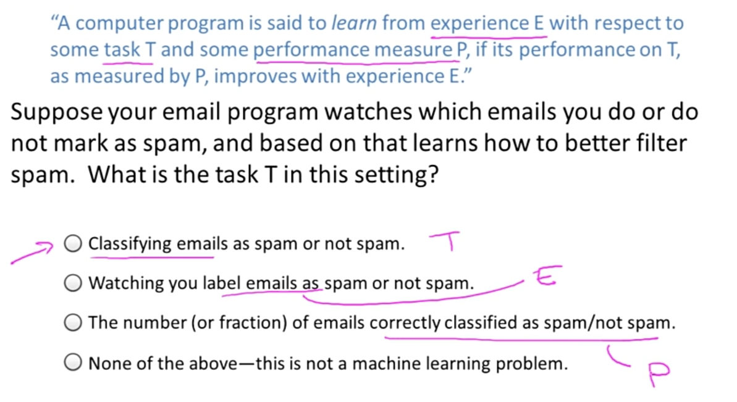
What is Machine learning in simple words?

Slide 6
Machine Learning Alogorithms
Supervised Learning
Unsupervised Learning
Reinforcement Learning

Slide 7
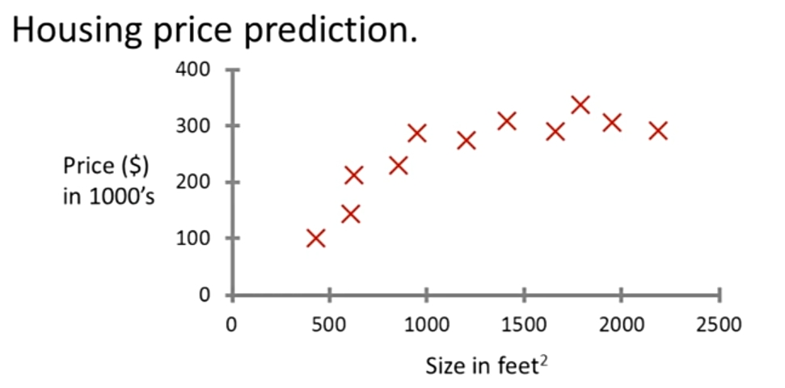
Supervised Learning (Regression)

Slide 8
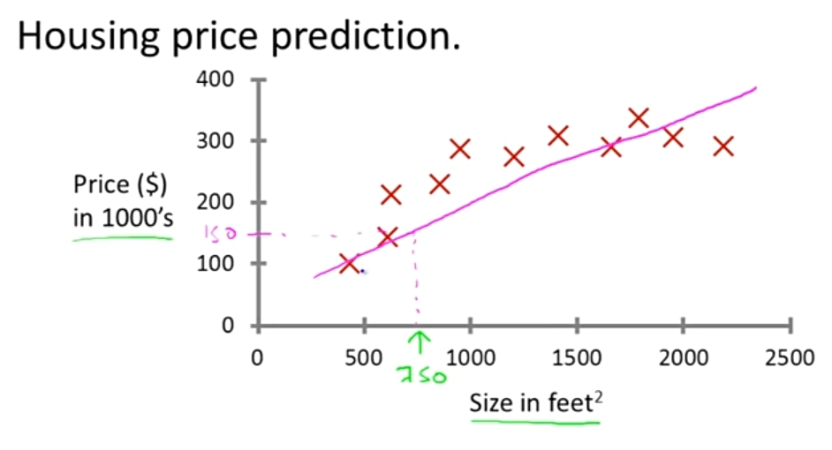
Supervised Learning (Regression)

Slide 9
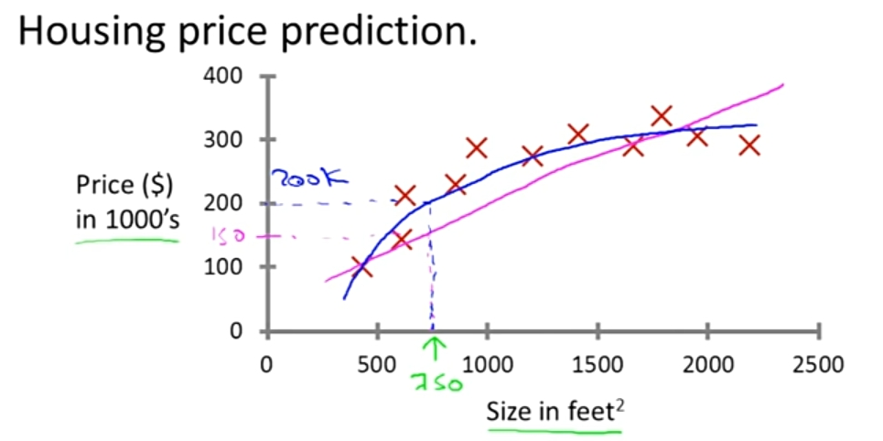
Supervised Learning (Regression)

Slide 10
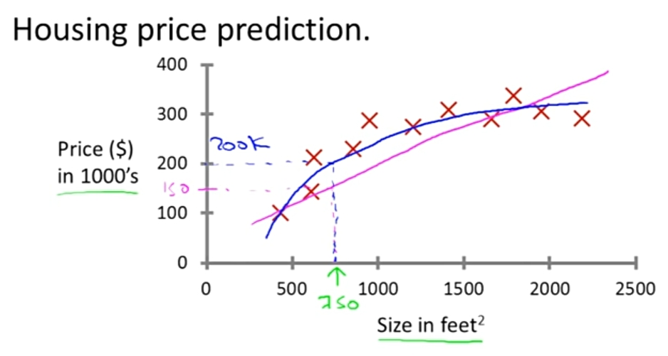
Supervised Learning (Regression)

Slide 11
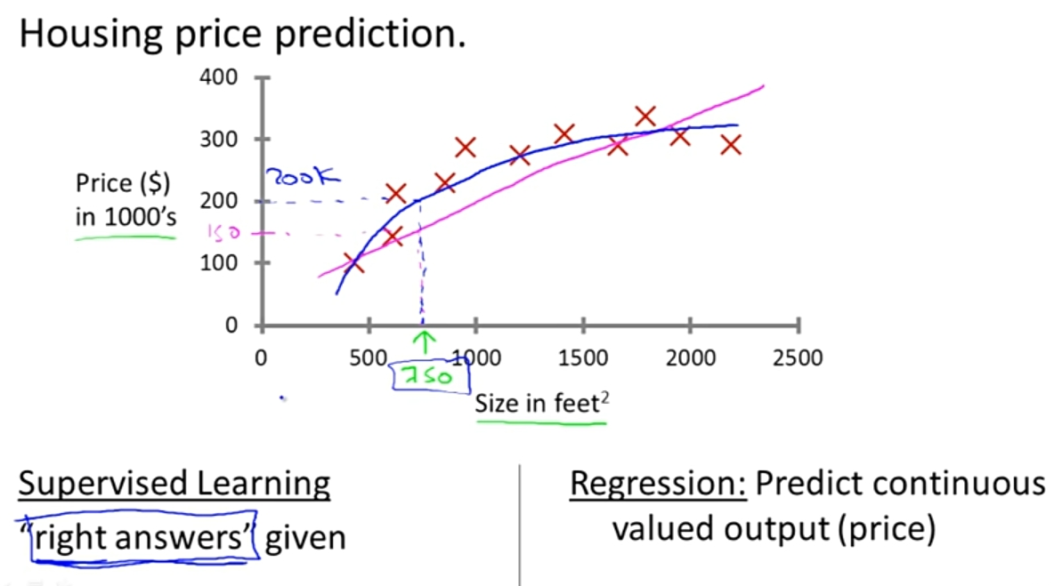
Supervised Learning (Regression)

Slide 12
Supervised Learning (Classification)
An emergency room in a hospital measures 17 variables (e.g., blood pressure, age, etc) of newly admitted patients. A decision must be taken whether to put the patient in an intensive-care unit. Due to the high cost of ICU, those patients who may survive less than a month are given higher priority. The problem is to predict high-risk patients and discriminate them from low-risk patients.

Slide 13
Supervised Learning (Classification)
A credit card company typically receives thousands of applications for new cards. The application contains information regarding several different attributes, such as annual salary, any outstanding debts, age etc. The problem is to categorize applications into those who have good credit, bad credit, or fall into a gray area (thus requiring further human analysis).

Slide 14
Supervised Learning (Classification)
Data: It has k attributes A₁, … A_{k}. Each tuple (case or example) is described by values of the attributes and a class label.
Goal: To learn rules or to build a model that can be used to predict the classes of new (or future or test) cases.
The data used for building the model is called the training data.
Notes:
Induction is different from deduction and DBMS does not not support induction;
The result of induction is higher-level information or knowledge: general statements about data
There are many approaches. Refer to the lecture notes for CS3244 available at the Co-Op.
We focus on three approaches here, other examples:
Other approaches
Instance-based learning
other neural networks
Concept learning (Version space, Focus, Aq11, …)
Genetic algorithms
Reinforcement learning

Slide 15
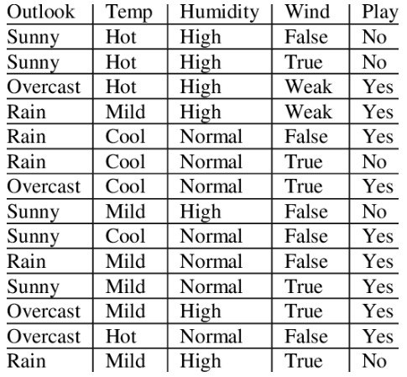
Supervised Learning (Classification)

Slide 16
Classification
Two-Step Process
Model construction: describing a set of predetermined classes based on a training set. It is also called learning.
  Each tuple/sample is assumed to belong to a predefined class
  The model is represented as classification rules, decision trees, or mathematical formulae
Model usage: for classifying future test data/objects
  Estimate accuracy of the model
    The known label of test example is compared with the classified result from the model
    Accuracy rate is the % of test cases that are correctly classified by the model
  If the accuracy is acceptable, use the model to classify data tuples whose class labels are not known.

Slide 17



Classification Process (1): Model Construction
Classification
Algorithms
Training
Data
Classifier
(Model)
IF rank = ‘professor’
OR years > 6
THEN tenured = ‘yes’

Slide 18


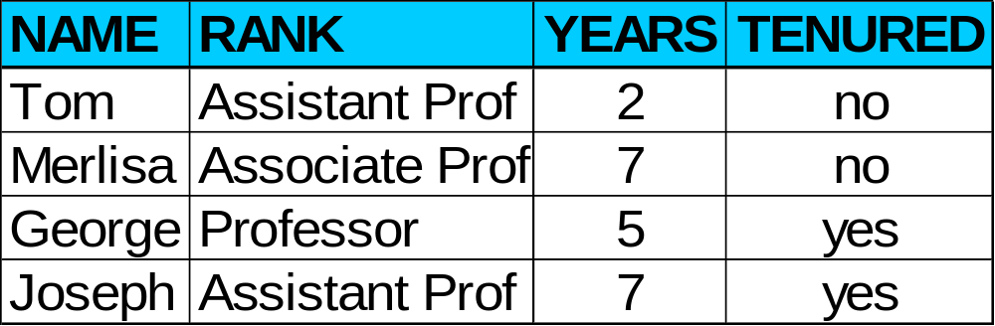

Classification Process (2): Use the Model in Prediction
Classifier
Testing
Data
Unseen Data
(Jeff, Professor, 4)
Tenured?

Slide 19
Supervised vs. Unsupervised Learning
Supervised learning: classification is seen as supervised learning from examples.
  Supervision: The training data (observations, measurements, etc.) are accompanied by labels indicating the classes of the observations/cases.
  New data is classified based on the training set
Unsupervised learning (clustering)
  The class labels of training data is unknown
  Given a set of measurements, observations, etc. with the aim of establishing the existence of classes or clusters in the data

Slide 20
Clustering
Clustering is a technique for finding similar groups in data, called clusters. i.e.,
  It groups data instances that are similar to (near) each other in one cluster and data instances that are very different (far away) from each other into different clusters.
Clustering is often called an unsupervised learning task as no class values denoting an a priori grouping of the data instances are given, which is the case in supervised learning.

Slide 21

An illustration
+
+++
We see that there are two natural groups or “clusters”

Slide 22
What is clustering for?
Let us see some real-life examples
Example 1: groups people of similar sizes together to make “small”, “medium” and “large” T-Shirts.
  Tailor-made for each person: too expensive
Example 2: In marketing, segment customers according to their similarities
To do targeted marketing.

Slide 23
What is clustering for? (cont…)
Example 3: Given a collection of text documents, we want to organize them according to their content similarities,
  To produce a topic hierarchy
  It has a long history, and used in almost every field, e.g., medicine, psychology, botany, sociology, biology, archeology, marketing, insurance, libraries, etc.
  In recent years, due to the rapid increase of online documents, text clustering becomes important.

Slide 24
What is reinforcement learning?
Reinforcement learning (RL) is a type of machine learning, in which an agent explores an environment to learn how to perform desired tasks by taking actions with good outcomes and avoiding actions with bad outcomes.
A reinforcement learning model will learn from its experience and over time will be able to identify which actions lead to the best rewards.

Slide 25
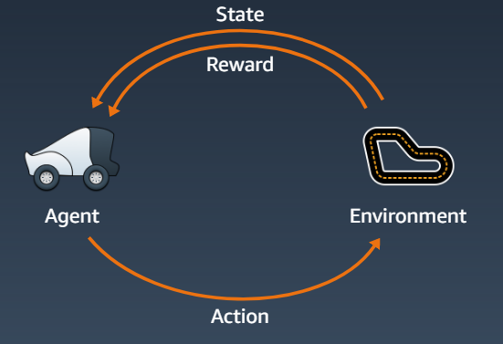
What is reinforcement learning?

Slide 26
What is reinforcement learning?
In reinforcement learning, an agent interacts with an environment with an objective to maximize its total reward.
The agent takes an action based on the environment state and the environment returns the reward and the next state. The agent learns from trial and error, initially taking random actions and over time identifying the actions that lead to long-term rewards.

