Slide 1

Capstone Project

Slide 2



Personal BACKGROUND
(Name, Past Experience, Qualification, Career Summary)
Name : MEERA NATARAJAN [AE24110027]
Past Experience : Completed structured training in software testing with Selenium (Java and C#).Previously worked on Machine Learning Projects
Qualification : Master of Computer Applications(MCA),
Software Testing: Selenium WebDriver, TestNG and Maven.
Career Summary :Results-driven Associate QA Engineer with hands-on experience in Selenium automation using Java and C#. Proficient in TestNG, POM framework, logging, and reporting.
www.collaberadigital.com

Slide 3


Key Takeaways/Learnings from the Program (HTD)
Selenium Automation: Developed robust Java-TestNG POM frameworks with integrated logging and automatic screenshot capture to handle negative test cases effectively.
API Testing: Executed full CRUD operations on localhost APIs using Postman, ran collections through Newman CLI for automated test runs, and generated comprehensive HTML reports for result analysis.
Performance Testing: Utilized JMeter to simulate load on the DemoBlaze website, creating realistic user scenarios recorded via BlazeMeter for accurate performance assessment and reporting.
Test Management: Organized and tracked development and testing workflows in JIRA, managing epics, user stories, test cases, and tasks to maintain project visibility and sprint progress.
GitHub Integration: Maintained Code with GitHub workflows and team collaboration.

Slide 4

Problem Statement of the Capstone Project
To demonstrate the application of end-to-end QA skills by building a comprehensive automation framework using Selenium with Java for functional testing on BlazeDemo, performing API testing on local services using Postman and Newman CLI, executing performance testing with JMeter recorded via BlazeMeter, and managing all test activities through JIRA.

Slide 5
I explored the fundamentals of automation testing with a focus on using industry-standard tools to manage test cases.
Tools & Technologies:
Selenium IDE – Used to record user interactions on web pages and generate test scripts. BlazeMeter – A no-code/low-code platform for recording test flows and automatically generating test scripts.
Selenium with Java (POM) – Built structured automation test suites using the Page Object Model with features like
logging(Log4J), headless execution, and screenshot capture for negative scenarios. Postman + Newman – Performed API testing (GET, POST, PUT, DELETE) on local servers, executed via command line, and generated detailed HTML reports. JMeter – Simulated concurrent users on the BlazeDemo website using BlazeMeter recorder and produced performances metrics. JIRA – Managed the test lifecycle using epics, user stories, tasks, and test cases with visual dashboards. GitHub – Used for version control, CI workflow, and code collaboration. Languages: Java Browsers Used: Microsoft Edge, Google Chrome
Introduction & Tools Used:

Slide 6

Work Flow :
JIRA (Using OrangeHRM)
✅ Created Epics
✅ User Stories
✅ Tasks
✅ Test Execution
✅ Dashboard Creation
✅ Summary Reports
SELENIUM (Using BlazeDemo)
✅ Implemented Page Object Model (POM)
✅ Excuting using Headless
✅ Log Handling
✅ Screenshot Capture for failure test
✅ Extent Report Generation
POSTMAN
✅ GET Method
✅ POST Method
✅ PUT Method
✅ PATCH Method
✅ DELETE Method
✅ Newman Report
JMETER (Using DemoBlaze)
✅ Login
✅ Select Product
✅ Add to Cart
✅ Place Order
✅ View Results Tree
✅ Summary report

Slide 7
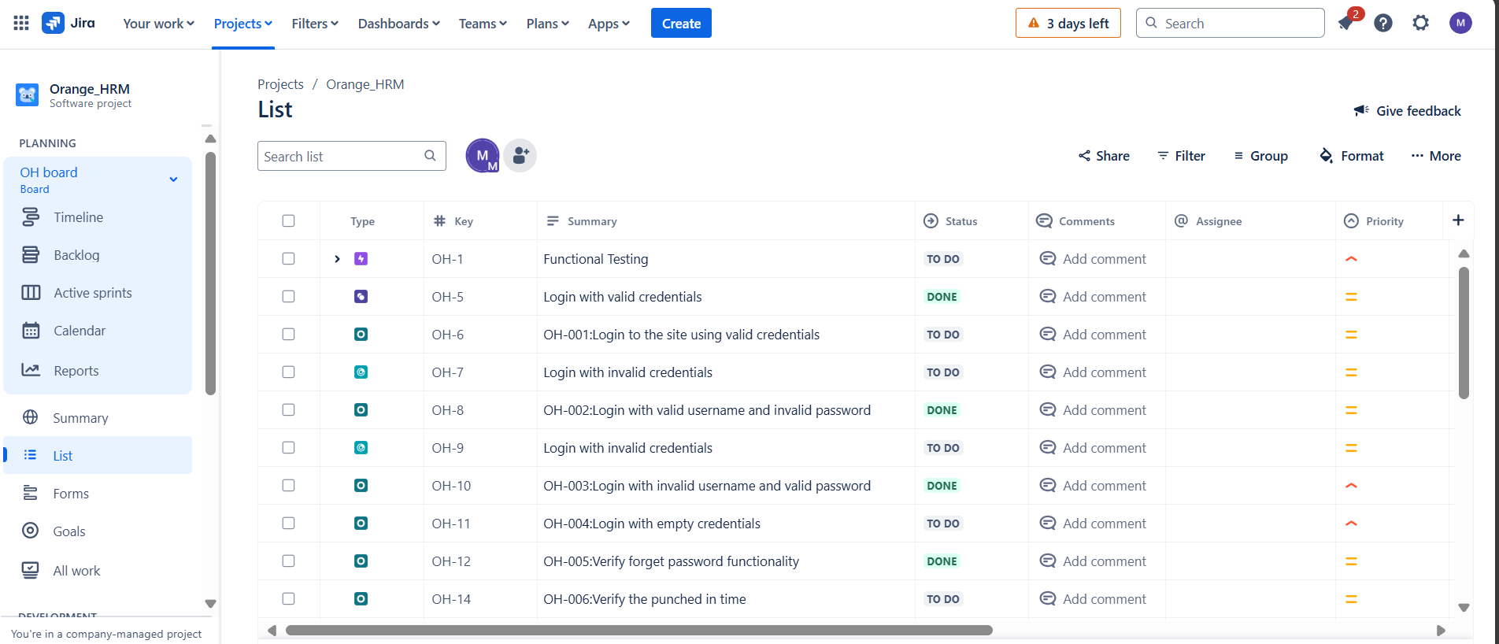
JIRA:Created Epics,User stories,Task,Test Execution using Orange HRM

Slide 8
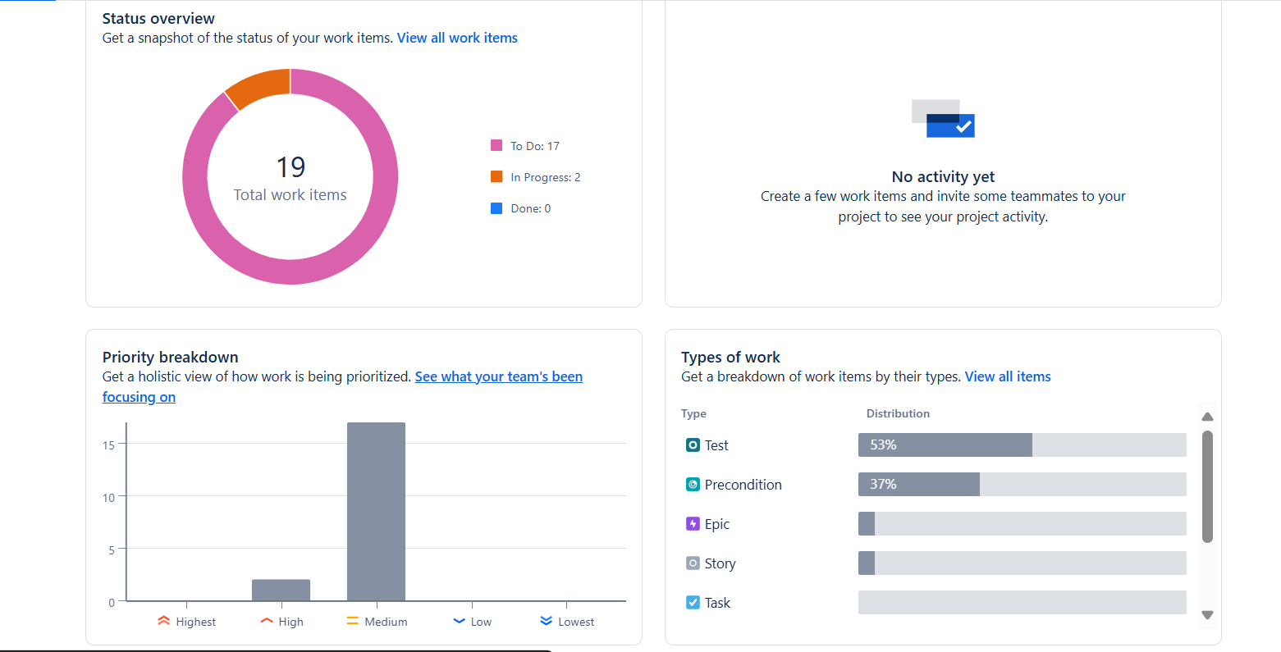
Status Overview and Priority Graph in Jira using Orange HRM

Slide 9
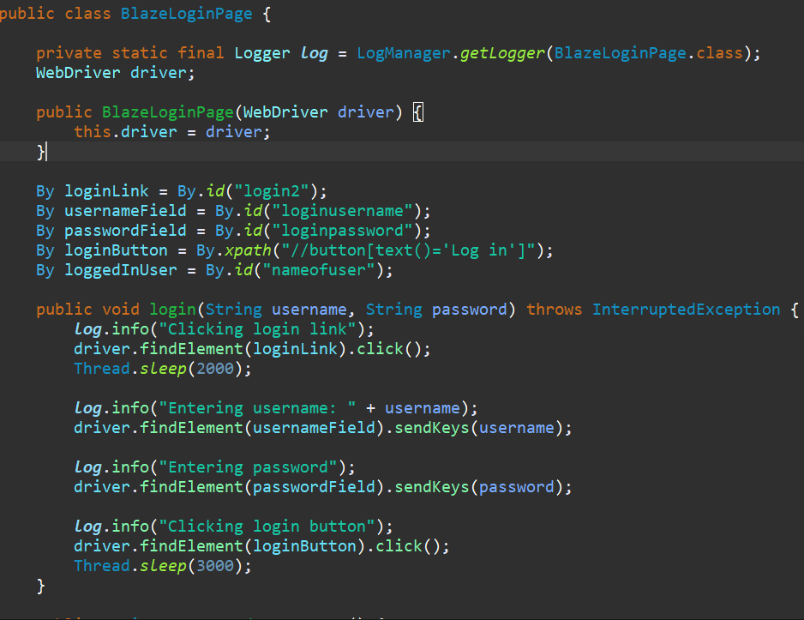
A. Pre-condition
A user must register before attempting to log in.
The user should log in using valid credentials.
B. Acceptance Criteria
The user should be able to log in with valid credentials
(username and password).
C. Expected Result
The user is navigated to the home page.
Scenario 1:Login using invalid credentials and valid credentials

Slide 10
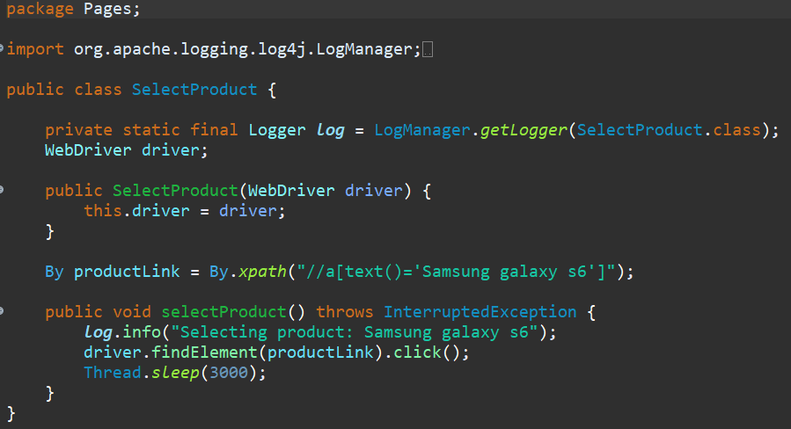
A. Pre-condition
The user must be logged in successfully.
The product catalog page must be accessible.
B. Acceptance Criteria
The user should be able to view the list of available products.
The user should be able to select a product from the catalog.
C. Expected Result
The selected product details are displayed, or the user is
navigated to the product detail page.
Scenario 2:Select a product from the product catalog.

Slide 11
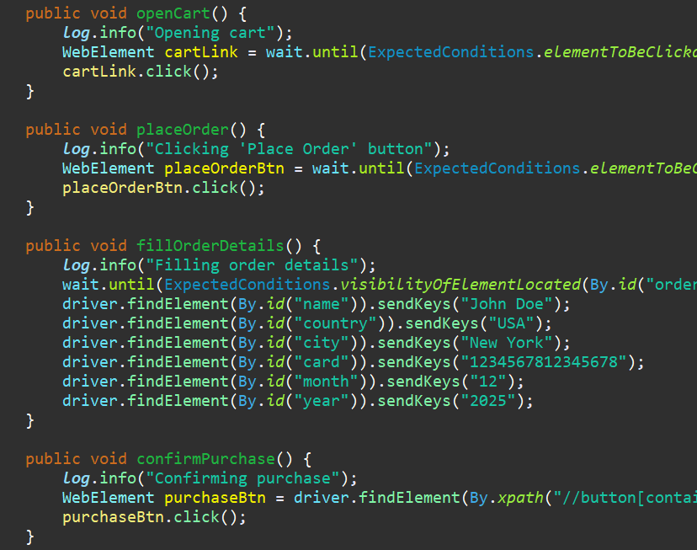
A. Pre-condition
The user must select a product from the catalog.
B. Acceptance Criteria
The user should be able to add the selected product to the
shopping cart.
The user should be able to place an order from the cart by
providing required purchase details (name, country, city, card,
month, year).
C. Expected Result
The selected product appears in the cart with accurate details.
The order is placed successfully, and a confirmation message
(e.g., "Thank you for your purchase!") is displayed with order
information.
Scenario 3:Verify the product is added to cart and successfully place an order.

Slide 12
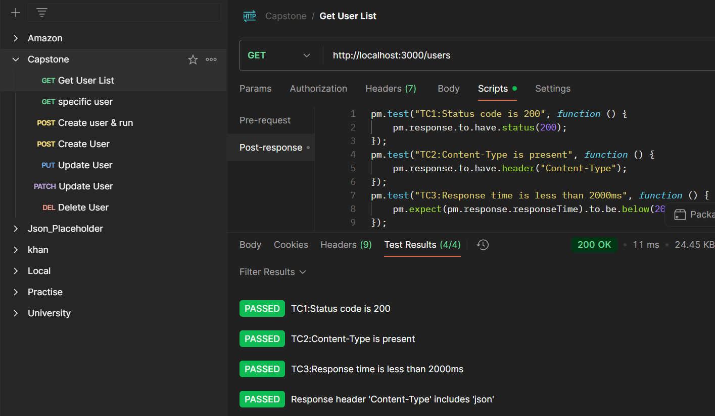
POSTMAN:Used GET,POST,PUT,PATCH,DELETE Methods and Scripts

Slide 13
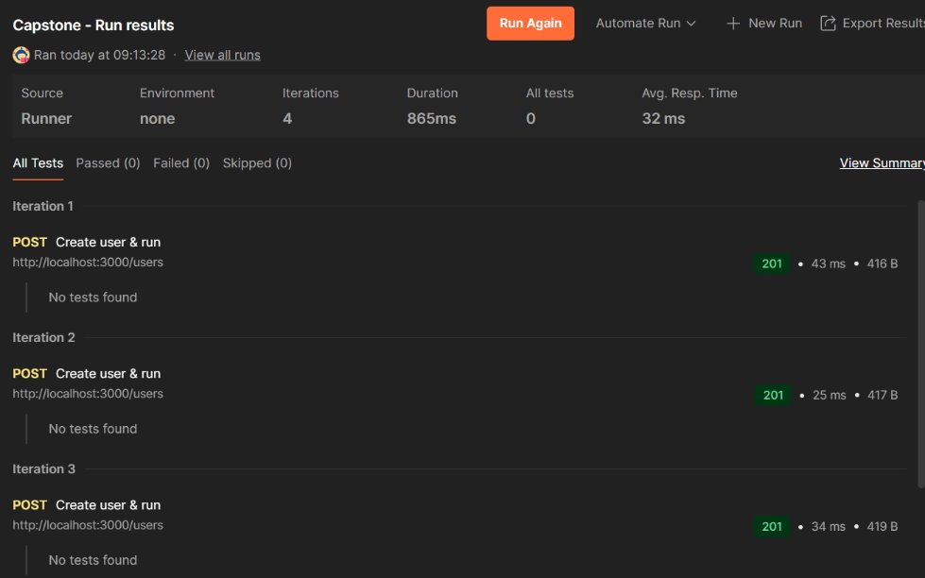
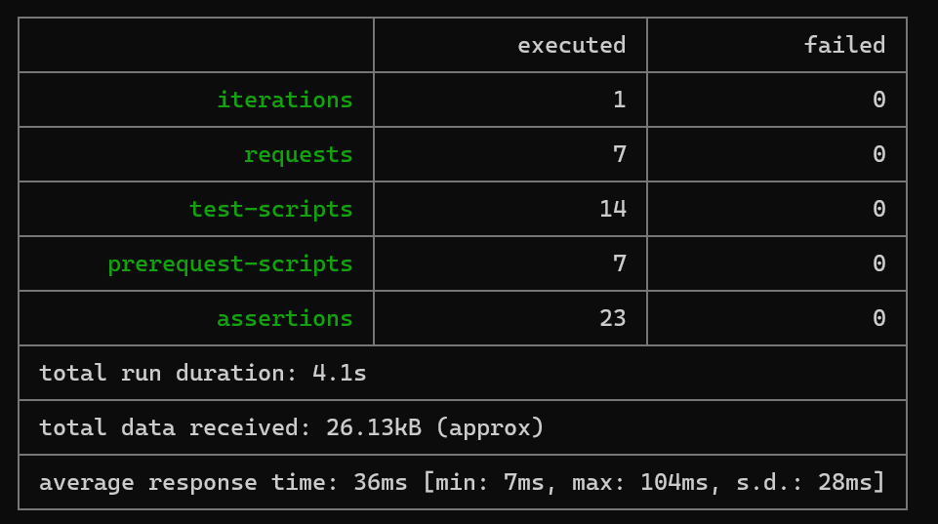
Executed POST method using csv file

Slide 14

Reference Links:
🔗 Web Application
https://www.demoblaze.com/
🔗 API Base URL
localhost:3000/users(Json server LocalHost)
🔗 Jmeter
https://www.demoblaze.com/
🔗 GitHub Repository
Meera1215/Capstone_Ascendion_Web_API_May2025
🔗 JIRA or Documentation
List - Orange_HRM - Jira

Slide 15
This capstone project helped me understand how end-to-end testing works in real-world scenarios. I learned
to use tools like JIRA, Selenium, Postman, and JMeter effectively. I practiced automation, API, and performance
testing on websites like OrangeHRM and DemoBlaze. Overall, this experience boosted my confidence to take on
real-time testing projects with a structured and efficient approach.
Conclusion

Slide 16
Thank You

