Slide 1
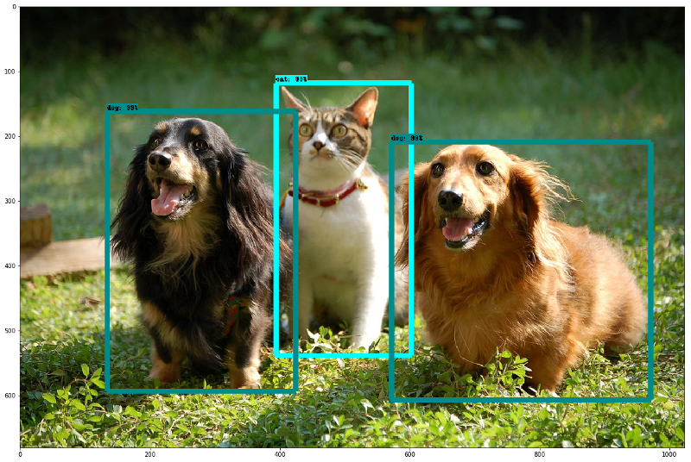
OBJECT - DETECTION USING SSD ARCHITECTURE (COMPUTER VISION PROJECT)
EOC 2 & MFC 2
GROUP 14
CSE(AI)-B
GROUP MEMBERS: ROLL NO:
VARSHITHA GADE CB.SC.U4AIE24114
MEERA NAMBIAR K C CB.SC.U4AIE24132
YASWANTH V CB.SC.U4AIE24160

Slide 2
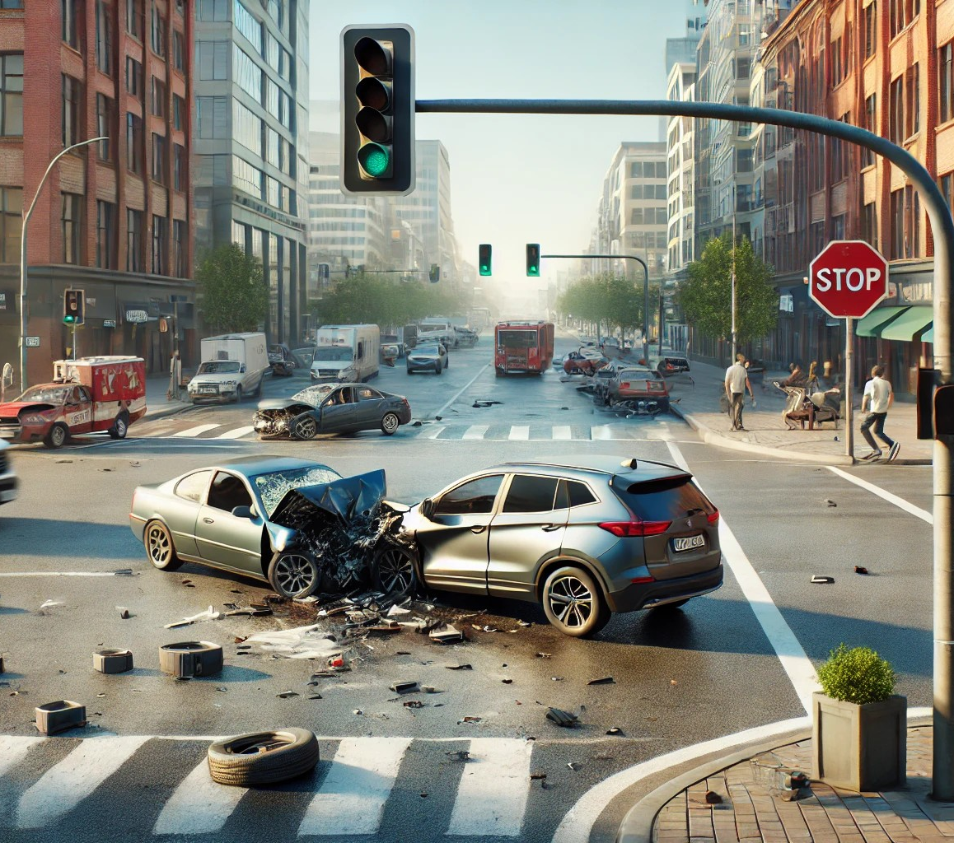
OBJECTIVE:
REAL TIME OBJECT DETECTION USING SSD ARCHITECTURES IN THE ACCIDENT PRONE AREA.
PROBLEM STATEMENT:
Road accidents are a leading cause of fatalities globally, often resulting from undetected hazardous driving conditions and delayed response times. Existing accident prediction systems rely heavily on historical data, lacking real-time detection and analysis capabilities.

Slide 3
Object Detection With SSD Architectures
Identifies and locates objects in images or videos.
SSD takes only one shot to detect multiple objects present in an image using multibox.
Object detection algorithms typically leverage machine learning or deep learning to produce meaningful results.
This process involves both object classification and localization.
SSD (Single Shot MultiBox Detector) stands out by offering a good balance between speed and accuracy, making it suitable for real-time applications where both factors are important.
INTRODUCTION

Slide 4
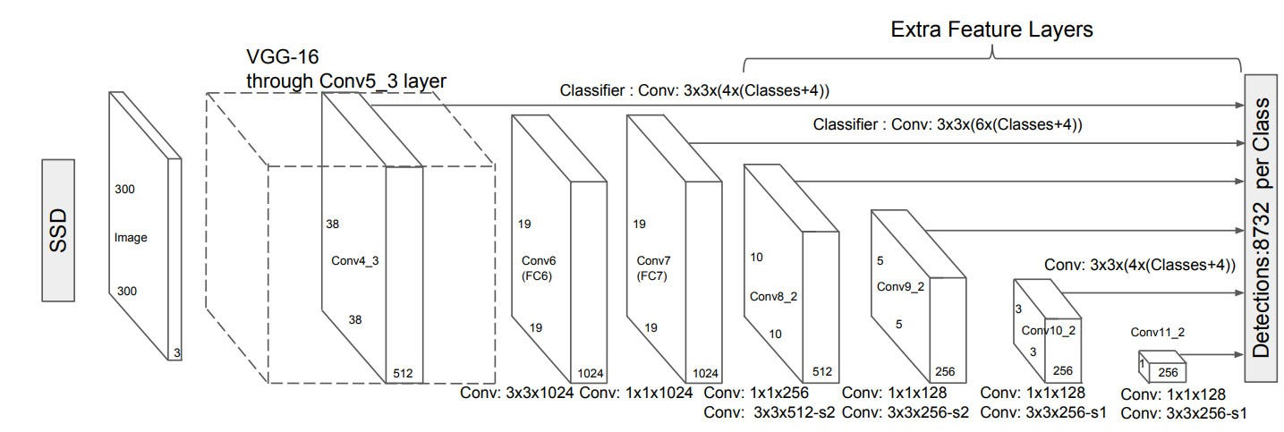
FIG:1: BLOCK DIAGRAM

Slide 5
Novelty
Use of SSD (Single Shot Detector) for High-Speed Processing: real-time object detection (cars, vehicles, etc.) to identify potential accident risks.
Accident-Prone Area Detection Using Object Detection: emphasizes real-time detection efficiency
Automated Data Pipeline:
XML-to-MAT conversion for efficient data storage.
Dynamic dataset splitting for robust training/testing.
Annotation visualization for quick error-checking in data labeling.
Adaptive Training Workflow: The code allows easy toggling between training new models and loading pre-trained detectors, making it adaptable to new datasets or environments without complete retraining.

Slide 6
Object Detection using SSD architectures
Based- Accident Prone System
Data Preparation: Load and label datasets with bounding boxes.
Data Spitting: Splitting the data for training and testing data.
Upcoming work...
Model Selection: Chose the Single Shot Multibox Detector (SSD) with a pre-trained ResNet-50 backbone for efficient real-time object detection.
Model Training: Defined training options such as learning rate, batch size, and number of epochs using trainingOptions().
Model Evaluation: Evaluated model performance using metrics like Precision and Recall,Mean Average Precision (mAP),Intersection over Union (IoU).

Slide 7
Why this data set?
provides real-world data for training and evaluating the object detection model.
helps train the model to accurately detect vehicles, pedestrians, other objects critical to understanding traffic dynamics
provides labeled data (bounding boxes) to teach the model how to locate and identify objects in images.
improve the generalization ability of the model, reducing false positives/negatives.
datasets often come with benchmark models, helping evaluate accuracy, precision, recall effectively.
Accident prone System
which includes .jpg and .xml file for the SSD algorithms.

Slide 8
Problem Gap & Limitations of SSD Architecture:
Less accurate than two-stage detectors
Sensitive to occlusions and crowded scenes
Poor Small Object Detection
Lower Precision Compared to Two-Stage Detectors
Sensitivity to Scale Variations
Trade-off Between Speed and Accuracy
Higher Computational Cost for High Accuracy
Limited Robustness to Occlusions

Slide 9
LITERATURE REVIEW
S.NO | PAPER NAME | METHODOLOGY | LIMITATIONS | MATRICES
1 | Object detection using Faster R-CNN | Faster R-CNN extracts features, generates region proposals, refines them with NMS, classifies objects, and adjusts bounding boxes for accurate detection. | High Computational Cost Poor Small Object Detection | Mean Average Precision (mAP) Intersection over Union (IoU)
2 | Object detection using YOLO | YOLO divides an image into grids, predicts bounding boxes and class probabilities, then uses NMS to refine detections for fast and accurate object recognition. | Struggles with Small Objects Lower Accuracy for Overlapping Objects | Mean Average Precision (mAP) Intersection over Union (IoU)

Slide 10
S.NO | PROJECT NAME | METHODOLOGY | LIMITATIONS | MATRICES
3 | Object detection using RetinaNet | RetinaNet uses a backbone CNN with FPN for feature extraction, applies anchor boxes, utilizes Focal Loss for balanced classification, and refines detections with bounding box regression and NMS. | High Computational Cost Slower Inference than YOLO | Focal Loss (unique to RetinaNet for handling class imbalance) Mean Average Precision (mAP) Intersection over Union (IoU)
4 | Object detection using Mask R-CNN | Mask R-CNN extends Faster R-CNN by adding a parallel branch for pixel-wise segmentation, enabling precise object detection and instance segmentation in a single framework. | Requires Large Datasets High Computational Cost | Mask IoU (for segmentation accuracy) Pixel Accuracy (for instance segmentation)

Slide 11
Research Gap
1. Small Object Detection: SSD struggles with detecting small objects because its lower-resolution feature maps lack detailed information, making it hard to recognize fine features.
Challenges:
Small objects often disappear in deep feature layers.
SSD primarily detects objects using default anchor boxes, which may not be suitable for small-sized objects.
2. Handling Occlusions & Crowded Scenes: When objects are too close together or overlap, SSD has difficulty distinguishing them, leading to incorrect detections or missing objects.
Challenges:
SSD processes objects independently, making it hard to separate overlapping ones.
SSD's feature maps detect object presence but struggle with position and spatial relationships.
3. Reducing False Positives: SSD often detects the same object multiple times, creating extra bounding boxes and false positives, which lowers accuracy.
Challenges:
SSD applies multiple anchor boxes per feature map, sometimes assigning multiple detections to one object.
Non-Maximum Suppression (NMS) may not effectively filter overlapping boxes.

Slide 12
Advantages of using SSD:
Fast and Real-Time Performance
No Need for Region Proposal Network (RPN)
Multi-Scale Feature Maps for Robust Detection
Better Trade-off Between Accuracy and Speed
Supports Detection of Multiple Object Categories
Lightweight and Efficient for Embedded Devices
End-to-End Trainable
Handles Aspect Ratio Variations Well

Slide 13
Applications:
Autonomous Vehicles
Video Surveillance & Security
Traffic Monitoring & Smart City Solutions
Robotics & Industrial Automation
Drone-Based Object Detection
Augmented Reality (AR) & Virtual Reality (VR)
Healthcare & Medical Imaging
Retail & Customer Analytics
Facial Recognition & Biometrics
Wildlife Conservation & Animal Monitoring

Slide 14
TIMELINE:
JAN 3RD WEEK
SELECTION OF DATA SET
JAN 4TH WEEK
SPLITTING THE DATASET FOR TRAINING AND TESTING
FEB 1ST & 2ND WEEK
MODEL SELECTION FOR TRAINING
FEB 3RD & 4TH WEEK
TRAINING THE MODEL
MARCH 1ST & 2ND WEEK
MODEL EVALUATION
MARCH 3RD WEEK
WRITING PAPER IN LATEX ENVORONMENT

Slide 15
THANKYOU

