Slide 1
Workflows
Chapter 6

Slide 2
Database Transactions
Definition of a Transaction: In computing, a transaction is a series of actions treated as a single unit.
Purpose of a Transaction: Ensures multiple changes during the same operation are confirmed.
Error Handling: Provides a method to revert changes if an error occurs during the transaction.
Use in Databases: Transactions in databases ensure that state changes (remove, insert, change) are successfully made.
Relational Databases: Transactions may involve updates across multiple tables within a single operation.

Slide 3
ACID Transactions
ACID Overview: ACID is an acronym for Atomicity, Consistency, Isolation, Durability—key properties ensuring reliable database transactions.
Atomicity: Guarantees that all operations within a transaction either completely succeed or fail; if one operation fails, the transaction is aborted as if no changes were made.
Consistency: Ensures the database remains in a valid state after changes, maintaining data integrity.
Isolation: Allows concurrent transactions without interference, keeping interim changes invisible to other transactions.
Durability: Once a transaction is completed, changes are permanent, protecting data against system failures.

Slide 4
ACID Transactions
Database Support: Not all databases support ACID properties; while relational databases typically do, some NoSQL databases like Neo4j also support ACID transactions.
Microservices and ACID: In a microservices architecture, each service can employ ACID transactions within its own database, though this limits the transaction scope to local state changes.
Challenges in Distributed Transactions: Introduces the complexity of coordinating across multiple services, potentially affecting atomicity and requiring advanced management techniques like the two-phase commit.

Slide 5
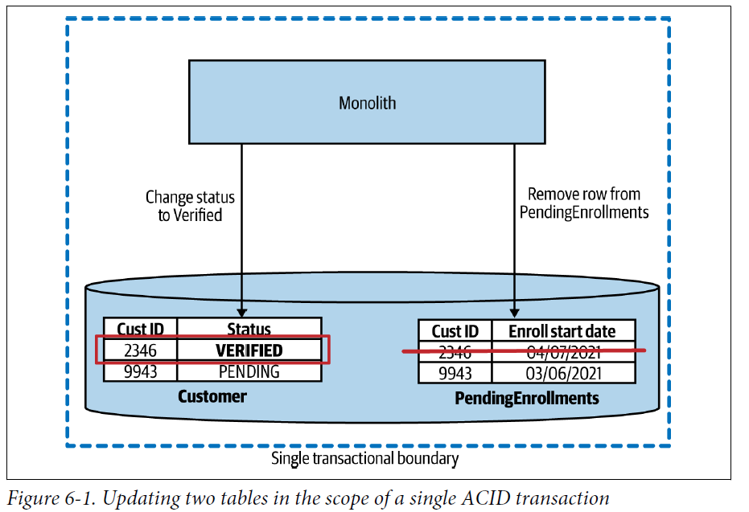
ACID Transactions

Slide 6
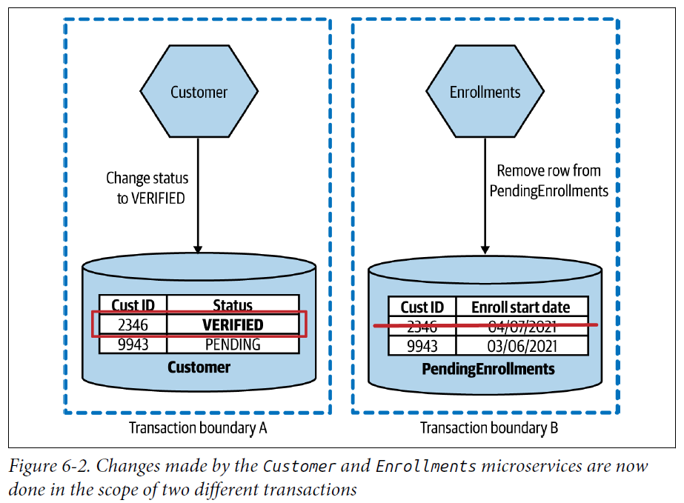
ACID Transactions

Slide 7
Distributed Transactions—Two-Phase Commits
Two-Phase Commit Overview: A method used to manage transactional changes in a distributed system involving multiple processes.
Phases of 2PC:
Voting Phase: A coordinator requests confirmation from all participants for a proposed state change. If any participant disagrees, the transaction is aborted.
Commit Phase: If all participants approve, the changes are implemented and locks released.

Slide 8
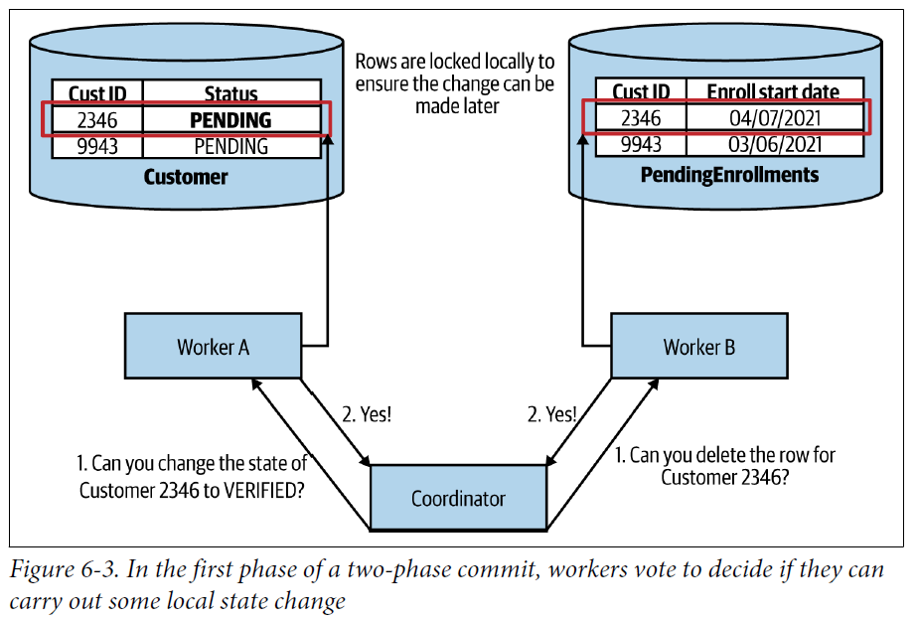
Distributed Transactions—Two-Phase Commits

Slide 9
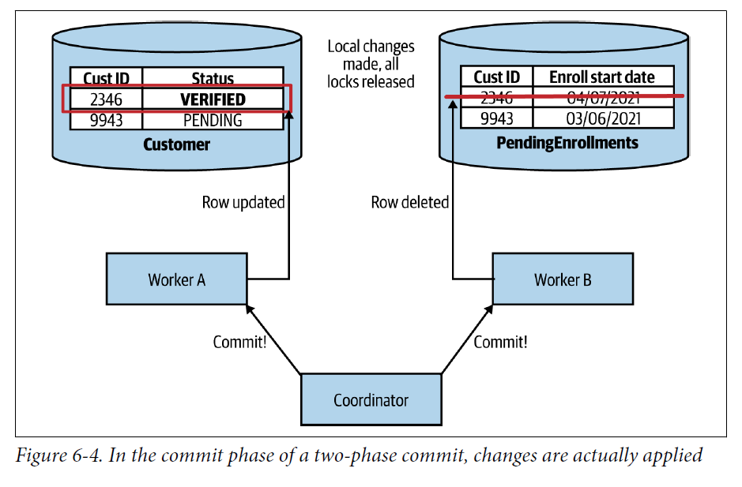
Distributed Transactions—Two-Phase Commits

Slide 10
Distributed Transactions—Two-Phase Commits
Coordination and Locks: The central coordinator plays a key role in managing the process, ensuring that changes are prepared before being committed.
Challenges with Timing: Commits may not happen simultaneously across all systems due to messaging delays, leading to potential inconsistencies.

Slide 11
Distributed Transactions—Two-Phase Commits
Reliability Concerns: Issues like failure in participant response during the commit phase can complicate the transaction, sometimes requiring manual intervention.
Failure Modes: Two-phase commits have various failure modes that need careful handling, some of which may lead to system states requiring manual fixes.
Performance Impacts: The use of distributed locks and the potential for increased latency make 2PC suitable mainly for short-lived operations to minimize locked resources.

Slide 12
Distributed Transactions—Just Say No
Avoid Distributed Transactions: Recommended to steer clear of complex coordination methods like two-phase commits for state changes across microservices.
Keep State Together: If atomicity and consistency are crucial, consider not splitting the state. Keep it managed within a single database and service to maintain ACID-style transactions.
Assess Monolith Decomposition: When deciding where to split a monolith, consider leaving transactionally managed data together if it seems too complex to handle right now. Focus on simpler areas first.
Alternative Approaches:
Sagas: A method to manage long-duration and complex transactions across microservices without requiring distributed locks.

Slide 13
Sagas
Definition of Sagas: An algorithm designed to manage long-lived transactions (LLTs) across multiple services without locking resources for extended periods.
Independent Execution: Sagas coordinate multiple state changes by breaking them down into discrete, independently executable activities.

Slide 14
Sagas
Business Process Modeling: Using sagas encourages explicit modeling of business processes, yielding significant benefits in clarity and management.
Origins and Concept: Introduced by Hector Garcia-Molina and Kenneth Salem, sagas address how to handle LLTs that could lock database resources detrimentally.

Slide 15
Sagas
Breakdown of Transactions: LLTs are divided into smaller, manageable transactions, reducing lock duration and scope, and minimizing database contention.
Application in Microservices: Sagas are applicable in microservice architectures to coordinate changes across services, breaking a single process into multiple service calls.

Slide 16
Sagas
Atomicity and ACID Compliance: While sagas do not provide saga-level atomicity, they ensure atomicity for each individual transaction within the saga.
Handling State Changes: Each service in a saga can manage its state changes locally, maintaining ACID properties within its own scope.

Slide 17
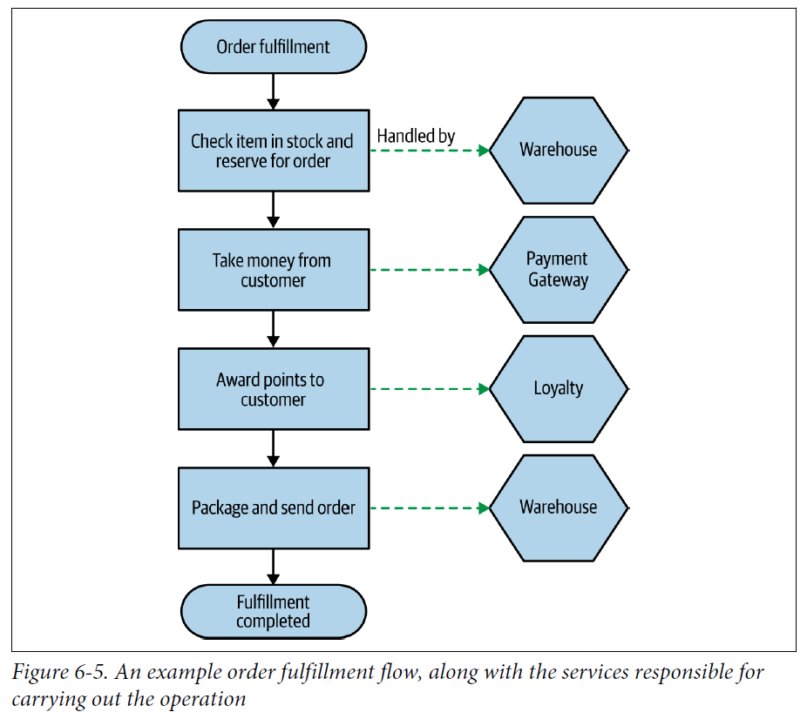
Sagas

Slide 18
Saga Failure Modes
Saga Recovery Types:
Backward Recovery: Involves rolling back the saga by defining compensating transactions to undo changes if a failure occurs.
Forward Recovery: Continues from the point of failure by retrying transactions, assuming the system persists necessary information for retries.

Slide 19
Saga Failure Modes
Business vs. Technical Failures:
Business Failures: Issues like insufficient customer funds are expected to be managed by sagas.
Technical Failures: Problems like payment gateway errors need separate handling, as sagas assume underlying system reliability.

Slide 20
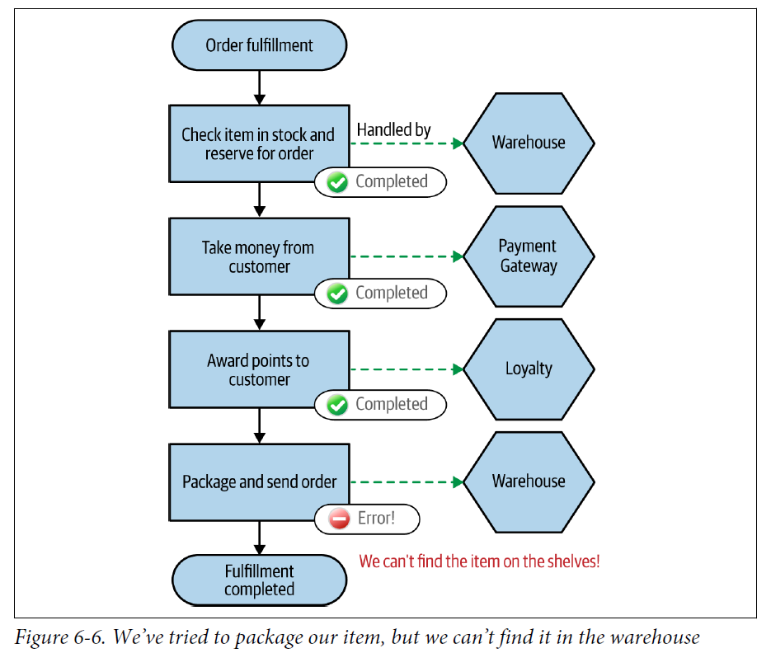
Saga Rollbacks

Slide 21
Saga Rollbacks
Role of Compensating Transactions: These are essential for sagas, allowing the undoing of changes after they are committed, unlike traditional rollbacks which prevent changes from being finalized.
Challenges with Complete Rollbacks: Some actions, like sent emails, cannot be undone; compensating transactions must manage such situations semantically rather than literally.

Slide 22
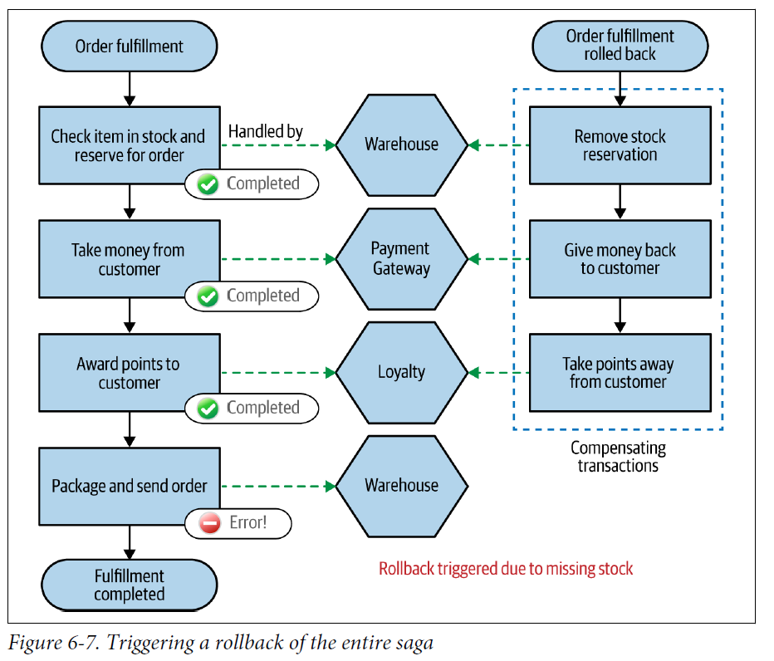
Saga rollbacks

Slide 23
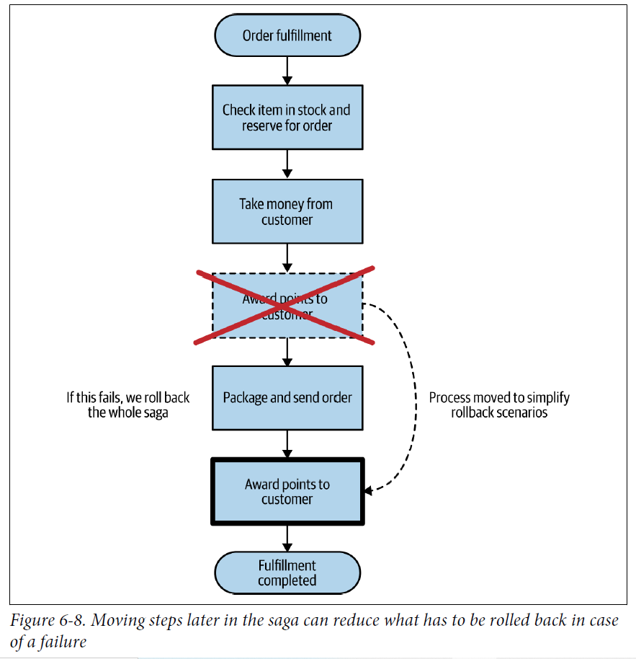
Reordering workflow steps to reduce rollbacks
Workflow Optimization: Reordering saga steps can reduce the need for complex rollbacks, simplifying the management of transactions and minimizing potential failures.

Slide 24
Sagas
Mixed Recovery Strategies: It's practical to mix backward and forward recovery strategies within a saga to optimize handling of different types of failures.
Human Intervention: Some scenarios may require manual resolution when automated recovery strategies fail.

Slide 25
Implementing Sagas
Types of Saga Implementations:
Orchestrated Sagas: Utilize a central coordinator (orchestrator) to manage the order of operations and compensating actions. This approach offers clear command and control with high visibility into the saga’s progress.
Choreographed Sagas: Operate without centralized coordination, using a distributed approach where services react to events. This model reduces domain coupling but may complicate tracking saga progress.

Slide 26
Implementing Sagas
Orchestrated Saga Characteristics:
Centralized control with a single orchestrator managing interactions and decisions.
Benefits include easier onboarding and understanding of business processes due to centralized logic.
Downsides include potential for high domain coupling and centralization of business logic, which may lead to anemic services.

Slide 27
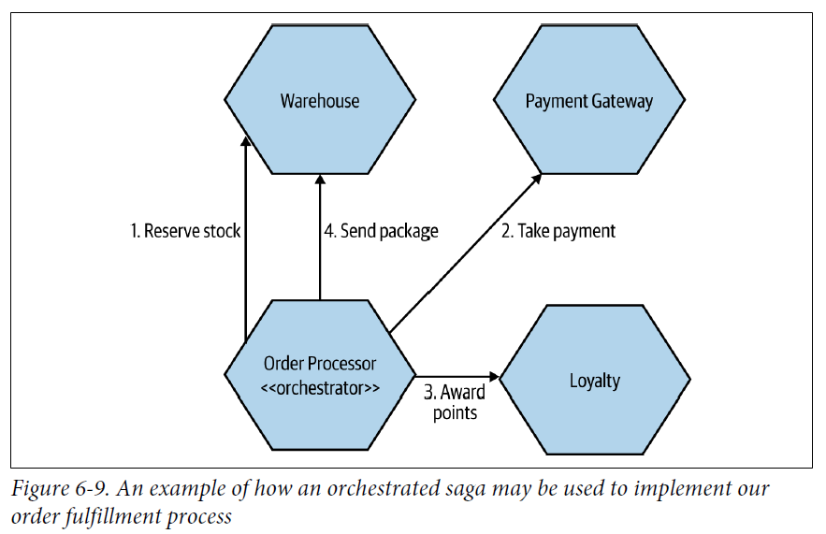
Orchestrated Saga

Slide 28
Implementing Sagas
Choreographed Saga Characteristics:
Services independently handle parts of the saga, responding to and emitting events.
Reduces coupling and centralization, distributing logic across services.
Challenges include difficulty in tracing and understanding the complete business process and state of the saga.

Slide 29
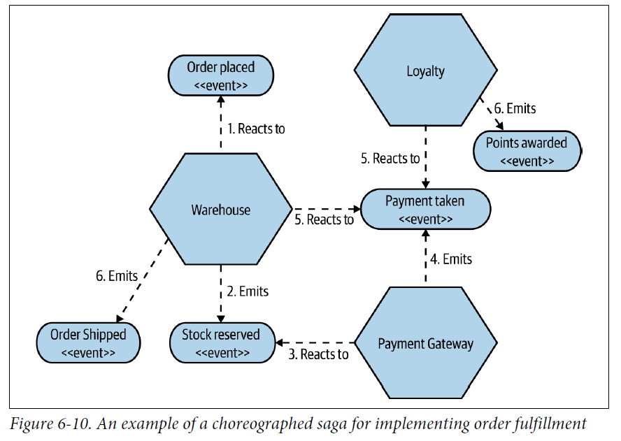
Choreographed Saga

Slide 30
Implementing Sagas
Business Process Modeling (BPM) Tools:
Often used to implement orchestrated sagas with a visual interface for defining business processes.
Criticisms include complexity and lack of suitability for developers, with issues in version control and testing.

Slide 31
Implementing Sagas
Tracing and Monitoring:
Both orchestrated and choreographed sagas benefit from mechanisms like correlation IDs for tracing transactions and building a comprehensive view of the saga’s state.
Mixing Saga Styles:
Combining orchestrated and choreographed elements in a saga can be effective, depending on the business context and team structure.
Important to maintain clarity on the state and progression of the saga to manage failures and ensure effective recovery strategies.

Slide 32
Sagas Versus Distributed Transactions
Fundamental Challenges of Distributed Transactions:
Susceptibility to node failure: Failure in a single node can stall transaction commits, potentially wedging the entire application.
Scalability issues: As the system scales, the likelihood of downtime increases due to the complexity and dependency on every node functioning correctly.

Slide 33
Sagas Versus Distributed Transactions
Comparison with Sagas:
Resilience to Failures: Sagas, by design, handle failures more gracefully by breaking down transactions into smaller, manageable operations that can be independently completed or compensated for if failures occur.
Process Clarity: Implementing sagas encourages explicit modeling of business processes, making it easier for developers to understand and maintain these processes.
Advantages of Sagas:
Enhanced visibility and clarity in business process modeling.
Reduced risk of system-wide failures due to localized handling of failures within individual components of a saga.
Potential for more robust system design, with flexibility in handling long-running and complex transactions.

